Slide 1
Purplle Store Intelligence
Next-Generation Retail Analytics

Slide 2
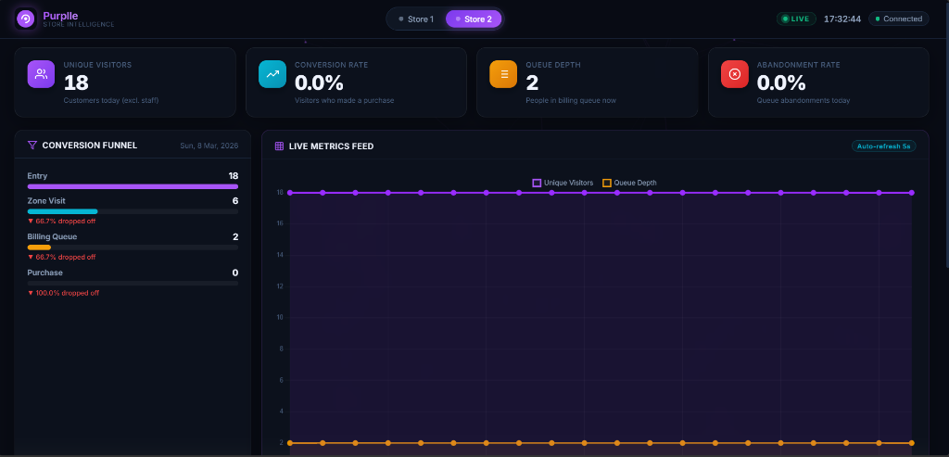
Full Dashboard Overview

Slide 3
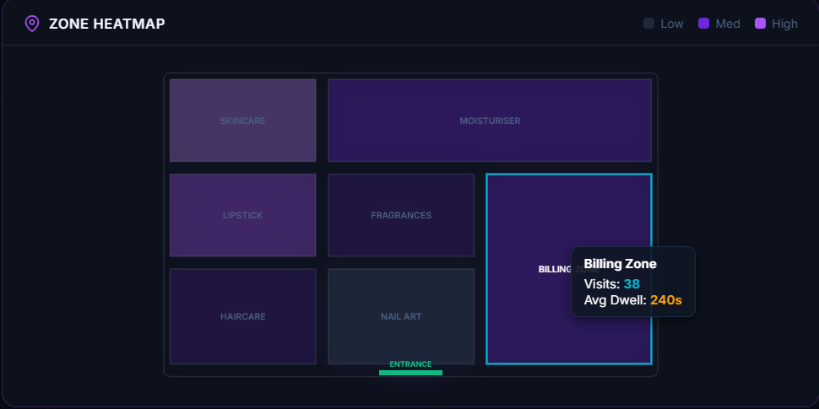
Zone Heatmap

Slide 4
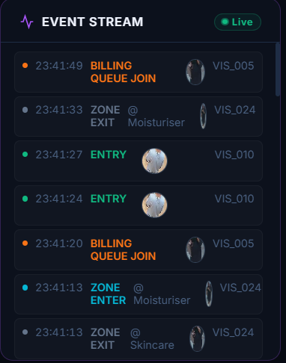
Event Stream

Slide 5
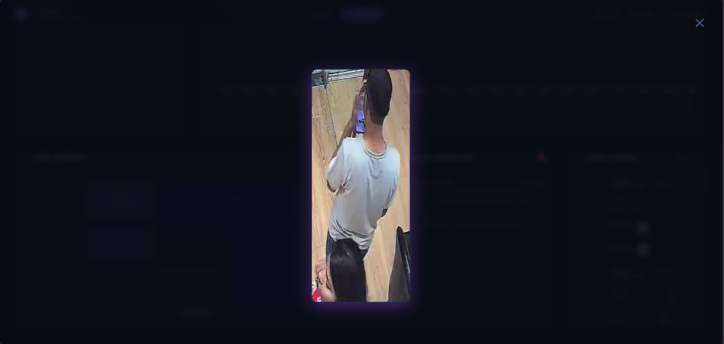
Camera Feed

Slide 6
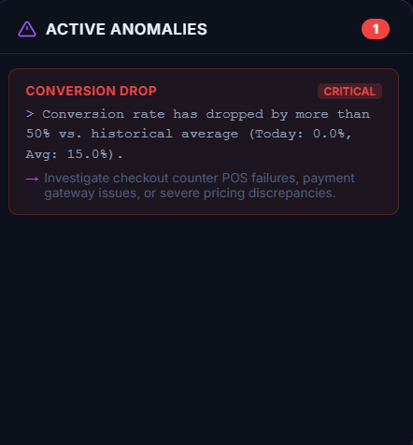
Active Anomalies

Slide 7
System Architecture
1. Real-time CCTV Video Ingestion
2. YOLOv8 Nano Edge Processing
3. Cross-Camera Tracking (ReID)
4. FastAPI + SQLite Analytics Engine
5. Millisecond-latency Web Dashboard

