Slide 1
PURPLLE
Store Intelligence System
Real-time retail analytics — from CCTV to actionable insight.
1 / 9

Slide 2
The Problem
68%
🔍 Physical Retail is Flying Blind
avg funnel drop-off between entry & zone visit
⚠ Store managers have no live view of how many customers are inside.
⚠ No way to know which product zones attract the most dwell time.
⚠ Conversion drop-offs are discovered days later via POS reports.
⚠ Billing queue spikes cause walk-outs — invisible until it's too late.
⚠ Staff can't distinguish visitors from customers without manual counting.
4–5 min
avg queue tolerance before abandonment
0
real-time alerts in most physical stores today
2 / 9

Slide 3
Our Solution
💡 End-to-End Store Intelligence Platform
We turn existing CCTV footage + POS data into a real-time intelligence layer — no new hardware required.
👁 Detect
🔗 Track
📊 Analyse
🚨 Alert
YOLOv8 Nano tracks every person entering the store.
Cross-camera Re-ID links the same person across zones.
FastAPI + SQLite compute live metrics & conversions.
Anomaly engine fires instant alerts for queues & drop-offs.
3 / 9

Slide 4
How It Works
⚙ 3-Layer Architecture
PIPELINE
API ENGINE
DASHBOARD
detect.py → tracker.py → emit.py
FastAPI + SQLite
HTML + CSS + Chart.js
YOLOv8n processes 1 frame/sec HSV Re-ID across cameras Emits JSONL events
POST /events/ingest (batch) GET /stores/{id}/metrics GET /stores/{id}/anomalies
Auto-refresh every 5s KPI cards, funnel, heatmap Anomaly alerts, event stream
→
→
POS CSV auto-imported at startup and correlated with billing events via 5-min window
4 / 9

Slide 5
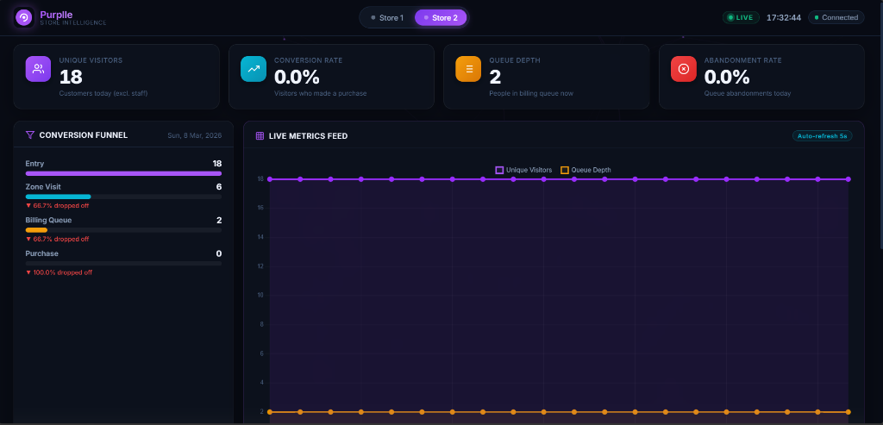
Live Dashboard
📺 Real-time Analytics at a Glance
KPI Cards
Visitors · Conversion Queue · Abandonment
Live Chart
Rolling time-series of visitors + queue
Store Toggle
Switch between Store 1 & Store 2
Auto-Refresh
Polls every 5s via fetch() API
5 / 9

Slide 6
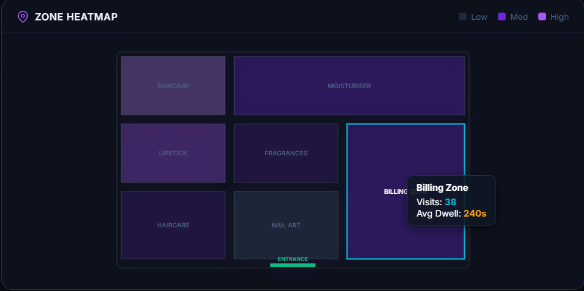
Zone Heatmap & Conversion Funnel
🗺 Understanding Where Customers Go
Zone Heatmap
› Color-coded grid of every product zone.
› Purple intensity = visit frequency.
› Hover tooltip: Visits count + Avg Dwell time.
› Identifies dead zones with zero traffic today.
Conversion Funnel (from dashboard)
▸ Entry → 18 customers
▸ Zone Visit → 6 (68.7% drop-off)
▸ Billing Queue → 2 (68.7% drop-off)
▸ Purchase → 0 (100% drop-off)
6 / 9

Slide 7
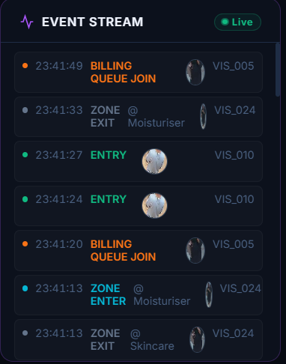
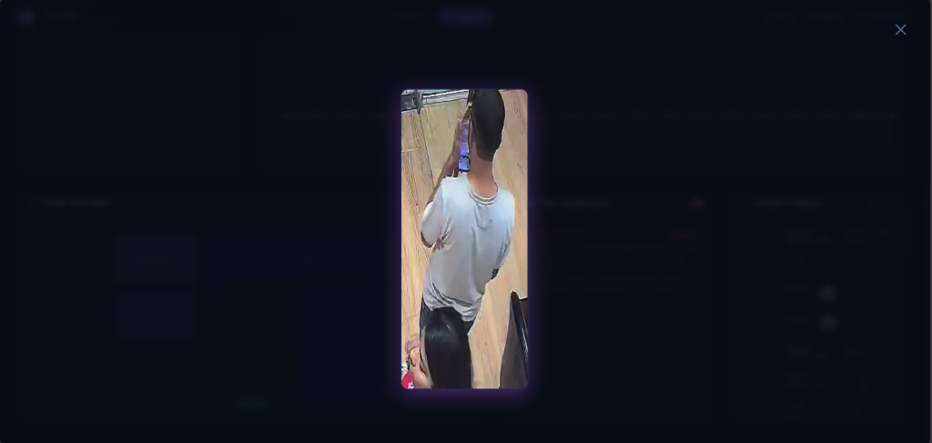
Real-time Event Stream
⚡ Every Customer Move, Captured as an Event
ENTRY / EXIT
Tracks door crossings, flags re-entries
ZONE_ENTER / EXIT
Captures product zone visits & dwell time
BILLING_QUEUE_JOIN
Detects customers joining checkout queue
BILLING_QUEUE_ABANDON
Flags walk-outs before purchase
7 / 9

Slide 8
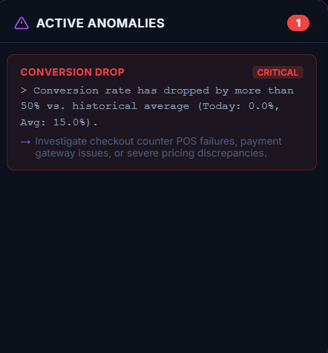
Anomaly Detection
🚨 Proactive Operational Alerts in Real-Time
Three Anomaly Types
BILLING QUEUE SPIKE
Queue > 5 → WARN Queue > 10 → CRITICAL Action: Deploy staff to checkout
CONVERSION DROP
Today < 70% of 7-day avg → WARN Today < 50% of 7-day avg → CRITICAL Action: Check POS / pricing issues
DEAD ZONE
No visits in 30+ min → WARN Zero visits today → INFO Action: Review zone merchandising
8 / 9

Slide 9
Tech Stack & Impact
🔧 Built Lean. Works on CPU. Zero New Hardware.
Detection
Re-ID
Key Outcomes
Backend
YOLOv8 Nano
HSV Histograms
FastAPI + SQLite
✅ Real-time visitor tracking
✅ Zone dwell & conversion KPIs
✅ Instant anomaly alerts
✅ POS-correlated conversion rate
✅ Works on existing CCTV + CPU
✅ Live dashboard, no new hardware
CPU inference · 1 FPS · 93% frame skip
Cosine similarity · No GPU required
Zero-infra · Swagger UI · Full REST API
Frontend
Deployment
Vanilla JS + Chart.js
Docker Compose
No build step · Opens in browser
Single command to run everything
Purplle Store Intelligence · Hackathon 2026
9 / 9

