Slide 1

How People Die! Analysis & Findings
Riti Kumari
sinhariti61@gmail.com

Slide 2
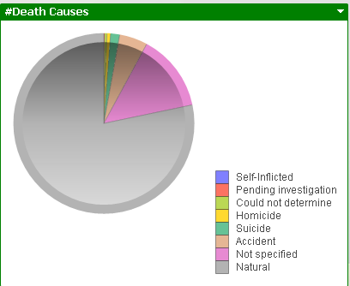
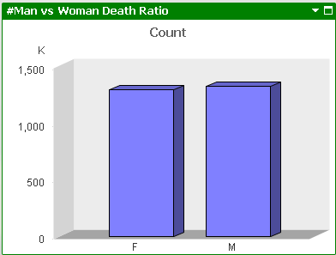
“How People Die” Finding
As per the dataset, the count for men dying in 2014 is recorded more than the count for women
Hispanic belonging to Central or South American Race were recorded the most
More than 75% people died because of nature reasons
Less than 2% committed suicide but around 5% got killed in accidents ; we can infer that people are less stressed and they are also serious about the traffic rules

Slide 3
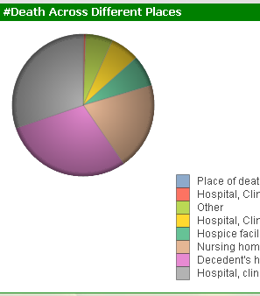
Continued..
The highest death recorded belonged to 85 years and above bin (this is also in accordance with the natural death)
Around 50% people died either at hospitals or nursing care unit
A few (around 25%) preferred to live at the decedent’s home before they died
There are less deaths recorded till 45 years of age

Slide 4
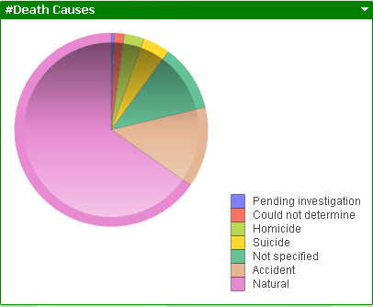
Continued..
Single people died more in accident than the married/ divorced/ widowed
And more than 50% died in hospitals, nursing home in emergency state
Around 25K infants die within one year of their birth
Most of the people were recorded to be high school graduate or GED graduate

Slide 5
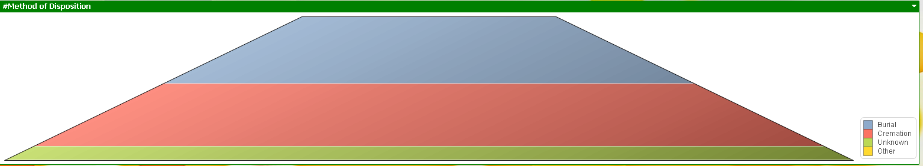
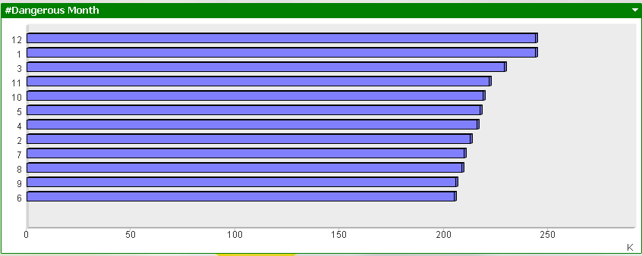
Continued..
January and December have been reported to witness maximum number of deaths
Similarly, Wednesday has been reported as deadly day
More than 80% people were either cremated or buried

Slide 6
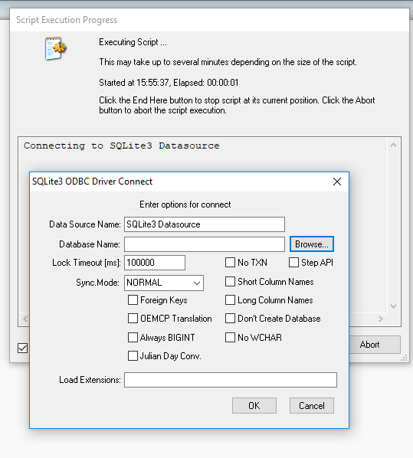
Problems Faced
The connection with SQLite takes a lot of time to load the data
In case of SQLite connectivity, for loading the data, there is need to browse every time to the database
We can use DB browser for SQLite to browse the database and also can be exported as excel
Loading the excel file in Qlikview takes lesser time than SQLite

Slide 7

Recommendations
There can be improvement in the emergency attending at the hospitals as there were many reported cases where people died
The care for infants can be enhanced as we witnessed a significant number of infants dying at the age of an year or less

