Slide 1
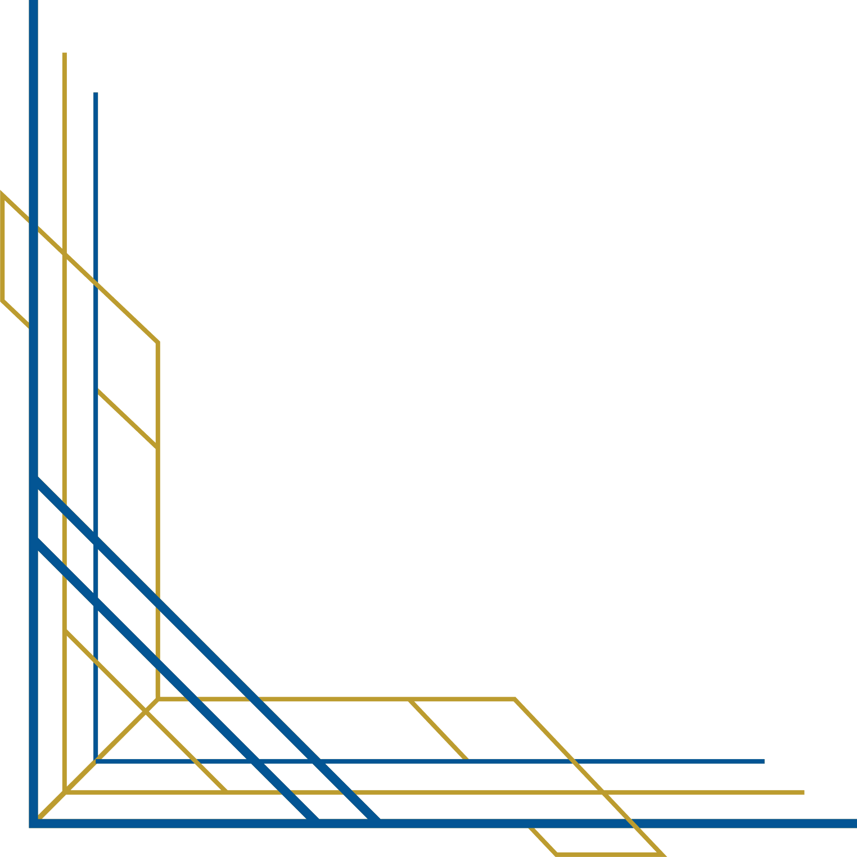

US Labor Statistics

Slide 2

OBJECTIVE
1.To study the trend of wage and opportunities in different fields
2.To provide a granular and detailed picture of various career options
3.Enhance Strategic decision making

Slide 3
Different Parts of Dashboard
1-Average wage by Industry
2-No of Employees by Industry
3-Average wage and no of employees by year
4-Per 1000 Capita population and Average Wage by area

Slide 4
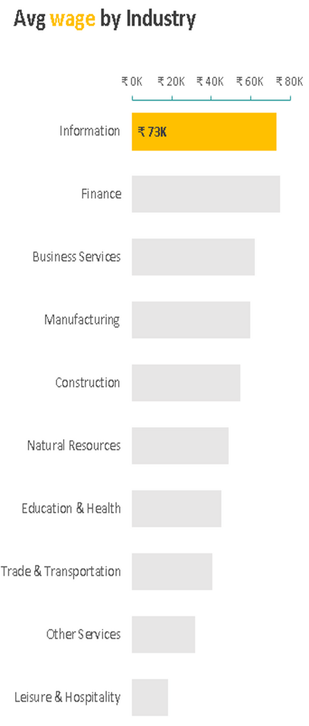
Average wage by Industry
Horizontal bar chart with buttons that shows how much each industry pays with respect to other
By comparison we can see that the Information and Finance are the most rewarding industries with an average wage of $73,000
Based on the selection of industry it filters the complete dashboard according to that particular industry

Slide 5
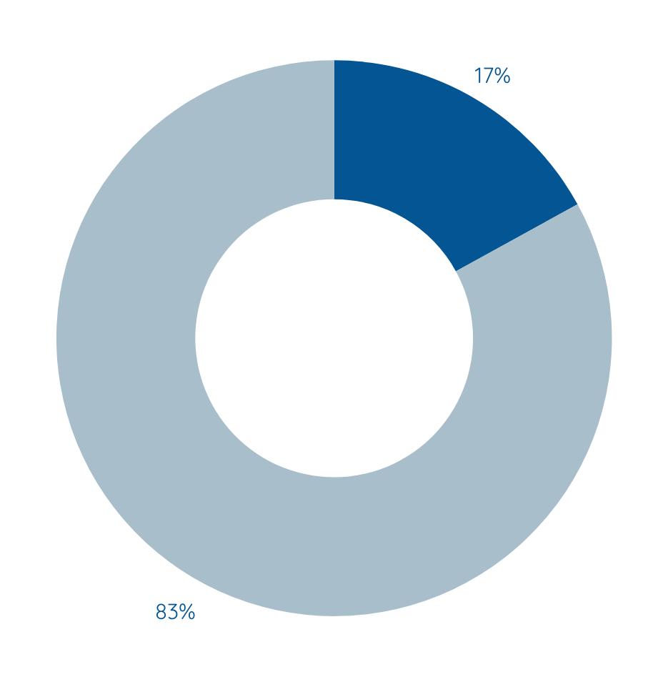
No. of Employees by Industry
Based on the Selection of Industry this displays the % of employees are currently working in that particular Industry
Trade and Transportation seems to be most populated industry with 22% of employees

Slide 6
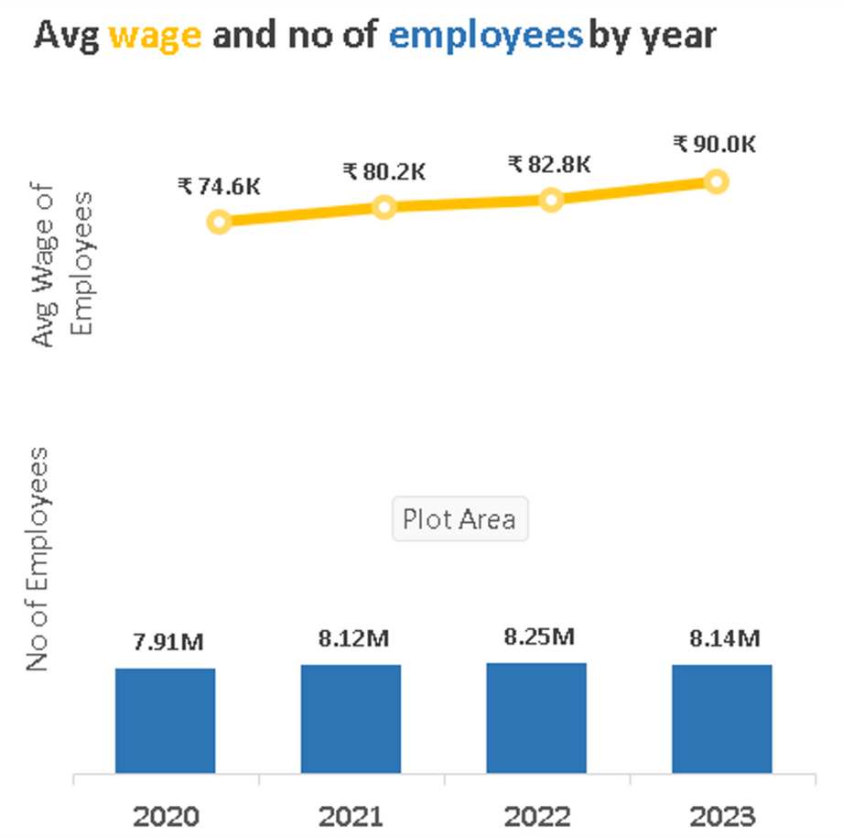
Average wage and no of employees by year
Shows the trend of average wage and no of employees working in the selected industry which can depict whether that particular industry is following uptrend or downtrend
Findings:- Almost in every industry we can see the no of employees decreased in 2023

Slide 7
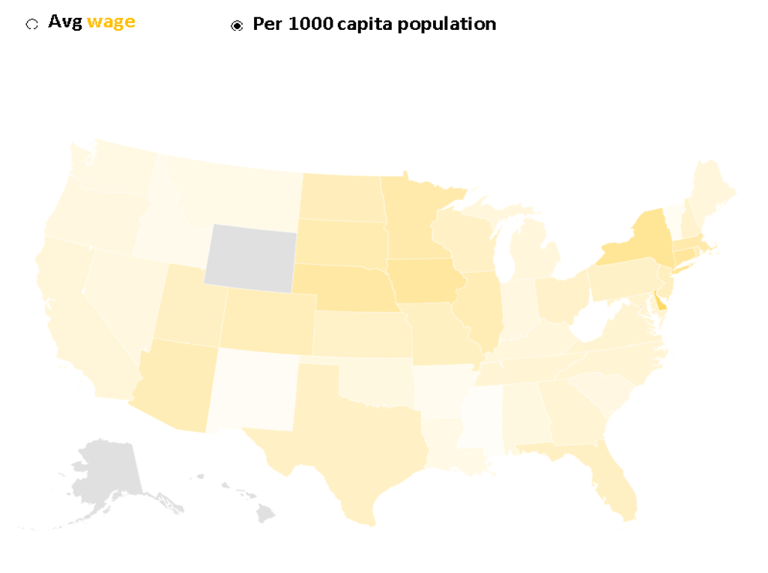
Per 1000 Capita population and Average Wage by area
Avg wage:-This button gives choice to customize the chart based on wage distribution among different states of US
By which one can know which are regions that pay the most in the selected industry
Per 1000 capita population:-This button gives option to display the distribution of opportunuities of selected industry over the different states of US

Slide 8
Some Important Insights
Top 5 highly paid industries:
1-Information:$94,000
2-Finance:$90,000
3-Business Services:$75,000
4-Manufacturing:-$68,000
5-Construction:-$64000

Slide 9
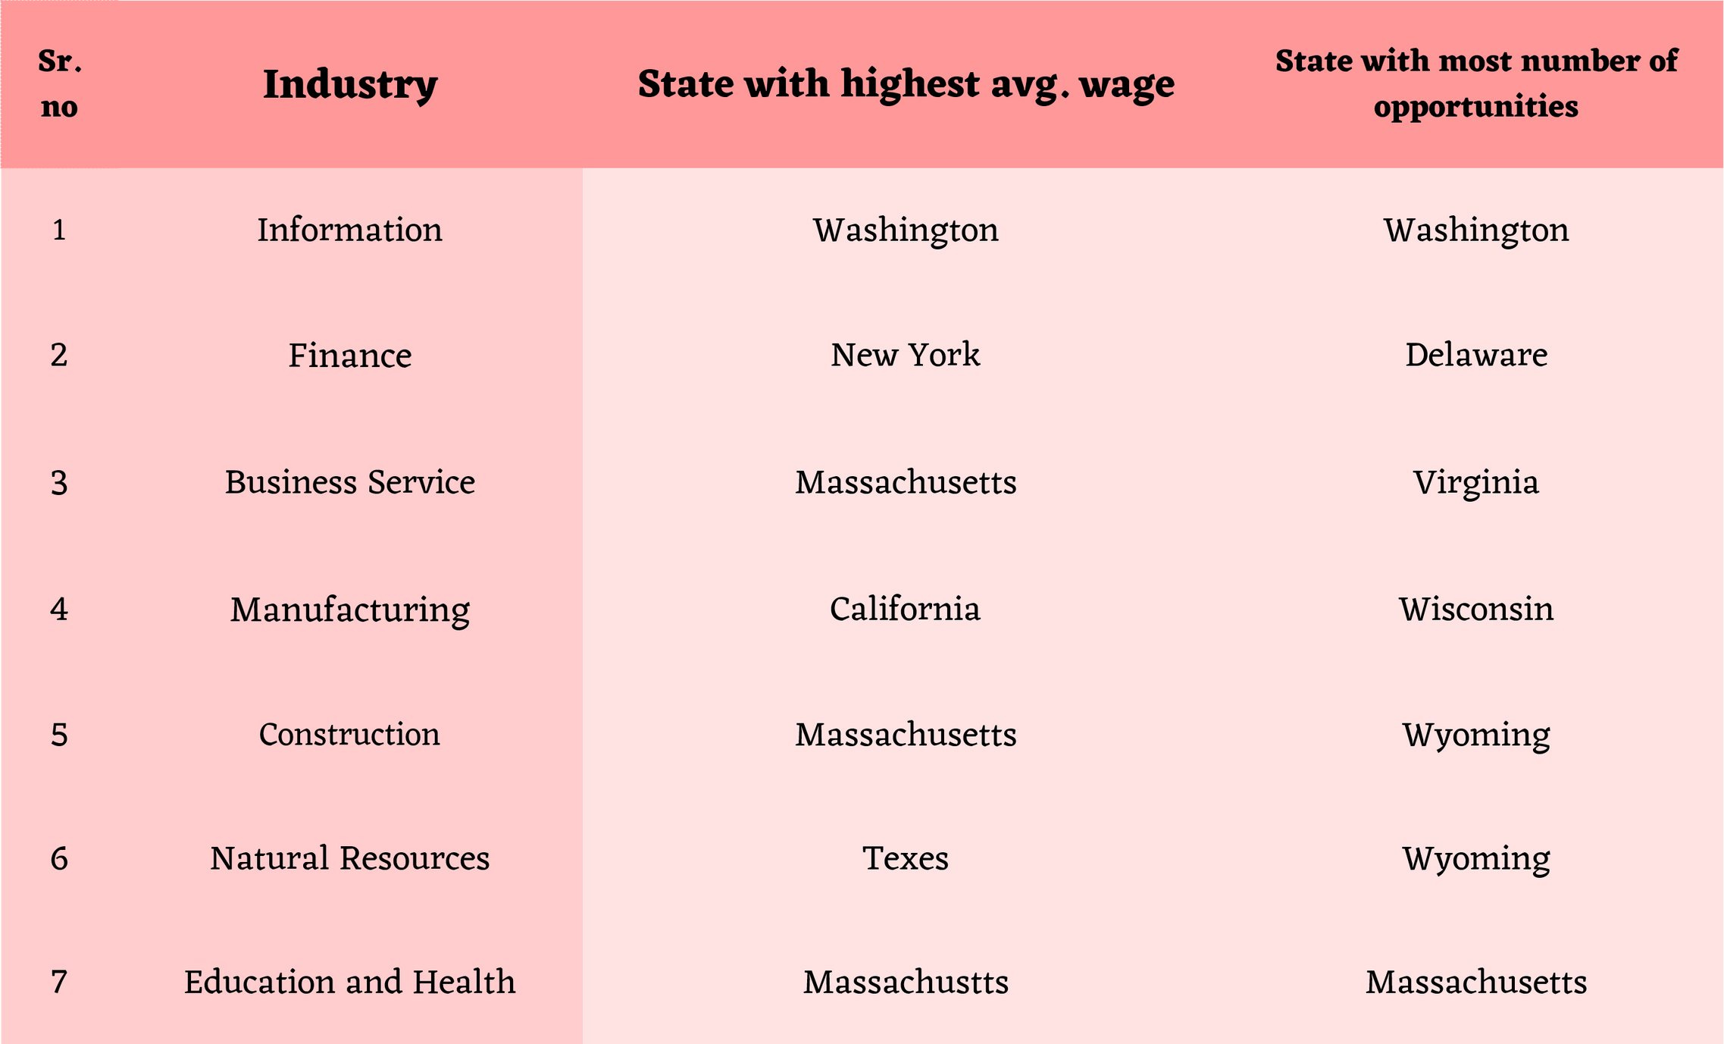

Slide 10
Steps Involve in making of project
Step-1 Taking the Raw data from BLS website
Step-2 Web Scrapping
Step-3 Data cleaning & Processing
Step-4 Importing Data in Excel
Step-5 Creating Data prep Tab
Step-6 Dashboard desing
Step-7 Making Visualization

Slide 11
Possible future Improvement
1.Currently Dashboard is built on 2020-2023(4 years dataset)
In future we can increase the size of dataset to get bigger picture
2.For now source of dataset is static in future we can connect it to Bloomberg for dynamic dataset

Slide 12
Thank you

