Slide 1
HAPPIEST HEALTH · DIGITAL TWIN CHALLENGE 2026
HealthTwin
See the change. Understand the risk. Explore what comes next.
A two-hour blood-sugar warning for one doctor and one person.
Team Ritik Awachat · Vijay Patil School of Management · solo

Slide 2
01 · PROBLEM
The average does not say what the next two hours will do.
HbA1c is a three-month average. It does not say the next meal will pass 180.
HealthTwin joins the clinic chart to a wearable stream.
The warning is two hours ahead: long enough to walk, eat later, or send a message.
The screen is for the doctor. It is not a diagnosis.

Slide 3
02 · USE CASE
One condition. One person. One decision.
A working-age adult with Type 2 diabetes, a glucose sensor, and a watch.
Sugar can still look ordinary when a spike is already likely.
The doctor sees who to message, then the chance, the peak, and the reasons.
It does not change a dose, and it does not forecast a heart attack.

Slide 4
03 · SANDBOX
No real patient record is in this prototype.
Real charts stay out. The clinic file and the wearable stream are synthetic.
Chart: labs, medicines, blood pressure, family history, simulated gene flags.
Wearable: glucose, heart rate, steps, and sleep, every 15 minutes.
Meals change the sugar. The model is not given a column called meal.

Slide 5
04 · ARCHITECTURE
Two streams, then the model, then the screen.
Clinic chart
Wearable stream
Model
Dashboard
Age, labs, medicines
Blood pressure
Family history
Simulated gene flags
Glucose every 15 min
Heart rate, steps, sleep
Past only
Nothing from later
Patient-level split
Spike at 180 or above
Drop under 70
Peak sketch
Who should get a message?
Then one person
Green line so far
Orange estimate
→
→
→
Features stop at the current minute. The label is the next two hours.
Two adverse events: glucose ≥180 (spike) and <70 (low).

Slide 6
05 · FUSION
The join is the product. Either stream alone is not.
Inputs are the chart plus sensors up to this minute. Nothing later is an input.
Two adverse events: glucose ≥180 (spike) and <70 (low).
People are split 70 / 15 / 15. One person is never in two sets.
The alert line is chosen on the validation people, then frozen.

Slide 7
06 · MODEL
Three models. One laptop. A frozen threshold.
Gradient boosting calls a spike, calls a drop under 70, and sketches the peak.
A glucose-only model is the baseline, with its own threshold.
The screen explains the call in sentences, not a table of weights.
Python, pandas, scikit-learn, Streamlit. Seed 2026. 150 people, 12 days, 23 held out.

Slide 8
07 · RESULTS
23 people the model had not seen.
Fusion ROC-AUC
Sensor-only ROC-AUC
In-range fusion
Peak error
0.918
0.828
0.873
16.6
Full twin
Glucose features only
Sugar still under 140
mg/dL, average
Threshold 0.58, set on validation: precision 0.66, recall 0.74.
While sugar is still under 140, fusion is 0.873 and the sensor-only model is 0.670.

Slide 9
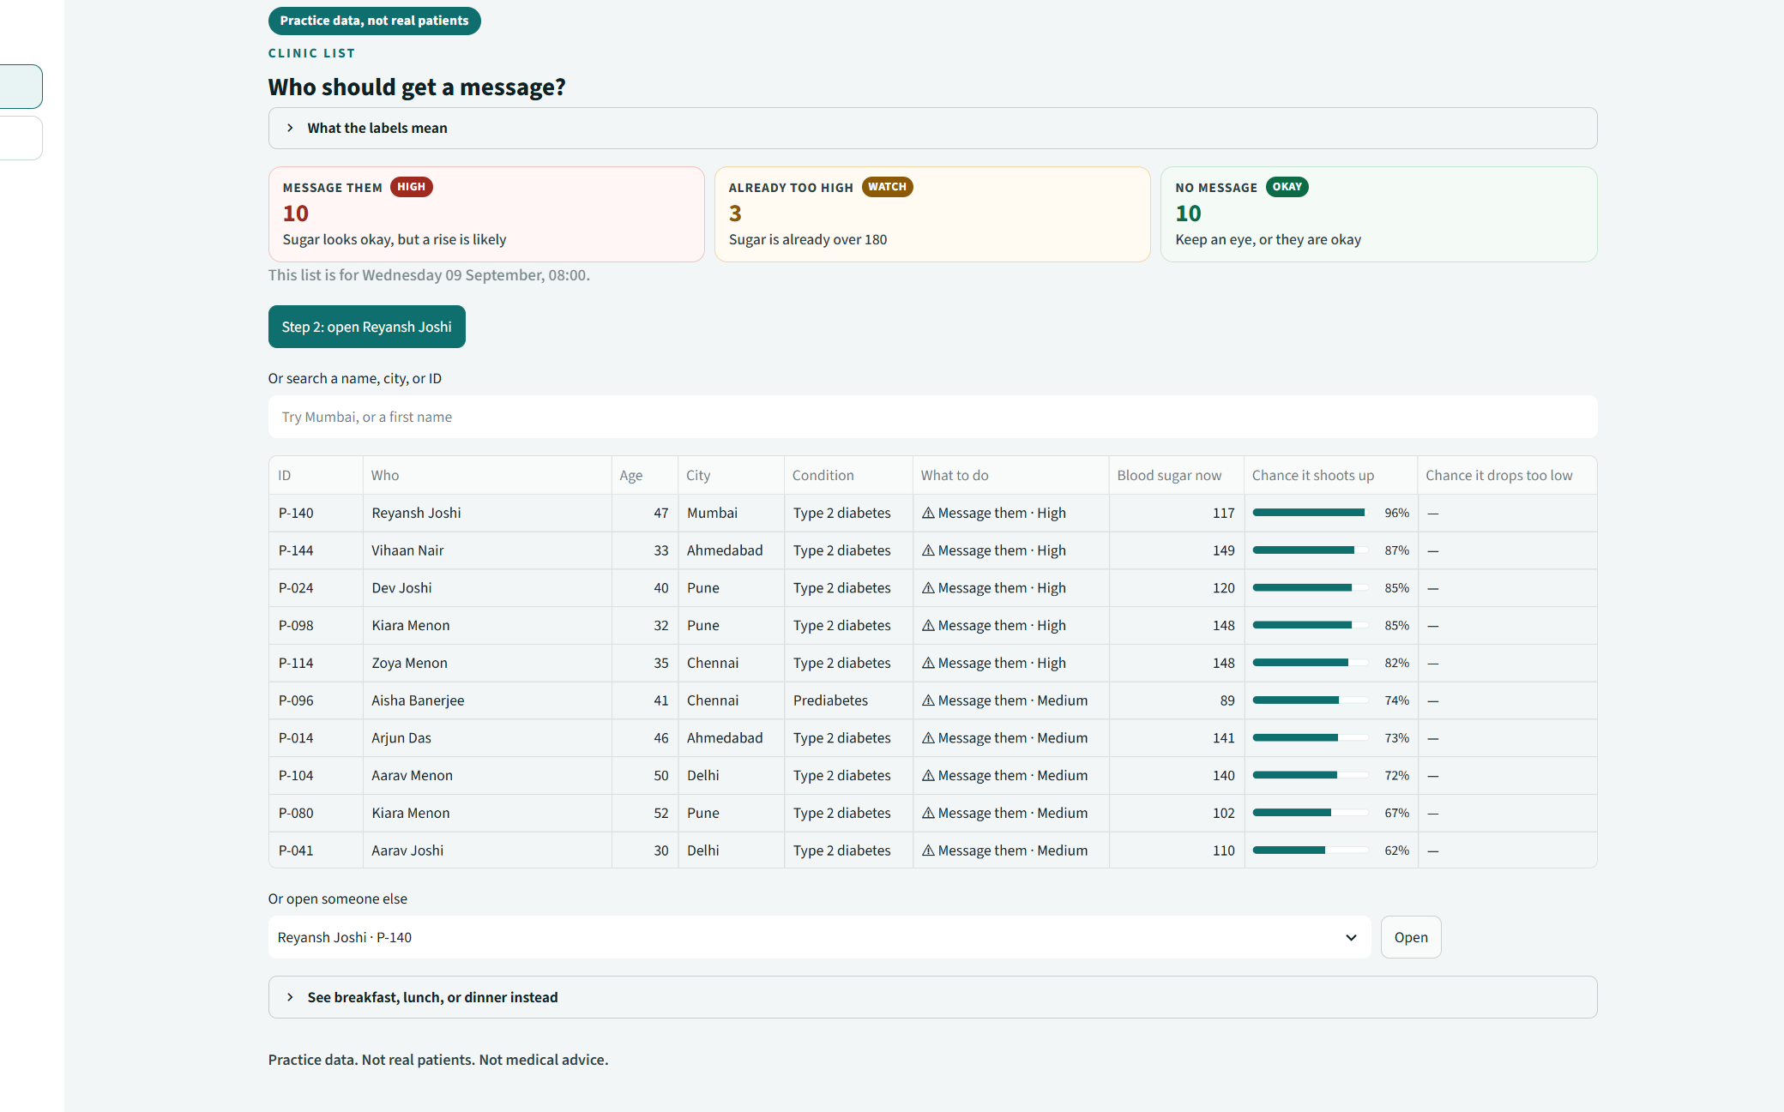
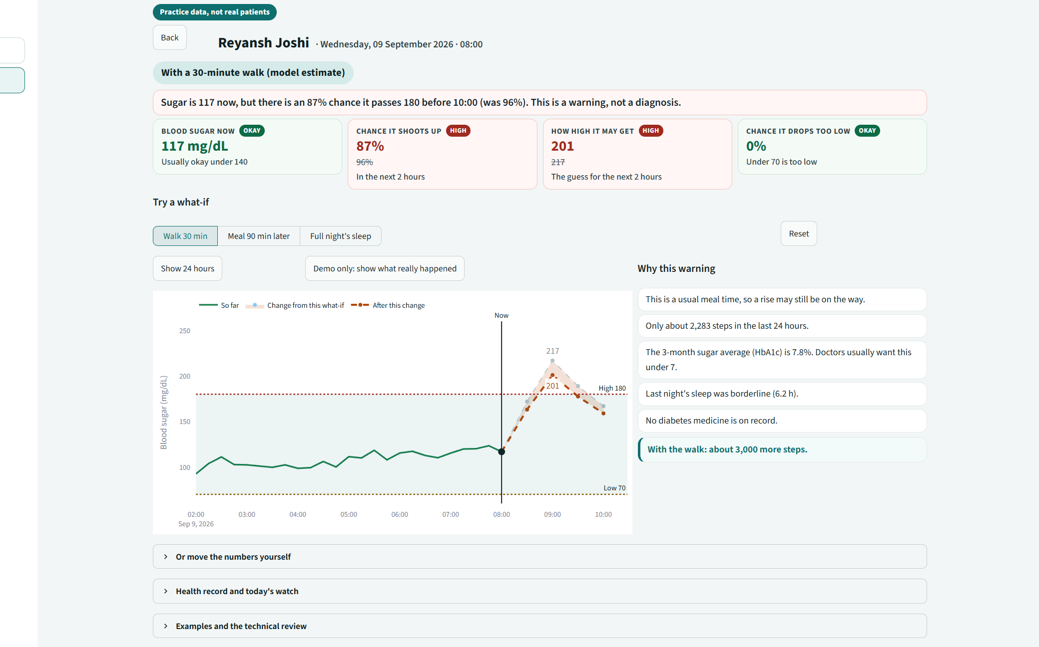
08 · DASHBOARD
Who should get a message, then one person.
Message them, already too high, or no message. Reyansh Joshi is first.
Sugar 117, a 96% chance it passes 180. A 30-minute walk moves that to 87%.
Green is sugar so far. Orange is the estimate. The recorded line does not move.

Slide 10
09 · LIMITS
Said here, before anyone has to ask.
The score is on a generator we wrote. It is not a ward validation.
Meals follow a clock. A next version needs a meal log.
The gene flags are simulated. The chart is a sketch, not a body.
Do not use this to change a dose.

Slide 11
10 · CLOSE
A quiet reading that will not stay quiet.
Two streams. Two warnings. One screen a doctor can stand in front of.
Team name: Ritik Awachat. College: Vijay Patil School of Management. Solo.
The code, the licence, and this deck are in the public repository.
Practice data. Not real patients. Not medical advice.

