Slide 1
Neuro-symbolic causal inference
Phase 2 · DistilBERT and reviewed Bayesian graphs
Does a causal claim follow from the evidence?
Aman · Ansh Tomar · Ravleen Singh · Ritik · Sarabjeet Singh
01
Notes:
Explain the project in one sentence: the reader judges claims, the graph checks structure, and the Bayesian model reasons under supplied assumptions. Sources: https://arxiv.org/abs/2306.05836 ; https://arxiv.org/abs/1910.01108 ; local outputs/phase2/metrics.json, selection.json, graph_metrics.json.

Slide 2
Dataset and training budget
Split | Records | Role
Training subset | 2100 | Matched ML and all DL runs
Development | 984 | Checkpoint, threshold and selection
Test | 1,162 | Final fixed-protocol evaluation
25 training systems · one seed · local Apple GPU
Label 1: entailed. Label 0: not entailed.
02
Notes:
The official raw splits remain unchanged. Whole premise groups are selected using seed 42. Do not compare the sampled DL model as if it had the same data budget as the full Phase 1 model. Sources: https://arxiv.org/abs/2306.05836 ; https://arxiv.org/abs/1910.01108 ; local outputs/phase2/metrics.json, selection.json, graph_metrics.json.

Slide 3
Phase 1 baseline and remaining gap
Phase 1: interpretable structural features
28 features measure counts, claim types and text structure.
Phase 2: learned text representations
Test whether adapting a pretrained reader improves claim judgments.
Improvement is measured, never assumed.
03
Notes:
The full-data calibrated RF macro F1 is 0.6357. This is context only. DistilBERT is assessed against a newly trained matched-data RF. Handcrafted counts have limited ability to encode which variables participate in each independence relation. Sources: https://arxiv.org/abs/2306.05836 ; https://arxiv.org/abs/1910.01108 ; local outputs/phase2/metrics.json, selection.json, graph_metrics.json.

Slide 4
One reader, one document decision
Premise segment + complete hypothesis
Shared DistilBERT encoder → average window summaries
Small classifier → entailed / not entailed
Up to 4 windows per training example; no silent truncation.
04
Notes:
The SAME pretrained encoder is reused for every window. Reserve room for the full hypothesis. Average valid window CLS representations before the classification head. A single document has one loss. This preserves all tokens but does not add cross-window attention. https://huggingface.co/docs/transformers/en/model_doc/distilbert

Slide 5
Training and validation
Three small experiments
Frozen encoder + weighted head
Fine-tuned encoder + weighted loss
Fine-tuned encoder + ordinary loss
Development macro F1 selects checkpoints and thresholds.
05
Notes:
Use AdamW, learning rate 2e-5 for fine-tuning; head LR 0.001 for the frozen baseline. Batch two documents, accumulation eight, maximum three epochs, patience one. Main and ordinary-loss runs use the same setup except class weighting. Frozen encoder vectors are cached; its head batch is 64. All settings are logged. Sources: https://arxiv.org/abs/2306.05836 ; https://arxiv.org/abs/1910.01108 ; local outputs/phase2/metrics.json, selection.json, graph_metrics.json.

Slide 6
ML, DL and their fixed average
Hybrid did not improve test F1; dev selection: hybrid.
06
Notes:
Hybrid score is (calibrated matched RF score + main DL score)/2. Equal weights are fixed; thresholds are chosen using dev only. This is an experiment in complementary errors, not a guarantee of calibrated probability or causal validity. Sources: https://arxiv.org/abs/2306.05836 ; https://arxiv.org/abs/1910.01108 ; local outputs/phase2/metrics.json, selection.json, graph_metrics.json.

Slide 7
Ablation results
Configuration | Dev macro F1 | Test macro F1
Frozen encoder | 0.5917 | 0.5679
Fine-tuned weighted | 0.6844 | 0.6726
Fine-tuned ordinary | 0.6510 | 0.6443
Same training records, tokenizer and windowing throughout.
07
Notes:
Do not attribute every difference solely to one architectural property: the frozen head has a different conventional optimizer learning rate and batch size. Weighted versus ordinary loss is the cleaner controlled comparison. One seed cannot establish statistical superiority. Sources: https://arxiv.org/abs/2306.05836 ; https://arxiv.org/abs/1910.01108 ; local outputs/phase2/metrics.json, selection.json, graph_metrics.json.

Slide 8
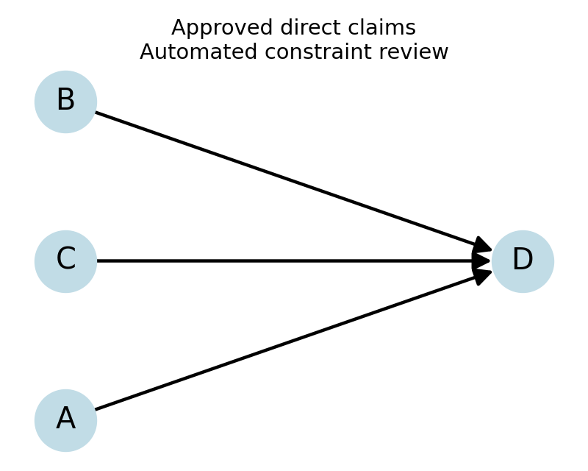
Graph precision and structural checks
18 systems. No-edge precision is undefined; recall and coverage are in the report.
08
Notes:
Integration graph source: Hybrid matched ML + DL. Reference graph: all label-1 direct-cause pairs among 18 systems with complete pair annotations. This is the graph of entailed direct relations, not the full latent generating DAG. Include seven systems with empty references. Cycle removal can reduce recall as well as change precision. Sources: https://arxiv.org/abs/2306.05836 ; https://arxiv.org/abs/1910.01108 ; local outputs/phase2/metrics.json, selection.json, graph_metrics.json.

Slide 9
Observation and intervention
Question | P(Y = 1)
Observe X = 1 | 0.89
Set X = 1 externally | 0.85
Set X = 0 externally | 0.25
Documented probability assumptions are required.
No empirical causal-effect claim is made from text labels.
09
Notes:
Specified confounded network Z→X, Z→Y, X→Y. Probabilities come from supplied CPDs, not Corr2Cause observations. Conditioning updates belief; intervention fixes X and removes its incoming mechanism. Independent enumeration also checks the reviewed-graph integration query. Sources: https://arxiv.org/abs/2306.05836 ; https://arxiv.org/abs/1910.01108 ; local outputs/phase2/metrics.json, selection.json, graph_metrics.json.

Slide 10
Limitations and conclusions
One transformer, explicit comparisons, checked inference
Small training budget and one seed
Synthetic language and limited independent systems
Graph consistency does not establish causal truth
Supplied CPDs do not represent learned real-world mechanisms
10
Notes:
One seed and a small training subset limit external validity. ML/DL scores are not causal effect probabilities. The small-system reviewer is an automated complete-independence DAG audit under strong assumptions, not a human reviewer. All team members should be able to explain the full pipeline and its assumptions. Sources: https://arxiv.org/abs/2306.05836 ; https://arxiv.org/abs/1910.01108 ; local outputs/phase2/metrics.json, selection.json, graph_metrics.json.

