Slide 1

Batch Normalization
Why does
Batch Norm work?
deeplearning.ai

Slide 2


















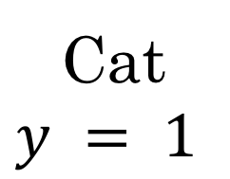
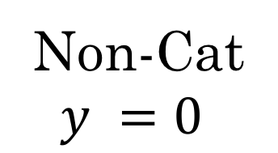
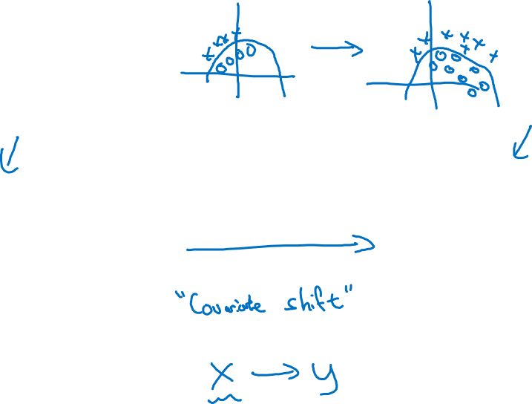
Learning on shifting input distribution
$$x_{1}$$
$$x_{2}$$
$$\hat{y}$$
$$x_{3}$$
Cat
$$y = 1$$
Non-Cat
$$y =0$$
$$y = 1$$
$$y =0$$

Slide 3

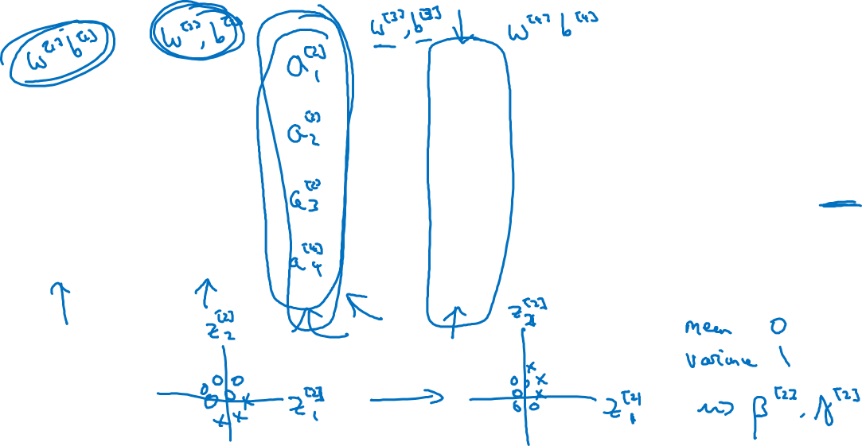



Why this is a problem with neural networks?
$$x_{1}$$
$$x_{2}$$
$$\hat{y}$$
$$x_{3}$$

Slide 4
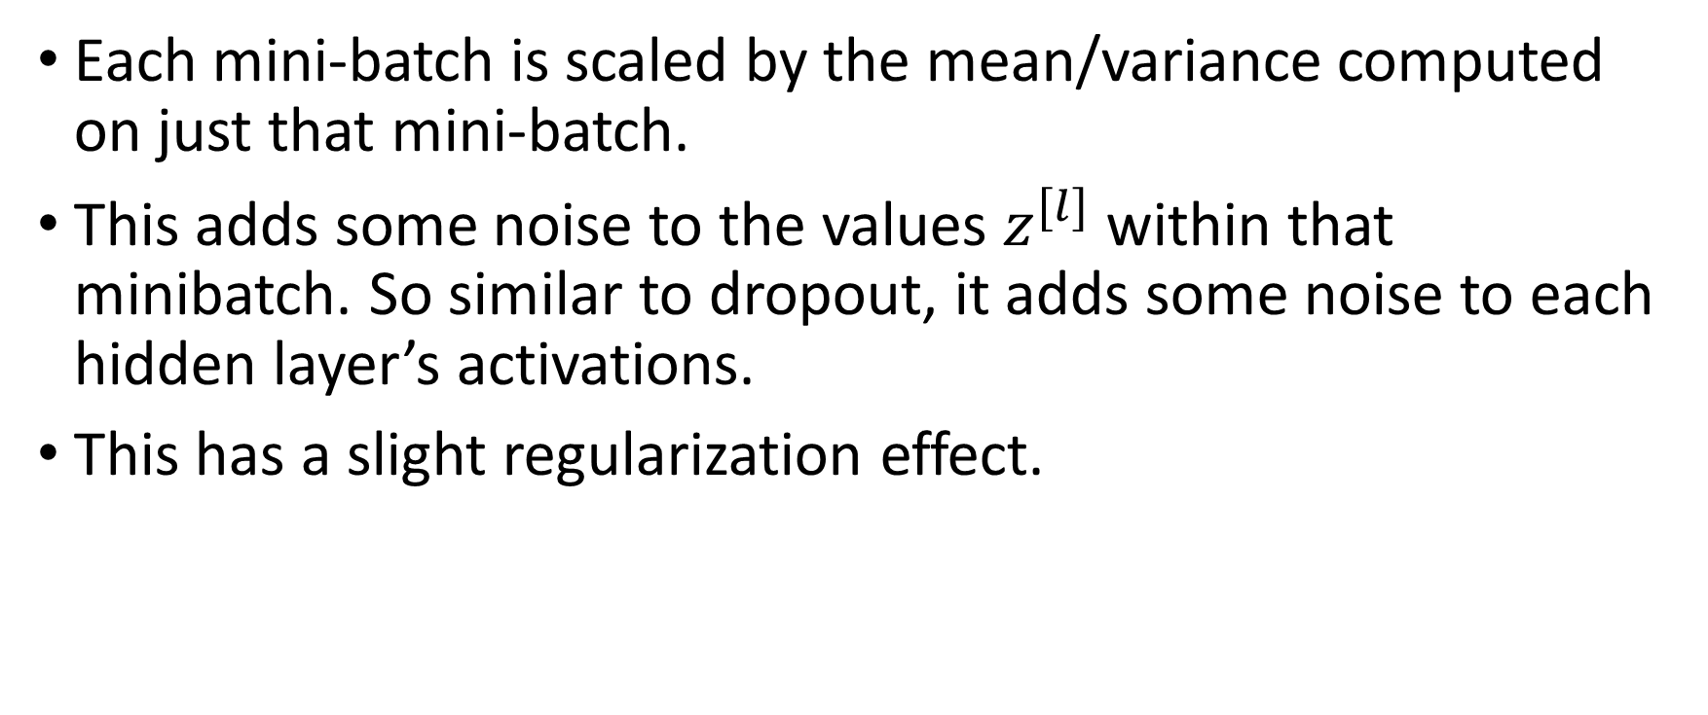
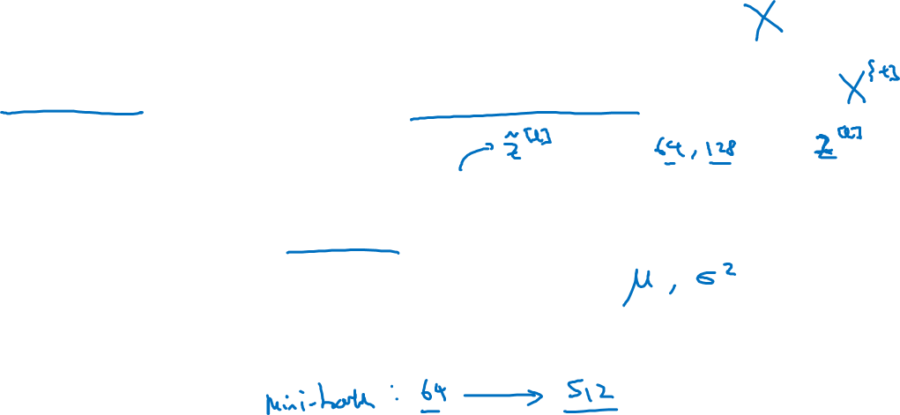
Batch Norm as regularization
Each mini-batch is scaled by the mean/variance computed on just that mini-batch.
This adds some noise to the values $z^{[l]}$ within that minibatch. So similar to dropout, it adds some noise to each hidden layer’s activations.
This has a slight regularization effect.

