Slide 1

Object Detection
Convolutional implementation of sliding windows
deeplearning.ai

Slide 2


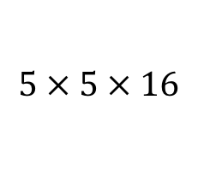
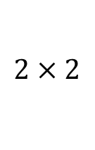

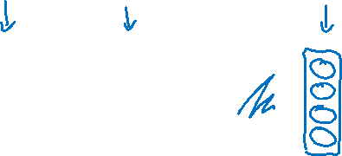
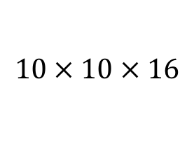

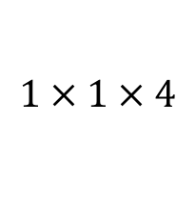
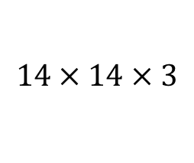

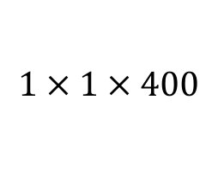
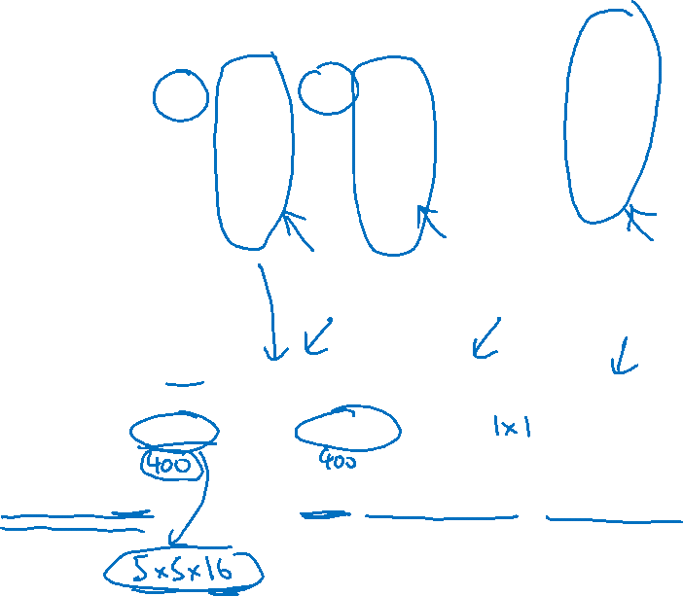
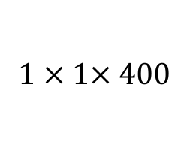


Turning FC layer into convolutional layers
MAX POOL
FC
FC
$$5 × 5$$
$$2 × 2$$
$$⋮$$
$$⋮$$
y
softmax (4)
$$14 × 14 × 3$$
$$10 × 10 × 16$$
$$5 × 5 × 16$$
$$400$$
$$400$$
MAX POOL
FC
FC
$$5 × 5$$
$$2 × 2$$
$$5 × 5$$
$$1 × 1$$
$$14 × 14 × 3$$
$$10 × 10 × 16$$
$$5 × 5 × 16$$
$$1 × 1× 400$$
$$1 × 1 × 400$$
$$1 × 1 × 4$$

Slide 3
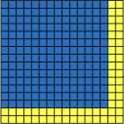
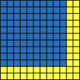
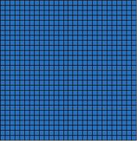
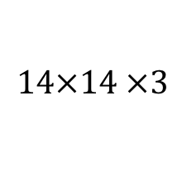
























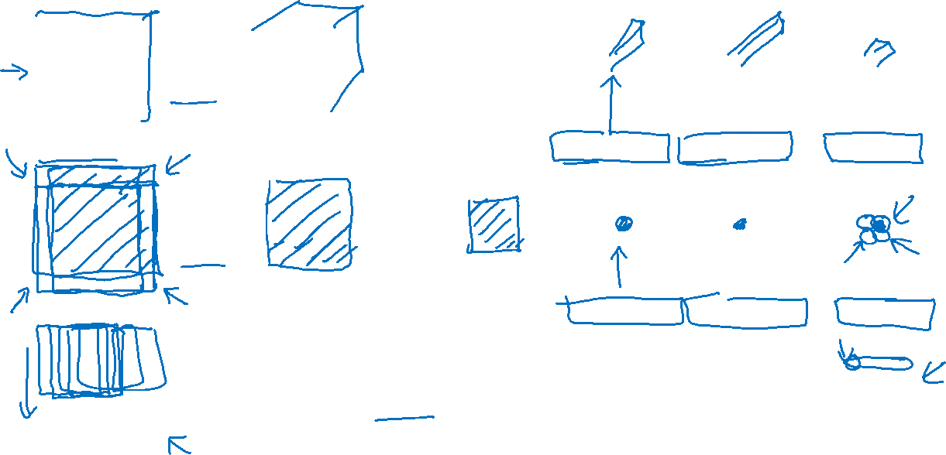
Convolution implementation of sliding windows
MAX POOL
FC
FC
FC
$$5×5$$
$$2×2$$
$$5×5$$
$$1×1$$
$$1×1$$
$$14×14 ×3$$
$$10×10×16$$
$$5×5×16$$
$$1×1×400$$
$$1×1×400$$
$$1×1×4$$
MAX POOL
FC
FC
FC
$$5×5$$
$$2×2$$
$$5×5$$
$$1×1$$
$$1×1$$
$$16×16×3$$
$$12×12×16$$
$$6×6×16$$
$$2×2×400$$
$$2×2×400$$
$$2×2×4$$
MAX POOL
$$5×5$$
$$2×2$$
$$5×5$$
$$1×1$$
$$1×1$$
$$28×28×3$$
$$24×24×16$$
$$12×12×16$$
$$8×8×400$$
$$8×8×400$$
$$8×8×4$$
[Sermanet et al., 2014, OverFeat: Integrated recognition, localization and detection using convolutional networks]

Slide 4
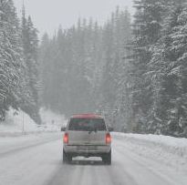



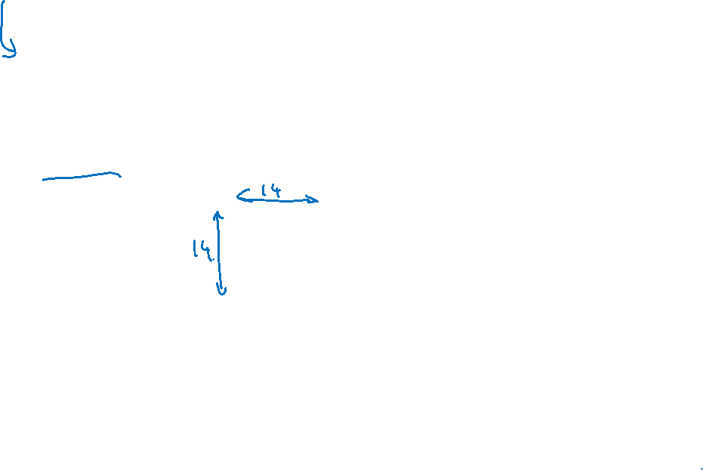



Convolution implementation of sliding windows
MAX POOL
$$5×5$$
$$2×2$$
$$5×5$$
$$1×1$$
$$1×1$$
$$28×28$$
$$16×16$$
$$12×12$$
$$8×8×400$$
$$8×8×400$$
$$8×8×4$$

