Slide 1

Face recognition
One-shot learning
deeplearning.ai

Slide 2

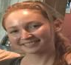


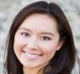

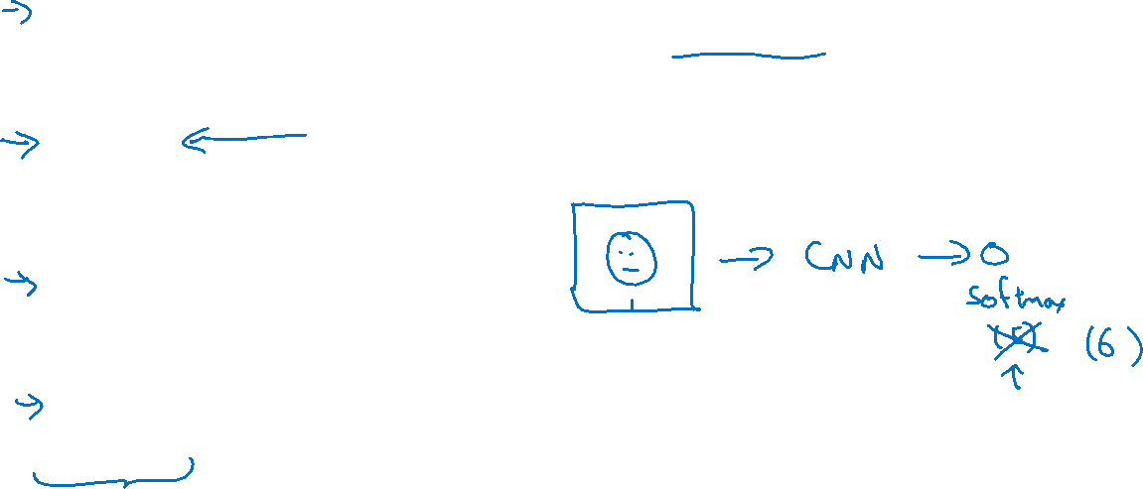
One-shot learning
Learning from one example to recognize the person again

Slide 3

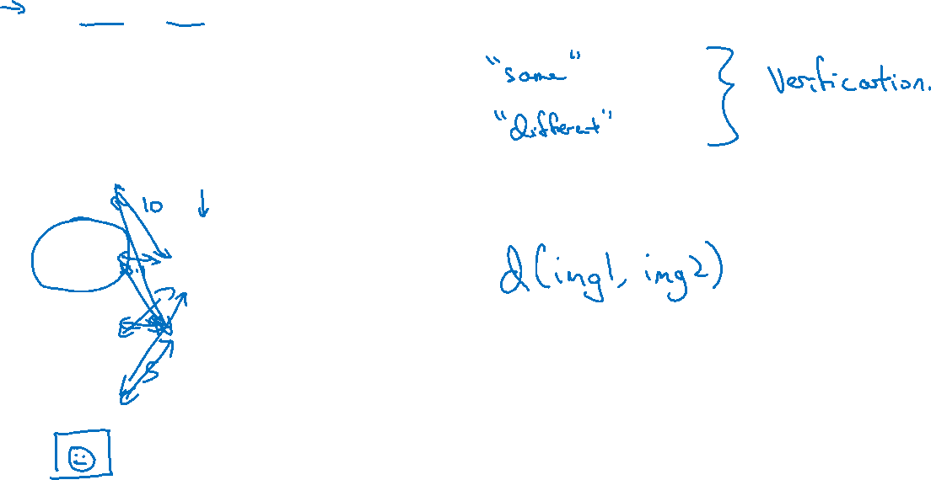

Learning a “similarity” function
d(img1,img2) $=$ degree of difference between images
If d(img1,img2) $≤ τ$
$$> τ$$

