Slide 1

Neural Style Transfer
What are deep
ConvNets learning?
deeplearning.ai

Slide 2

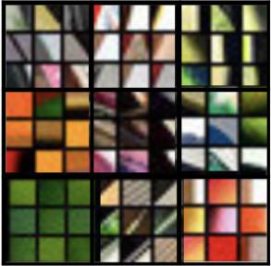




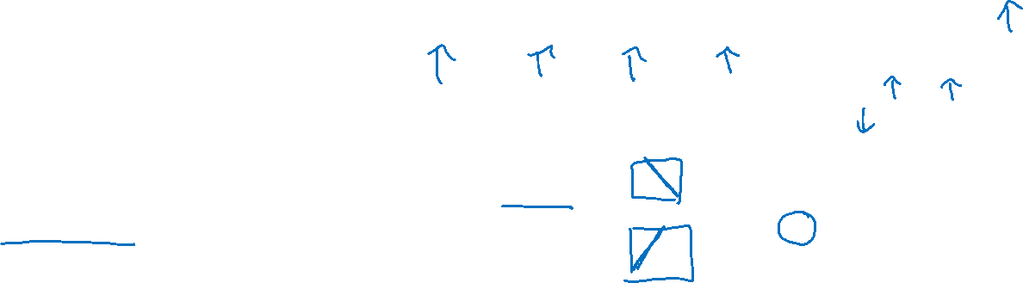







Visualizing what a deep network is learning
Note: 3 by 3 max pool with stride 2:
$$\hat{y}$$
$$⋮$$
$$⋮$$
$$26×26×256$$
$$13×13×256$$
$$13×13×384$$
$$13×13×384$$
$$6×6×256$$
$$55×55×96$$
FC
4096
FC
4096
$$224×224×3$$
$$110×110×96$$
Pick a unit in layer 1. Find the nine image patches that maximize the unit’s activation.
Repeat for other units.
[Zeiler and Fergus., 2013, Visualizing and understanding convolutional networks]

Slide 3
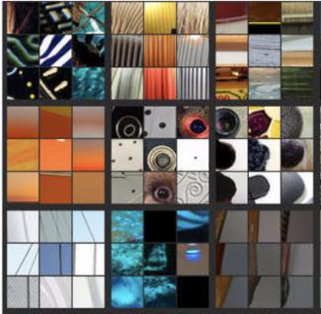
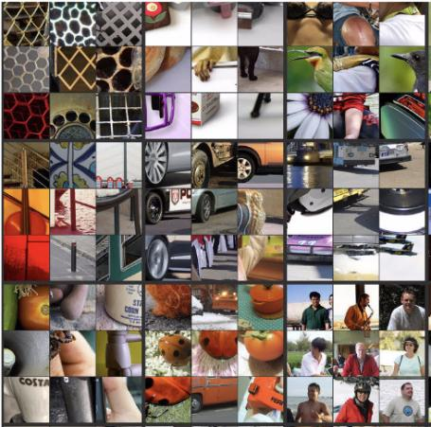
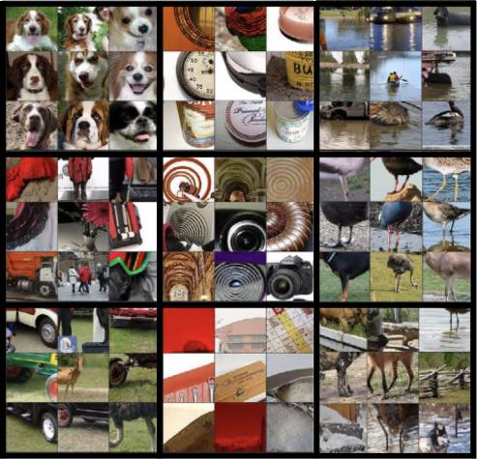
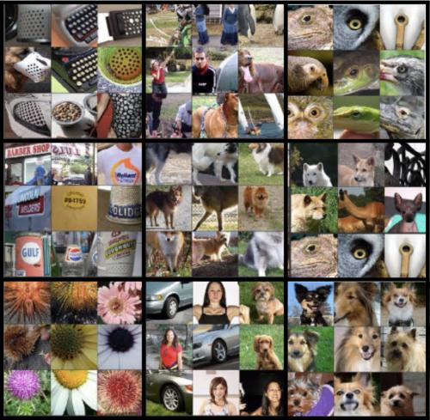
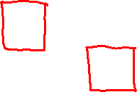
Visualizing deep layers
Layer 1
Layer 2
Layer 3
Layer 4
Layer 5

Slide 4
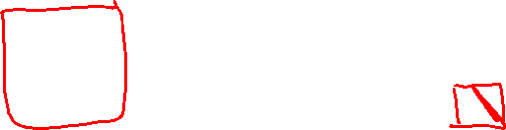
Visualizing deep layers: Layer 1
Layer 1
Layer 2
Layer 3
Layer 4
Layer 5

Slide 5
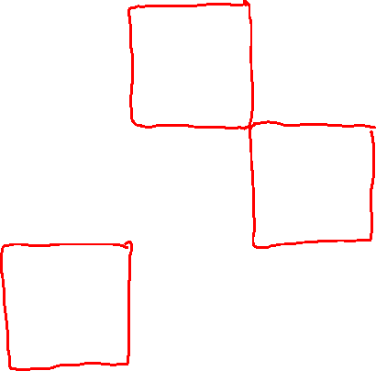
Visualizing deep layers: Layer 2
Layer 1
Layer 2
Layer 3
Layer 4
Layer 5

Slide 6

Visualizing deep layers: Layer 3
Layer 1
Layer 2
Layer 3
Layer 4
Layer 5

Slide 7
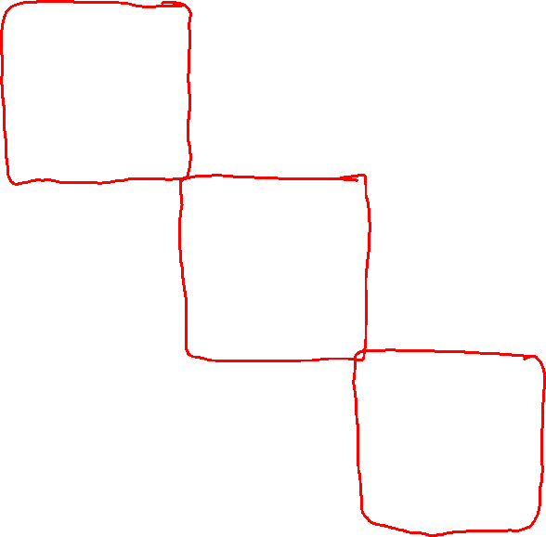
Visualizing deep layers: Layer 3
Layer 1
Layer 2
Layer 3
Layer 4
Layer 5

Slide 8
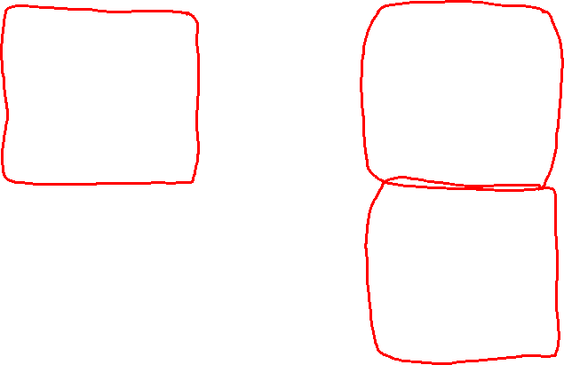
Visualizing deep layers: Layer 4
Layer 1
Layer 2
Layer 3
Layer 4
Layer 5

Slide 9
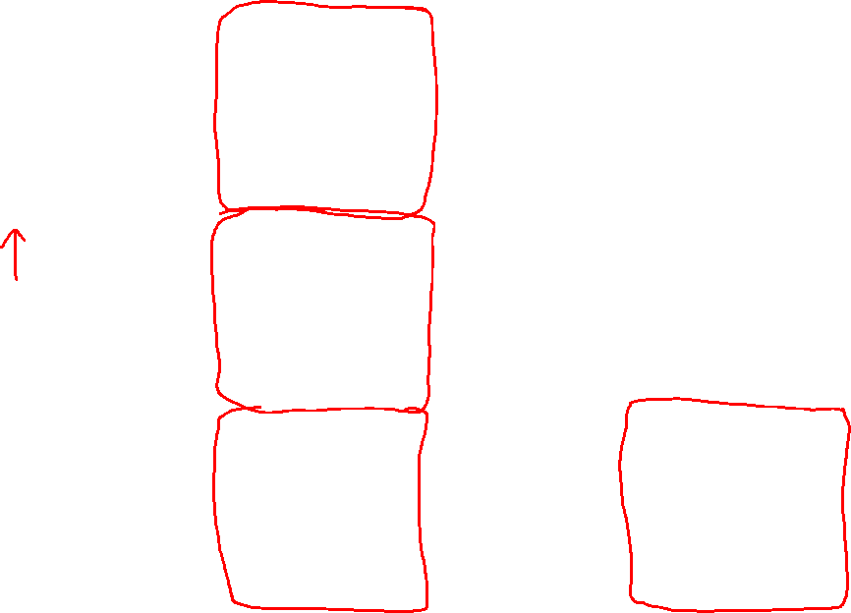
Visualizing deep layers: Layer 5
Layer 1
Layer 2
Layer 3
Layer 4
Layer 5

