Slide 1
Neural Style Transfer
Cost function

Slide 2

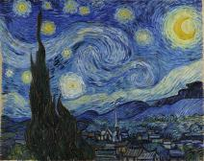
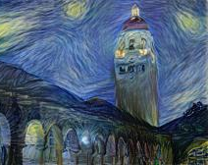
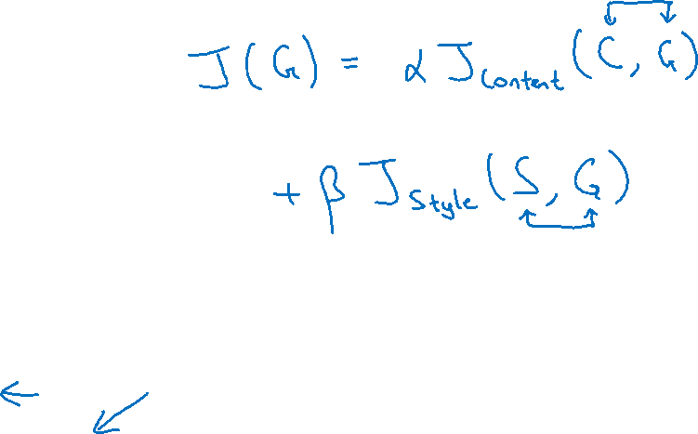
Neural style transfer cost function
Content C
Style S
Generated image G
[Gatys et al., 2015. A neural algorithm of artistic style. Images on slide generated by Justin Johnson]

Slide 3





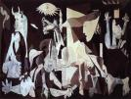
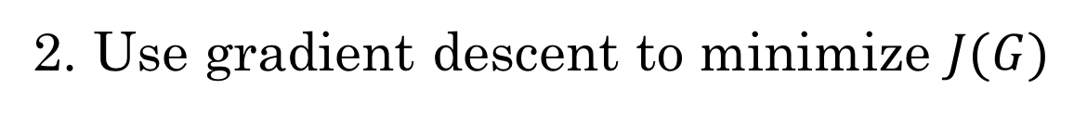
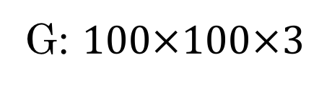
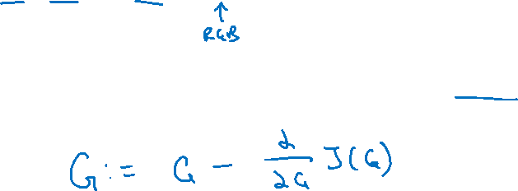
Find the generated image G
1. Initiate G randomly
G: $100×100×3$
2. Use gradient descent to minimize $J(G)$
[Gatys et al., 2015. A neural algorithm of artistic style]

