Slide 1
Algorithm Design and Analysis
Divide & Conquer

Slide 2
Divide and Conquer

Slide 3
Divide and Conquer
divide the problem into a number of sub problems
conquer the subproblems (solve them)
combine the subproblem solutions to get the solution to the original problem
Note: often the “conquer” step is done recursively

Slide 4
Divide and Conquer
•
Based on dividing problem into subproblems
Approach
Divide problem into smaller sub problems Sub problems must be of same type Sub problems do not need to overlap
Solve each subproblem recursively
Combine solutions to solve original problem
Usually contains two or more recursive calls
•
•

Slide 5
Divide-and-conquer technique
a problem of size n
subproblem 1 of size n/2
subproblem 2 of size n/2
a solution to subproblem 1 |  |  |  | a solution to subproblem 2
a solution to
the original problem

Slide 6
Divide and Conquer Algorithms
Based on dividing problem into subproblems
Divide problem into sub-problems Subproblems must be of same type Subproblems do not need to overlap
Conquer by solving sub-problems recursively. If the sub-problems are small enough, solve them in brute force fashion
Combine the solutions of sub-problems into a solution of the original problem (tricky part)

Slide 7
D-A-C
For Divide-and-Conquer algorithms the running time is mainly affected by 3 criteria:
The number of sub-instances into which a problem is split.
The ratio of initial problem size to sub- problem size.
The number of steps required to divide the initial instance and to combine sub- solutions.

Slide 8
Algorithm for General Divide and Conquer Sorting
Algorithm for General Divide and Conquer Sorting
Begin Algorithm
Start Sort(L)
If L has length greater than 1 then Begin
Partition the list into two lists, high and low Start Sort(high)
Start Sort(low) Combine high and low
End
End Algorithm

Slide 9
Analyzing Divide-and-Conquer Algorithms
When an algorithm contains a recursive call to itself, its running time can often be described by a recurrence equation which describes the overall running time on a problem of size n in terms of the running time on smaller inputs.
For divide-and-conquer algorithms, we get
recurrences that look like:
{
•
Θ(1) if n < c
aT(n/b) +D(n) +C(n)
T(n) = otherwise

Slide 10
Analyzing Divide-and-Conquer Algorithms (cont.)
where
a
= the number of subproblems we break
the problem into
n/b = the size of the subproblems (in terms of n)
D(n) is the time to divide the problem of size n into the subproblems
C(n) is the time to combine the subproblem solutions to get the answer for the problem of size n

Slide 11
The algorithm
Lets assume the following array
2 6 7 3 5 6 9 2 4 1
We divide the values into pairs
2 6 7 3 5 6 9 2 4 1
We sort each pair
2 6 3 7 5 6 2 9 1 4
Get the first pair (both lowest values!)

Slide 12
The algorithm (2)
We compare these values (2 and 6) with the values of the next pair (3 and 7)
2 6 3 7 5 6 2 9 1 4
Lowest 2,3
The next one (5 and 6)
Lowest 2,3
The next one (2 and 9)
Lowest 2,2
The next one (1 and 4)
Lowest 1,2

Slide 13
Example: Divide and Conquer
Binary Search
Heap Construction
Tower of Hanoi
Exponentiation
– Fibonnacci Sequence
Quick Sort
Merge Sort
Multiplying large Integers
Matrix Multiplications
Closest Pairs

Slide 14
Binary Search

Slide 15
Binary Search
Binary Search is classical example of Divide and Conquer method.
Search for a number x in a sorted array A[1..n], return the index of x in the array or -1 if not found.

Slide 16
Binary Search Algorithm
Binary-Search(A,x,l,r)
//intial call parameters are Binary-Search (A,1,n,x)
if l > r then
return −1; //Not found
end if
4. m := [(l + r )/2];
if A[m] = x then
return m
else if x < A[m] then
return Binary-Search(A, x, l ,m − 1))
else
return Binary-Search (A, x,m + 1, r ))
end if

Slide 17
Binary search
Find an element in a sorted array:
Divide: Check middle element.
Conquer: Recursively search 1 subarray.
Combine: Trivial.
Example: Find 9
3 5 7 8 9 12 15

Slide 18
Binary search
Find an element in a sorted array:
Divide: Check middle element.
Conquer: Recursively search 1 subarray.
Combine: Trivial.
Example: Find 9
3 5 7 8 9 12 15

Slide 19
Binary search
Find an element in a sorted array:
Divide: Check middle element.
Conquer: Recursively search 1 subarray.
Combine: Trivial.
Example: Find 9
3 5 7 8 9 12 15

Slide 20
Binary search
Find an element in a sorted array:
Divide: Check middle element.
Conquer: Recursively search 1 subarray.
Combine: Trivial.
Example: Find 9
3 5 7 8 9 12 15

Slide 21
Binary search
Find an element in a sorted array:
Divide: Check middle element.
Conquer: Recursively search 1 subarray.
Combine: Trivial.
Example: Find 9
3 5 7 8 9 12 15

Slide 22
Binary search
Find an element in a sorted array:
Divide: Check middle element.
Conquer: Recursively search 1 subarray.
Combine: Trivial.
Example: Find 9
3 5 7 8 9 12 15

Slide 23
Binary Search-Analysis
The time required for a call on Binary-Search(A[1..n],x) is T(n) upto a small additive constant.
Let T(m) be the time required for a call on Binary- Search(A[l…j],x) where m=r-l+1 is the number of elements still under consideration in the search.
When m>1, the algorithm takes a constant amount of time in addition to one recursive call on ⌊m/2⌋ or ⌈m/2⌉ elements, depending whether or not x<=A[m].
Therefore T(m)=T(m/2) + g(m)

Slide 24
Recurrence for binary search
T(n) = 1 T(n/2) + O(1)
# subproblems
work dividing and combining
subproblem size
a=1, b=2, n^{logb a}= n⁰ ⇒ CASE 2
⇒ T(n) = Θ(lg n) .

Slide 25
Binary Search Complexities
Successful Searches :
Best Case: Θ(1)
Average Case: Θ(log n)
Worst Case: Θ(log n)
Unsuccessful Search :
Best, Average and Worst Cases : Θ (log n).
Recurrence Relation :
– T(n)=T(n/2)+O(1)
By applying Masters theorem (case 2), log n is the complexity

Slide 26
Quicksort

Slide 27
Design
Follows the divide-and-conquer paradigm.
Divide: Partition (separate) the array A[p..r] into two (possibly nonempty) subarrays A[p..q–1] and A[q+1..r].
θEach element in A[p..q–1] ≤ A[q].
θA[q] ≤ each element in A[q+1..r].
θIndex q is computed as part of the partitioning procedure.
Conquer: Sort the two subarrays A[p..q–1] &
A[q+1..r] by recursive calls to quicksort.
Combine: Since the subarrays are sorted in place – no work is needed to combine them.
How do the divide and combine steps of quicksort compare with those of merge sort?

Slide 28
Pseudocode
Quicksort(A, p, r)
if p < r then
q := Partition(A, p, r); Quicksort(A, p, q – 1); Quicksort(A, q + 1, r)
EndIf
Partition(A, p, r) x:= A[r],
i :=p – 1;
for j := p to r – 1 do if A[j] ≤ x then
i := i + 1;
A[i] ↔ A[j]
endif
endfor;
A[i + 1] ↔ A[r];
return i + 1
A[p..r]
 |  |  |  | 5
A[p..q – 1] A[q+1..r]
5
≤ 5 ≥ 5
Partition

Slide 29
Example
initially: |  | p 2 | 5 | 8 | 3 | 9 | 4 | 1 | 7 | 10 | r 6
 | i | j
next iteration: |  | 2 i | 5 j | 8 | 3 | 9 | 4 | 1 | 7 | 10 | 6
next iteration: |  | 2 | 5 i | 8 j | 3 | 9 | 4 | 1 | 7 | 10 | 6
next iteration: |  | 2 | 5 i | 8 | 3 j | 9 | 4 | 1 | 7 | 10 | 6
next iteration: |  | 2 | 5 | 3 i | 8 | 9 j | 4 | 1 | 7 | 10 | 6
note: pivot (x) = 6
Partition(A, p, r)
x, i := A[r], p – 1;
for j := p to r – 1 do if A[j] ≤ x then
i := i + 1;
A[i] ↔ A[j]
Endif
endfor;
A[i + 1] ↔ A[r];
return i + 1

Slide 30
Example (Continued)
next iteration: | 2 | 5 | 3 i | 8 | 9 j | 4 | 1 | 7 | 10 | 6
next iteration: | 2 | 5 | 3 i | 8 | 9 | 4 j | 1 | 7 | 10 | 6
next iteration: | 2 | 5 | 3 | 4 i | 9 | 8 | 1 j | 7 | 10 | 6
next iteration: | 2 | 5 | 3 | 4 | 1 i | 8 | 9 | 7 j | 10 | 6
next iteration: | 2 | 5 | 3 | 4 | 1 i | 8 | 9 | 7 | 10 j | 6
next iteration: | 2 | 5 | 3 | 4 | 1 i | 8 | 9 | 7 | 10 | 6 j
after final swap: | 2 | 5 | 3 | 4 | 1 i | 6 | 9 | 7 | 10 | 8 j
Partition(A, p, r)
x, i := A[r], p – 1;
for j := p to r – 1 do if A[j] ≤ x then
i := i + 1;
A[i] ↔ A[j]
endif
endfor;
A[i + 1] ↔ A[r];
return i + 1

Slide 31
Partitioning
ϖ
Select the last element A[r] in the subarray A[p..r] as the pivot – the element around which to partition.
As the procedure executes, the array is partitioned into three regions.
ϖ
A[p..q-1] — All entries in this region are ≤ pivot.
A[q+1..r– 1] — All entries in this region are > pivot.
A[r] = pivot.
ϖ
The above hold before each iteration of the for loop, and constitute a loop invariant.

Slide 32
Complexity of Partition
PartitionTime(n) is given by the number of iterations in the for loop.
∀ Θ(n) : n = r – p + 1.
Partition(A, p, r)
x, i := A[r], p – 1;
for j := p to r – 1 do if A[j] ≤ x then
i := i + 1;
A[i] ↔ A[j]
fi
od;
A[i + 1] ↔ A[r];
return i + 1

Slide 33
Algorithm Performance
•
Running time of quicksort depends on whether the partitioning is balanced or not.
Worst-Case Partitioning (Unbalanced Partitions):
Occurs when every call to partition results in the most unbalanced partition.
Partition is most unbalanced when
Subproblem 1 is of size n – 1, and subproblem 2 is of size 0 or vice versa.
pivot ≥ every element in A[p..r – 1] or pivot < every element in
A[p..r – 1].
Every call to partition is most unbalanced when
Array A[1..n] is sorted or reverse sorted!

Slide 34
Worst-case Partition Analysis
Recursion tree for worst-case partition
n
n – 1
Running time for worst-case partitions at each recursive level:
T(n) = T(n – 1) + T(0) + PartitionTime(n)
= T(n – 1) + Θ(n)
= ∑_{k=1 to n}Θ(k)
= Θ(∑_{k=1 to n} k )
= Θ(n²)
•
n – 2
•
•
•
•
n
n – 3
2
1

Slide 35
Best-case Partitioning
Size of each subproblem ≤ n/2.
One of the subproblems is of size ⎣n/2⎦
The other is of size ⎡n/2⎤ −1.
Recurrence for running time
T(n) ≤ 2T(n/2) + PartitionTime(n)
= 2T(n/2) + Θ(n)
T(n) = Θ(n lg n)

Slide 36
Recursion Tree for Best-case Partition
cn
cn
cn/2
cn/2
cn
lg n
cn/4
cn/4 cn/4
cn/4
cn
c c c
c c c
cn
Total
: O(n lg n)

Slide 37
Conclusion
•
•
Divide and conquer is just one of several powerful techniques for algorithm design.
Divide-and-conquer algorithms can be analyzed using recurrences and the master method (so practice this math).
Can lead to more efficient algorithms
•

Slide 38
Divide and Conquer (Merge Sort)

Slide 39
Divide and Conquer
Recursive in structure
Divide the problem into sub-problems that are similar to the original but smaller in size
Conquer the sub-problems by solving them recursively. If they are small enough, just solve them in a straightforward manner.
Combine the solutions to create a solution to the original problem

Slide 40
An Example: Merge Sort
Sorting Problem: Sort a sequence of n
elements into non-decreasing order.
Divide: Divide the n-element sequence to be sorted into two subsequences of n/2 elements each
Conquer: Sort the two subsequences recursively using merge sort.
Combine: Merge the two sorted subsequences to produce the sorted

Slide 41
Merge-Sort (A, p, r)
INPUT: a sequence of n numbers stored in
array A
• OUTPUT: an ordered sequence of n
numbers
MergeSort (A, p, r) // sort A[p..r] by divide & conquer
1 if p < r
2 then q ← ⎣(p+r)/2⎦
MergeSort (A, p, q)
MergeSort (A, q+1, r)
Merge (A, p, q, r) // merges A[p..q] with A[q+1..r]
Initial Call: MergeSort(A, 1, n)

Slide 42
Procedure Merge
Merge(A, p, q, r)
1 n₁ ← q – p + 1
2 n₂ ← r – q
for i ← 1 to n₁
ω do L[i] ← A[p + i – 1]
for j ← 1 to n₂
do R[j] ← A[q + j]
ω L[n₁+1] ← ∞
ω R[n₂+1] ← ∞
ω i ← 1
ω j ← 1
for k ←p to r
do if L[i] ≤ R[j]
then A[k] ← L[i]
ω i ← i + 1
else A[k] ← R[j]
ω j ← j + 1
Input: Array containing sorted subarrays A[p..q] and A[q+1..r].
Output: Merged sorted subarray in A[p..r].
Sentinels, to avoid having to check if either subarray is fully copied at each step.

Slide 43
Merge – Example
A
… | 1 | 6 | 8 | 9 | 26 | 32 | 42 | 43 | …
6
8
26
32
1
9
42
43
k
k
k
k
k
k
k
k
k
L
6 | 8 | 26 | 32 | ∞
R
1 | 9 | 42 | 43 | ∞
6
8
26
32
1
9
42
43
i
i
i
i
i
j
j
j
j
j

Slide 44
Merge Sort – Example
Original Sequence
Sorted Sequence
18 | 26 | 32 | 6 | 43 | 15 | 9 | 1
1 | 6 | 9 | 15 | 18 | 26 | 32 | 43
18
26
32
6
43
15
9
1
18 | 26 | 32 | 6
43 | 15 | 9 | 1
6 | 18 | 26 | 32
1 | 9 | 15 | 43
18
26
32
6
43
15
9
1
6
18
26
32
1
9
15
43
18 | 26 | 32 | 6
43 | 15 | 9 | 1
18
26
6
32
15
43
1
9
18
26
32
6
43
15
9
1
18
26
6
32
15
43
1
9
32 |  | 6 |  | 43 | 15
18 |  |  |  | 26 |  |  |  | 32 |  |  | 6 |  | 43 |  |  | 15 |  | 9 |  | 1 |  | 18 |  | 26 |  |  |  |  |  |  |  |  | 9 |  | 1
18 |  |  |  | 26 |  |  |  | 32 |  |  | 6 |  | 43 |  |  | 15 |  | 9 |  | 1
18
26
32
6
43
15
9
1
18
26
32
6
43
15
9
1
18
26
32
6
43
15
9
1

Slide 45
Analysis of Merge Sort
Running time T(n) of Merge Sort:
Divide: computing the middle takes Θ(1)
Conquer: solving 2 subproblems takes 2T(n/2)
Combine: merging n elements takes Θ(n)
Total:
T(n) = Θ(1)
T(n) = 2T(n/2) + Θ(n)
if n = 1 if n > 1
⇒ T(n) = Θ(n lg n)

Slide 46
Heap Sort

Slide 47

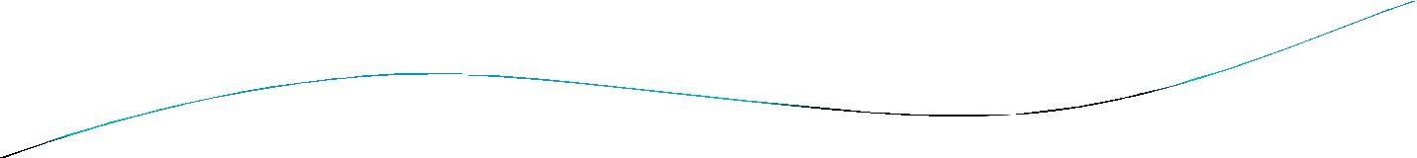


Definitions of heap:
A heap is a data structure that stores a collection of objects (with keys), and has the following properties:
Complete Binary tree
Heap Order

Slide 48

The heap sort algorithm has two major steps :
The first major step involves transforming the complete tree into a heap.
The second major step is to perform the actual sort by extracting the largest or lowerst element from the root and transforming the remaining tree into a heap.

Slide 49

Types of heap
Max Heap
Min Heap

Slide 50

Max Heap Example
19
12
16
1
4
7
19 | 12 | 16 | 1 | 4 | 7
Array A

Slide 51

Min heap example
1
4
16
7
12
19
1 | 4 | 16 | 7 | 12 | 19
Array A

Slide 52
1-Max heap :
max-heap Definition:
is a complete binary tree in which the value in each internal node is greater than or equal to the values in the children of that node.
Max-heap property:
The key of a node is ≥ than the keys of its children.

Slide 53
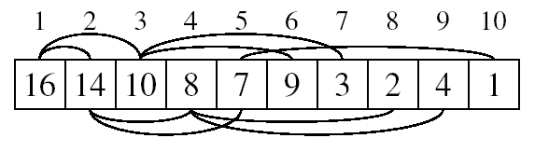
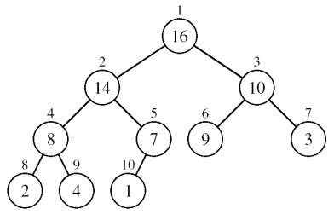
Max heap Operation
A heap can be stored as an array A.
Root of tree is A[1]
Left child of A[i] = A[2i]
Right child of A[i] = A[2i + 1]
Parent of A[i] = A[ ⎣i/2⎦ ]

Slide 54
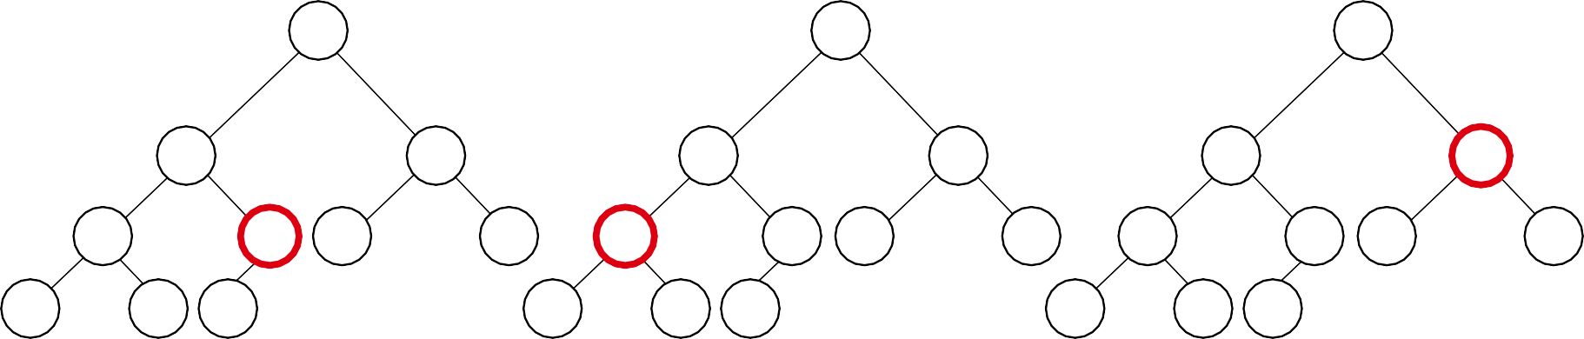
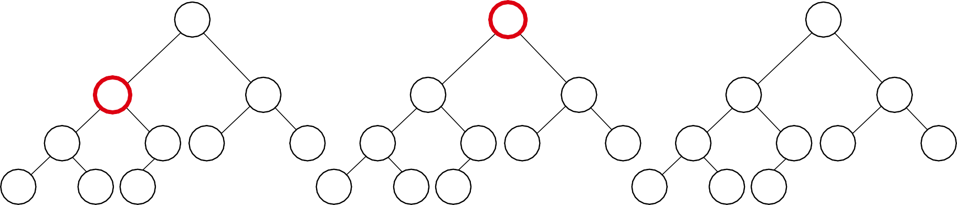
Example Explaining : A
4 | 1 | 3 | 2 | 16 | 9 | 10 | 14 | 8 | 7
i = 5
i = 4
i = 3
1 | 1 | 1
4 | 4 | 4
2
1
3
3
2
1
3
3
2
1
3
3
4
6
16 9
6
16 9
6
16 9
7
10
5
7
4
5
7
4
5
2
10
2
10
14
8
9
10
8
9
10
8
9
 |  |  |  |  |  |  |  | 10
14 | 8 | 7 | 14 | 8 | 7 | 2 | 8 | 7
i = 2
1
4
i = 1
1
4
1
16
2
1
3
10
2
16
3
10
2
14
3
10
4
6
16 9
6
7 9
6
7 9
7
3
5
7
4
5
7
4
5
14
3
14
3
8
8
2
9 10
8 7
8
2
9 10
8 1
8
2
9 10
4 1

Slide 55

Build Max-heap
Heapify() Example
16
4
10
14
7
9
3
2
8
1
A =
16 | 4 | 10 | 14 | 7 | 9 | 3 | 2 | 8 | 1

Slide 56
Heapify() Example
16
4
10
14
7
9
3
2
8
1
A =
16 | 4 | 10 | 14 | 7 | 9 | 3 | 2 | 8 | 1
11/0/2017

Slide 57

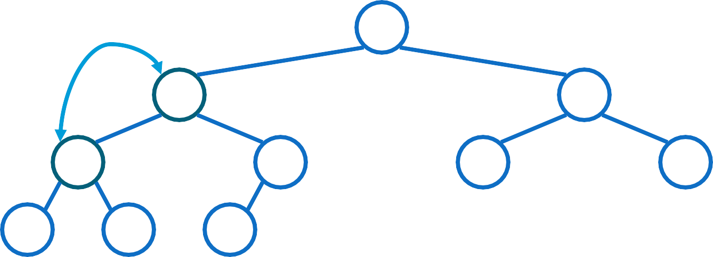
Heapify() Example
16
4
10
14
7
9
3
2
8
1
A =
16 | 4 | 10 | 14 | 7 | 9 | 3 | 2 | 8 | 1
David Luebke
12
11/20/2017

Slide 58
Heapify() Example
16
14
10
4
7
9
3
2
8
1
A =
16 | 14 | 10 | 4 | 7 | 9 | 3 | 2 | 8 | 1

Slide 59

Heapify() Example
16
14
10
4
7
9
3
2
8
1
A =
16 | 14 | 10 | 4 | 7 | 9 | 3 | 2 | 8 | 1

Slide 60

Heapify() Example
16
14
10
4
7
9
3
2
8
1
A =
16 | 14 | 10 | 4 | 7 | 9 | 3 | 2 | 8 | 1

Slide 61

Heapify() Example
16
14
10
8
7
9
3
2
4
1
A =
16 | 14 | 10 | 8 | 7 | 9 | 3 | 2 | 4 | 1

Slide 62

Heapify() Example
16
14
10
8
7
9
3
2
4
1
A =
16 | 14 | 10 | 8 | 7 | 9 | 3 | 2 | 4 | 1

Slide 63
Heapify() Example
16
14
10
8
7
9
3
2
4
1
A =
16 | 14 | 10 | 8 | 7 | 9 | 3 | 2 | 4 | 1

Slide 64
Heap-Sort
sorting strategy:
Build Max Heap from unordered array;
Find maximum element A[1];
Swap elements A[n] and A[1] :
now max element is at the end of the array! .
Discard node n from heap
(by decrementing heap-size variable).
New root may violate max heap property, but its children are max heaps. Run max_heapify to fix this.
Go to Step 2 unless heap is empty.

Slide 65

HeapSort() Example
A = {16, 14, 10, 8, 7, 9, 3, 2, 4, 1}
1
16
2
14
3
10
4
8
5
7
6
9
7
3
8
2
9
4
10
1
20

Slide 66

HeapSort() Example
A = {14, 8, 10, 4, 7, 9, 3, 2, 1, 16}
1
14
2
8
3
10
4
4
5
7
6
9
7
3
8
2
9
1
16
i = 10
21

Slide 67

HeapSort() Example
A = {10, 8, 9, 4, 7, 1, 3, 2, 14, 16}
1
10
2
8
3
9
4
4
5
7
6
1
7
3
8
2
14
i = 9
16
10
22

Slide 68
HeapSort() Example
A = {9, 8, 3, 4, 7, 1, 2, 10, 14, 16}
1
9
2
8
3
3
4
4
5
7
6
1
7
2
10
i = 8
14
9
16
10
23

Slide 69

HeapSort() Example
A = {8, 7, 3, 4, 2, 1, 9, 10, 14, 16}
1
8
2
7
3
3
4
4
5
2
6
1
9
i = 7
10
8
14
9
16
10
24

Slide 70

HeapSort() Example
A = {7, 4, 3, 1, 2, 8, 9, 10, 14, 16}
1
7
2
4
3
3
4
1
5
2
8
i = 6
9
7
10
8
14
9
16
10
25

Slide 71

HeapSort() Example
A = {4, 2, 3, 1, 7, 8, 9, 10, 14, 16}
1
4
2
2
3
3
4
1
i = 5
7
8
6
9
7
10
8
14
9
16
10
26

Slide 72
HeapSort() Example
A = {3, 2, 1, 4, 7, 8, 9, 10, 14, 16}
1
3
2
2
3
1
i = 4
4
7
5
8
6
9
7
10
8
14
9
16
10
27

Slide 73

HeapSort() Example
A = {2, 1, 3, 4, 7, 8, 9, 10, 14, 16}
1
2
2
1
i = 3
3
4
4
7
5
8
6
9
7
10
8
14
9
16
10
28

Slide 74

HeapSort() Example
A = {1, 2, 3, 4, 7, 8, 9, 10, 14, 16} >>orederd
1
1
i =2
2
3
3
4
4
7
5
8
6
9
7
10
8
14
9
16
10
29

Slide 75

Heap Sort pseducode
Heapsort(A as array) BuildHeap(A)
for i = n to 1 swap(A[1], A[i]) n = n - 1 Heapify(A, 1)
BuildHeap(A as array) n = elements_in(A) for i = floor(n/2) to 1
Heapify(A,i)

Slide 76

Heapify(A as array, i as int) left = 2i
right = 2i+1
if (left <= n) and (A[left] > A[i]) max = left
else
max = i
if (right<=n) and (A[right] > A[max]) max = right
if (max != i) swap(A[i], A[max]) Heapify(A, max)

Slide 77

Conclusion
The primary advantage of the heap sort is its efficiency. The execution time efficiency of the heap sort is O(n log n).
The memory efficiency of the heap sort, unlike the other n log n sorts, is constant, O(1), because the heap sort algorithm is not recursive.

Slide 78
Strassen's Matrix Multiplication

Slide 79


Basic Matrix Multiplication
void matrix_mult (){
for (i = 1; i <= N; i++) {
for (j = 1; j <= N; j++) {
for(k=1;k<=N;k++){ compute C_{i,j};
}
}}
algorithm
N
^{C}i, j ªi,k^{b}k , j
Time analysis
k 1
N N N
ThusT (N )
c cN ³ O(N ³ )
i 1 j 1 k 1

Slide 80

Basic Matrix Multiplication
Suppose we want to multiply two matrices of size N
x N: for example A x B = C.
^{C}11 ^{= a}11^{b}11 ^{+ a}12^{b}21
^{C}12 ^{= a}11^{b}12 ^{+ a}12^{b}22 ^{C}21 ^{= a}21^{b}11 ^{+ a}22^{b}21 ^{C}22 ^{= a}21^{b}12 ^{+ a}22^{b}22
2x2 matrix multiplication can be accomplished in 8
multiplication.(2^{log 8} =2³)
2

Slide 81
Divide and Conquer Matrix Multiplication
In order to compute AB using the above decomposition, we need to perform 8 multiplications of n/2 X n/2 matrices and 4 additions of n/2 matrices.
Since two n/2Xn/2 may be added in time Cn² for some constant C, the overall computing time, T(n) of the resulting divide and conquer algorithm is given by the recurrence as:

Slide 82














b
n 2
T (n) 8T ^{n} 2
(n² ) n 2
Compare above recurrencewith T(n)
aT ^{n} f (n) b
_{n}2
a 8, b 2 f(n)
_{n}log_{b} a
T (n)
_{n}log₂ 8 _{n}3
O(n³ )

Slide 83
Strassens’s Matrix Multiplication
Strassen showed that 2x2 matrix multiplication can be accomplished in 7 multiplication and 18 additions or subtractions. .(2^{log}₂⁷ =2^{2.807})
This reduce can be done by Divide and Conquer Approach.

Slide 84
Strassens’s Matrix Multiplication
P₁ = (A₁₁+ A₂₂)(B₁₁+B₂₂) P₂ = (A₂₁ + A₂₂) * B₁₁
P₃ = A₁₁ * (B₁₂ - B₂₂) P₄ = A₂₂ * (B₂₁ - B₁₁) P₅ = (A₁₁ + A₁₂) * B₂₂
P₆ = (A₂₁ - A₁₁) * (B₁₁ + B₁₂) P₇ = (A₁₂ - A₂₂) * (B₂₁ + B₂₂)
C₁₁ = P₁ + P₄ - P₅ + P₇ C₁₂ = P₃ + P₅
C₂₁ = P₂ + P₄
C₂₂ = P₁ + P₃ - P₂ + P₆

Slide 85
Comparison
C₁₁ = P₁ + P₄ - P₅ + P₇
= (A₁₁+ A₂₂)(B₁₁+B₂₂) + A₂₂ * (B₂₁ - B₁₁) - (A₁₁ + A₁₂) * B₂₂+ (A₁₂ - A₂₂) * (B₂₁ + B₂₂)
^{= A}11 ^{B}11 ^{+ A}11 ^{B}22 ^{+ A}22 ^{B}11 ^{+ A}22 ^{B}22 ^{+ A}22 ^{B}21 ^{– A}22 ^{B}11 ^{- A}11 ^{B}22 ^{-A}12 ^{B}22 ^{+ A}12 ^{B}21 ^{+ A}12 ^{B}22 ^{– A}22 ^{B}21 ^{– A}22 ^{B}22
^{= A}11 ^{B}11 ^{+ A}12 ^{B}21

Slide 86
Analysis
b
n 2
(n² ) n 2
T (n) 7T ^{n} 2
n b
Compare above recurrencewith T(n) aT
f (n)
_{n}2
a 7, b 2 f(n)
_{n}log₂ 7
_{O(n}2.81 ₎
_{n}log_{b} a
T (n)
_{n}2.81

Slide 87
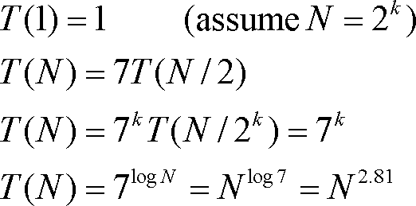
Time Analysis

