Slide 1

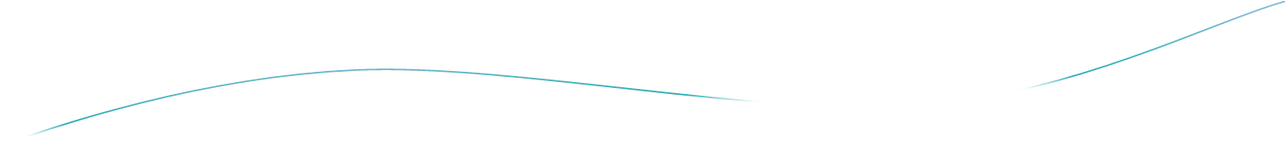


Slide 2
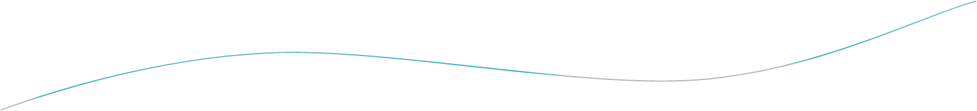
Outline
Introduction
Optimization Problem
Characteristics And Features
Greedy Properties.
Greedy Approach
⎫The Coin Changing Problem.
⎫Traveling Salesman.
MST
Kruskal’s And Prim’s Algorithm.
Huffman Code.
Advantages And Disadvantages

Slide 3
Greedy Introduction
¬Greedy algorithms are simple and straightforward.
¬They are shortsighted in their approach
¬A greedy algorithm is similar to a dynamic programming algorithm, but the difference is that solutions to the sub problems do not have to be known at each stage
¬It is used to solve the optimization problems.

Slide 4
Optimization Problems
An optimization problem is one in which you want to find, not just a solution, but the best solution
A “greedy algorithm” sometimes works well for optimization problems
A greedy algorithm works in phases. At each phase:
⎫You take the best you can get right now, without regard for future consequences
⎫You hope that by choosing a local optimum at each step, you will end up at a global optimum
4

Slide 5
Characteristics And Features
¬To construct the solution in an optimal way.
Algorithm Maintains two sets
⎫One contains chosen items and
⎫The other contains rejected items.
¬Greedy algorithms make good local choices in the hope that They result in
⎫An optimal solution.
⎫Feasible solutions.

Slide 6
Greedy Property
It consists of two property.
Greedy-Choice Property:
It says that a globally optimal solution can be arrived at by making a locally optimal choice.
Optimal Substructure:
An optimal global solution contains the optimal solutions of all its sub problems.

Slide 7
Greedy Approach
Greedy Algorithm works by making the decision that seems most promising at any moment; it never reconsiders this decision, whatever situation may arise later.
As an example consider the problem of "Making Change".
Coins available are:
⎫ 100 cents
⎫ 25 cents
⎫ 10 cents
⎫ 15 cents
⎫ 1 cent

Slide 8
CONTINUED…
Problem:
Make a change of a given amount using the smallest possible number of coins.
Solution:
⎫The coin is selected using greedy criterion: at each stage increases the total amount of change constructed as much as possible.
⎫To assure feasibility i.e. the change given exactly equals the desired amount of the solution

Slide 9
Coin Changing Problem
Algorithm:
Make change for n units using the least possible number of coins.
MAKE-CHANGE (n)
C ← {100, 25, 10, 15, 1} // constant.
S← {}; // set that will hold the solution set.
Sum ← 0 sum of item in solution set
WHILE sum not = n
x = largest item in set C such that sum + x ≤ n
IF no such item THEN RETURN "No Solution"
S ← S {value of x} & Remove x from C.
sum ← sum + x
RETURN S

Slide 10
Suppose you want to count out a certain amount of money, using the fewest possible bills and coins
A greedy algorithm to do this would be: At each step, take the largest possible bill or coin that does not overshoot
Example: To make $6.39, you can choose:
a $5 bill
a $1 bill, to make $6
a 25¢ coin, to make $6.25
A 10¢ coin, to make $6.35
four 1¢ coins, to make $6.39
For US money, the greedy algorithm always gives the optimum solution

Slide 11


Traveling Salesman
A salesman must visit every city (starting from city A), and wants to cover the least possible distance
He can revisit a city (and reuse a road) if necessary
He does this by using a greedy algorithm: He goes to the next nearest city from wherever he is
⎫From A he goes to B
⎫From B he goes to D
A B
C
2
4
⎫This is not going to result in a shortest path!
⎫The best result he can get now will be ABDBCE, at a cost of 16
⎫ An actual least-cost path from A
is ADBCE, at a cost of 14
3 3
4
4
D
E
10

Slide 12
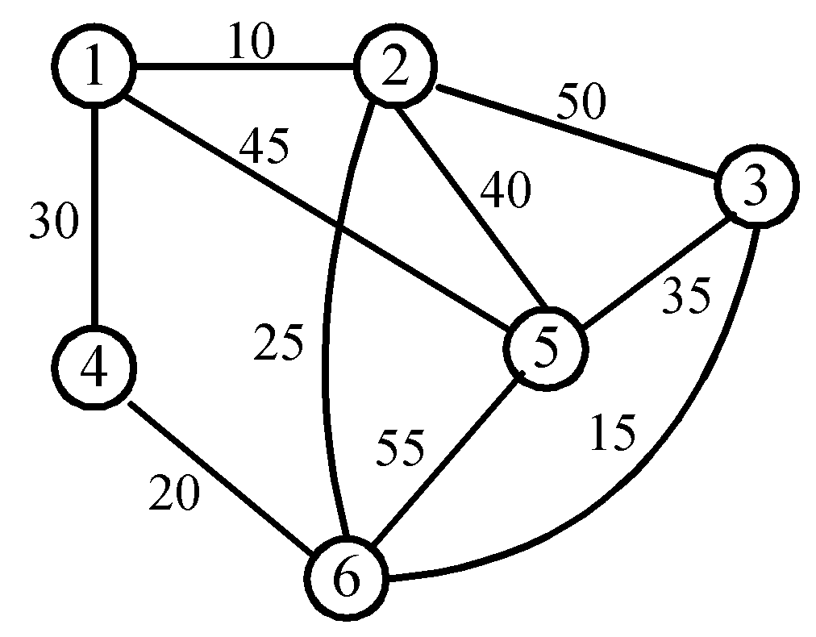
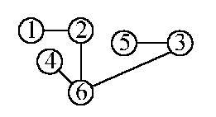
An Example Of MST
A graph and one of its minimum costs spanning tree.
Application of MST.

Slide 13
Kruskal’s Algorithm For Finding MST
Step 1: Sort all edges into non decreasing order.
Step 2: Add the next smallest weight edge to the forest if it will not cause a cycle.
Step 3: Stop if n-1 edges. Otherwise, go to Step2.

Slide 14
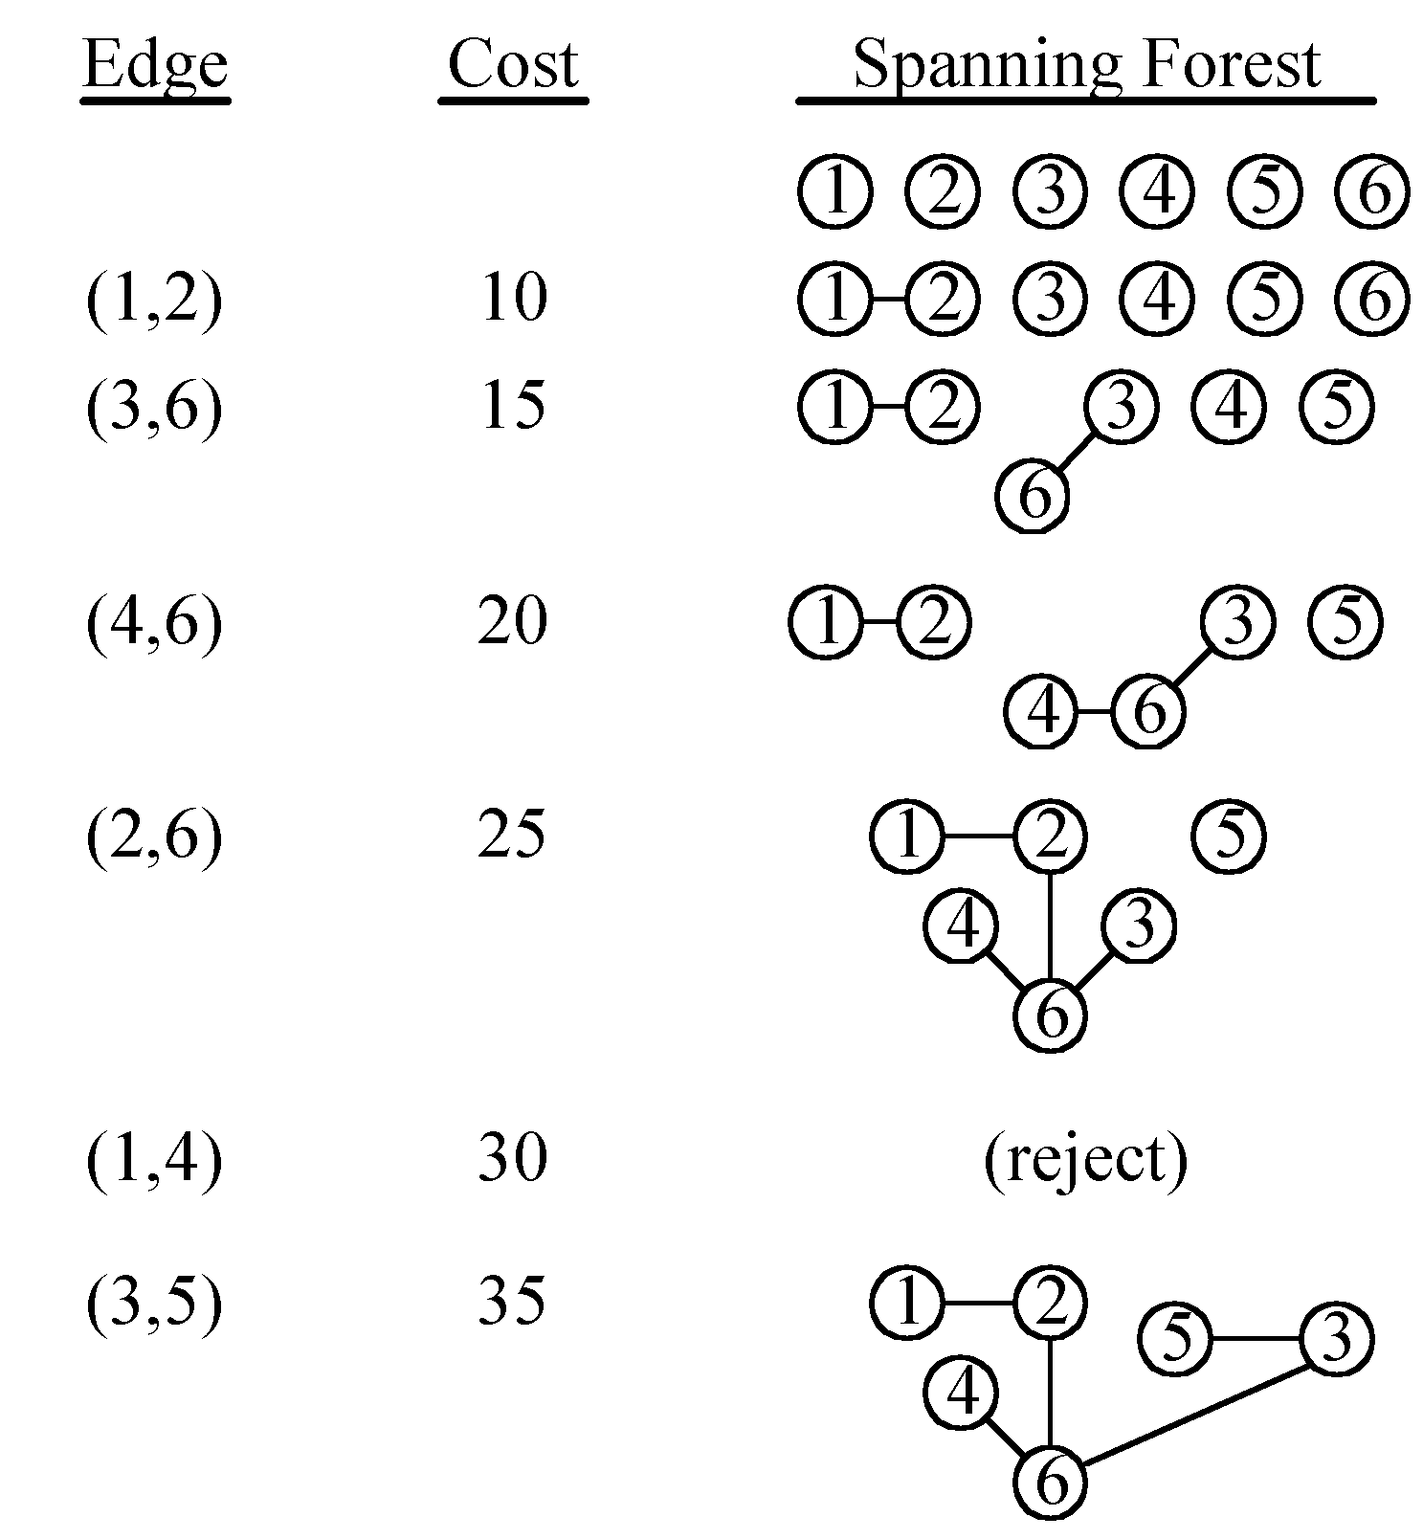
An Example Of Kruskal’s Algorithm

Slide 15
Prim’s Algorithm For Finding MST
¬Initialize a tree with a single vertex, chosen arbitrarily from the graph.
¬Grow the tree by one edge: of the edges that connect the tree to vertices not yet in the tree, find the minimum-weight edge, and transfer it to the tree.
¬Repeat step 2 (until all vertices are in the tree).And E=V-1.

Slide 16
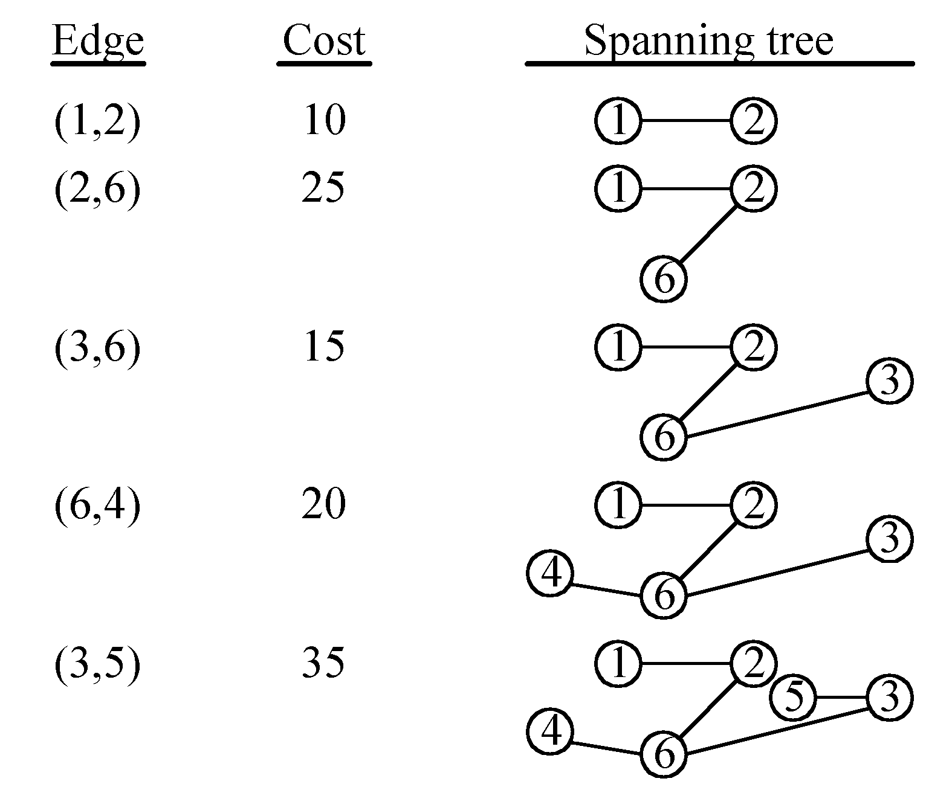
An Example For Prim’s Algorithm

Slide 17
Huffman Encoding
The Huffman encoding algorithm is a greedy algorithm
You always pick the two smallest numbers to combine
100
1
0
54
¬ The Huffman algorithm finds an optimal solution
0
27
A=00 B=100 C=01 D=1010 E=11 F=1011
1
15
0
1
46
0 ₁ 0
22 12 24 6
A B C D
1
27 9
E F
16

Slide 18
Advantages And Disadvantages
Advantages:
They are easier to implement.
They require much less computing resources.
They are much faster to execute.
Greedy algorithms are used to solve optimization problems
Disadvantages:
Their only disadvantage being that they not always reach the global optimum solution.
On the other hand, even when the global optimum solution is not reached, most of the times the reached sub- optimal solution is a very good solution.

