Slide 1
Algorithm Design and Analysis
Introduction to Algorithms

Slide 2
WHAT IS AN ALGORITHM?
An algorithm is a sequence of unambiguous instructions for solving a problem, i.e., for obtaining a required output for any legitimate input in a finite amount of time.

Slide 3
NOTION OF ALGORITHM
problem
algorithm
“computer”
input
output
Algorithmic solution

Slide 4
EXAMPLE: SORTING
Statement of problem:
❑ Input:
A sequence of n numbers
<a₁, a₂, …, a_{n}>
❑ Output:
A reordering of the input sequence
<b₁, b₂, …, b_{n}>
so that b_{i} ≤ b_{j} whenever i < j

Slide 5
Example:
Sorting algorithms:
Selection sort?
Insertion sort?
Merge sort?
…
problem
algorithm
“computer”
input
output
<5, 3, 2, 8, 3>
<2, 3, 3, 5, 8>

Slide 6
SELECTION SORT
Input:
array a[0], …, a[n-1]
Output:
array a sorted in non-decreasing order
Algorithm:
for i=0 to n-1
swap a[i] with smallest of a[i],…a[n-1]

Slide 7
SOME WELL-KNOWN COMPUTATIONAL PROBLEMS
Sorting
Searching
Shortest paths in a graph
Minimum spanning tree
Primality testing
Traveling salesman problem
Knapsack problem
Chess
Towers of Hanoi
Program termination

Slide 8
BASIC ISSUES RELATED TO ALGORITHMS
How to design algorithms
How to express algorithms
Proving correctness of algorithms
Efficiency
❑ Theoretical analysis Empirical analysis
❑
Optimality

Slide 9
ALGORITHM DESIGN STRATEGIES
Brute force
Divide and conquer
Decrease and conquer
Transform and conquer
Greedy approach
Dynamic programming
Backtracking and Branch and bound
Space and time tradeoffs

Slide 10
ANALYSIS OF ALGORITHMS
How good is the algorithm?
❑ Correctness Time efficiency Space efficiency
❑
❑
Does there exist a better algorithm?
❑ Lower bounds
❑ Optimality

Slide 11
WHAT IS AN ALGORITHM?
■
Recipe, process, method, technique, procedure, routine,… with following requirements:
Finiteness
terminates after a finite number of steps
Definiteness
rigorously and unambiguously specified
Input
valid inputs are clearly specified
Output
can be proved to produce the correct output given a valid input
Effectiveness
steps are sufficiently simple and basic

Slide 12
WHY STUDY ALGORITHMS
Theoretical importance
❑ The core of computer science
Practical importance
❑
❑
A practitioner’s toolkit of known algorithms
Framework for designing and analyzing algorithms for new problems

Slide 13
IMPORTANT PROBLEM TYPES
sorting
searching
string processing
graph problems
combinatorial problems
geometric problems
numerical problems

Slide 14
FUNDAMENTAL DATA STRUCTURES
list
❑
❑
❑
array linked list
string
stack
queue
priority queue
graph
tree
set and dictionary

Slide 15
Analysis of Algorithms
Involves evaluating the following parameters
Memory – Unit generalized as “WORDS”
Computer time – Unit generalized as “CYCLES”
Correctness – Producing the desired output

Slide 16
Sample Algorithm
FINDING LARGEST NUMBER
INPUT: unsorted array „A[n]‟of n numbers OUTPUT: largest number
large ← A[j]
for j ← 2 to length[A]
if large < A[j]
large ← A[j]
end

Slide 17
Space and Time Analysis
(Largest Number Scan Algorithm)
SPACE S(n): One “word” is required to run the algorithm (step 1…to store variable „large‟)
TIME T(n): n-1 comparisons are required to find the largest (every comparison takes one cycle)
*Aim is to reduce both T(n) and S(n)

Slide 18
ASYMPTOTICS
Used to formalize that an algorithm has running time or storage requirements that are ``never more than,'' ``always greater than,'' or ``exactly'' some amount

Slide 19
ASYMPTOTICS NOTATIONS
O-notation (Big Oh)
Asymptotic Upper Bound
For a given function g(n), we denote O(g(n)) as the set of functions:
O(g(n)) = { f(n)| there exists positive
constants c and n₀ such that 0 ≤ f(n) ≤ c g(n) for all n ≥ n₀ }

Slide 20
ASYMPTOTICS NOTATIONS
Θ-notation
Asymptotic tight bound
Θ (g(n)) represents a set of functions such that:
Θ (g(n)) = {f(n): there exist positive
constants c₁, c₂, and n₀ such that 0 ≤ c₁g(n) ≤ f(n) ≤ c₂g(n) for all n≥ n₀}

Slide 21
ASYMPTOTICS NOTATIONS
Ω-notation
Asymptotic lower bound
Ω (g(n)) represents a set of functions such that:
Ω(g(n)) = {f(n): there exist positive constants c and n₀ such that
0 ≤ c g(n) ≤ f(n) for all n≥ n₀}

Slide 22
O-notation ------------------ Less than equal to (“≤”)
Θ-notation ------------------ Equal to (“=“)
Ω-notation ------------------ Greater than equal to
(“≥”)

Slide 23
Mappings for n²
Ω (n² )
Θ(n²)
O(n² )

Slide 24
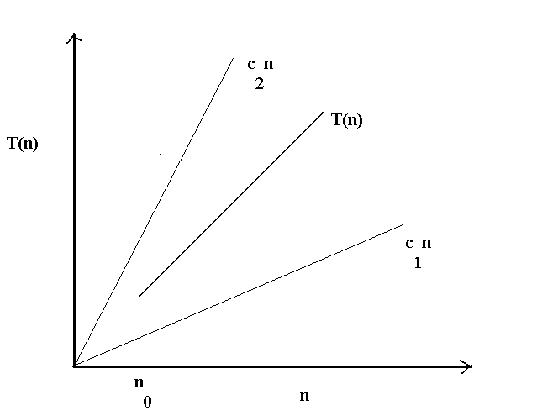
Bounds of a Function
Cntd…

Slide 25
Cntd…
c₁ , c₂ & n₀ -> constants
T(n) exists between c₁n & c₂n
Below n₀ we do not plot T(n)
T(n) becomes significant only above n₀

Slide 26
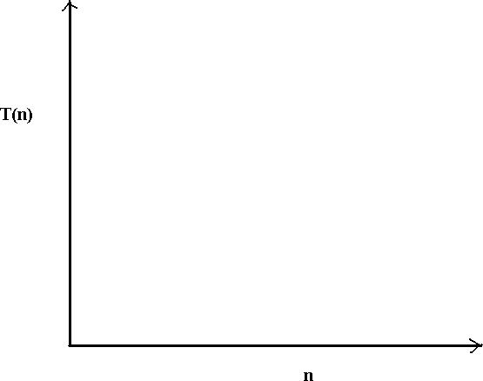
Common plots of O( )
O(2^{n})
_{O(n3 )} O(n²)
O(nlogn)
O(n)
O(√n)
O(logn)
O(1)

Slide 27
Examples of algorithms for sorting techniques and their complexities
Insertion sort : O(n²)
Selection sort : O(n²)
Quick sort : O(n logn)
Merge sort : O(n logn)

Slide 28
RECURRENCE RELATIONS
A Recurrence is an equation or inequality that describes a function in terms of its value on smaller inputs
Special techniques are required to analyze the space and time required

Slide 29
RECURRENCE RELATIONS EXAMPLE
EXAMPLE 1: QUICK SORT
T(n)= 2T(n/2) + O(n) T(1)= O(1)
In the above case the presence of function of T on both sides of the equation signifies the presence of recurrence relation
(SUBSTITUTION MEATHOD used) The equations are simplified to produce the final result:
……cntd

Slide 30
T(n) = 2T(n/2) + O(n)
= 2(2(n/2²) + (n/2)) + n
Cntd….
= 2² T(n/2²) + n + n
= 2² (T(n/2³)+ (n/2²)) + n + n
= 2³ T(n/2³) + n + n + n
= n log n

Slide 31
EXAMPLE 2: BINARY SEARCH
T(n)=O(1) + T(n/2) T(1)=1
Cntd…
Above is another example of recurrence relation and the way to solve it is by Substitution.
T(n)=T(n/2) +1
= T(n/2²)+1+1
= T(n/2³)+1+1+1
= logn
T(n)= O(logn)

Slide 32
Solving Recurrences
There are mainly three ways for solving recurrences.
1) Substitution Method: We make a guess for the solution and then we use mathematical induction to prove the guess is correct or incorrect.
For example consider the recurrence T(n) = 2T(n/2) + n
We know the solution is T(n) = O(nLogn). Now we have to prove our guess.
T(1)=1 for n=1
T(n)= 2T(n/2) + n for n>1

Slide 33
T(n) = 2T(n/2) + O(n)
= 2(2(n/2²) + (n/2)) + n
= 2² T(n/2²) + n + n
= 2² (T(n/2³)+ (n/2²)) + n + n
= 2³ T(n/2³) + n + n + n
Let us take this for k term
= 2^{k} T(n/2^{k}) + kn
Assume
T(n/2^{k})=T(1)
Therefore n/2^{k} = 1 => n=2^{k}
^{K=log n}

Slide 34
T(n)= 2^{k} T(n/2^{k}) + kn
T(n) = 2^{k} T(1) + kn
T(n) = n*1 + nlogn
T(n) = n + nlogn
So it is O(nlogn)
Highest term

Slide 35
2) Recurrence Tree Method: In this method, we draw a recurrence tree and calculate the time taken by every level of tree. Finally, we sum the work done at all levels. To draw the recurrence tree, we start from the given recurrence and keep drawing till we find a pattern among levels. The pattern is typically a arithmetic or geometric series.

Slide 36
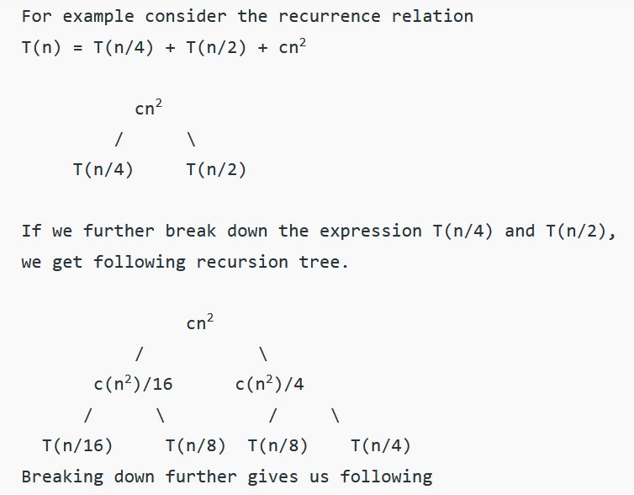

Slide 37
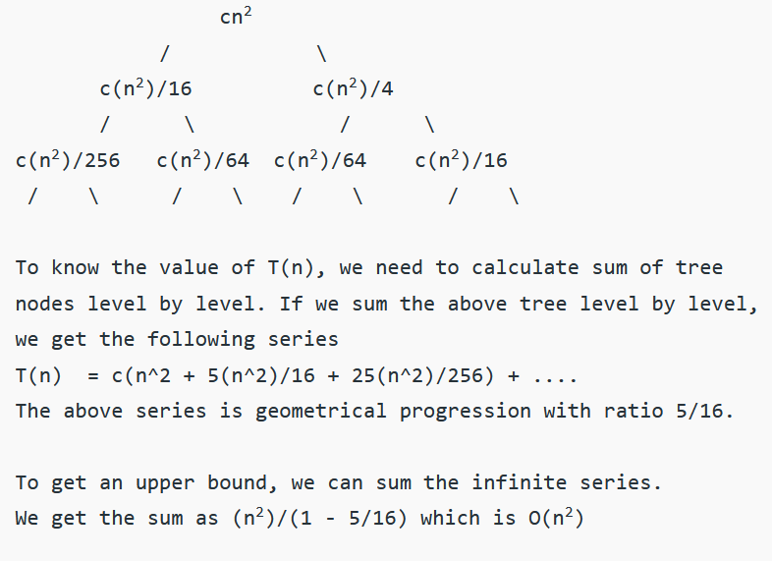

Slide 38
T(1)= 1 for n=1 T(n)= 2T(n/2) + n for n>1
n
n/2 n/2
n/ 2² n/ 2² n/ 2² n/ 2²
n/ 2³ n/ 2³
N time
N time
Total time is nk
N time
N time
N time
N time
n/ 2^{k} n/ 2^{k} n/ 2^{k} n/ 2^{k} n/ 2^{k}
K steps

Slide 39
Assume
T(n/2^{k})=T(1)
Therefore n/2^{k} = 1 => n=2^{k}
^{K=log n}
Hence total time is nk
ie. nlogn
Hence time complexity of T(n) = 2T(n/2) + n is O(nlogn)

Slide 40
3) Master Method: Master Method is a direct way to get the solution. The master method works only for following type of recurrences or for recurrences that can be transformed to following type.

Slide 41
T(n) = aT(n/b) + f(n) where a >= 1 and b > 1
There are following three cases:
1. If f(n) = Θ(n^{c}) where c < Log_{b}a then T(n) = Θ(n^{Log}_{b}ª)
2. If f(n) = Θ(n^{c}) where c = Log_{b}a then T(n) = Θ(n^{c}Log n)
3.If f(n) = Θ(n^{c}) where c > Log_{b}a then T(n) = Θ(f(n))

Slide 42
How does this work? Master method is mainly derived from recurrence tree method. If we draw recurrence tree of T(n) = aT(n/b) + f(n), we can see that the work done at root is f(n) and work done at all leaves is Θ(n^{c}) where c is Log_{b}a. And the height of recurrence tree is Log_{b}n

Slide 43
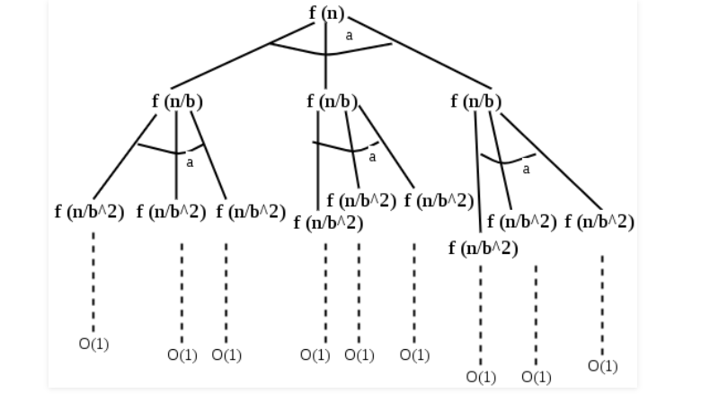

Slide 44
In recurrence tree method, we calculate total work done. If the work done at leaves is polynomially more, then leaves are the dominant part, and our result becomes the work done at leaves (Case 1). If work done at leaves and root is asymptotically same, then our result becomes height multiplied by work done at any level (Case 2). If work done at root is asymptotically more, then our result becomes work done at root (Case 3).

Slide 45
Examples of some standard algorithms whose time complexity can be evaluated using Master Method
Merge Sort: T(n) = 2T(n/2) + Θ(n). It falls in case 2 as c is 1 and Log_{b}a is also 1. So the solution is Θ(n Logn)
Binary Search: T(n) = T(n/2) + Θ(1). It also falls in case 2 as c is 0 and Log_{b}a is also 0. So the solution is Θ(Logn)

Slide 46
Notes: 1) It is not necessary that a recurrence of the form T(n) = aT(n/b) + f(n) can be solved using Master Theorem. The given three cases have some gaps between them. For example, the recurrence T(n) = 2T(n/2) + n/Logn cannot be solved using master method.
2) Case 2 can be extended for f(n) = Θ(n^{c}Log^{k}n) If f(n) = Θ(n^{c}Log^{k}n) for some constant k >= 0 and c = Log_{b}a, then T(n) = Θ(n^{c}Log^{k+1}n)

Slide 47
Master Theorem
The master method is a formula for solving recurrence relations of the form:
T(n) = aT(n/b) + f(n), where,
n = size of input
a = number of sub problems in the recursion
n/b = size of each sub problem. All sub problems are assumed to have the same size.
f(n) = cost of the work done outside the recursive call, which includes the cost of dividing the problem and cost of merging the solutions
Here, a ≥ 1 and b > 1 are constants, and f(n) is an asymptotically positive function.

Slide 48
An asymptotically positive function means that for a sufficiently large value of n, we have f(n) > 0.
The master theorem is used in calculating the time complexity of recurrence relations (divide and conquer algorithms) in a simple and quick way.

Slide 49
Master Theorem
If a ≥ 1 and b > 1 are constants and f(n) is an asymptotically positive function, then the time complexity of a recursive relation is given by
T(n) = aT(n/b) + f(n)
where, T(n) has the following asymptotic bounds:
Case 1. If f(n) = O(n^{log}_{b} ^{a-ϵ}), then T(n) = Θ(n^{log}_{b} ª).
Case 2. If f(n) = Θ(n^{log}_{b} ª), then T(n) = Θ(n^{log}_{b} ª * log n).
Case 3. If f(n) = Ω(n^{log}_{b} ^{a+ϵ}), then T(n) = Θ(f(n)).
ϵ > 0 is a constant.

Slide 50
Each of the above conditions can be interpreted as:
If the cost of solving the sub-problems at each level increases by a certain factor, the value of f(n) will become polynomially smaller than n^{log}_{b} ª. Thus, the time complexity is oppressed by the cost of the last level ie. n^{log}_{b} ª
If the cost of solving the sub-problem at each level is nearly equal, then the value of f(n) will be n^{log}_{b} ª. Thus, the time complexity will be f(n) times the total number of levels ie. n^{log}_{b} ª * log n
If the cost of solving the sub problems at each level decreases by a certain factor, the value of f(n) will become polynomially larger than n^{log}_{b} ª. Thus, the time complexity is oppressed by the cost of f(n).

Slide 51
Solved Example of Master Theorem
T(n) = 3T(n/2) + n²
Here,
a = 3
n/b = n/2, b = 2
f(n) = n²
log_{b} a = log₂ 3 ≈ 1.58 < 2
ie. f(n) < n^{log}_{b} ^{a+ϵ} , where, ϵ is a constant.
Hence, Case 3 implies here.
Thus, T(n) = f(n) = Θ(n²)

Slide 52
Master Theorem Limitations
The master theorem cannot be used if:
T(n) is not monotone. eg. T(n) = sin n
f(n) is not a polynomial. eg. f(n) = 2n
a is not a constant. eg. a = 2n
a < 1

