Slide 1
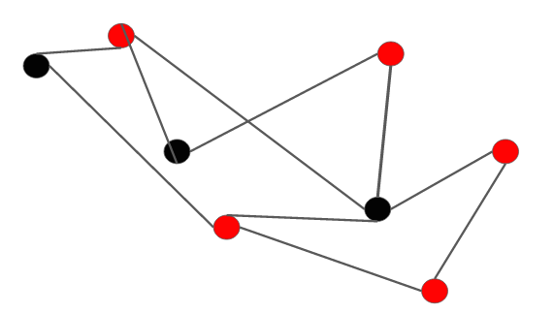
VERTEX COVER
RITIK SINGH 2K19/CO/319
Rishabh Kumar 2K19/CO/314

Slide 2
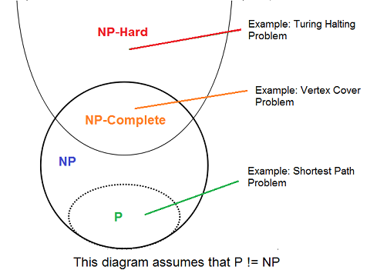
Introduction
Its a type of NP-complete problem.
NP complete problem does not have Polynomial Time algorithm
if the actual inputs are small then exponential time complexity is perfect.
It is possible to find near optimal solution.
Which can be done Through approximation algorithm.
2

Slide 3
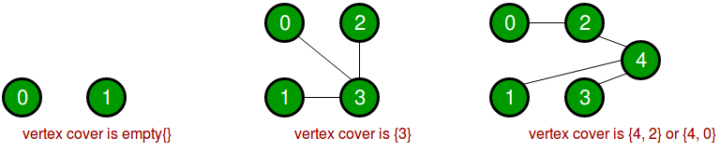
Defination:
Consider a graph G= (V, E) where V and E are accordingly vertex and
edges. A vertex cover of an undirected graph is a subset V ⊆ V such that if (u, v) is
an edge of G, Then either u Ɛ V’ or v Ɛ V’ or both.
3

Slide 4
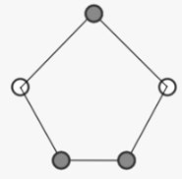
Vertex Cover Problem
A vertex cover of a graph G is a set of vertices, V_{c .}
every vertex touches at least one edge.
It also has applications in matching problems and optimization problems.
4

Slide 5
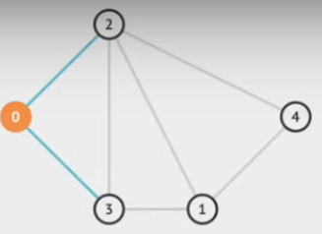
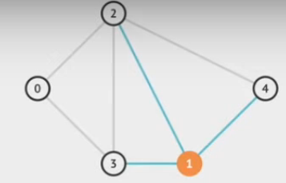
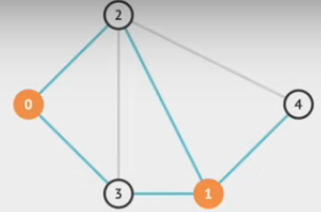
BRUTE FORCE APPROACH: -
-Initialize current best = |vertex list|
-For every possible Subset S of V
- if S is a vertex cover
- try to update current best
-Return current best
5

Slide 6
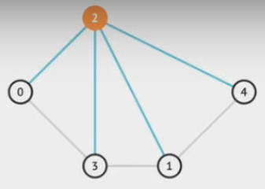
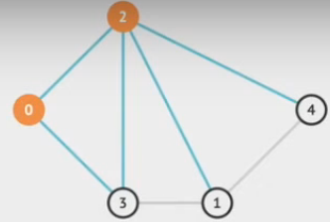
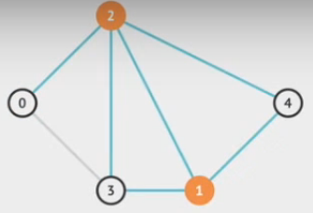
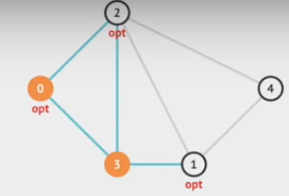
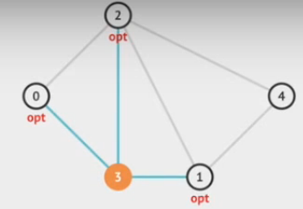
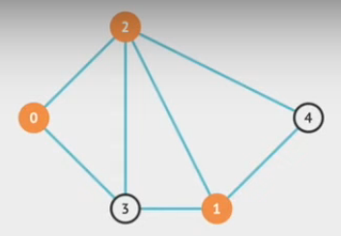
Here we update our current best which is {0, 2, 1}
6

Slide 7
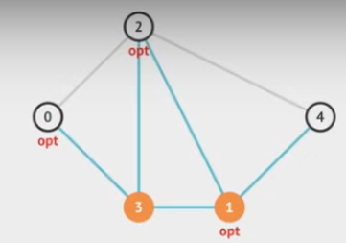
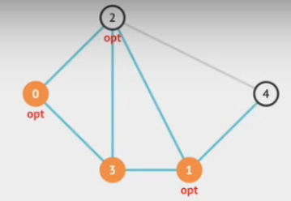
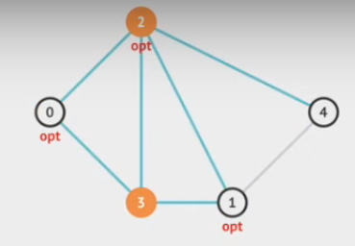
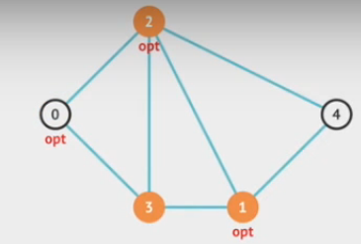
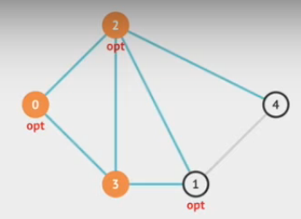
Here we have found our another
vertex cover
As {2, 3, 1}, but our previous vertex
size is also 3, so we do not update it.
Hence after trying all the vertices our
final vertex
cover build is {0, 2, 1} having size 3.
7

Slide 8
Worst case Time complexity will become O(N * N)
8

Slide 9
ALGORITHM FOR VERTEX COVER PROBLEM
1. Approximation algorithm:
obtaining an optimal solution is intractable for NP complete problems.
the approximation problem is to find the vertex cover with few vertices.
Its a polynomial-time algorithm.
when given input i, outputs an element of FS(i). Where FS(i) ) is the set of feasible solutions for i.
9

Slide 10
Steps For approximation algorithm:-
Initialize the result as {}
Consider a set of all edges in given graph. Let the set be E.
Do following while E is not empty ...
a) Pick an arbitrary edge (u, v) from set E and add 'u' and 'v' to
result ...
b) Remove all edges from E which are either incident on u or v. 4)
Return result
10

Slide 11
Pseudo Code for approximation algorithm:
1 C ← Ø
2 E′ ← E [G]
3 while E′ ≠ Ø
4 do let (u, v) be an arbitrary edge of E′
5 C ← C U {u, v}
6 remove every edge in E′ incident on u or v
7 return C
11

Slide 12
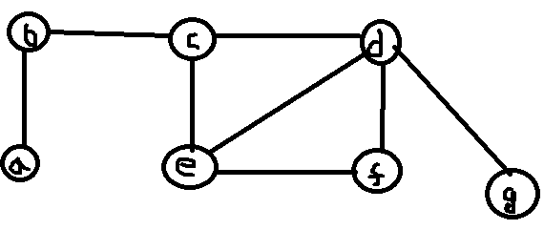
Explanation of the Approximate algorithm
Let the graph be:
a.
select any edge and removes the incident edges to it.
continues until to cover all the vertexes.
12

Slide 13
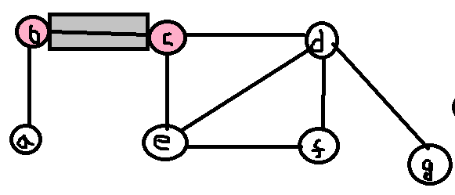
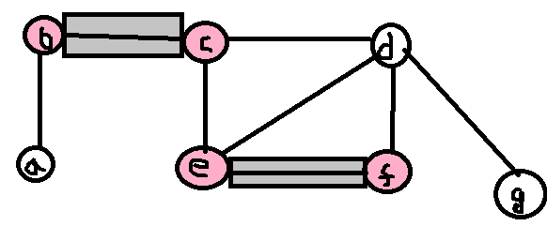
first edge (b, c) is chosen, then (b, a), (c, d) and (c, e) edges are discarded from the graph.
b.
Next arbitrary
edge (e, f) is chosen and edge (e, d) is discarded.
c.
13

Slide 14
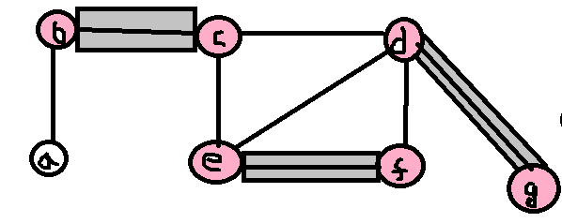
d.
Last edge (d, g) is chosen.
no edge remains to be discarded.
set for vertex cover becomes {b, c, d, e, f, g}.
14

Slide 15
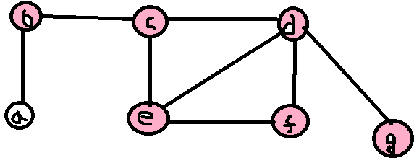
solution of above graph is {b, c, d, e, f, g}.
e.
Complexity Analysis of the approximate vertex cover algorithm
Since the loop in algorithm at on lines (3-6) repeatedly picks an edge (u, v) from E′ adds its endpoints u and v to C, and deletes all edges in E′ that are covered by either u or v. The running time of this algorithm is O (E).
15

Slide 16
2. GREEDY ALGORITHM
Simplest Greedy: -
→ Idea:
Keep finding a vertex which covers the maximum number of edges.
Step 1: Find a vertex v with maximum degree.
Step 2: Add v to the solution and remove v and all its incident edges from the graph.
Step 3: Repeat until all the edges are covered.
16

Slide 17
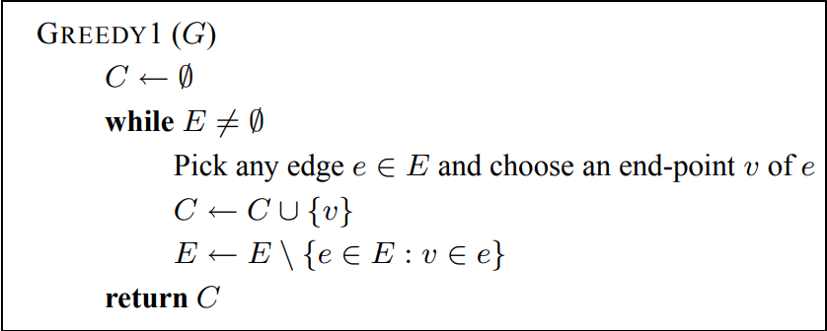
Pseudo Code
17

Slide 18
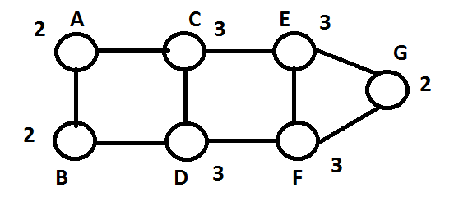
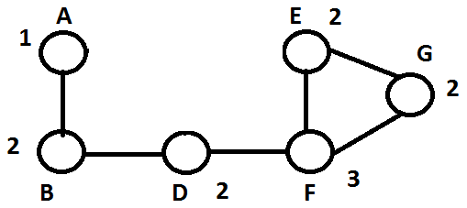
Example solved using simplest greedy
V = {A, B, C, D, E, F, G}
C = {}
Here max degree vertices are C, D, E, F.
Now we choose vertex C.
C = {C}
Here max degree vertices are F.
Now we choose vertex F.
C = {C, F}
18

Slide 19
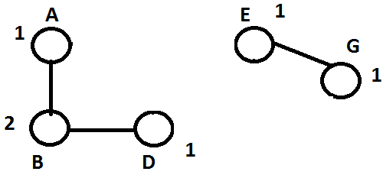
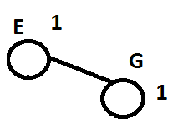
Here max degree vertices are B.
Now we choose vertex B.
C = {C, F, B}
At last Now we choose vertex E.
C = {C, F, B, E}
19

Slide 20
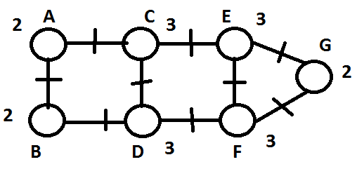
This is our final result which is C = {C, F, B, E}
20

Slide 21
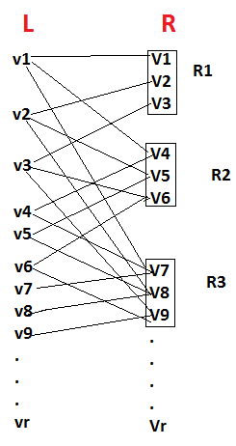
Algorithm Analysis
To see this, consider the following example bipartite graph:- B = (L, R).
L consists of r vertices.
vertex set R is further sub-divided into r sets.
called R1, . . . , Rr.
Ri has an edge to i vertices in L and no two vertices in Ri have a common neighbor in L.
each vertex in L has degree at most r
Ri has degree i.
The total number of vertices n = Θ(r log r).
21

Slide 22
Greedy Algorithm(1): Analysis
Optimal Solution = 6, select all red vertices.
Greedy approach does not lead to the best approximation algorithm.
22

Slide 23
Greedy Algorithm(1): Analysis
First we might choose all the green vertices.
Then we might choose all the blue vertices.
And then we might choose all the orange vertices Solution=11
23

Slide 24
Clever Greedy
modify the Algorithm GREEDY1.
Modification is to repeatedly choose vertices which are incident to the largest number of currently uncovered edges.
24

Slide 25
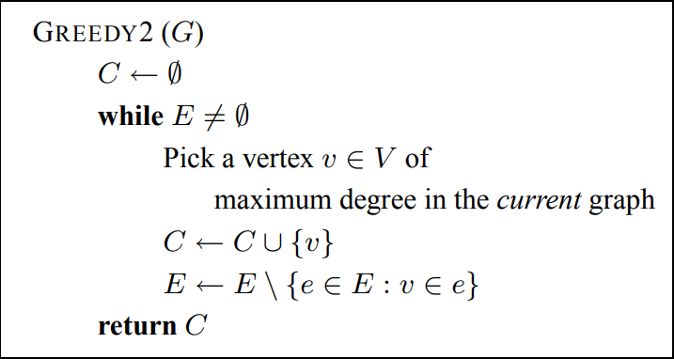
Pseudo Code
25

Slide 26
Algorithm Analysis
Let us consider the behavior of this algorithm on the graph B.
GREEDY2 (clever greedy) could also output R as a vertex cover.
choose vertices from Rr from first stage.
After this, choose vertices from Rr−1.
It is very surprising that this algorithm is also not brought up any better heuristic than the previous one(greedy 1).
It may shown the ratio of O(log n) for general set cover problem.
26

Slide 27
3. MAXIMAL MATCHINGS FOR VERTEX COVERS
Matching in graph:- A matching graph is a subgraph of a graph G where there are no
edges adjacent to each other and the Maximum degree of any vertex is always less then equals to 1.
A heuristic which achieves a bounded ratio for the problem.
This will made by modify GREEDY1 by placing both end-points of edge into C.
It’s a claim that this algorithm performs better than GREEDY1 and GREEDY 2..
Algorithm Maximal Matching
Pick any maximal matching M in the graph G = (V, E).
Place both end-points of each edge in M into the cover
27

Slide 28
Alogrithm Analysis
Claim. Maximal Matching always computes a vertex cover in the input graph G.
2-approximation algorithm.
All edges in E /M are such that at least one of their end-points is incident to some e ∈ M
Every edge in E has one end-point in C.
we need at least |M| vertices, since no two of them share a vertex. It implies vertex cover has size at least |M|.
The cover C contains exactly 2|M| vertices.
28

Slide 29
THE END
THANK YOU

