Slide 1




Slide 2
Minimum Spanning TREE
Kruskal’s Algorithm Prim’s Algorithm

Slide 3
What is a Spanning Tree
3
◆ In order to find a spanning tree, we must make sure that every node (vertex) is some how connected to the rest of the nodes by arcs (edges)
◆ Use the fewest number of edges possible.

Slide 4
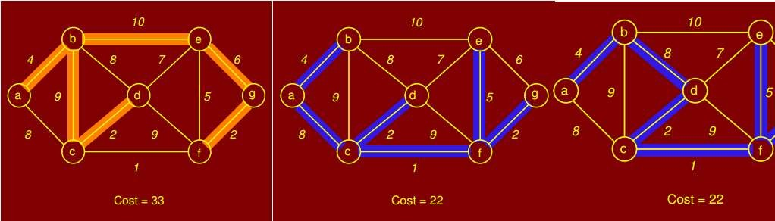
4
Spanning tree but not MST
Spanning trees

Slide 5
What is a Spanning Tree
5
◆ In order to find a spanning tree, we must make sure that every node (vertex) is some how connected to the rest of the nodes by arcs (edge)
◆ Use the fewest number of edges possible.

Slide 6
What is a Spanning Tree
6
◆ In order to find a spanning tree, we must make sure that every node (vertex) is some how connected to the rest of the nodes by arcs (edge)
◆ Use the fewest number of edges possible.
◆ If a loop can be found,
then one of the edges is not necessary

Slide 7
What is a Spanning Tree
7
◆ In order to find a spanning tree, we must make sure that every node (vertex) is some how connected to the rest of the nodes by an arc (edge)
◆ Use the fewest number of edges possible.
◆ You may think now, How many edges you
have in a spanning tree given N vertices

Slide 8
Minimum Spanning Tree
8
◆ The subset of edges E that connects all vertices V in the graph, and has minimum total weight.
6
c
b
4
5
1
a
2
d

Slide 9
Minimum Spanning Tree
9
◆ The subset of edges E that connects all vertices V in the graph, and has minimum total weight.
6
c
b
4
5
1
a
2
d
MST = { (a,b),(a,d),(d,c) }

Slide 10
APPLICATIONS OF MST
10
Communication problem.
Circuit diagram.
T.V. cables.

Slide 11
Kruskal’s Algorithm
THE PROBLEM: GIVING A GRAPH WITH WEIGHTED EDGES, FIND ITS MINIMUM SPANNING TREE

Slide 12

Kruskal’s Algorithm
12
◆ Kruskal's algorithm utilizes Disjoint Sets (DS).
Kruskal(V,E)
A = ø
foreach v V:
Make-disjoint-set(v)
Sort E by weight increasingly
foreach (v1,v2) E:
if Find(v1) ≠ Find(v2): A = A U {(v1,v2)}
Union (v1,v2)
6
c
b
d
3
4
5
1
2
a
e
2
f
4
Return A

Slide 13
Kruskal’s Algorithm
13
◆ Kruskal's algorithm utilizes Disjoint Sets (DS).
◆ DS has two Operations Find and Union.
Kruskal(V,E)
A = ø
foreach v V:
6
c
Make-disjoint-set(v)
Sort E by weight increasingly
b
d
3
4
foreach (v1,v2) E:
if Find(v1) ≠ Find(v2): A = A U {(v1,v2)}
Union (v1,v2)
5
1
2
a
e
2
f
4
Return A

Slide 14
Kruskal’s Algorithm
14
◆ Find: takes an item and pretend that this is a
DS that item belongs to
◆ Union: will merge two DS of its input items in to one DS
6
Kruskal(V,E)
A = ø
foreach v V:
c
Make-disjoint-set(v)
Sort E by weight increasingly
b
d
3
4
foreach (v1,v2) E:
if Find(v1) ≠ Find(v2): A = A U {(v1,v2)}
Union (v1,v2)
5
1
2
a
e
2
f
4
Return A

Slide 15
Kruskal’s Algorithm
15
◆ A: is used to store all edges of the minimum
spanning tree
Initially A is empty Eventually return A
6
Kruskal(V,E)
A = ø
foreach v V:
c
Make-disjoint-set(v)
Sort E by weight increasingly
b
d
3
4
foreach (v1,v2) E:
if Find(v1) ≠ Find(v2): A = A U {(v1,v2)}
Union (v1,v2)
Return A
5
1
2
a
e
2
f
4
A = { }

Slide 16

Kruskal’s Algorithm
16
◆ for each vertex v of the graph, make a DS with v
◆ Each vertex will be used to create a single vertex Disjoint Set
Kruskal(V,E)
A = ø
foreach v V:
Make-disjoint-set(v)
Sort E by weight increasingly
foreach (v1,v2) E:
if Find(v1) ≠ Find(v2): A = A U {(v1,v2)}
Union (v1,v2)
Return A
6
c
b
d
3
4
5
1
2
a
e
2
f
4
A = { }

Slide 17
Kruskal’s Algorithm
17
◆ Sort all edges by weight increasingly
◆ the edge of smallest weight will be in front and the one with largest weight will be at the end
Kruskal(V,E)
A = ø
foreach v V:
Make-disjoint-set(v)
Sort E by weight increasingly
foreach (v1,v2) E:
if Find(v1) ≠ Find(v2): A = A U {(v1,v2)}
Union (v1,v2)
Return A
6
c
b
d
3
4
5
1
2
a
e
2
f
4
A = { }

Slide 18
Kruskal’s Algorithm
18
◆ 1st we will take the edge with the smallest weight
◆ C and f don’t belong to the same DS
Kruskal(V,E)
A = ø
foreach v V:
Make-disjoint-set(v)
Sort E by weight increasingly
foreach (v1,v2) E:
if Find(v1) ≠ Find(v2): A = A U {(v1,v2)}
Union (v1,v2)
Return A
6
c
b
d
3
4
5
1
2
a
e
2
f
4
A = { }

Slide 19
Kruskal’s Algorithm
19
◆ c and f will be merged in a one DS
◆ (c,f) is pushed to A
Kruskal(V,E)
A = ø
foreach v V:
Make-disjoint-set(v)
Sort E by weight increasingly
foreach (v1,v2) E:
if Find(v1) ≠ Find(v2): A = A U {(v1,v2)}
Union (v1,v2)
6
c
b
d
3
4
5
1
2
a
e
2
f
4
Return A
A = { (c,f),}

Slide 20
Kruskal’s Algorithm
20
Kruskal(V,E)
A = ø
foreach v V:
Make-disjoint-set(v)
Sort E by weight increasingly
foreach (v1,v2) E:
if Find(v1) ≠ Find(v2): A = A U {(v1,v2)}
Union (v1,v2)
6
c
b
d
3
4
5
1
2
a
e
2
f
4
Return A
A = { (c,f),(a,f),}

Slide 21
Kruskal’s Algorithm
21
Kruskal(V,E)
A = ø
foreach v V:
Make-disjoint-set(v)
Sort E by weight increasingly
foreach (v1,v2) E:
if Find(v1) ≠ Find(v2): A = A U {(v1,v2)}
Union (v1,v2)
6
c
b
d
3
4
5
1
2
a
e
2
f
4
Return A
A = { (c,f),(a,f),(d,e),}

Slide 22
Kruskal’s Algorithm
22
◆ c and d will be merged in a one DS
Kruskal(V,E)
A = ø
foreach v V:
Make-disjoint-set(v)
Sort E by weight increasingly
foreach (v1,v2) E:
if Find(v1) ≠ Find(v2): A = A U {(v1,v2)}
Union (v1,v2)
6
c
b
d
3
4
5
1
2
a
e
2
f
4
Return A
A = { (c,f),(a,f),(d,e),}

Slide 23
Kruskal’s Algorithm
23
◆ c and d will be merged in a one DS
Kruskal(V,E)
A = ø
foreach v V:
Make-disjoint-set(v)
Sort E by weight increasingly
foreach (v1,v2) E:
if Find(v1) ≠ Find(v2): A = A U {(v1,v2)}
Union (v1,v2)
6
c
b
d
3
4
5
1
2
a
e
2
f
4
Return A
A = { (c,f),(a,f),(d,e),}

Slide 24
Kruskal’s Algorithm
24
Kruskal(V,E)
A = ø
foreach v V:
Make-disjoint-set(v)
Sort E by weight increasingly
foreach (v1,v2) E:
if Find(v1) ≠ Find(v2): A = A U {(v1,v2)}
Union (v1,v2)
6
c
b
d
3
4
5
1
2
a
e
2
f
4
Return A
A = { (c,f),(a,f),(d,e),(c,d),}

Slide 25
Kruskal’s Algorithm
25
◆ e and f belong to the same DS
◆ DO NOT MERGE !!
Kruskal(V,E)
A = ø
foreach v V:
Make-disjoint-set(v)
Sort E by weight increasingly
foreach (v1,v2) E:
if Find(v1) ≠ Find(v2): A = A U {(v1,v2)}
Union (v1,v2)
6
c
b
d
3
4
5
1
2
a
e
2
f
4
Return A
A = { (c,f),(a,f),(d,e),(c,d),}

Slide 26
Kruskal’s Algorithm
26
Kruskal(V,E)
A = ø
foreach v V:
Make-disjoint-set(v)
Sort E by weight increasingly
foreach (v1,v2) E:
if Find(v1) ≠ Find(v2): A = A U {(v1,v2)}
Union (v1,v2)
6
c
b
d
3
4
5
1
2
a
e
2
f
4
Return A
A = { (c,f),(a,f),(d,e),(c,d),(a,b)}

Slide 27
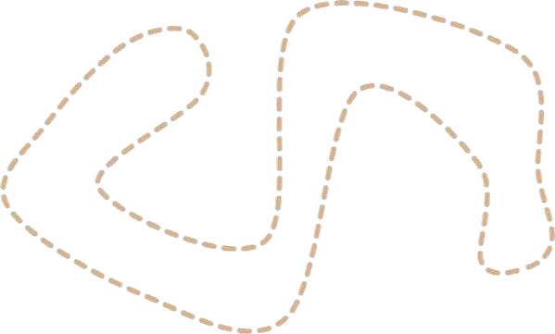
Kruskal’s Algorithm
27
◆ Now we have a Spanning Tree that connects all
vertices which have the minimum total weight
Kruskal(V,E)
A = ø
foreach v V:
Make-disjoint-set(v)
Sort E by weight increasingly
foreach (v1,v2) E:
if Find(v1) ≠ Find(v2): A = A U {(v1,v2)}
Union (v1,v2)
6
c
b
d
3
4
5
1
2
a
e
2
f
4
Return A
A = { (c,f),(a,f),(d,e),(c,d),(a,b)}

Slide 28
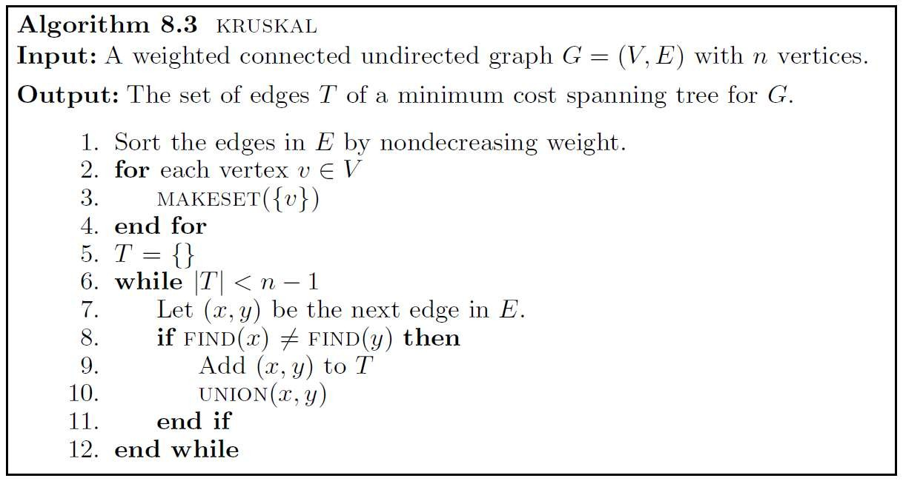
Kruskal’s Algorithm
28

Slide 29
Prim’s Algorithm
THE PROBLEM: GIVING A GRAPH WITH WEIGHTED EDGES, FIND ITS MINIMUM SPANNING TREE

Slide 30

Prim’s Algorithm
31
◆ A: is used to store all edges of the minimum
spanning tree
Initially A is empty Eventually return A
A = ø
foreach v V: KEY[v] = ∞
PARENT[v] = null KEY[r] = 0
Q = V
While Q != ø:
u = min (Q) by KEY value Q = Q – u
if PARENT(u) != null:
A = A U (u, PARENT(u))
foreach v Adj(u):
if v Q and w(u,v) < KEY[v]: PARENT[v] = u
6
c
b
d
3
4
5
1
2
a
e
2
f
4
KEY[v] = w
A = { }
Return A

Slide 31

Prim’s Algorithm
32
◆ for each vertex v of the graph, Each vertex will have
two attributes KEY and PARENT
◆ KEY and PARENT initialized to ∞ and null Respectively
A = ø
foreach v V: KEY[v] = ∞
PARENT[v] = null KEY[r] = 0
Q = V
While Q != ø:
u = min (Q) by KEY value Q = Q – u
if PARENT(u) != null:
A = A U (u, PARENT(u))
foreach v Adj(u):
if v Q and w(u,v) < KEY[v]: PARENT[v] = u
6
c
b
d
3
4
5
1
2
a
e
2
f
4
KEY[v] = w
A = { }
Return A

Slide 32
Prim’s Algorithm
33
◆ for each vertex v of the graph, Each vertex will have
two attributes KEY and PARENT
◆ KEY and PARENT initialized to ∞ and null Respectively
A = ø
foreach v V: KEY[v] = ∞
PARENT[v] = null KEY[r] = 0
Q = V
While Q != ø:
u = min (Q) by KEY value Q = Q – u
if PARENT(u) != null:
A = A U (u, PARENT(u))
∞,null
∞,null
6
c
b
∞,null
3
d
4
5
1
2
a
∞,null
e
foreach v
Adj(u):
2
∞,null
if v
Q and w(u,v) < KEY[v]:
PARENT[v] = u KEY[v] = w
f
4
∞,null
A = { }
Return A

Slide 33
Prim’s Algorithm
34
◆ Randomly choose a vertex as a ROOT r and set its
KEY value to Zero
A = ø
foreach v V: KEY[v] = ∞
PARENT[v] = null KEY[r] = 0
Q = V
While Q != ø:
u = min (Q) by KEY value Q = Q – u
if PARENT(u) != null:
A = A U (u, PARENT(u))
∞,null
∞,null
6
c
b
∞,null
3
d
4
0,null
a
2
5
1
e
foreach v
Adj(u):
2
∞,null
if v
Q and w(u,v) < KEY[v]:
PARENT[v] = u KEY[v] = w
f
4
∞,null
A = { }
Return A

Slide 34
Prim’s Algorithm
35
◆ Create Q list which contains all vertices in the graph
A = ø
foreach v V: KEY[v] = ∞
PARENT[v] = null KEY[r] = 0
Q = V
While Q != ø:
u = min (Q) by KEY value Q = Q – u
if PARENT(u) != null:
A = A U (u, PARENT(u))
foreach v Adj(u):
if v Q and w(u,v) < KEY[v]: PARENT[v] = u
KEY[v] = w
Return A
∞,null
∞,null
6
c
b
∞,null
3
d
4
0,null
a
2
5
1
e
2
∞,null
f
4
∞,null
A = { }
Q = { a,b,c,d,e,f }

Slide 35
Prim’s Algorithm
36
A = ø
foreach v V: KEY[v] = ∞
PARENT[v] = null KEY[r] = 0
Q = V
While Q != ø:
u = min (Q) by KEY value Q = Q – u
if PARENT(u) != null:
A = A U (u, PARENT(u))
foreach v Adj(u):
if v Q and w(u,v) < KEY[v]: PARENT[v] = u
KEY[v] = w
Return A
◆ Find Q with the smallest (Minimum) KEY
◆ In this case, KEY[a] = 0 (Minimum KEY)
∞,null
∞,null
6
c
b
∞,null
3
d
4
0,null
a
2
5
1
e
2
∞,null
f
4
∞,null
A = { }
Q = { a,b,c,d,e,f }

Slide 36
Prim’s Algorithm
37
◆ Remove a from Q
A = ø
foreach v V: KEY[v] = ∞
PARENT[v] = null KEY[r] = 0
Q = V
While Q != ø:
u = min (Q) by KEY value Q = Q – u
if PARENT(u) != null:
A = A U (u, PARENT(u))
foreach v Adj(u):
if v Q and w(u,v) < KEY[v]: PARENT[v] = u
KEY[v] = w
Return A
∞,null
∞,null
6
c
b
∞,null
3
d
4
0,null
a
2
5
1
e
2
∞,null
f
4
∞,null
A = { }
Q = { b,c,d,e,f }

Slide 37
Prim’s Algorithm
38
◆ PARENT [a] = null !!
◆ Skip the if statement
A = ø
foreach v V: KEY[v] = ∞
PARENT[v] = null KEY[r] = 0
Q = V
While Q != ø:
u = min (Q) by KEY value Q = Q – u
if PARENT(u) != null:
A = A U (u, PARENT(u))
foreach v Adj(u):
if v Q and w(u,v) < KEY[v]: PARENT[v] = u
KEY[v] = w
Return A
∞,null
∞,null
6
c
b
∞,null
3
d
4
0,null
a
2
5
1
e
2
∞,null
f
4
∞,null
A = { }
Q = { b,c,d,e,f }

Slide 38
Prim’s Algorithm
39
◆ Update attributes for all vertices Adjacent to a which
are b and f
◆ Starting with f , 2 < ∞
A = ø
foreach v V: KEY[v] = ∞
PARENT[v] = null KEY[r] = 0
Q = V
While Q != ø:
u = min (Q) by KEY value Q = Q – u
if PARENT(u) != null:
A = A U (u, PARENT(u))
foreach v Adj(u):
if v Q and w(u,v) < KEY[v]: PARENT[v] = u
KEY[v] = w
∞,null
∞,null
6
c
b
∞,null
3
d
4
0,null
a
2
5
1
e
2
∞,null
f
4
∞,null
A = { }
Q = { b,c,d,e,f }
Return A

Slide 39
Prim’s Algorithm
40
◆ | Update attributes for all vertices Adjacent to a which are b | A = ø
◆ | and f Starting with f , 2 < ∞ | foreach v V: KEY[v] = ∞
◆ | PARENT [ f ] = a and KEY [ f ] = 2 | PARENT[v] = null
KEY[r] = 0 Q = V
While Q != ø:
u = min (Q) by KEY value Q = Q – u
if PARENT(u) != null:
A = A U (u, PARENT(u))
foreach v Adj(u):
∞,null
4, a
6
c
b
∞,null
3
d
4
0,null
a
2
5
1
e
2
∞,null
if v Q and w(u,v) < KEY[v]: PARENT[v] = u
KEY[v] = w
f
4
2, a
A = { }
Q = { b,c,d,e,f }
Return A

Slide 40

Prim’s Algorithm
41
◆ Now, Enter the Second Loop
◆
◆
◆
A = ø
foreach v V: KEY[v] = ∞
PARENT[v] = null KEY[r] = 0
Q = V
While Q != ø:
u = min (Q) by KEY value Q = Q – u
if PARENT(u) != null:
A = A U (u, PARENT(u))
foreach v Adj(u):
if v Q and w(u,v) < KEY[v]:
a ! Q
u = min(Q) = f , Remove f from Q PARENT [ f ] ! = null, push (a,f) to A
∞,null
4, a
6
c
b
∞,null
3
d
4
0,null
a
2
5
1
e
2
∞,null
f
4
PARENT[v] = u
KEY[v] = w
2, a
A = { (a,f) }
Q = { b,c,d,e }
Return A

Slide 41
Prim’s Algorithm
42
◆ Update attributes for all vertices Adjacent to f which
are c and d where weight < KEY
A = ø
foreach v V: KEY[v] = ∞
PARENT[v] = null KEY[r] = 0
Q = V
While Q != ø:
u = min (Q) by KEY value Q = Q – u
if PARENT(u) != null:
A = A U (u, PARENT(u))
foreach v Adj(u):
if v Q and w(u,v) < KEY[v]:
1, f
4, a
6
c
b
∞,null
3
d
4
0,null
a
2
5
1
e
2
4, f
f
4
PARENT[v] = u
KEY[v] = w
2, a
A = { (a,f) }
Q = { b,c,d,e }
Return A

Slide 42
Prim’s Algorithm
43
◆ Now, Enter the NEXT Loop
◆ u = min(Q) = c , Remove c from Q
◆ PARENT [ c ] ! = null, push (c,f) to A
A = ø
foreach v V: KEY[v] = ∞
PARENT[v] = null KEY[r] = 0
Q = V
While Q != ø:
u = min (Q) by KEY value Q = Q – u
if PARENT(u) != null:
A = A U (u, PARENT(u))
foreach v Adj(u):
if v Q and w(u,v) < KEY[v]: PARENT[v] = u
KEY[v] = w
Return A
1, f
4, a
6
c
b
∞,null
3
d
4
0,null
a
2
5
1
e
2
4, f
f
4
2, a
A = { (a,f), (c,f) }
Q = { b,d,e }

Slide 43
Prim’s Algorithm
44
◆ Update attributes for all vertices Adjacent to c where
weight < KEY
A = ø
foreach v V: KEY[v] = ∞
PARENT[v] = null KEY[r] = 0
Q = V
While Q != ø:
u = min (Q) by KEY value Q = Q – u
if PARENT(u) != null:
A = A U (u, PARENT(u))
foreach v Adj(u):
if v Q and w(u,v) < KEY[v]: PARENT[v] = u
KEY[v] = w
Return A
1, f
4, a
6
c
b
3, c
3
d
4
0,null
a
2
5
1
e
2
4, f
f
4
2, a
A = { (a,f), (c,f) }
Q = { b,d,e }

Slide 44
Prim’s Algorithm
45
◆ Enter the NEXT Loop
◆ u = min(Q) = d , Remove d from Q
◆ PARENT [ d ] ! = null, push (c,d) to A
A = ø
foreach v V: KEY[v] = ∞
PARENT[v] = null KEY[r] = 0
Q = V
While Q != ø:
u = min (Q) by KEY value Q = Q – u
if PARENT(u) != null:
A = A U (u, PARENT(u))
foreach v Adj(u):
if v Q and w(u,v) < KEY[v]:
1, f
4, a
6
c
b
3, c
3
d
4
0,null
a
2
5
1
e
2
4, f
f
4
PARENT[v] = u
KEY[v] = w
2, a
A = { (a,f), (c,f), (c,d) }
Q = { b,e }
Return A

Slide 45
Prim’s Algorithm
46
◆ Update attributes for all vertices Adjacent to d where
weight < KEY
A = ø
foreach v V: KEY[v] = ∞
PARENT[v] = null KEY[r] = 0
Q = V
While Q != ø:
u = min (Q) by KEY value Q = Q – u
if PARENT(u) != null:
A = A U (u, PARENT(u))
foreach v Adj(u):
if v Q and w(u,v) < KEY[v]:
1, f
4, a
6
c
b
3, c
3
d
4
0,null
a
2
5
1
e
2
2, d
f
4
PARENT[v] = u
KEY[v] = w
2, a
A = { (a,f), (c,f), (c,d) }
Q = { b,e }
Return A

Slide 46
Prim’s Algorithm
47
◆ Enter the NEXT Loop
◆ u = min(Q) = e , Remove e from Q
◆ PARENT [ e] ! = null, push (d,e) to A
A = ø
foreach v V: KEY[v] = ∞
PARENT[v] = null KEY[r] = 0
Q = V
While Q != ø:
u = min (Q) by KEY value Q = Q – u
if PARENT(u) != null:
A = A U (u, PARENT(u))
foreach v Adj(u):
if v Q and w(u,v) < KEY[v]: PARENT[v] = u
KEY[v] = w
Return A
1, f
4, a
6
c
b
3, c
3
d
4
0,null
a
2
5
1
e
2
2, d
f
4
2, a
A = { (a,f), (c,f), (c,d), (d,e) }
Q = { b }

Slide 47

Prim’s Algorithm
48
◆ No Updates for attributes because d and f ! Q
A = ø
foreach v V: KEY[v] = ∞
PARENT[v] = null KEY[r] = 0
Q = V
While Q != ø:
u = min (Q) by KEY value Q = Q – u
if PARENT(u) != null:
A = A U (u, PARENT(u))
foreach v Adj(u):
if v Q and w(u,v) < KEY[v]: PARENT[v] = u
KEY[v] = w
Return A
1, f
4, a
6
c
b
3, c
3
d
4
0,null
a
2
5
1
e
2
2, d
f
4
2, a
A = { (a,f), (c,f), (c,d), (d,e) }
Q = { b }

Slide 48
Prim’s Algorithm
49
◆ Enter the NEXT Loop
◆ u = b , Remove b from Q
◆ PARENT [ b] ! = null, push (a,b) to A
A = ø
foreach v V: KEY[v] = ∞
PARENT[v] = null KEY[r] = 0
Q = V
While Q != ø:
u = min (Q) by KEY value Q = Q – u
if PARENT(u) != null:
A = A U (u, PARENT(u))
foreach v Adj(u):
if v Q and w(u,v) < KEY[v]: PARENT[v] = u
KEY[v] = w
Return A
1, f
4, a
6
c
b
3, c
3
d
4
0,null
a
2
5
1
e
2
2, d
f
4
2, a
A = { (a,f), (c,f), (c,d), (d,e), (a,b) }
Q = { }

Slide 49
Prim’s Algorithm
50
◆ No Updates for attributes because all neighbors of b
doesn’t exist in Q
A = ø
foreach v V: KEY[v] = ∞
PARENT[v] = null KEY[r] = 0
Q = V
While Q != ø:
u = min (Q) by KEY value Q = Q – u
if PARENT(u) != null:
A = A U (u, PARENT(u))
foreach v Adj(u):
if v Q and w(u,v) < KEY[v]: PARENT[v] = u
KEY[v] = w
1, f
4, a
6
c
b
3, c
3
d
4
0,null
a
2
5
1
e
2
2, d
f
4
2, a
A = { (a,f), (c,f), (c,d), (d,e), (a,b) }
Q = { }
Return A

Slide 50
Prim’s Algorithm
51
◆ Enter the NEXT Loop, Q = ø
◆ Exit loop
◆ Return A
A = ø
foreach v V: KEY[v] = ∞
PARENT[v] = null KEY[r] = 0
Q = V
While Q != ø:
u = min (Q) by KEY value Q = Q – u
if PARENT(u) != null:
A = A U (u, PARENT(u))
foreach v Adj(u):
if v Q and w(u,v) < KEY[v]: PARENT[v] = u
6
c
b
d
3
4
5
1
2
a
e
2
f
4
KEY[v] = w
A = { (a,f), (c,f), (c,d), (d,e), (a,b) }
Q = { }
Return A

Slide 51
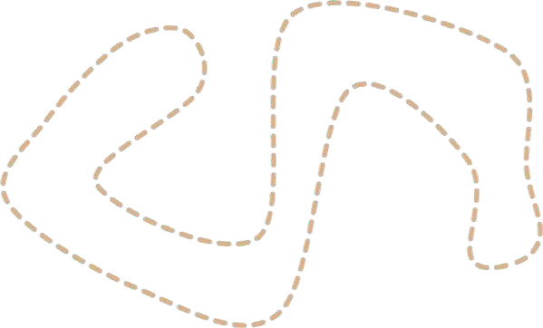
Prim’s Algorithm
52
◆ Now we have a Spanning Tree that connects all
vertices which have the minimum total weight
A = ø
foreach v V: KEY[v] = ∞
PARENT[v] = null KEY[r] = 0
Q = V
While Q != ø:
u = min (Q) by KEY value Q = Q – u
if PARENT(u) != null:
A = A U (u, PARENT(u))
foreach v Adj(u):
if v Q and w(u,v) < KEY[v]: PARENT[v] = u
6
c
b
d
3
4
5
1
2
a
e
2
f
4
KEY[v] = w
A = { (a,f), (c,f), (c,d), (d,e), (a,b) }
Q = { }
Return A

Slide 52
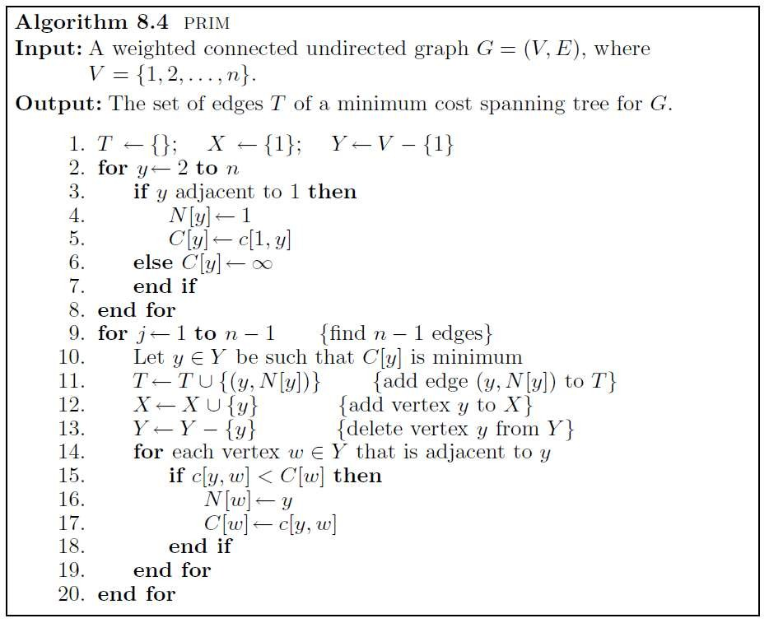
Prim’s Algorithm
53

Slide 53
Prim’s Algorithm
54
◆ The time complexity of the algorithm is computed as follows:
◆ Step 1 costs q(n) time.
◆ The for loop in Step 2 requires Ø(n) time.
◆ The time taken by steps 3 - 6 is O(n).
◆ The time taken by Step 10 to search for a vertex y closest to X is Ø(n) per iteration. This is because the algorithm inspects each entry in the vector representing the set Y. Since it is executed n-1 times, the overall time required by Step 10 is Ø(n²).
◆ Steps 11,12 and 13 cost Ø(1) time per iteration for a total of q(n) time.
◆ The for loop in Step 14 is executed 2m times, where m=|E|. This is because each edge (y, w) is inspected twice: once when y is moved to X and the other when w is moved to X.
◆ Hence, the overall time required by step 14 is Ø(m).
◆ The test in Step 15 is executed exactly m times, and Steps 16 and 17 are executed at
most m times.
◆ Thus, Steps 14 to 19 cost q(m) time.
◆ It follows that the time complexity of the algorithm is
◆ Ø(m + n²) = Ø (n²)

Slide 54
THANKS

