Slide 1
Decoder

Slide 2
A decoder is a combinational circuit that decodes the information on n input lines to a maximum of 2^{n} unique output lines.
Various Decoders: 2-to-4, 3-to-8 and 4-to-16
A decoder is a special case of a demultiplexer without the input line.

Slide 3
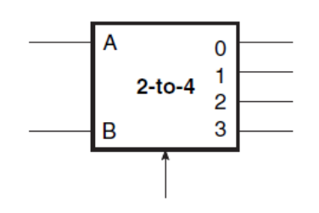
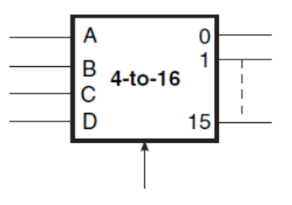
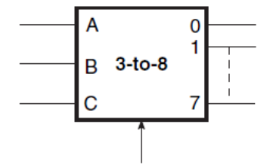
Various Decoders

Slide 4
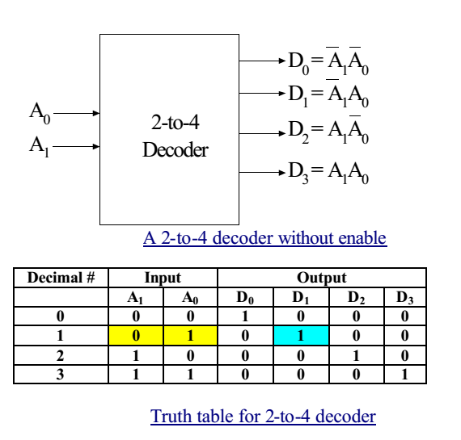
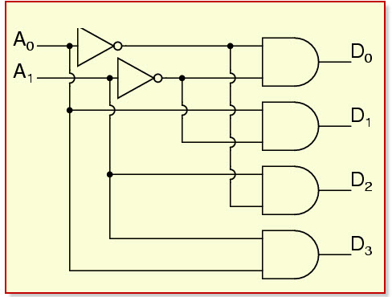

Slide 5

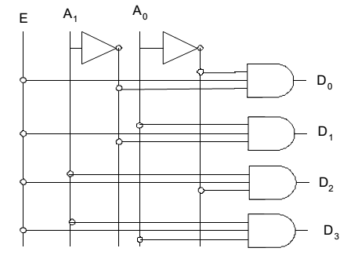

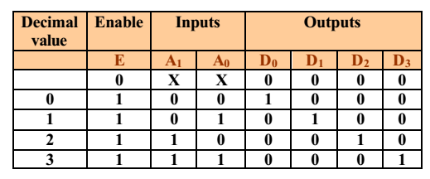

Slide 6
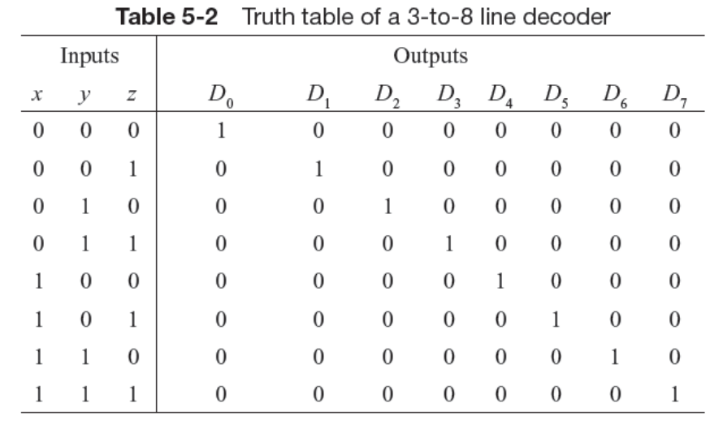
3x8 Decoder

Slide 7
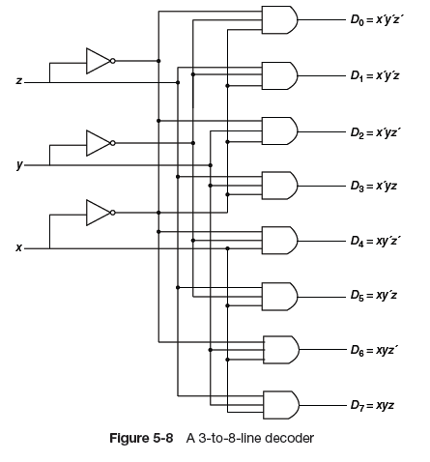
3x8 Decoder

Slide 8
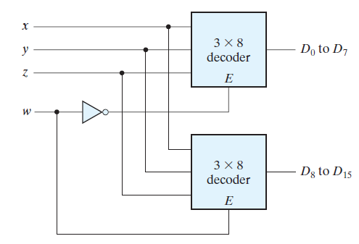
Higher Order Decoders
Decoders with enable inputs can be connected together to form a larger decoder circuit
two 3-to-8-line decoders with enable inputs connected to form a 4-to-16-line decoder.

Slide 9
For n input variables, a decoder provides the 2^{n} minterms.
Each asserted output of the decoder is associated with a unique pattern of input bits.
These mean terms can be used to generate any Boolean function with the help of OR Gate.
any combinational circuit with n inputs and m outputs can be implemented with an n -to-2^{n} -line decoder and m OR gates.

Slide 10
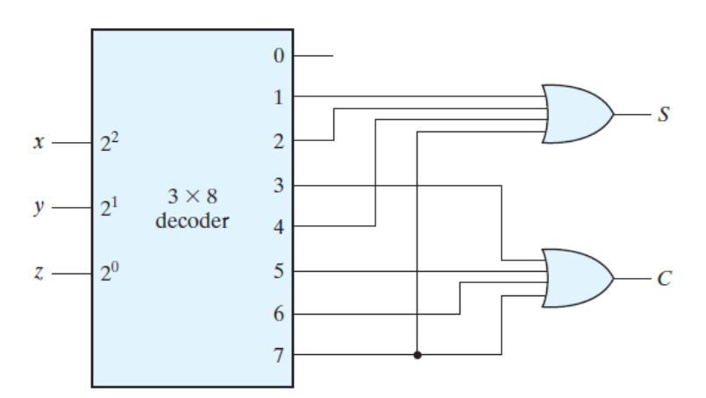
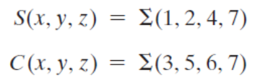

Slide 11
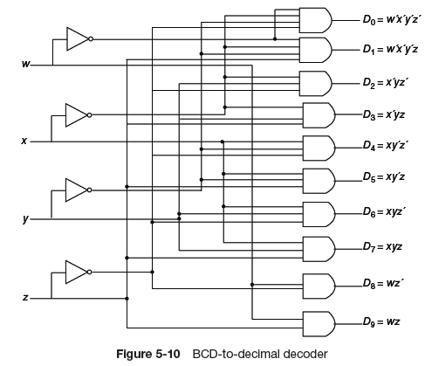
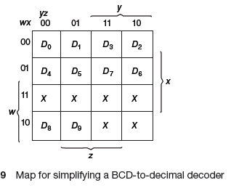
The BCD-to-decimal decoder converts each BCD code (8421 code) into one of ten possible decimal digit indications.
There are six don’t-care conditions

Slide 12
An encoder is a combinational logic circuit that essentially performs a “reverse” decoder function.
An encoder has 2^{n} (or less) input lines and n output lines.
The output lines generate the binary code for the 2^{n} input variables.

Slide 13

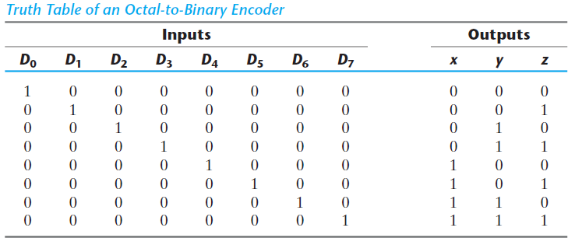
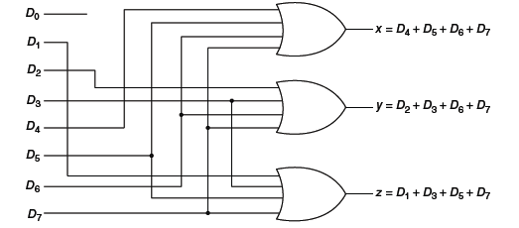
The encoder has the limitation that only one input can be active at any given time.
If two inputs are active simultaneously, the output produces an undefined combination.

Slide 14

The Priority Encoder solves the problems by allocating a priority level to each input.
The priority encoders output corresponds to the currently active input which has the highest priority.
So when an input with a higher priority is present, all other inputs with a lower priority will be ignored.

Slide 15
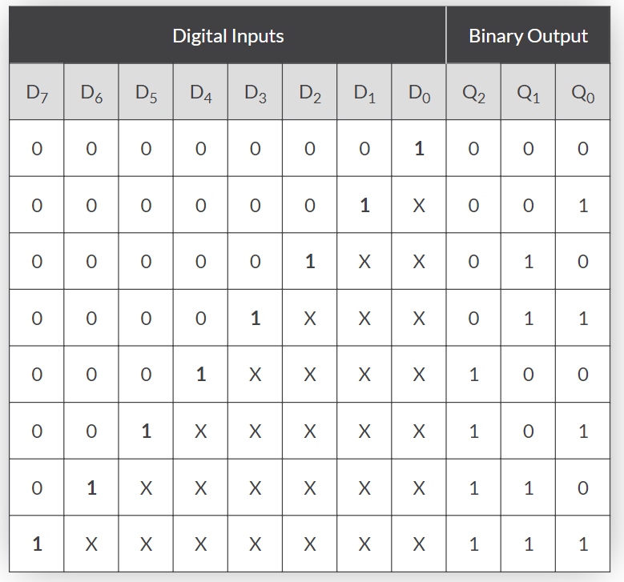
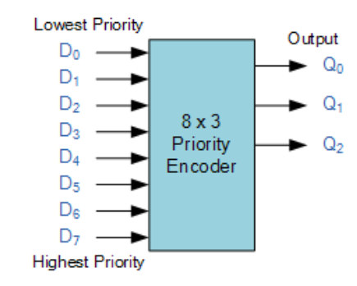
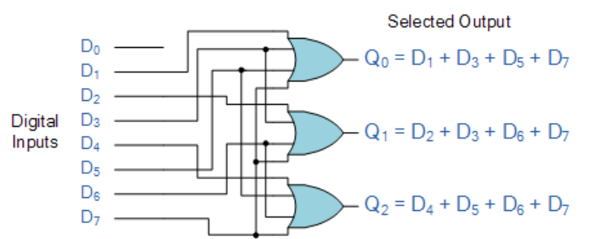
X = don’t care

Slide 17
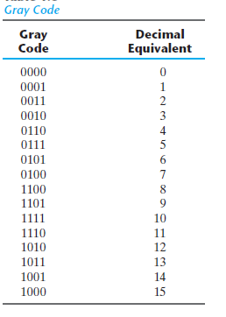
Gray Code
Gray code is an ordering of the binary numeral system such that two successive values differ in only one bit (binary digit).
The Gray code is used in applications in which the normal sequence of binary numbers generated by the hardware may produce an error or ambiguity during the transition from one number to the next.

Slide 18
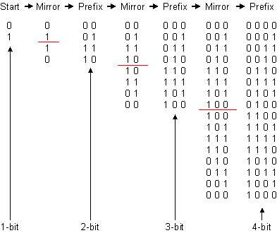
Gray code is not weighted that means it does not depends on positional value of digit.

Slide 19
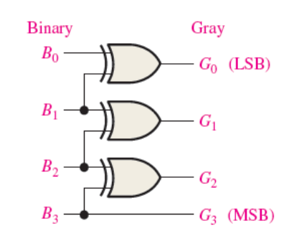
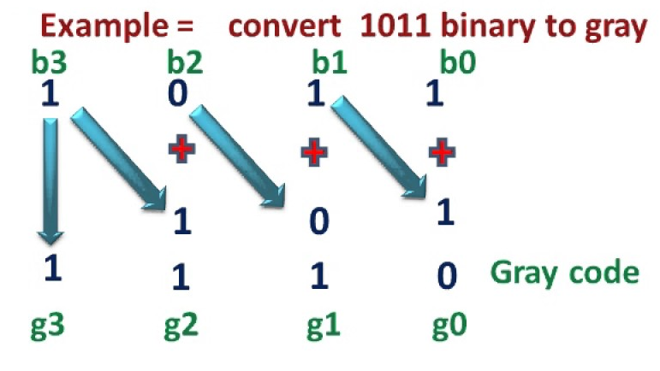
Binary to Grey Code

Slide 20
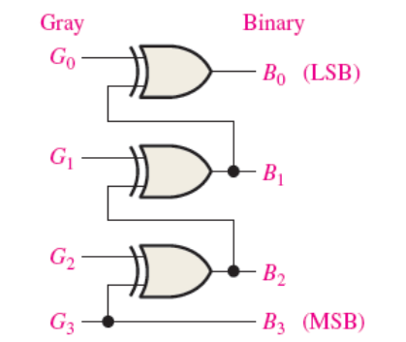
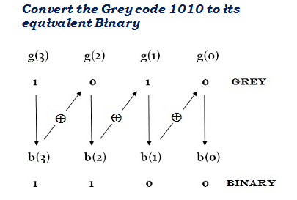
Grey Code to Binary Number

Slide 21
Excess 3 code
The excess-3 code (or XS3) is a non-weighted code
It is a self-complementary binary coded decimal (BCD) code
It is particularly significant for arithmetic operations as it overcomes shortcoming encountered while using 8421 BCD code to add two decimal digits whose sum exceeds 9.
Excess-3 codes are unweighted and can be obtained by adding 3 to each decimal digit then it can be represented by using 4 bit binary number for each digit.

Slide 22
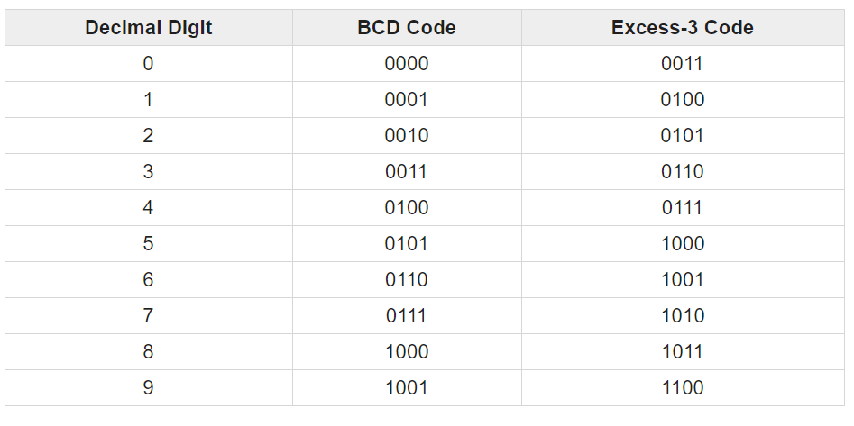

Slide 23
Advantages of Excess-3 Codes
These are unweighted binary decimal codes.
These are self-complementary codes.
These use biased representation.
The codes 0000 and 1111 are not used for any digit which is an advantage for memory organization as these codes can cause fault in transmission line.
It has no limitation, and it considerably simplifies arithmetic operations.
It is particularly significant for arithmetic operations as it overcomes shortcoming encountered while using 8421 BCD code to add two decimal digits whose sum exceeds 9.

Slide 24
