Slide 1
Replication

Slide 2
What is replication? ?& why replication?
Replication is having multiple copies of data and services in a distributed system
Reasons:
  Reliability of the system
  Better protection against corrupted data
  Improved Performance and faster response time
  Facilitates scaling in numbers and geographical area.

Slide 3
Key Issues:
Where, when and by whom replicas should be placed.
Mechanisms to keep them consistent.
Two main sub-problems:
  Replica-server Placement
    Finding best location or placed where a server can be placed.
  Content Placement
    Finding out which server is best for storing a particular content.
Notes:
(RWX) (R- -) (R - -) a.text
USER GROUP OTHER

Slide 4
Content Replication and Placement
Permanent Replicas
  Geographically distributed - Mirroring
  Same location – Round Robin
Server Initiated Replicas
Client Initiated Replicas

Slide 5
Server Initiated Replicas
Initiative of owner of data store
Enhance performance
C2
Server without copy of F
P
Q
Server with copy of F
C1

Slide 6
Client Initiated Replicas
Client caches
Managing is entirely by client
Improve access time
Placement
  Same machine
  LAN
  WAN

Slide 7
Content Distribution
Propagation of Updated content
  Propagate only notification of an update
    Invalidation Protocols
  Transfer data from one copy to another
  Propagate the update operation to other copies
Notes:
Soft Links ( Symbolic links/ symlinks)
Hard links

Slide 8
Push Vs Pull Protocols
Push
  Server based
  Read to update ratio is high
  High degree of consistency
  Multicasting
Pull
  Client based
  Read to update ratio is low
  Unicasting
Lease

Slide 9
Why Use Replication
Enhances a service (object/data/service)
  Increased Availability
    Of service. When servers fail or when the network is partitioned, service still available at at least once server.
  Fault Tolerance
    Under the fail-stop model, if up to f of f+1 servers crash, at least one is alive.
  Load Balancing
    One approach: Multiple server IPs can be assigned to the same name in DNS, which returns answers/IPs round-robin.
P: probability that one server fails= 1 – P= availability of service. e.g. P = 5% => service is available 95% of the time.
P^{n}: probability that n servers fail= 1 – P^{n}= availability of replicated service. e.g. P = 5%, n = 3 => service available 99.875% of the time

Slide 10
Goals of Replication
Replica Manager
Replication Transparency
  User/client need not know that multiple physical copies of data exist.
Replication Consistency
  Data is consistent on all of the replicas of an object (or is converging towards becoming consistent).
Client
Front End (FE)
server
RM
Client
Front End (FE)
RM
server
Client
Front End (FE)
RM
server
Service
Notes:
Increase the availability of data.
Speed up the query evaluation.

Slide 11
Types of data replication
1. Synchronous Replication:
In synchronous replication, the replica will be modified immediately after some changes are made in the relation table. So there is no difference between original data and replica.
2. Asynchronous replication:
In asynchronous replication, the replica will be modified after commit is fired on to the database.

Slide 12
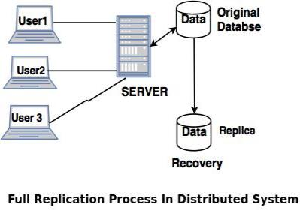
Replication Schemes
Full Replication
In full replication scheme, the database is available to almost every location or user in communication network.
Advantages of full replication
High availability of data, as database is available to almost every location.
Faster execution of queries.
Disadvantages of full replication
Concurrency control is difficult to achieve in full replication.
Update operation is slower.

Slide 13
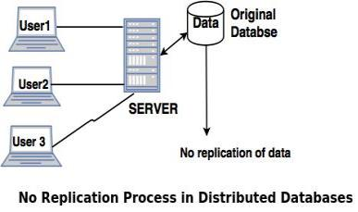
Replication Schemes
No Replication
No replication means, each fragment is stored exactly at one location.
Advantages of no replication
Concurrency can be minimized.
Easy recovery of data.
Disadvantages of no replication
Poor availability of data.
Slows down the query execution process, as multiple clients are accessing the same server
.

Slide 14
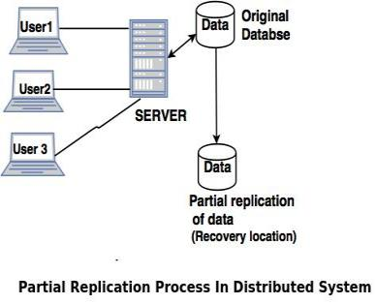
Replication Schemes
Partial replication
Partial replication means only some fragments are replicated from the database.
Advantages of partial replication
The number of replicas created for fragments depend upon the importance of data in that fragment.
Disadvantages of partial replication
Identification of critical & non critical data

