Slide 1










Lead Scoring Case Study
Ritik Sanjay Patel

Slide 2
Problem Statement
X Education specializes in selling online courses tailored for industry professionals. However, the company faces a significant challenge with its low lead conversion rate.
For example, out of 100 leads acquired daily, only about 30 are converted into paying customers.
To address this, X Education aims to identify its most promising leads, referred to as Hot Leads. By focusing its sales efforts on these high-potential prospects, the company hopes to boost its lead conversion rates and overall efficiency.

Slide 3
Objective
The primary goal is to build a model that identifies potential hot leads and deploy this model for future use.

Slide 4
Solution Approach
The solution is implemented through the following steps:
1. Data Cleaning and Preparation
Duplicate Data: Identified and handled duplicates.
Missing Values: Addressed missing data by dropping unnecessary columns or imputing values as needed.
Irrelevant Features: Removed columns that either had low variance or were not useful for analysis, such as "Do Not Call," "Digital Advertisement," etc.
Outliers: Reviewed and managed outliers to maintain data quality.
2. Exploratory Data Analysis (EDA)
Univariate Analysis: Examined individual variables for their value distributions.
Bivariate Analysis: Assessed relationships between variables, using correlation coefficients and patterns.

Slide 5
Continued
3. Data Transformation
Feature Scaling: Normalized numerical variables.
Encoding: Created dummy variables for categorical data.
4. Model Development
Data Splitting: Divided data into training (70%) and testing (30%) sets.
Feature Selection: Used Recursive Feature Elimination (RFE) to identify the top 15 variables.
Model Refinement: Iteratively removed variables with high p-values (>0.05) or high Variance Inflation Factors (VIF > 5).
Model Accuracy: Achieved an overall accuracy of 81%.
5. Model Validation
ROC Curve: Used the Receiver Operating Characteristic (ROC) curve to identify the optimal cutoff point for balanced sensitivity and specificity.
Optimal Cutoff Probability: Determined to be 0.4.

Slide 6
Data Manipulation
During the data preparation phase, several steps were taken to refine the dataset for analysis:
1. Initial Dataset Overview
Rows: 37
Columns: 9,240
2. Eliminating Features with Single Values
Certain columns that contained only one unique value and provided no meaningful variation were removed. Examples include:
"Magazine"
"Receive More Updates About Our Courses"
"Update Me on Supply"
"Chain Content"
"Get Updates on DM Content"
"I Agree to Pay the Amount Through Cheque"

Slide 7
3. Removing Irrelevant Identifiers
Columns such as "Prospect ID" and "Lead Number," which did not contribute to the analysis, were discarded.
4. Dropping Low-Variance Features
Features with minimal variability were identified and excluded. These included:
"Do Not Call"
"What Matters Most to You in Choosing a Course"
"Search"
"Newspaper Article"
"X Education Forums"
"Newspaper"
"Digital Advertisement"

Slide 8
5. Handling Columns with Excessive Missing Data
Columns with over 35% missing values were dropped, including:
"How Did You Hear About X Education"
"Lead Profile"
By applying these steps, the dataset was significantly streamlined, ensuring only relevant and high-quality data was retained for further analysis.

Slide 9
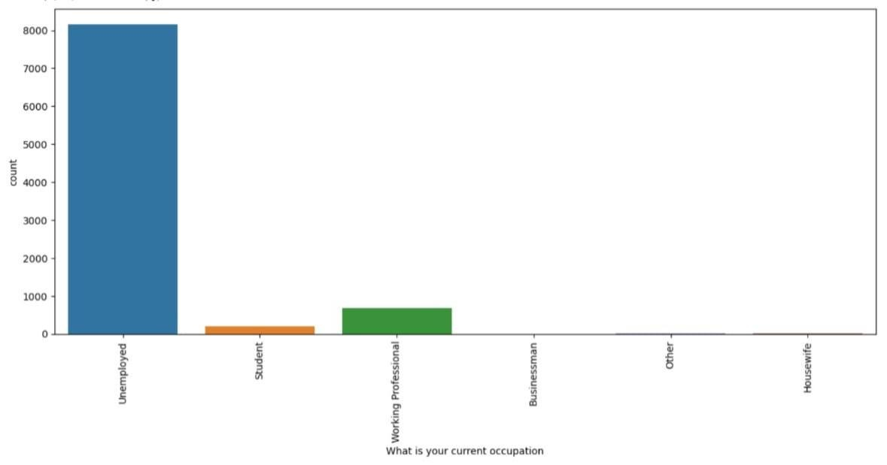
EDA

Slide 10
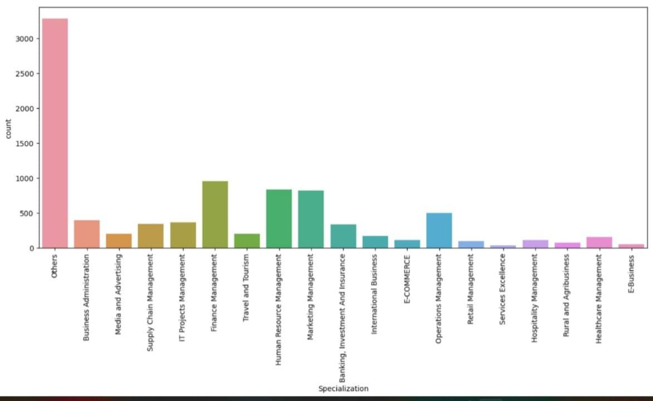

Slide 11
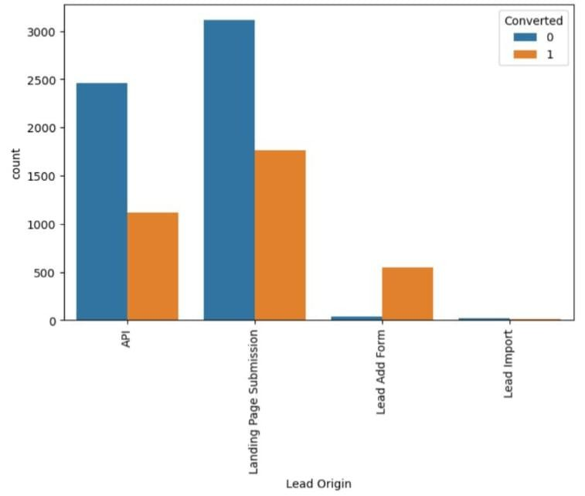
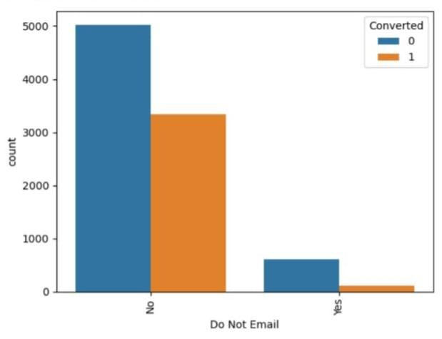
Categorical Variable Relation

Slide 12
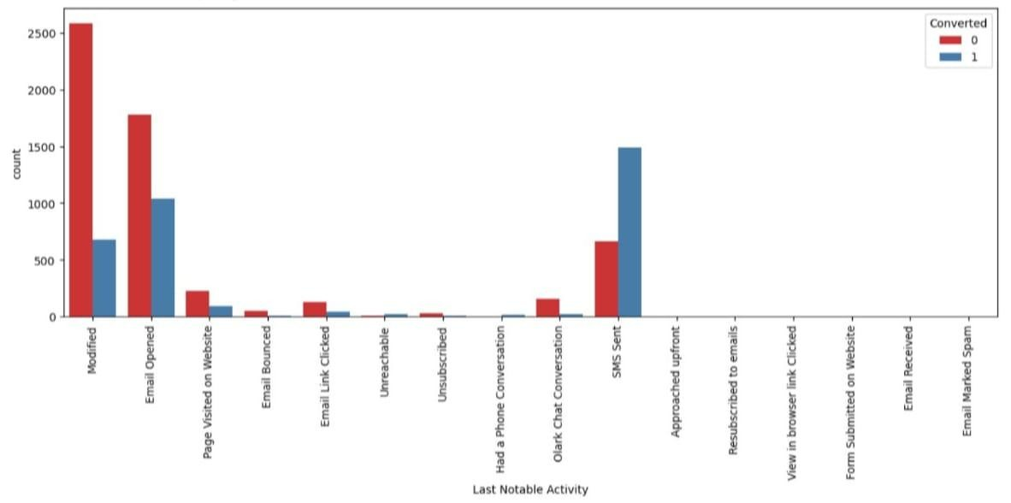
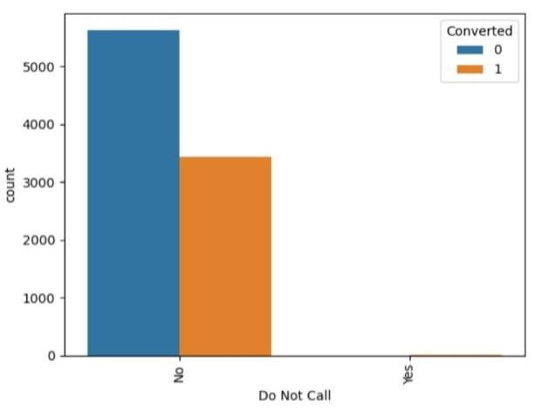

Slide 13
Data Conversion
Numerical Data: All numeric variables have been normalized to ensure consistent scaling and comparability.
Categorical Data: Dummy variables were created to represent non-numeric (object type) categories, converting them into a usable format for analysis.
Dataset Overview: The dataset contains 8,792 rows (individual entries) and 43 columns (features) ready for analysis.

Slide 14
Building Model
Data Splitting: The dataset was divided into training (70%) and testing (30%) sets for model evaluation.
Feature Selection: Recursive Feature Elimination (RFE) was used to narrow down the features, selecting the 15 most relevant variables.
Model Optimization: The model was refined by systematically removing variables with a p-value > 0.05 (indicating low statistical significance) or a VIF > 5 (indicating multicollinearity).
Predictions: The refined model was tested on the test dataset to make predictions.
Performance: The model achieved an overall accuracy of 81% on the test data.

Slide 15
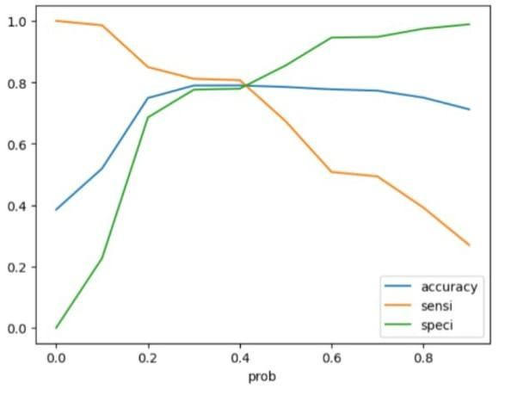
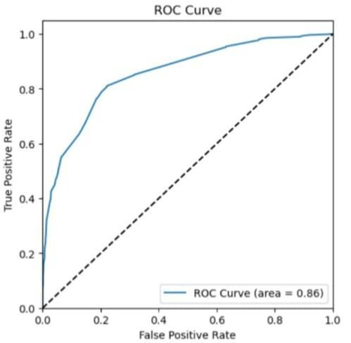
ROC Curve

Slide 16
Conclusion
The analysis revealed key factors influencing potential buyers, listed in order of importance:
Time Spent on the Website: The more time users spend on the website, the higher the likelihood of conversion.
Number of Visits: Frequent visits indicate stronger interest.
Lead Sources: Buyers are more likely to convert when leads come from:
Google
Direct Traffic
Organic Search
The Welingkar Website
4. Last Activity: Certain actions like:
Receiving an SMS
Engaging in an Olark Chat Conversation
show strong potential for conversion.

Slide 17
Lead Origin: Leads originating from Lead Ad Forms are highly valuable.
Occupation: Working Professionals are significantly more likely to purchase courses.
By focusing on these key variables, X Education can enhance its strategies and effectively convert a majority of potential buyers into actual customers, driving growth and success.

