Slide 1



Lecture – 14
Programming Abstraction using java
2D - Arrays

Slide 2


2D Arrays
A 2D array, also known as a two-dimensional array, is a data structure that organizes elements in a grid-like format with rows and columns. It can be thought of as an array of arrays. In a 2D array, each element is identified by a pair of indices: one for the row and one for the column.
Imagine it like a table or a matrix, where each cell holds a value. The first index refers to the row number, and the second index refers to the column number. This allows you to access or manipulate elements in the array using both row and column indices.

Slide 3
Structure of a 2D Array
0 1 2 3
0
1
2
3
1 | 2 | 3 | 4
5 | 6 | 7 | 8
9 | 10 | 11 | 12
13 | 14 | 15 | 16

Slide 4
Actual Structure of 2d Array
1k
3k
9k
14k
7k
1 | 2 | 3 | 4
3k
9k
5 | 6 | 7 | 8
9 | 10 | 11 | 12
14k
13 | 14 | 15 | 16
7k

Slide 5
How to initialize a 2d Array
Int [] [] arr= new int[4][4];
Now lets see what will happen if we initialize a 2d arrays like
Int [] [] arr= new int[4][];
Quick question: what will be the total no of 1d arrays created if we write int[][] arr=new int[n][m];

Slide 6
How To print 2d Array
To print a value in 2d array we have to get the value by accessing its index same like 1d array so to access all the indexes in a 2d array we have to iterate through two nested loops one to get address of array and other to get values from that array
like:
int[][] arr=new int[5][5];
for(int row=0; row< arr.length ; row++){
for(int col=0;col<arr[i].length;col++){
System.out.print(arr[row][col]+” ”);
}
System.out.println();
}

Slide 7
How To take input in 2d Array
First we have to take input of size of array
The we have to iterate over every index of array
And take the input for each index like 1d Array
Write a code to take input for 2d array of 5x5 size
Inputs are:
5 5
1 2 3 4 5
6 7 8 9 10
11 12 13 14 15
16 17 18 19 20
21 22 23 24 25

Slide 8
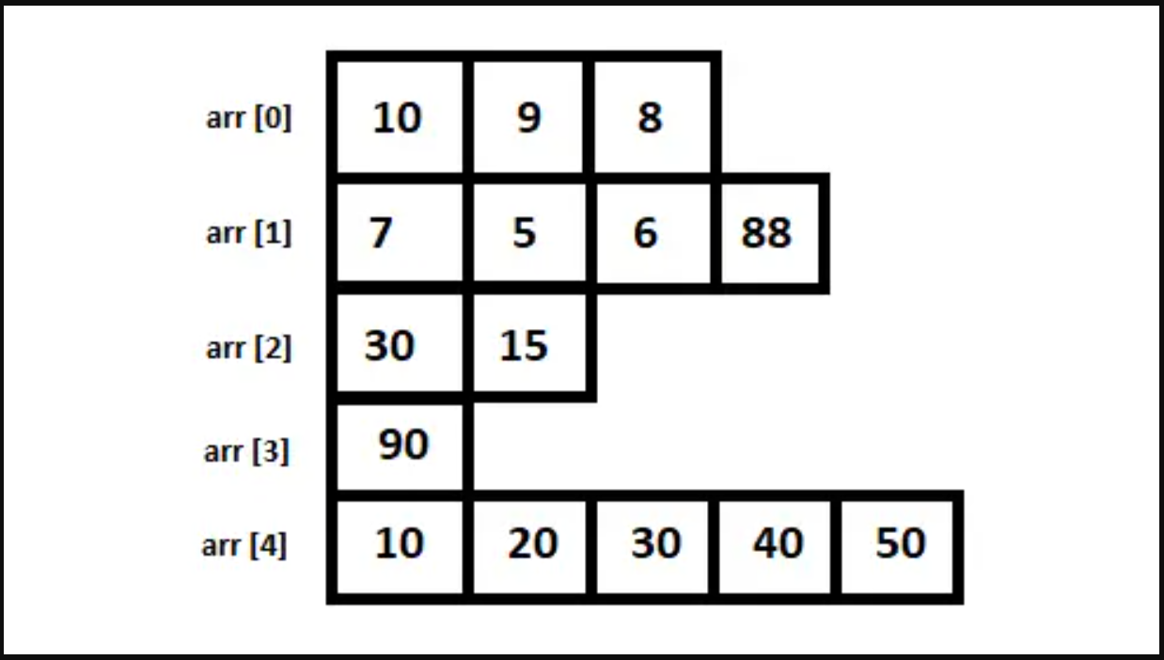
Jagged Array
Write a program to print this jagged array

Slide 9
Wave Print Row wise
1 | 2 | 3 | 4
5 | 6 | 7 | 8
9 | 10 | 11 | 12
13 | 14 | 15 | 16

Slide 10
Wave Print Column wise
1 | 2 | 3 | 4
5 | 6 | 7 | 8
9 | 10 | 11 | 12
13 | 14 | 15 | 16

Slide 11
Spiral Print Clockwise
1 | 2 | 3 | 4
5 | 6 | 7 | 8
9 | 10 | 11 | 12
13 | 14 | 15 | 16

Slide 12
Transpose of Square Matrix
Row
1 | 2 | 3 | 4
5 | 6 | 7 | 8
9 | 10 | 11 | 12
13 | 14 | 15 | 16
1 | 5 | 9 | 13
2 | 6 | 10 | 14
3 | 7 | 11 | 15
4 | 8 | 12 | 16
Col

