Slide 1



Lecture- 4
Programming Abstraction using java
Patterns with spaces
Mirror Pattern

Slide 2

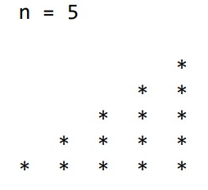

Write a Program For The Pattern Below

Slide 3
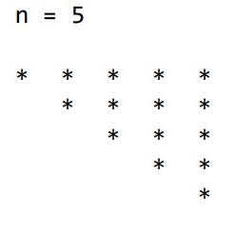
Write a Program For The Pattern Below

Slide 4
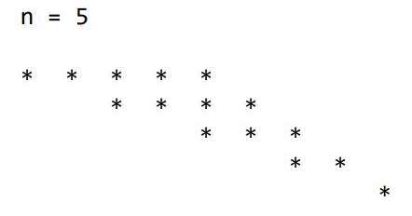
Write a Program For The Pattern Below

Slide 5
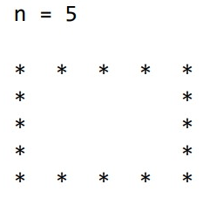
Write a Program For The Pattern Below

Slide 6
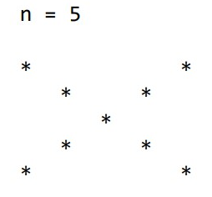
Write a Program For The Pattern Below

Slide 7
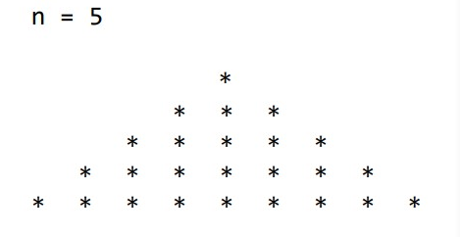
Write a Program For The Pattern Below

Slide 8
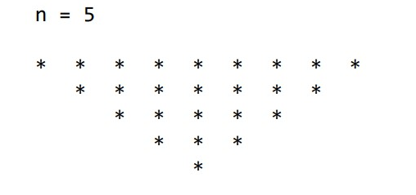
Write a Program For The Pattern Below

Slide 9
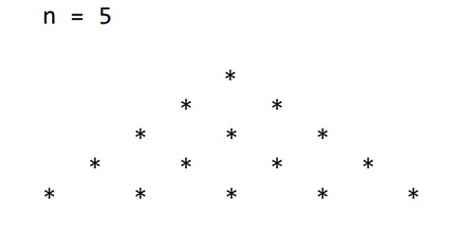
Write a Program For The Pattern Below

Slide 10
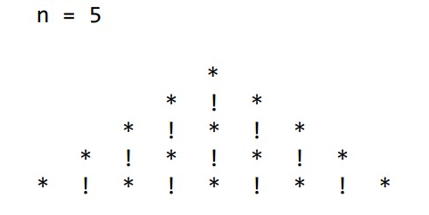
Write a Program For The Pattern Below

Slide 11
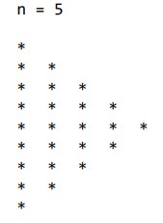
Write a Program For The Pattern Below

Slide 12
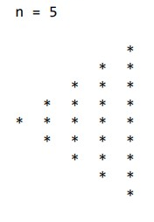
Write a Program For The Pattern Below

Slide 13
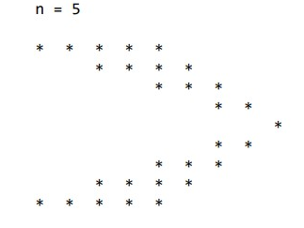
Write a Program For The Pattern Below

Slide 14
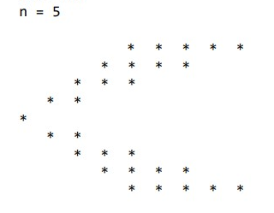
Write a Program For The Pattern Below

Slide 15
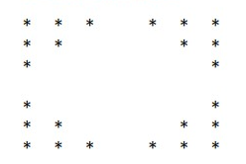
Write a Program For The Pattern Below
n = 7

