Slide 1



Lecture – 7
Programming Abstraction using java
Type Casting

Slide 2


Ranges in Integer’s data types
Byte →1 byte →8 bits →-2⁷ -> 2⁷ - 1
Short →2 bytes →16 bits →-2¹⁵ ->2¹⁵-1
Int →4 bytes →32 bits → -2³¹ -> 2³¹ -1
Long → 8 bytes →64 bits → -2⁶³ ->2⁶³-1

Slide 3
Now lets try to put 134 in a byte type of variable
If we put the above number in byte data type we will see an error because the number is out of range of byte so to resolve that error we need to do typecasting
Now , lets see how type casting is done

Slide 4
Quick Code
Write a code in which you have a byte b=14 and an int i=300, now typecast value of I in byte and store that in b. print b before and after type casting so that we can make observations on changes.
Now ,write the same program for i=428 and b=14
Conclusion : if we store bigger things in smaller datatypes there will be data loss.

Slide 5
Smaller datatypes to larger data types
Write a code in which you have a byte b=120 and an int i=3, now typecast value of b in int and store that in i. print i before and after type casting so that we can make observations on changes.(here empty space is filled by padding of 0).
Now ,we can see here no data is lost and no conversion occurred
Conclusion : if we store smaller things in bigger datatypes there will not be any data loss.

Slide 6
Now Lets write the above program and type cast -5 from byte to int

Slide 7
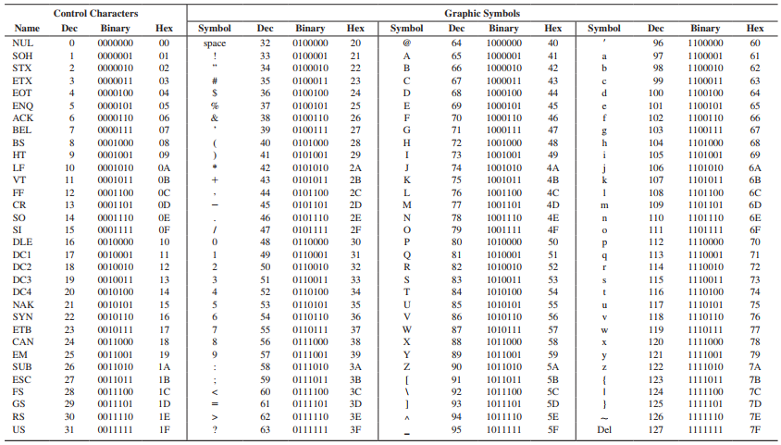
CHAR
Range → 2byte →16bits → 2¹⁶Different characters
65536 different characters

Slide 8
Loop demo
For(byte b=0 ;b<=128;b++){
System.out.println(b);
}

Slide 9
Write a program to convert decimal to binary

Slide 10
Write a program to convert binary to decimal

Slide 11
Write a program to convert binary to decimal

Slide 12
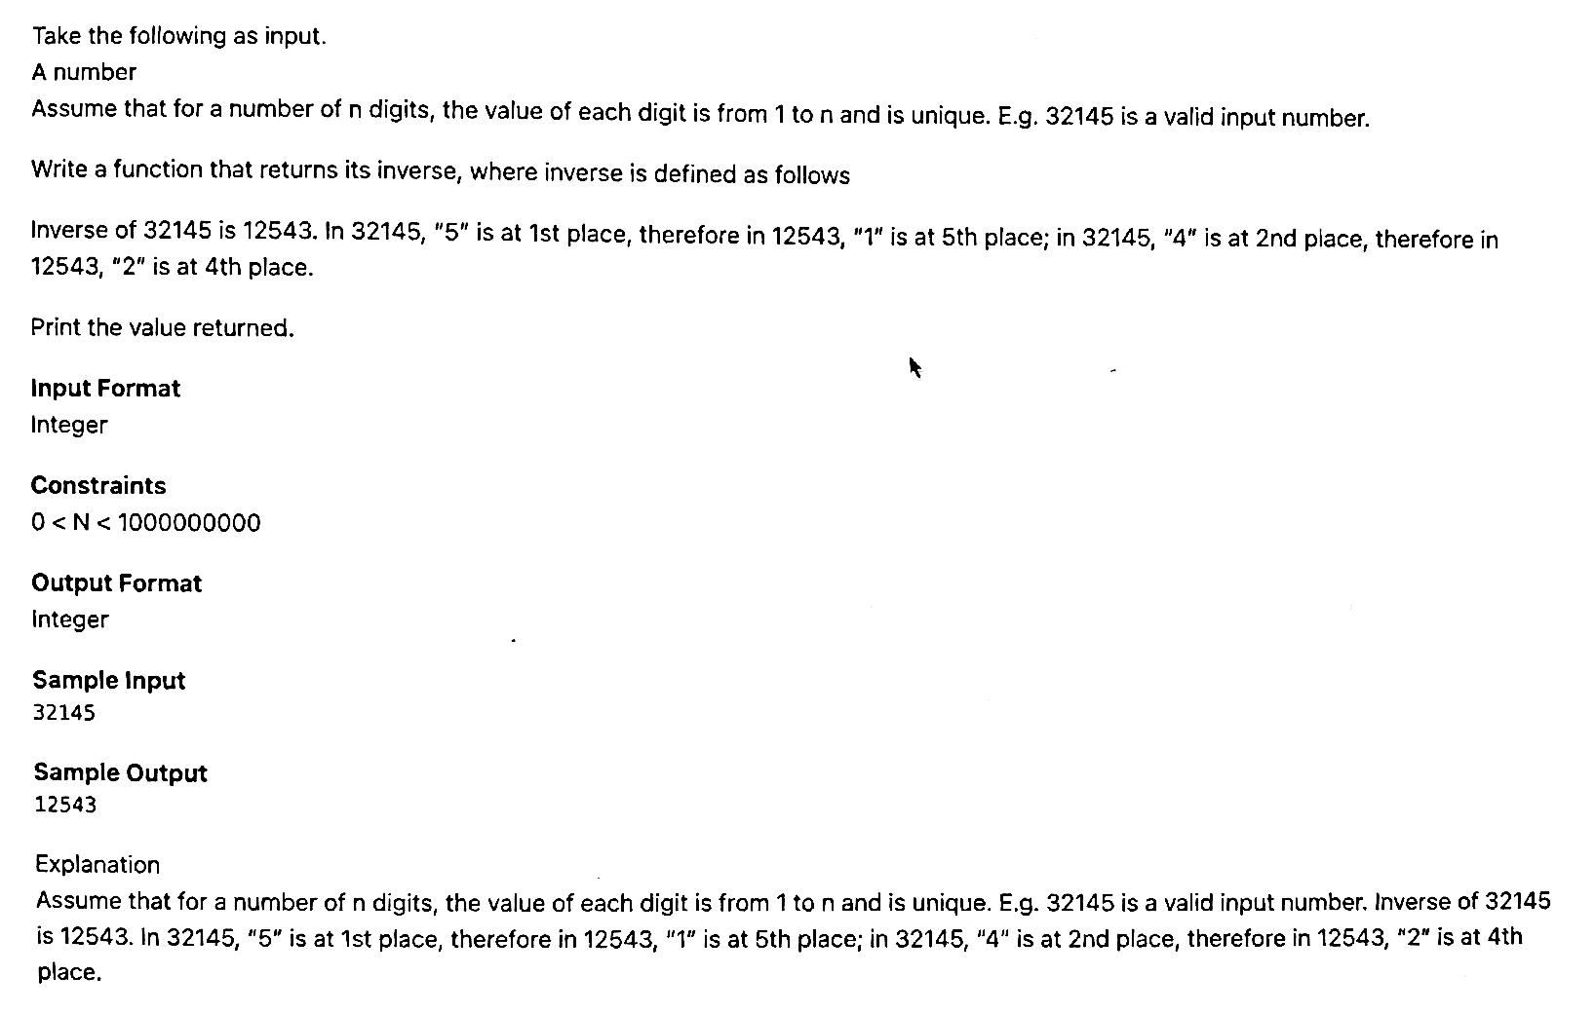
Write solution of given problem

