Slide 1



Lecture – 8
Programming Abstraction using java
Functions

Slide 2


Quick question what helps us in managing resources of our device ?
So similarly when we have to run a program j.v.m. manages the resources for our program so lets see how jvm manages the memory

Slide 3
JVM
All 8 primitive data types
+
Function calling
Function()
{
a=1
b=2
c=a+b
}
Heap Memory
Non-Primitive

Slide 4
How jvm runs a program?
In the entire code jvm searches for the main function and executes that function only.
Now, before heading towers main function lets see what is a function in general
Example: y=f(x) ans: x=1 y=2
f(x)=x²+1 x=2 y=5

Slide 5
Now lets see what is main function?
Public static void main(String args[]){
int a=0;
int b=1;
function();
}

Slide 6
Now lets create a function to add two numbers
Public static void add(){
int a=1;
int b=2;
system.out.println(a+b);
}

Slide 7
Parameterized function to add two numbers
Public static void add(int a , int b){
System.out.println(a+b);
}

Slide 8
Parameterized function to add two numbers and returns the answer
Public static int add(int a , int b){
c=a+b;
return c;
}

Slide 9
Now lets call a function from a function and see how it is working
For example:
write a function for addition of two number and then call a function for subtraction of two numbers in addition function and then call a function of multiplication from function of subtraction and then calla function of division from function of multiplication.

Slide 10
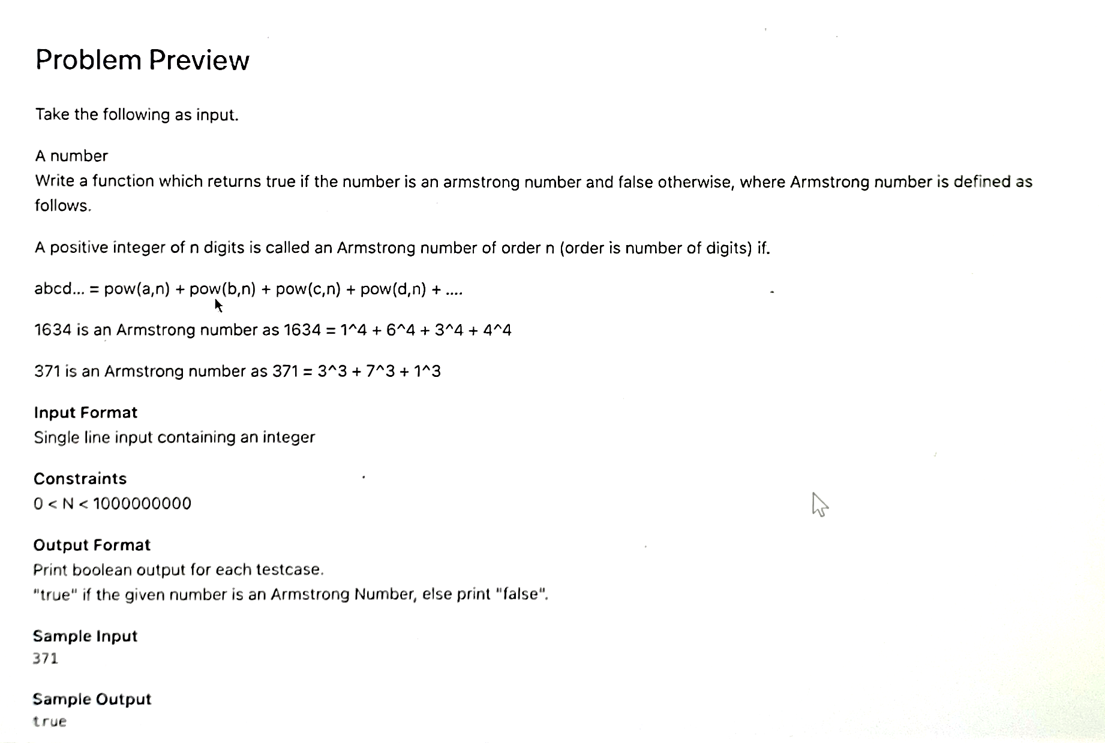
Question

