Slide 1
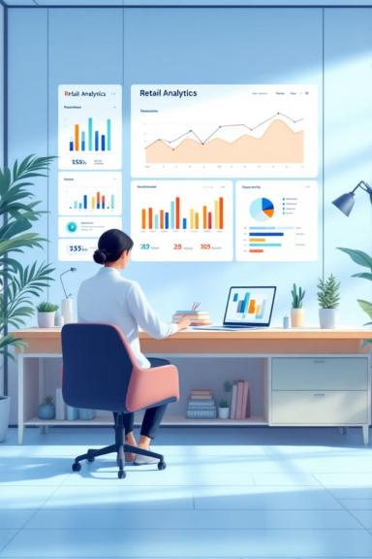
Customer Shopping Behavior Analysis
Uncovering insights from 3,900 purchases to guide strategic business decisions

Slide 2

Project Overview
Dataset Size
Key Features
3,900 purchases across 18 columns
Demographics, purchase details, shopping behavior
Goal
Uncover spending patterns and customer segments

Slide 3

Revenue by Gender
Key Finding
Male customers generated $157,890 in revenue, while female customers generated $75,191.
This significant difference suggests gender-based marketing opportunities.

Slide 4
Top Products by Rating
1
2
3
Gloves
Sandals
Boots
3.86 average rating
3.84 average rating
3.82 average rating
4
5
Hat
Handbag
3.80 average rating
3.78 average rating
These high-rated products represent quality offerings that drive customer satisfaction.

Slide 5
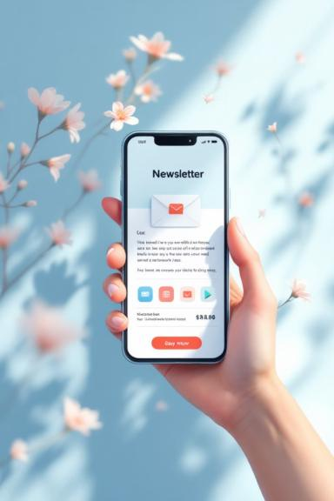
Subscription Impact Analysis
27%
73%
$59.87
Subscribed
Non-Subscribed
Avg Spend
1,053 customers with subscriptions
2,847 customers without subscriptions
Non-subscribers spend slightly more per purchase

Slide 6
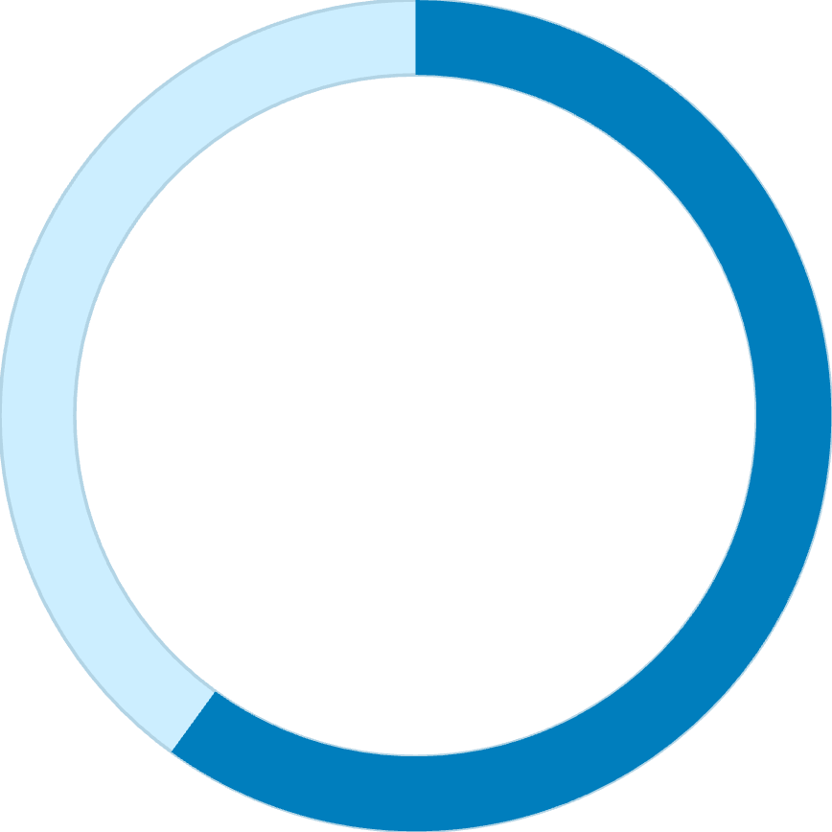
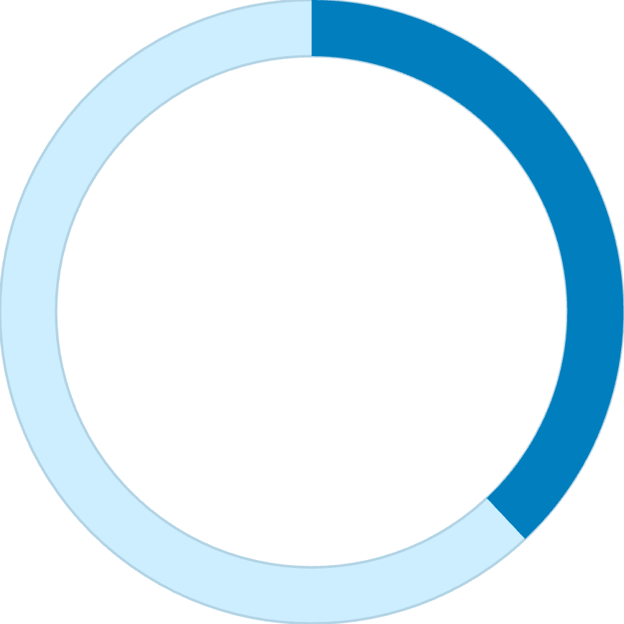
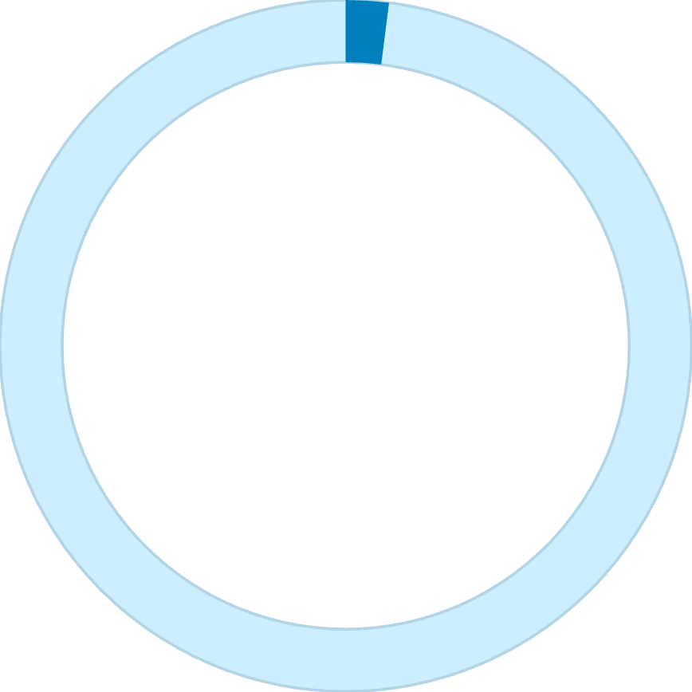
Customer Segmentation
60%
38%
2%
Loyal Customers
Returning
New
2,339 repeat buyers
1,478 customers
83 customers
Key Insight
High loyalty rate indicates strong customer retention. Focus on converting new customers to returning buyers.

Slide 7
Revenue by Category
47%
34%
Clothing
Accessories
$110K revenue
$80K revenue
17%
8%
Footwear
Outerwear
$40K revenue
$20K revenue

Slide 8

Age Group Performance
Revenue Leaders
Young Adults: $120K
Midlife: $80K
Adults: $60K
Seniors: $40K
Young adults drive the highest revenue and purchase frequency, making them the primary target demographic.

Slide 9
Key Business Decisions
01
02
03
Focus on Clothing
Boost Subscriptions
Target Young Adults
Increase inventory and marketing for highest-revenue category
Introduce special discounts and loyalty programs to increase from 27%
Focus marketing campaigns on highest-spending age group
04
05
Improve Satisfaction
Optimize Shipping
Enhance product quality and service to increase 3.75 average rating
Focus on most-used shipping methods and improve delivery services

Slide 10

Thank You
Ready to transform customer insights into strategic action

