Slide 1
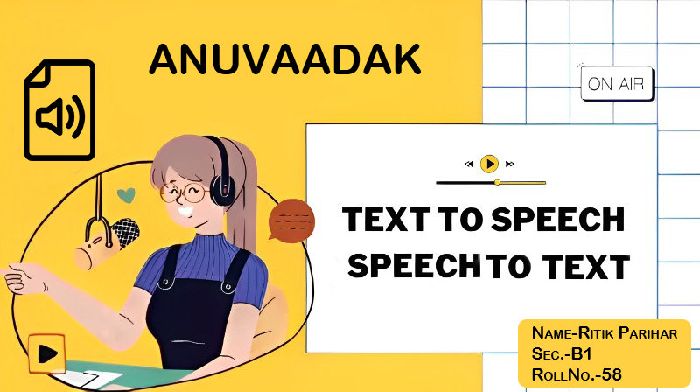

Slide 2


Introduction
This project is a web application that can convert text to voice and voice to text
1
It supports 11 Indian languages, including English, Hindi, Bengali, Marathi ,etc.
2
The project is developed using Flask.
3

Slide 3




Languages and Framework Used:
HTML: Used to structure the content of the web pages.
CSS: Used to style the web pages and enhancing their visual presentation.
Flask: A Python web framework that makes it easy to create web applications.
JavaScript: Used to add interactivity to the web pages, such as the ability to play and pause the audio recordings.

Slide 4
Libraries Used
Flask:
Purpose: Web framework for building Python web applications.
Usage in the Script: Creates a web server, defines routes, and handles HTTP requests.
render_template:
Purpose: Renders HTML templates using Jinja2 templating.
Usage in the Script: Renders the 'index.html' template with data.
request:
Purpose: Accesses incoming request data, such as form submissions.
Usage in the Script: Retrieves form data submitted by the user.
jsonify:
Purpose: Creates JSON responses from Python dictionaries.
Usage in the Script: Not used explicitly but useful for building APIs.
gTTS (Google Text-to-Speech):
Purpose: Converts text to speech using Google's API.
Usage in the Script: Generates audio files from input text in various languages.
speech_recognition (SpeechRecognition):
Purpose: Provides a simple interface for speech recognition engines.
Usage in the Script: Imported but not used; potential for future speech recognition features.

Slide 5
Accessibility
This project can be used by people who are learning Indian languages
It can also be used by people facing challenges in reading or writing.
It can be a helpful tool for people who want to create audio recordings in Indian languages

Slide 6
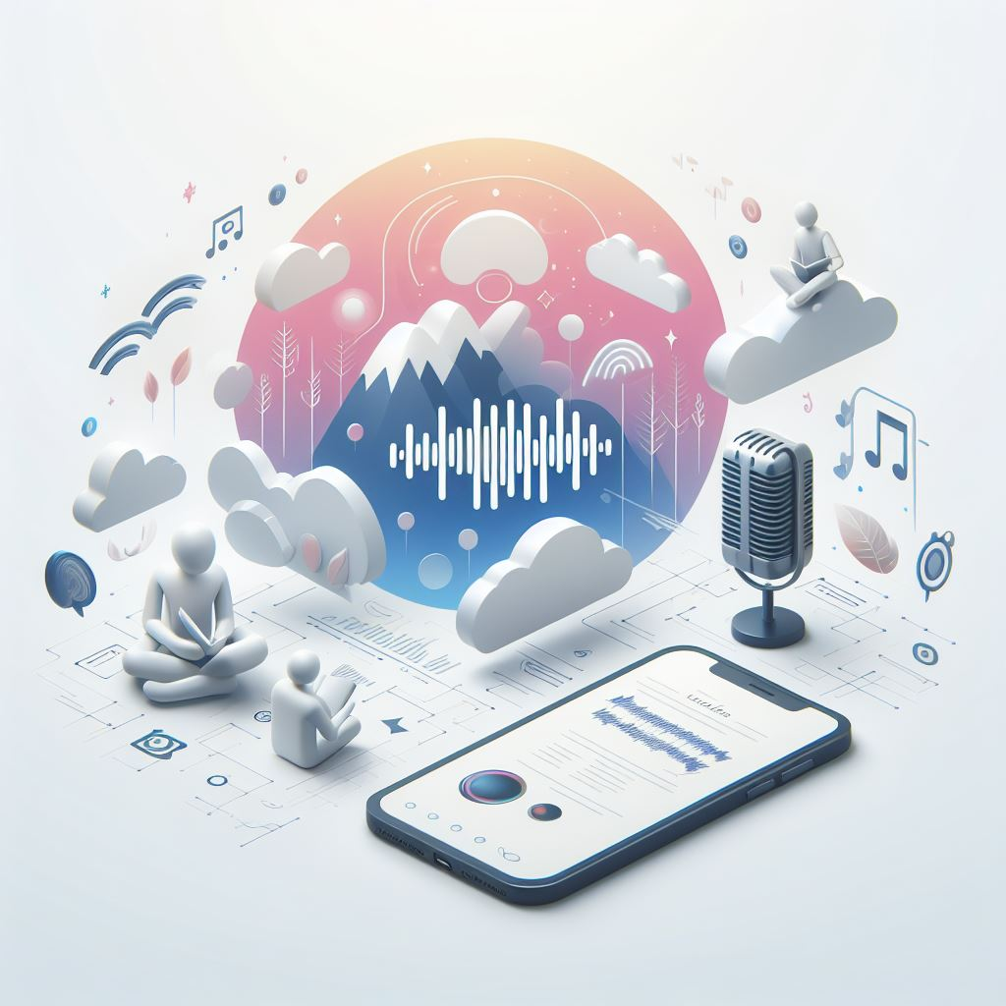
Challenges With This Project
One of the challenges of this project was finding a text-to-speech engine that supports multiple Indian languages
Another challenge was ensuring that the speech-to-text engine was accurate for all of the supported languages

Slide 7
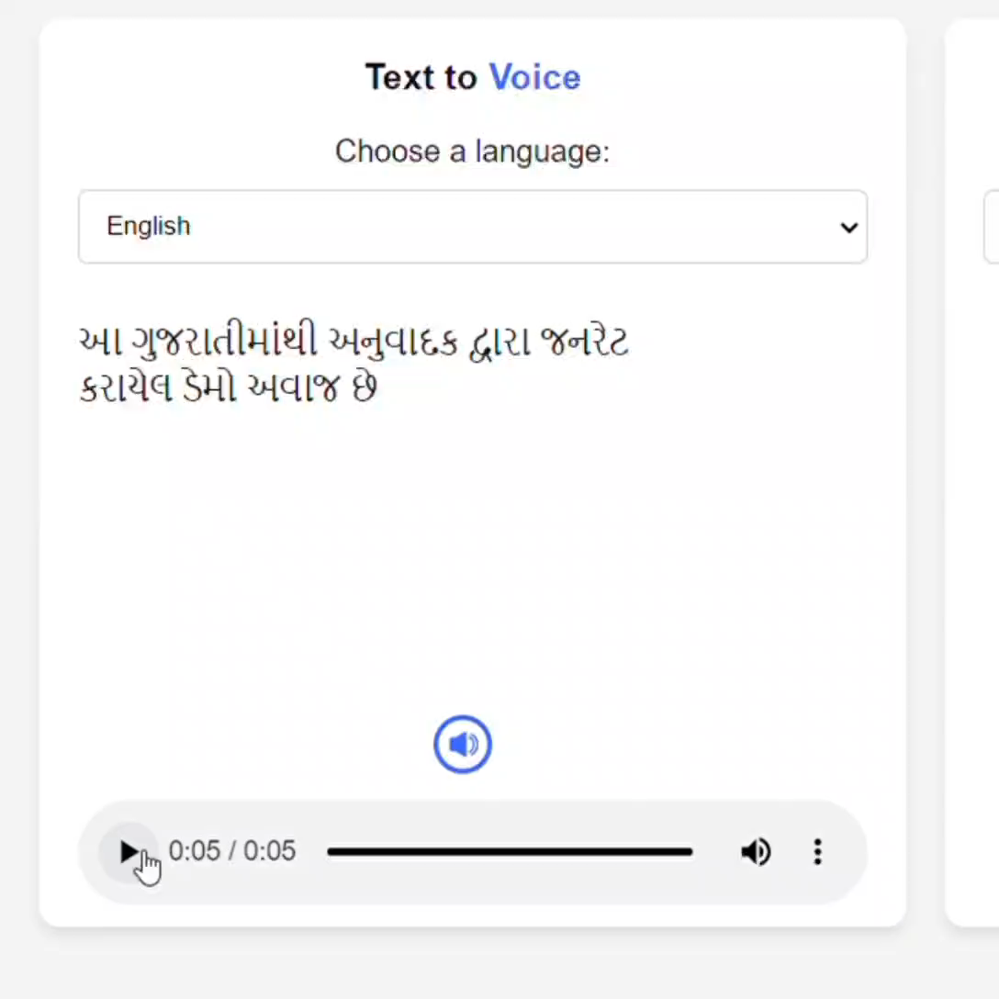
How To Use
Text-To-Voice
Select Language: Choose the language you want to translate from the available options.
Process Text to Voice: Initiate the process to convert the entered text into spoken language using a text-to-voice engine.
Listen to Output: Access the generated voice output and listen to the translated text.
Enter Text: Input the desired text into the designated text area.

Slide 8
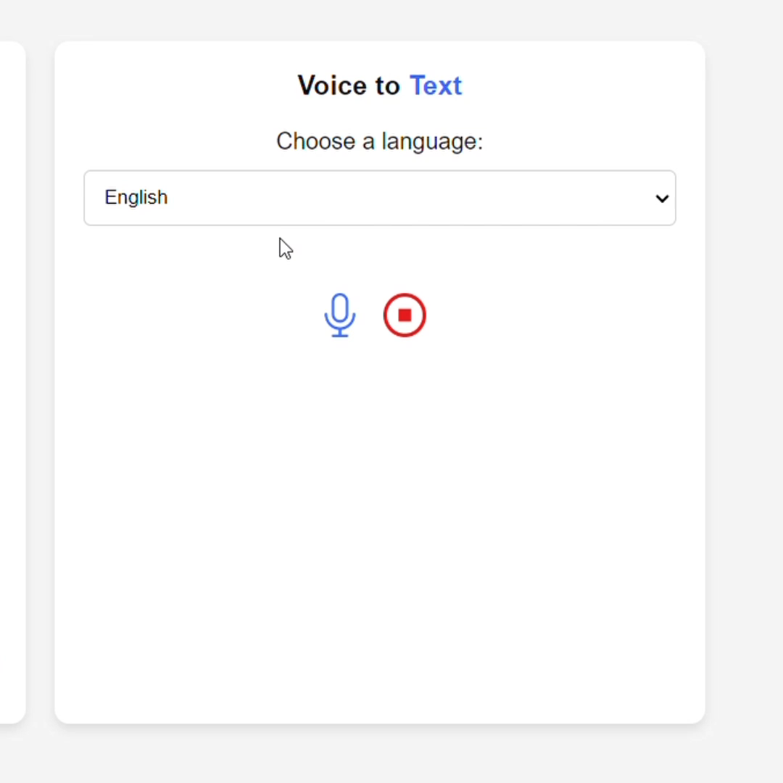
How To Use
Voice-To-Text
Select Language: Choose the language for voice-to-text conversion from the available options.
Process to Text: Initiate the processing of the recorded voice to convert it into text using a speech-to-text engine.
Converted Text: Access and review the converted text output.
Record and Stop: Begin recording your voice, and click 'Stop' when finished.

Slide 9
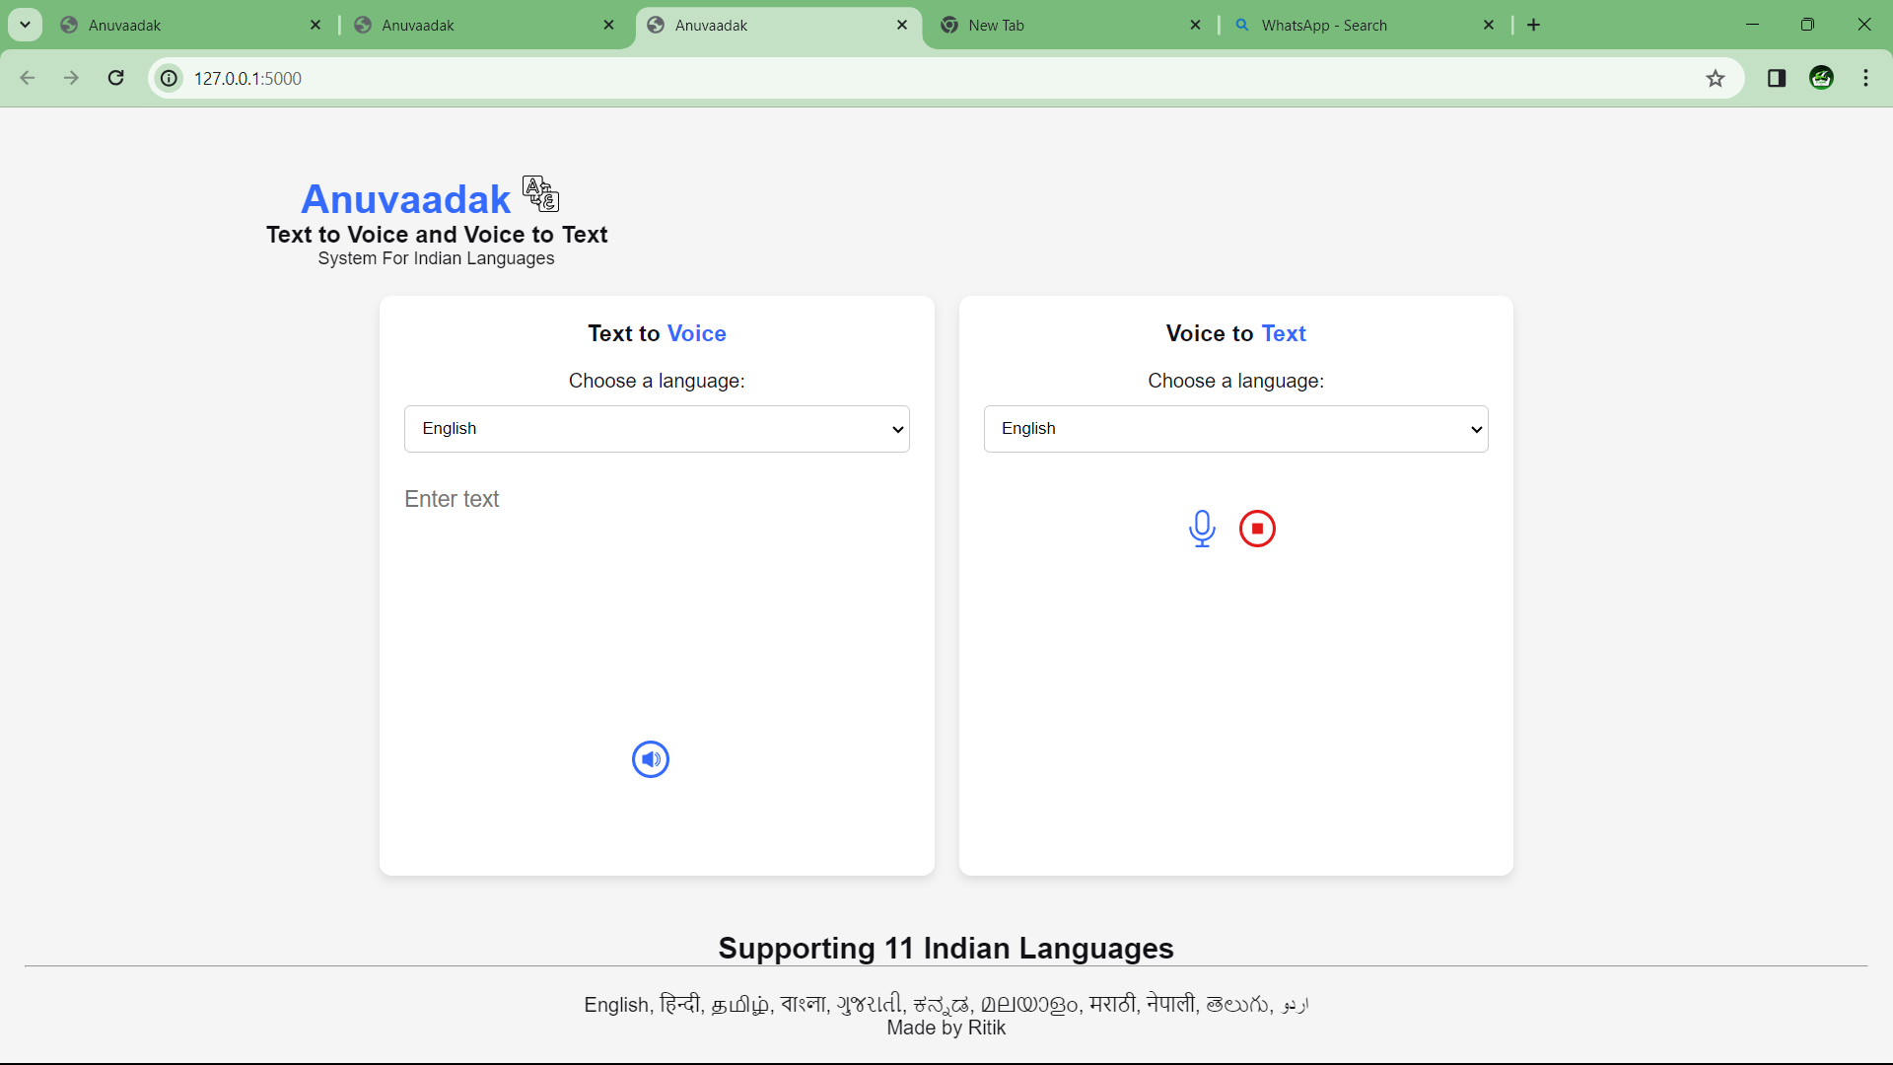
Appearance Of Webpage

Slide 10
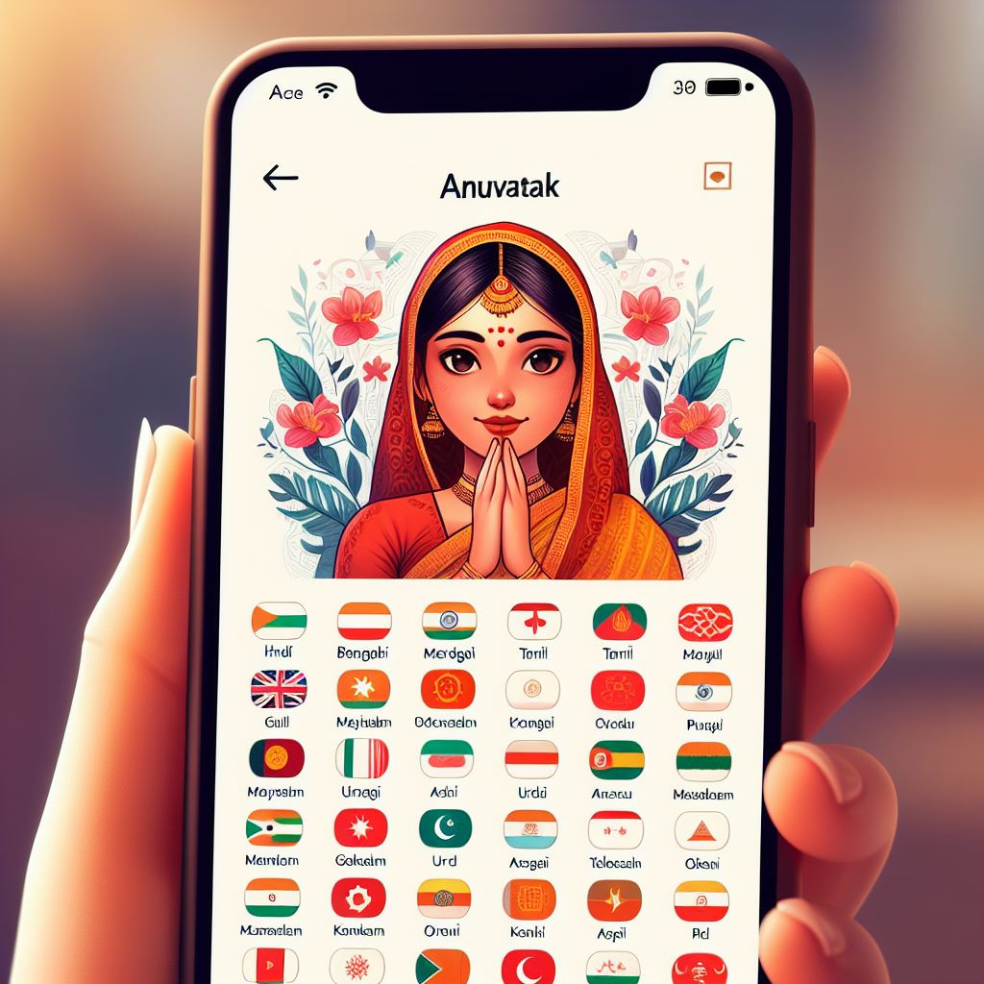
Text-to-voice: Convert text into spoken audio in a chosen Indian language
Voice-to-text: Convert spoken audio in a chosen Indian language into text
Supports multiple languages: Choose from 11 Indian languages for both text-to-voice and voice-to-text conversion
Simple and easy-to-use interface: The website is easy to navigate and use, even for those who are not familiar with technology

Slide 11
References
Research from
YouTube
ChatGPT
Google
Internet

Slide 12
Thank You!
I hope you found this presentation informative
Thank you for your time

