Slide 1
REPORT
Exploratory Data Analysis
& Business Intelligence
Sales Data 2025 | Retail Analytics Deep Dive
1,000
6
5
8
Orders
Products
Categories
Cities
Prepared by: Ritika | Dataset: Cleaned_Sales_Dataset.xlsx

Slide 2
TABLE OF CONTENTS
01
Dataset Overview
02
Descriptive Statistics
Shape, columns, data types, missing values
Numerical summary, distributions, outliers
03
Univariate Analysis
04
SQL Business Insights
Category, product, city, gender, age distributions
Revenue, top customers, monthly trends via SQL
05
Multivariate Analysis
06
Key Findings & KPIs
Correlations, scatter plots, heatmap
Dashboard mock-up, insights, recommendations

Slide 3
01
Dataset Overview
1,000 rows
18 features
Jan – Dec 2025
None (Cleaned)
Total Records
Columns
Time Period
Missing Values
Key Columns & Data Types
Column | Data Type | Description
Order_ID | String | Unique order identifier
Customer_Name / ID | String | Customer details
Age / Gender | Int / String | Demographic attributes
City | String | 8 cities across India
Product / Category | String | 6 products, 5 categories
Quantity | Integer | Units ordered (1–10)
Unit_Price | Float | Price per unit (₹145 – ₹50K)
Total_Sales | Float | Revenue per order
Month / Quarter / Year | String/Int | Time-based features
Age_Group | String | Young Adult, Adult, Middle Age, Senior

Slide 4
02
Descriptive Statistics — Numerical Summary
Statistic | Age | Quantity | Unit Price (₹) | Total Sales (₹)
Count | 1,000 | 1,000 | 1,000 | 1,000
Mean | 41.35 | 5.44 | 25,486.78 | 1,39,399.44
Std Dev | 13.68 | 2.84 | 14,179.40 | 1,14,100.05
Min | 18 | 1 | 145.78 | 437.34
25th %ile | 30 | 3 | 13,895.72 | 47,066.63
Median | 41 | 5 | 25,398.74 | 1,08,594.02
75th %ile | 53 | 8 | 37,512.38 | 2,03,722.88
Max | 65 | 10 | 49,997.53 | 4,93,677.50
Key Observations
📊 Avg sale value ₹1.39L — high variability (std ₹1.14L)
👥 Customer age range: 18–65 yrs, median 41 — balanced adult-heavy base
📦 Quantity ranges 1–10 units, avg 5.44 — bulk buying is common
💰 Unit price spans ₹145 to ₹50K — wide premium product range

Slide 5
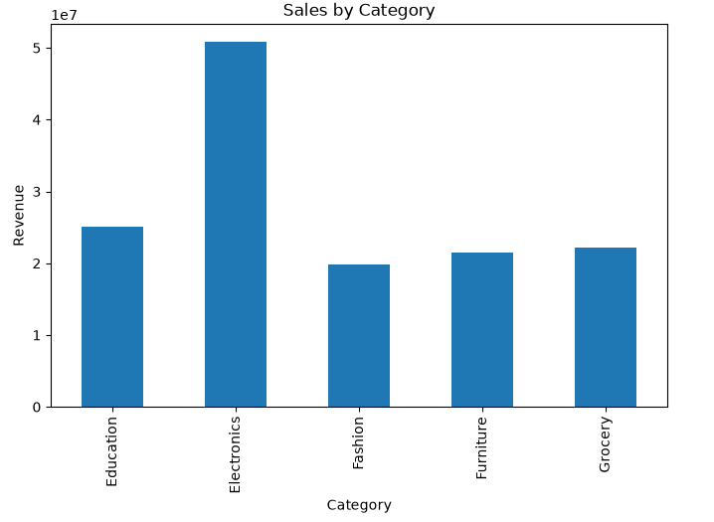
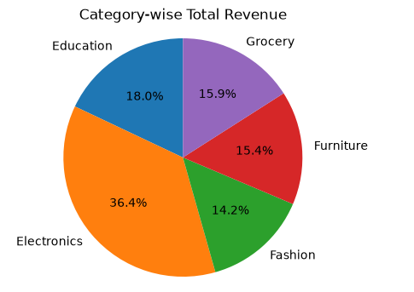
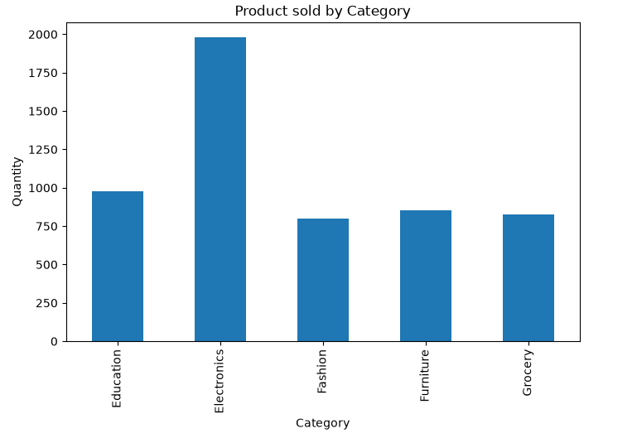
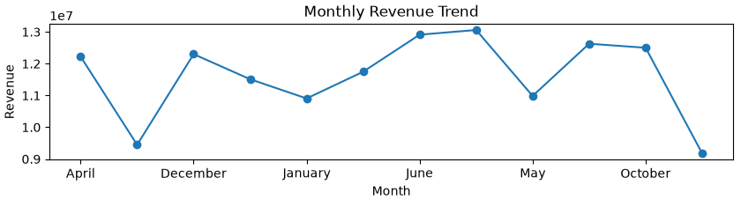
03
Univariate Analysis — Revenue by Category & Product

Slide 6
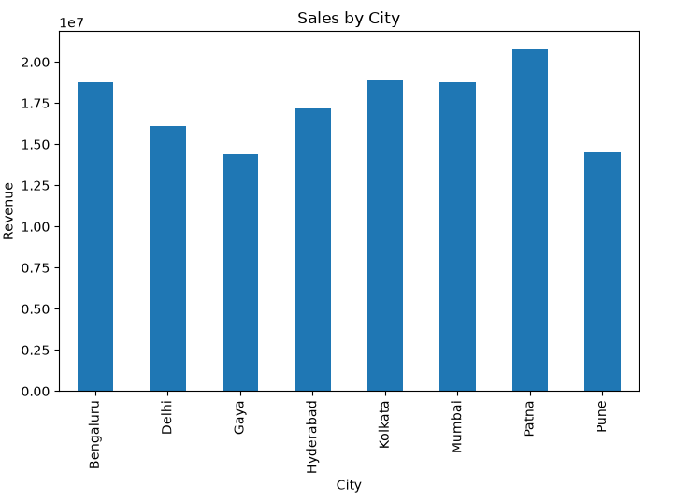
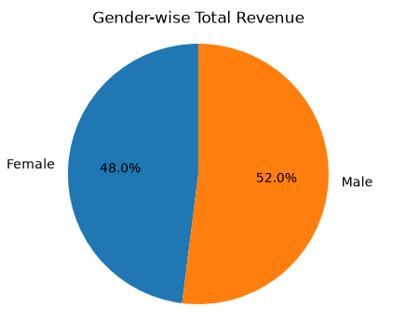
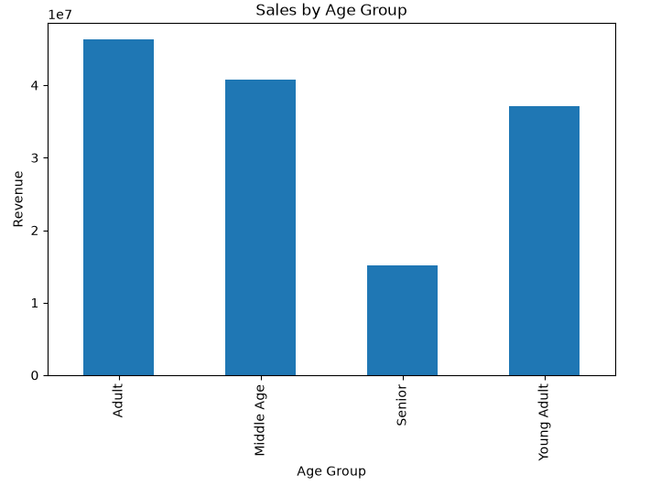
03
Univariate Analysis — City, Gender & Age Group

Slide 7
04
SQL Business Insights — Key Query Results
Total Revenue → ₹13,93,99,439.65
Top 5 Customers by Revenue
Avg Order Value by Category
Customer | Revenue (₹)
Customer_335 | 16,84,832.52
Customer_138 | 13,05,932.64
Customer_266 | 12,69,445.22
Customer_375 | 11,96,934.33
Customer_274 | 10,60,340.15
Category | Avg Order (₹)
Grocery | 1,45,305
Electronics | 1,43,442
Education | 1,40,627
Furniture | 1,35,355
Fashion | 1,27,153
SELECT Category, ROUND(AVG(Total_Sales),2) AS Avg_Order_Value FROM sales_data GROUP BY Category ORDER BY Avg_Order_Value DESC;

Slide 8
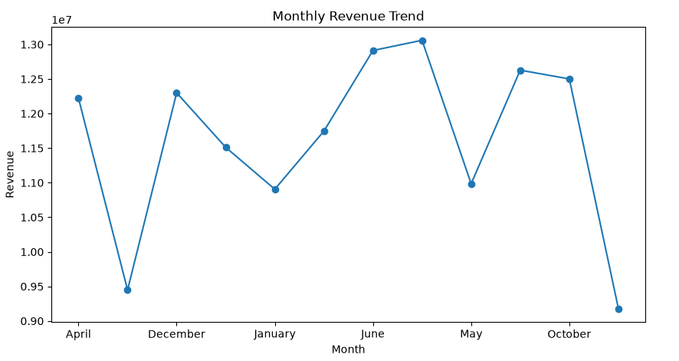
04
SQL Insight — Monthly Revenue Trend
March
September
₹1.24 Cr
Seasonal dips Q3
Peak Month
Lowest Month
Q4 Avg/Month
YoY Pattern

Slide 9
05
Multivariate Analysis — Correlation Insights
Correlation Matrix (Pearson)
Key Findings
 | Age | Quantity | Unit Price | Total Sales
Age | 1.000 | -0.028 | -0.012 | 0.001
Quantity | -0.028 | 1.000 | 0.022 | 0.647 ↑
Unit Price | -0.012 | 0.022 | 1.000 | 0.686 ↑
Total Sales | 0.001 | 0.647 ↑ | 0.686 ↑ | 1.000
0.686
Unit Price ↔ Total Sales — strongest driver
0.647
Quantity ↔ Total Sales — volume matters too
~0.00
Age has no correlation with purchase value
Legend:
Strong (≥0.6)
Moderate (0.3–0.6)
Weak (<0.3)
−0.028
Older customers order slightly less quantity

Slide 10
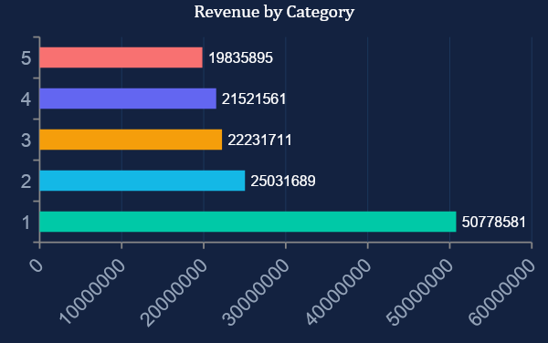
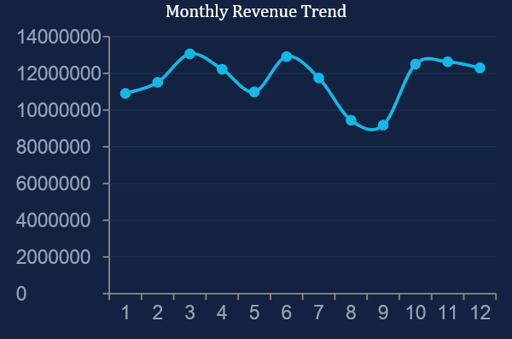
06
KPI Dashboard Mock-up
₹13.94 Cr
1,000
5.44
₹25,486
Total Revenue
Total Orders
Avg Qty/Order
Avg Unit Price
FY 2025
Avg ₹1.39L / order
Units per transaction
Across all products

Slide 11
06
Key Findings & Business Recommendations
📈
Electronics Dominates
🏙️
Patna is Top City
Electronics accounts for 36.4% of total revenue (₹5.08 Cr) — prioritize inventory and marketing here.
Patna generates ₹2.08 Cr, slightly above Kolkata & Bengaluru. Consider region-specific promotions.
💰
Price Drives Sales
📦
Quantity Also Matters
Unit Price has the highest correlation with Total Sales (r=0.686). Premium product strategies yield higher revenue.
Quantity has r=0.647 with Total Sales — bulk offers and combo deals can significantly boost revenue.
👤
Adults are Core Buyers
📉
Q3 Shows Seasonal Dip
Adults (25–45 yrs) contribute ₹4.63 Cr. Target campaigns for Young Adults to expand this segment.
August–September sees lowest sales. Plan festive pre-season campaigns to fill this trough.
EDA completed using Python (Pandas, Matplotlib, Seaborn) • SQL queries executed in MySQL • Dataset: 1,000 orders across 8 Indian cities | 2025

Slide 12
Thank You
EDA & Business Intelligence Report
Prepared by: Ritika

