Slide 1
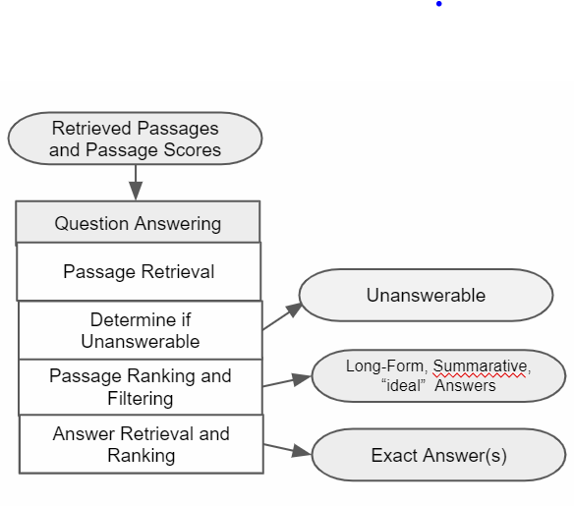
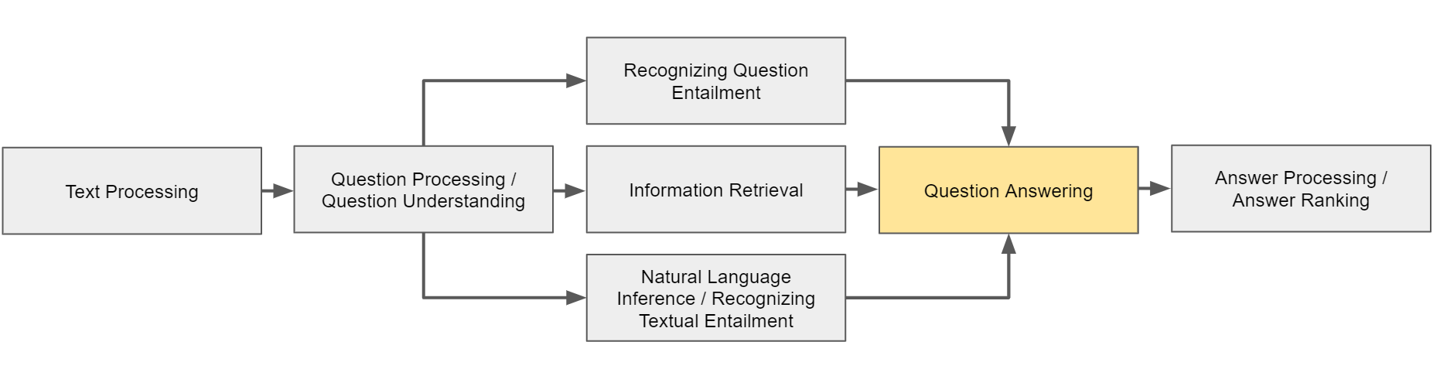
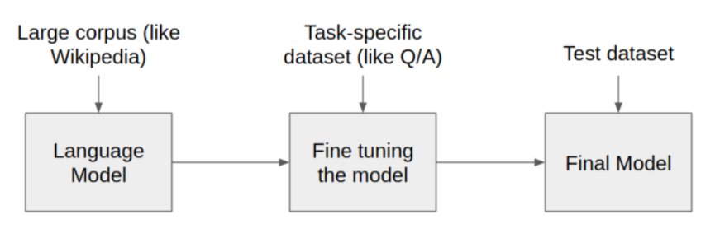
Consumer Health Question Answering System
Ritika Raju, Sam Henry, Özlem Uzuner| rraju@gmu.edu
Department of Information Science and Technology| George Mason University
Background
Question Answering
After the IR module retrieves and ranks the relevant documents and passages, the answering module focusses on extracting and ranking the answers from the passages. This process is different for various question types. For list and factoid questions, one or more terms are typically selected by identifying text spans within snippets. For Yes/No type questions, sentence classification is used. BioBert is used for answer generation. BioBERT is trained on Squad and SQuAD 2.0 for transfer learning and is finetuned on BioASQ datasets to improve its performance. Also, the last layer of BioBERT is modified to be trained/tested on three different types of BioASQ questions, i.e., factoid, list and yes/no. This facilitates in reduction of cost of using biomedical question answering systems as the structure of BioBERT works well for all the three types of questions.
The field of Health Information Technology has tremendously developed to increase efficiency, reduce medical errors, reduce cost, increase patient satisfaction and improvise on the care provided. While systems like Electronic Health Records exist for clinicians and medical practitioners to help them improve their efficiency, very few systems out there focus on making life easier for patients. There still exists a need for the development of efficient information extraction and retrieval systems to identify key concepts related to the patient’s medical condition.
This medical information retrieval system based on question answering interprets the question posed in natural language and can retrieve succinct and precise answers from a knowledge base for the patient to identify their illness. By using methods from NLP (Natural Language Processing), this system accepts questions in free-text and precisely serves the patients’ information need. The expected result is an improvement in retrieval performance with a lot less effort required by the patient.
BioBERT
Method
Future Directions
BERT, developed recently by Google, is built upon multi-layer bidirectional Transformers, uses contextualized word embeddings and has attained state-of-the-art results on various NLP tasks including question answering. BioBERT, a domain-specific BERT based model further pre-trained on PubMed abstracts and full texts, performs better than BERT and other state-of-the-art models in bioNLP tasks such as biomedical NER, RE and QA. It takes in the question and the snippet as an input sequence. Then, it learns positional embeddings during training and uses segment embeddings to mark question and passage locations in the input sequence. BioBERT uses WordPiece embeddings (sub word units) to address out-of-vocabulary problems and broken sub-words are marked by ##. To the beginning of every sequence, to process yes/no type questions, [CLS] tokens are added.
For factoid and list type questions, exact answers are included in the given snippets, while only binary answers are provided for yes/no questions. The data set contains multiple snippers or documents for each question and question type. To gain the best performance, the BioBERT model was further pretrained on SQuAD dataset. The trainable parameters for factoid and list type questions were pre-trained on the SQuAD 1.1 dataset, and the parameters for yes/no type questions were pretrained on the SQuAD 2.0 dataset. The pre-trained system is then fine-tuned on BIOASQ Task 7B for each task. The XML document retrieved from the IR module is first converted to JSoN to get results with BioBERT and post-processed back to XML.
1. Problem: At times, BioBERT misses out on identifying the exact correct start and end positions of the answer text span, thus ending up missing out on a few (1-3) words in the answer. Possible reason : Not enough fine-tuning data and possible errors in finetuning dataset. Additional datasets could be added to pretrain the model.
Example: Which proteins in the cerebro-spinal fluid can be used for early diagnosis of Alzheimer’s disease? Expected answer: phosphorylated tau (p-tau 181p) , BERT’s answer: tau
2. Problem: When the correct text span is clearly present, BERT identifies the wrong text span altogether. Possible reason : Not enough pretraining. To identify if an answer is relevant for a question, it needs to leverage its prior knowledge developed during the pretraining phase. Maybe not enough knowledge gathered. Example: List autoimmune disorders associated with GAD65 autoantibodies. BERT’s answer: Grave's disease, Hashimoto's thyroiditis , Expected answer: cerebellar ataxia
3. Problem: Ambiguous context paragraph provided in the data set, making it hard to find an answer. Possible fix: IR system can try to fetch a clearer context paragraph. If a close enough paragraph doesn’t exist, BERT’s attention and text span identification has to improved by further pretraining.
Example: What is the target of the drug Olaparib?
Expected answer: PARP, Bert’s answer: RAD51
Results
An 80-20 split was made on the preprocessed dataset of BIOASQ Task 7b in SQuAD format for finetuning and evaluation. The following results were obtained on comparison with the gold standard BioASQ-7B dataset:
Question Type | No. of training data | Questions/ Answers after finetuning
Factoid | 4598 | 1063/1291 = 0.823
List | 7027 | 1555/1748 = 88.95
Yes/No | 5374 | 1029/1384 = 74.35

