Slide 1
MIET · CSE – DATA SCIENCE
DeciXAI
AI-Powered Explainable Decision Intelligence System
A Hybrid AI Framework for Transparent, Explainable, and Actionable Decision Making
Presented by: Prachi · Riyanshi Verma · Ritika Bhati · Riya Singhal

Slide 2

PROBLEM STATEMENT
The Black-Box Problem in AI
Traditional AI/ML systems excel at prediction but fail to answer the questions that matter most — leaving high-stakes decisions opaque and untrustworthy.
Why?
Which Factors?
Why was a particular prediction generated?
What drove the decision?
What If?
How Reliable?
What can be changed to improve the outcome?
Is the prediction robust and unbiased?
Core Challenge: How can AI move beyond prediction to provide transparent, actionable decision support — especially in career placement, financial risk, and policy analysis?

Slide 3
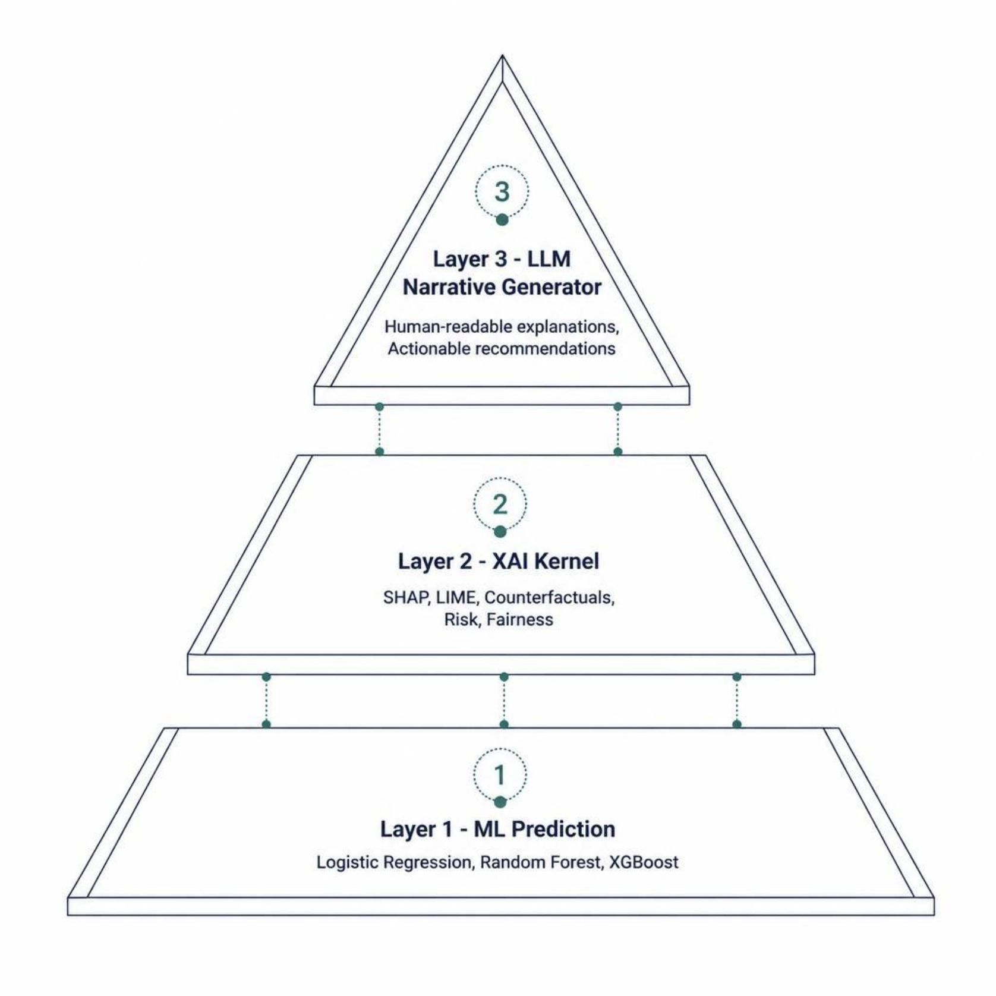

PROPOSED SOLUTION
Introducing DeciXAI
DeciXAI is a hybrid Decision Intelligence framework that unifies Machine Learning, Explainable AI, and LLM-based Natural Language Generation — answering not just what will happen, but why, how confident we are, and what to do next.
Key Capabilities
ML-based prediction with confidence scoring
SHAP/LIME feature attribution
Counterfactual "What-if" analysis
Risk, fairness & robustness evaluation
Natural-language recommendations

Slide 4
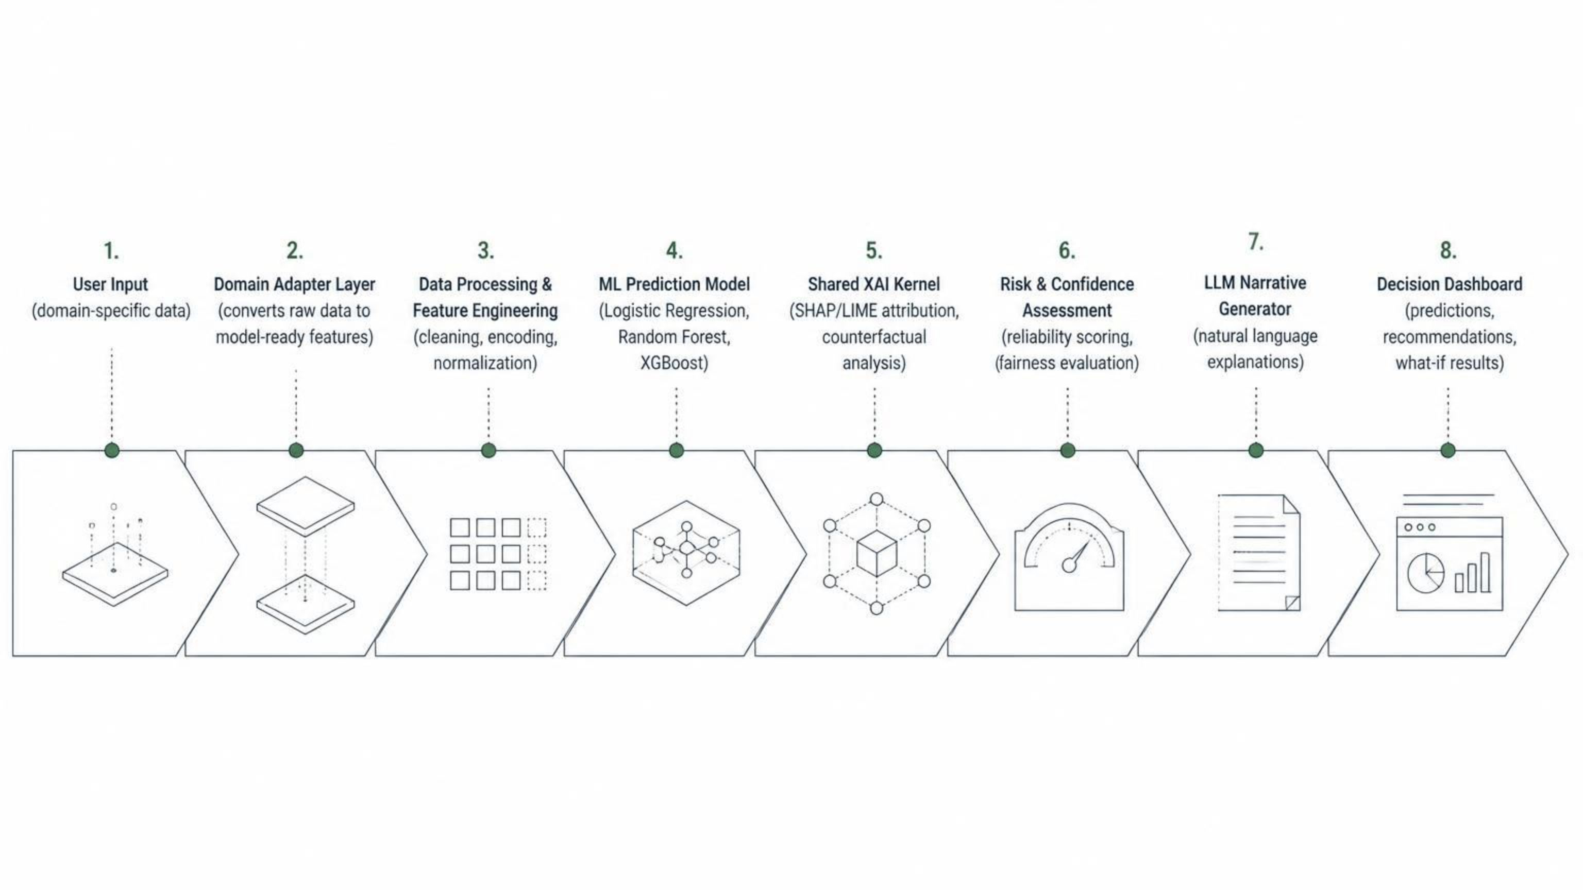
SYSTEM ARCHITECTURE
End-to-End Architecture
DeciXAI's modular pipeline processes raw input through domain adaptation, ML prediction, explainability, and LLM interpretation — delivering a unified decision dashboard.
Design Advantage: The Shared XAI Kernel is reusable across Career, Finance, and Policy domains — only the Domain Adapter Layer changes per use case.

Slide 5
DEVELOPMENT PROCEDURE
A Systematic 10-Step Pipeline
01
02
Problem Identification
Domain Analysis
Identify limitations of black-box systems.
Study decision requirements across domains.
03
04
Data Collection
Data Preprocessing
Gather domain-specific datasets.
Handle missing values, encode, normalize.
05
06
Model Development
XAI Integration
Train and evaluate ML models.
Integrate SHAP/LIME attribution.
07
08
Counterfactual Analysis
Decision Intelligence Layer
Generate "What-if" scenarios.
Combine prediction, explanation, and risk.
09
10
LLM Integration
Dashboard & Evaluation
Convert outputs to natural language.
Present results and evaluate performance.

Slide 6




METHODOLOGIES
Hybrid AI Methodology
DeciXAI combines three complementary approaches — each addressing a distinct gap in traditional AI systems.
Machine Learning
Explainable AI (XAI)
Logistic Regression, Random Forest, and XGBoost provide the core prediction layer with high accuracy and interpretability.
SHAP measures global and local feature contributions. LIME provides instance-level explanations for individual predictions.
Counterfactual Analysis
LLM Narration
Answers: "What must change for the outcome to differ?" Enables actionable what-if scenarios for users.
Technical ML/XAI outputs are translated into human-readable explanations and recommendations via a Large Language Model.

Slide 7

ADVANCED DECISION INTELLIGENCE
Beyond Prediction: Robustness & Fairness
DeciXAI integrates critical evaluation modules to ensure not just accurate, but also reliable, stable, and ethical decision support.
Risk & Confidence Analysis
Robustness Evaluation
Fairness Evaluation
Provides prediction confidence scores and identifies important influencing factors, helping users understand the reliability of each decision.
Checks the stability of predictions under minor changes in input conditions, ensuring consistent outcomes in dynamic environments.
Examines potential biases and disproportionate influence of sensitive factors, promoting equitable and ethical decision-making.

Slide 8

METHODOLOGY JUSTIFICATION
Why Hybrid AI?
A single ML model is insufficient for true decision intelligence. DeciXAI's hybrid approach addresses the multifaceted demands of transparent and actionable AI.
Requirement | Selected Method
Prediction | ML Models
Feature Contribution | SHAP
Local Explanation | LIME
What-if Analysis | Counterfactuals
Reliability | Confidence/Risk Analysis
Stability | Robustness Evaluation
Bias Assessment | Fairness Evaluation
Human-readable Output | LLM
ML + XAI + LLM = Complete Decision Intelligence. This synergy ensures decisions are not just predicted, but also understood, evaluated, and acted upon.

Slide 9

SYSTEMATIC APPROACH
Modular Development & Reusability
DeciXAI employs a modular design, allowing for reusability of its core components across diverse domains, enhancing efficiency and scalability.
Input
Processing
Prediction
Explanation
The Shared XAI Kernel is a key advantage, enabling adaptation to new domains by simply modifying the domain-specific adapter layer.

Slide 10




IMPLEMENTATION
Key Modules of DeciXAI
DeciXAI is composed of specialized modules working in concert to deliver comprehensive decision intelligence.
1
2
Feature Attribution Engine
Counterfactual Engine
Identifies the most influential features driving predictions.
Generates alternative scenarios and improvement possibilities.
3
4
Robustness Evaluation
Fairness Evaluation
Assesses prediction stability under input variations.
Detects potential disparities and biases in model outcomes.
5
6
Natural-Language Narrative Generator
Decision Dashboard
Transforms technical outputs into understandable explanations.
Displays predictions, confidence, risk, explanations, and recommendations.

