Slide 1
Neural network and adaptive system final project part a
Biometric Face verification using Auto encoder
Ritika Chowdri
16230840

Slide 2
Using the at and t database for face recognition
Read the folders and images using cd command.
fn = cd(['C:\Users\Ritika\Desktop\Neural Networks\Ritika_Chowdri_AE\s' num2str(i)]);
Normalized the images between values 0 and 1.
img = double(img)/256;
Created a row cell vector for training and testing images (112 * 92 pixels each).
Train_cell = mat2cell(img,112,92);
Test_cell = mat2cell(img,112,92);

Slide 3
Variations in Learning parameters
For first auto encoder
‘Hidden_layer1’ = 100
'MaxEpochs‘ = 400
For second auto encoder
‘Hidden_layer2’ = 50
‘MaxEpochs’ = 100
'L2WeightRegularization‘ = 0.006 and 0.008
'SparsityRegularization‘ = 1 and 3
'SparsityProportion‘ = 0.15 and 0.30
Total 8 combinations of L2WR, SR and SP

Slide 4
Using different combinations of the learning parameters, Find the best deep representation(s) using stacked auto-encoders that maximize the inter-class to intra-class variations (d’) in -MSE sense.
First we train the sparse auto encoder on the training data without using the labels.
Weights are randomly initialized before training.
The feature vector is generated and passed to the second auto encoder.
Train the softmax layer to classify the 50 dimensional feature vector.
Genuine scores = 600
Imposter scores = 28080

Slide 5
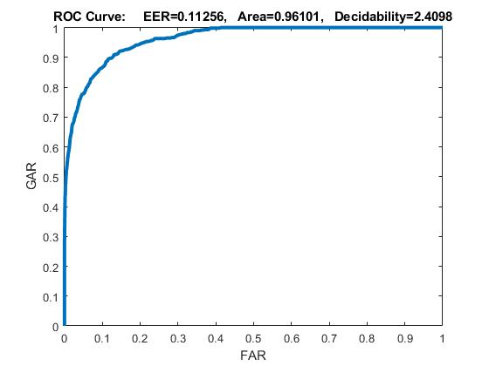

results

Slide 6

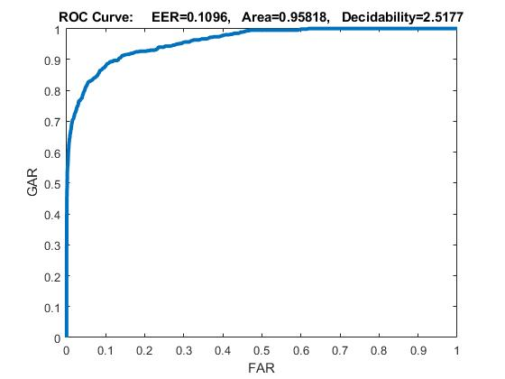
results

Slide 7
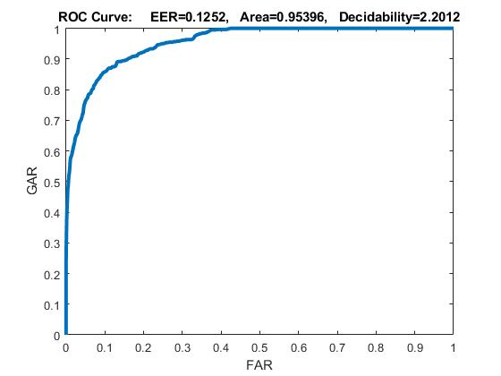
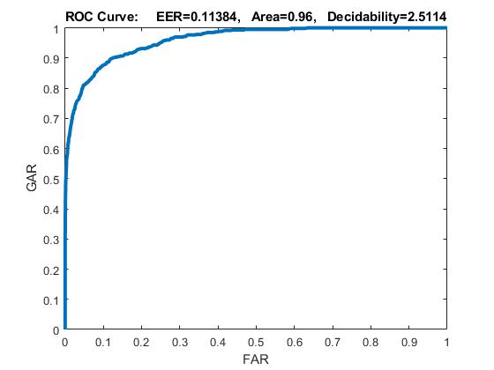
results

Slide 8
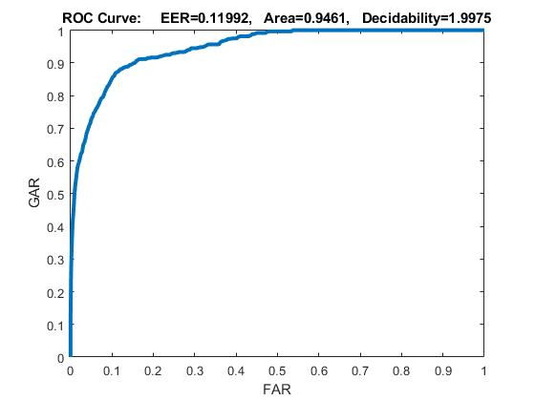

results

Slide 9
Area Under the curve
S. No. | L2WR | SR | SP | AUC
1. | 0.006 | 1 | 0.15 | 0.9610
2. | 0.006 | 1 | 0.30 | 0.9657
3. | 0.006 | 3 | 0.15 | 0.9566
4. | 0.006 | 3 | 0.30 | 0.9581
5. | 0.008 | 1 | 0.15 | 0.9539
6. | 0.008 | 1 | 0.30 | 0.96
7. | 0.008 | 3 | 0.15 | 0.9461
8. | 0.008 | 3 | 0.30 | 0.9597

Slide 10
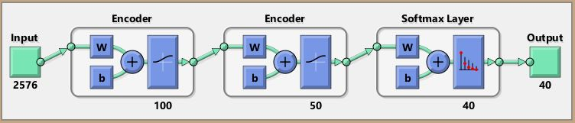
Deepnet using two auto encoder and a softmax layer

Slide 11
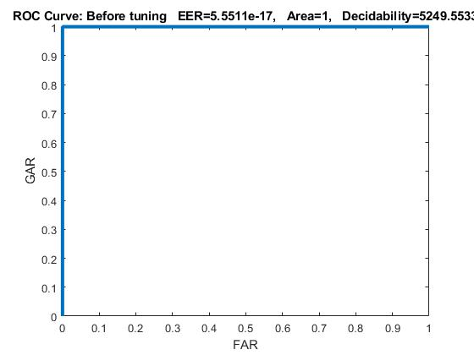
Taking the best configuration we train the neural network and generate roc curves for test images.

Slide 12
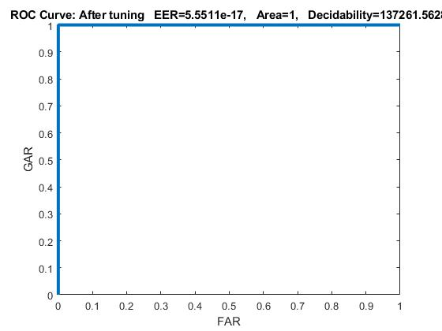
The above result can be further improved by tuning the data by performing back propagation on multilayer network.

Slide 13
conclusions
Normalizing the data is done to improve the performance of the network.
Larger the Sparsity Regularization, worse is the ROC curve.
Larger the Weight Decay, lesser is the effect of Sparsity Regularization on ROC.
Fine tuning the network improves the performance.

Slide 14
Thank you.

