Slide 1
SUPERSTORE SALES
& PROFITABILITY STORY
Turning 9,994 transaction rows into one business decision
SALES
$2.30M
PROFIT
$286.4K
MARGIN
12.47%
QUANTITY
37,873
Central question: Where is growth creating value — and where is revenue hiding weak economics?
Ritika Mishra • Data Analytics Internship • Task 4 | 1/6

Slide 2
1. The business is growing — but growth is uneven
Executive scorecard from the Tableau Sample Superstore dataset
TOTAL SALES
$2.30M
TOTAL PROFIT
$286.4K
PROFIT MARGIN
12.47%
CUSTOMERS
793
ORDERS
9,994
• Sales reached $2.30M, with $286.4K in profit — a healthy but not high-margin retail model.
• 2017 was the strongest sales year at $733.2K, 20.4% above 2016.
• Technology contributes 50.8% of total profit, making it the clearest value engine.
• Furniture generates 32.3% of sales but only 6.4% of profit — the largest profitability gap.
Management implication → Protect Technology momentum while fixing Furniture economics rather than chasing sales volume alone.
Ritika Mishra • Data Analytics Internship • Task 4 | 2/6

Slide 3
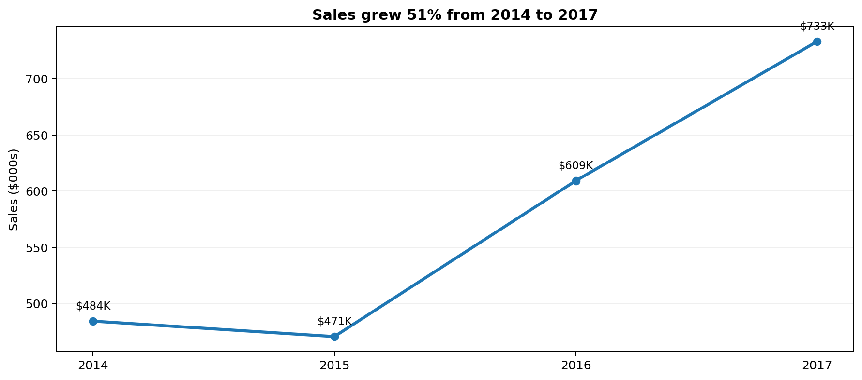
2. Growth accelerated into 2017
Sales increased 51.4% from 2014 to 2017
THE SIGNAL
+20.4%
2017 sales growth vs. 2016
2017 sales: $733.2K
The growth story is real. The next question is whether the mix of products and regions producing that growth is equally attractive.
Ritika Mishra • Data Analytics Internship • Task 4 | 3/6

Slide 4
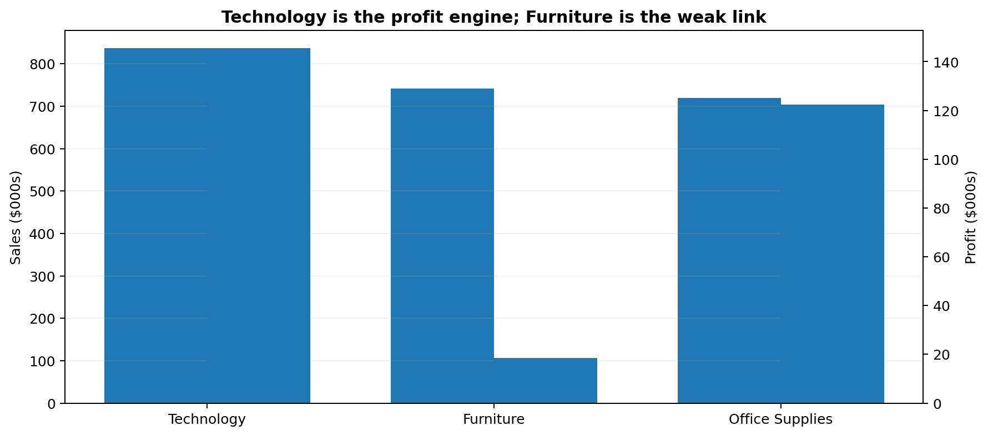
3. Technology pays the bills; Furniture needs intervention
Sales mix and profit contribution tell different stories
• Technology: $836.2K sales and $145.5K profit — 50.8% of total profit.
• Office Supplies: $719.0K sales and $122.5K profit — 42.8% of total profit.
• Furniture: $742.0K sales but only $18.5K profit — just 6.4% of total profit.
• Furniture’s 2.5% category margin is the clearest portfolio weakness.
Action: review Furniture pricing, discounting and sourcing by sub-category.
Ritika Mishra • Data Analytics Internship • Task 4 | 4/6

Slide 5
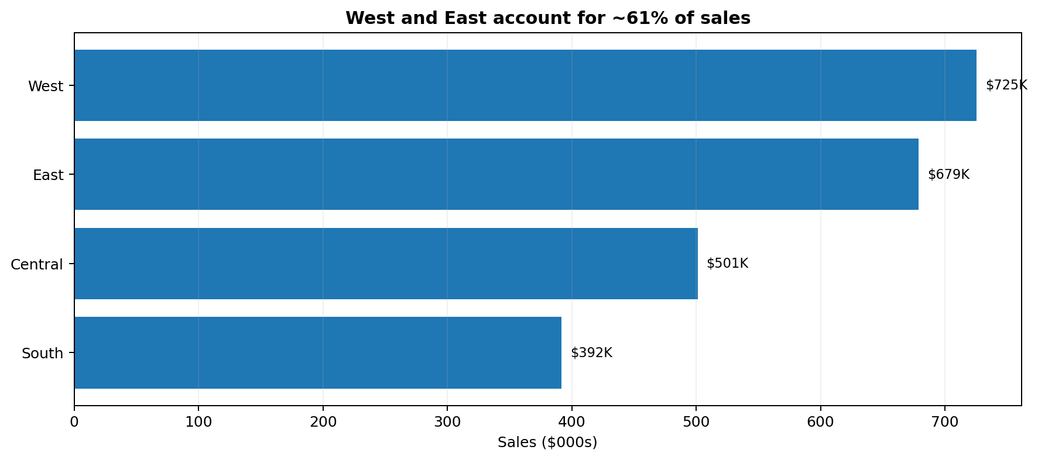
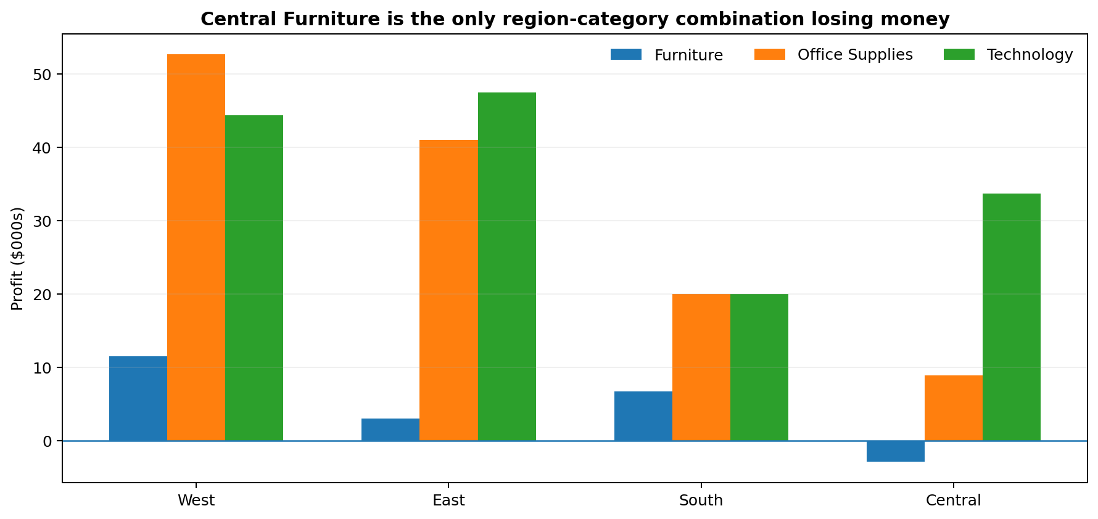
4. West leads; Central has a specific profitability problem
Regional performance becomes more useful when paired with category economics
Key finding: Central Furniture is loss-making (−$2.9K), while West Furniture remains profitable (+$11.5K). This suggests the issue is not simply the category — execution varies by region.
Ritika Mishra • Data Analytics Internship • Task 4 | 5/6

Slide 6
5. From insight to action
A focused 90-day plan for profitable growth
Protect the profit engine
Keep Technology well-stocked; replicate the West/East playbook in underperforming regions.
01
Fix Furniture economics
Audit Furniture by sub-category, discount band, supplier and region; prioritize Central first.
02
Manage discounts by margin
Set approval thresholds for high-discount orders and track profit impact, not just sales lift.
03
Build a decision dashboard
Track Sales, Profit, Margin, Region, Category and Discount with drill-downs for weekly management review.
04
Decision principle: optimize for profitable growth — not revenue growth alone.
Ritika Mishra • Data Analytics Internship • Task 4 | 6/6

