Slide 1
FOUNDATIONS OF SQL

Slide 2
Learning Objectives
Introduction to SQL
2. Retrieving Data with SELECT
3. Using WHERE to Filter data
4. GROUP BY and ORDER BY
5. CASE expressions
6. JOIN operators

Slide 3
Introduction to SQL
What is SQL? Why and Where is SQL used? Why should you learn it?
What are Databases and Relational Databases? And How the tables in a relational database are related?
How to run SQL? And different types of RDBMS and Database management tools

Slide 4
SQL stands for Structured Query Language.
It was developed in the 1970s by IBM researchers Raymond Boyce and Donald Chamberlin.
SQL is a standard language for storing, manipulating and retrieving data in databases.
SQL is designed to interact with databases by defining, querying, updating, and managing the data within them.
SQL is used in Data Analytics, Healthcare, Marketing, Business, Government and Public services, E-commerce, Finance etc.

Slide 5
Why should you learn SQL?
SQL is a lucrative skill that helps in handling large databases and making informed decisions using data analysis.
It can be utilized to open up many career paths in both businesses and IT.
In Businesses it helps in performing analysis, research, making strategies and managerial decisions.
In Technology it helps in data analysis, database management, software management and Project management etc.
It’s a time saving skill that helps in problem solving and data processing.

Slide 6
What are Databases and Relational databases?
Databases are collections of structured information that are stored and accessed electronically.
They make it easy for companies to extract, update, and analyze internal data, often by using SQL or similar languages.
In relational databases, the data is stored in one or more tables and each table can be viewed as a two-dimensional matrix consisting of rows and columns.
rows and columns of the relational database are more referred to as records and fields. The value stored at the intersection of each row and column is sometimes called a Cell.

Slide 7
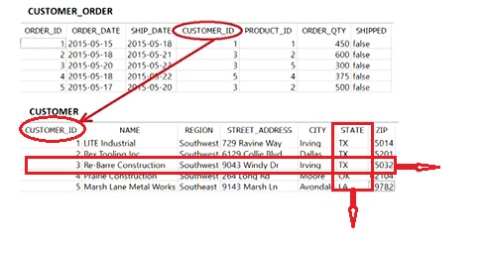
PRIMARY KEY
FOREIGN KEY
ROW
COLUMN

Slide 8
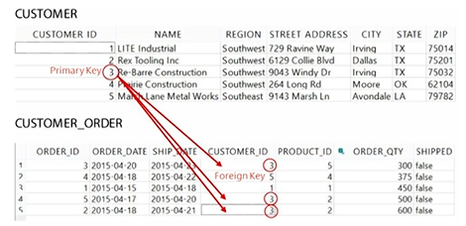

Slide 9
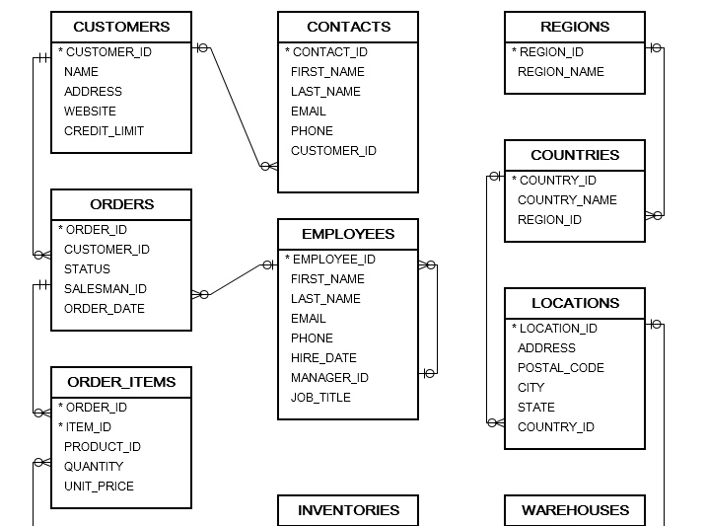

Slide 10
How the tables in a relational database are related?
The tables in a relational database can be related to other tables by values in specific columns.
For eg., a row in a primary table can be related to a column in another table.
If in case each row in primary table is related to one or more rows in the second table, then it is called one to many relationship.
Typically, relationships exist between primary key in one table and the foreign key in another table.
The foreign key is simply one or more columns in a table that refer to a primary key in another table.
Many to many relationship can be broken down into two one to many relationships.

Slide 11
Different types of RDBMS
Microsoft SQL Server
It is a relational database management system. As a database server that stores and retrieves data as requested by other software applications on the same computer or a remote computer using the client-server model. It is used for small to medium sized systems
MySQL
MySQL is one of the most popular, widely used open-source relational database management systems in modern app development. Unlike SQL, MySQL is a piece of software, not a language. MySQL uses SQL as its query language, which allows users to define, manipulate, and retrieve data from the database using standardized syntax. It is owned by Oracle.

Slide 12
SQLite
SQLite is an embedded, server-less relational database management system. It is an in-memory open-source library with zero configuration and does not require any installation. Also, it is very convenient as it’s less than 500kb in size, which is significantly lesser than other database management systems. It operates as a library that applications can directly link to and use.
Postgre SQL
PostgreSQL is a powerful, open-source object-relational database system that uses and extends the SQL language combined with many features that safely store and scale the most complicated data workloads.

Slide 13
Oracle DB
Oracle Database, simply referred to as Oracle DB, is a widely used relational database management system (RDBMS) developed by the Oracle corporation. It is one of the most popular and powerful database systems in the world, known for its scalability, security and reliability.
In this course we are using the SQLite as our Database management System. SQLite is a lightweight database and can be found on all our day-to-day appliances like different Smartphones, Smartwatches, Smart TVs, Car infotainment systems, Digital cameras, home security systems and ATMs. It is also great for training SQL because we don’t have the need to set up a server and do the configuration process

Slide 14
Basic Math Operators in SQL
S.no | Operator | Operation | Example
1 | + | Adds two numbers | LAB1_POINTS + LAB2_POINTS
2 | - | Subtracts two number | TOTAL_POINTS – GRADED_POINTS
3 | * | Multiplies two numbers | PRICE* TAX
4 | / | Divides two numbers | GRADED-POINTS/ TOTAL_POINTS
5 | % | Divides two numbers but returns the remainders | GRADED_POINTS% TOTAL_POINTS

Slide 15
Github Codespaces
A codespace is a development environment that's hosted in the cloud. You can customize your project for GitHub Codespaces by committing configuration files to your repository (often known as Configuration-as-Code), which creates a repeatable codespace configuration for all users of your project.

Slide 16
Instructions for the workshop
Please ensure you have a working email to create a free account with Github at https://github.com/signup
Now ensure you click on the link
https://github.com/The-CEAS-Library/Foundations-of-SQL

Slide 17
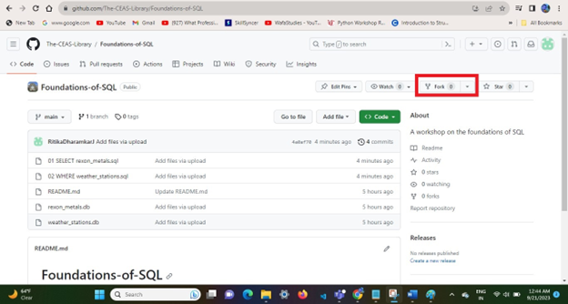
You will be redirected to this page. Where you need to click on fork.

Slide 18
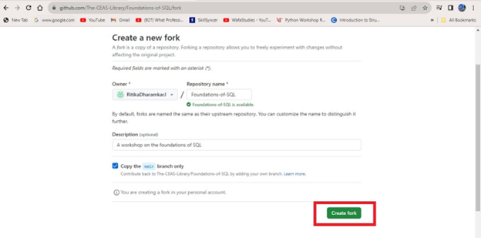
In the next page, click on create fork. [You can also edit the repository name to your liking]

Slide 19
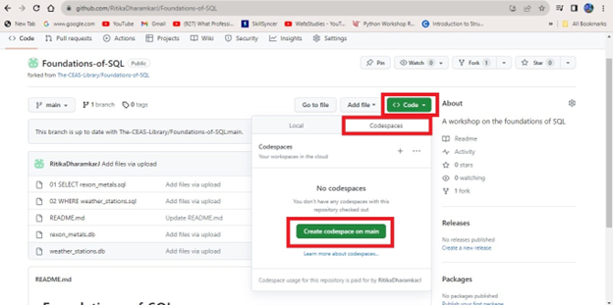
You will be taken to this page below where you need to click on Code << Codespaces << Create codespaces on main

Slide 20
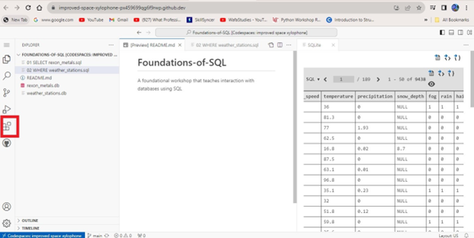
Post creating the codespaces on main. The codespaces will be created. Post the creation of the new page. Ensure that you click on the extensions tab on the extreme left as shown in the picture below. [This icon has four boxes symbol]

Slide 21
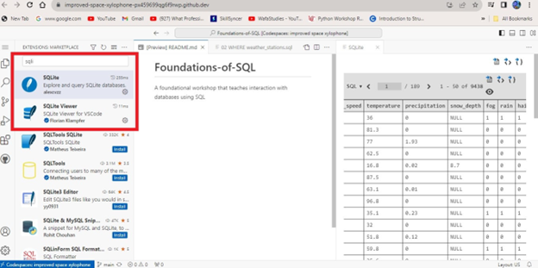
In the search bar that pops up. You can search for sqlite term. And click on install for the two extensions – SQLite by alexcvzz and SQLite Viewer by Florian Klampfer, just like in the screenshot below. That’s all and you are good to go.

Slide 22
Now you can go ahead navigate through the entire codespace environment.
On top left side you will have documents section where all files will be present.
You can open any files inside, you will be prompted to choose SQLite viewer by Florain Klampfer to view the files.
There are two databases that we have, You can choose to view these databases in the text editor on the right-hand side.
To run the code, open any of the two files that have code in them, select the code which you want to run. Now left click the code and choose "Run selected Query" option. It will prompt you to select which database you want to choose at first. You can select the relevant database. The output shows on the left side text editor.

