Slide 1
Clock Synchronization in Sensor Networks(Distributed Systems)
Ritika Kumari
Vinit Kamboj

Slide 2
Motivation
Synchronizing time is essential for many applications
Coordination of wake-up and sleeping times (energy efficiency)
TDMA schedules
Ordering of collected sensor data/events
Co-operation of multiple sensor nodes
Estimation of position information (e.g. shooter detection)
Goals of clock synchronization
Compensate offset between clocks
Compensate drift between clocks
Agreement in reading two clocks
Localization
Sensing
Duty-Cycling
TDMA
Time Synchronization

Slide 3
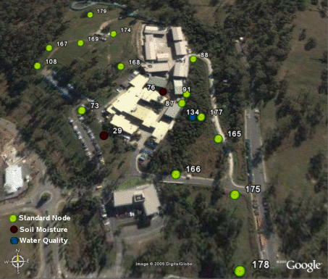
Wireless Sensor Network (WSN)
Network using many wireless sensors
Dropped from a plane to monitor area
Random placement
Sensors build hierarchical network once deployed

Slide 4
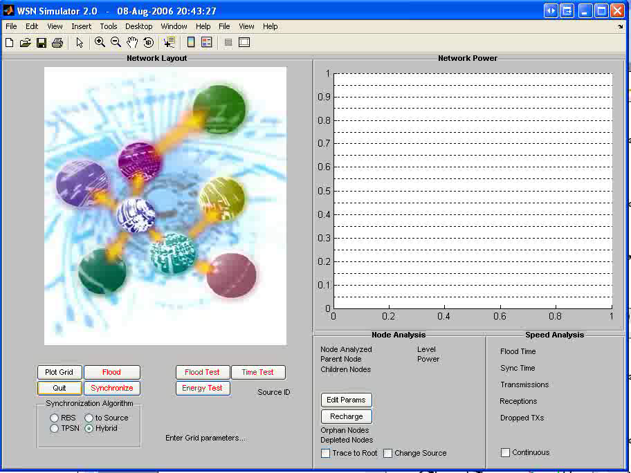
Network Flooding
Broadcast packet from root node
If packet received for the first time
Set Parent on Tree = Source of message
Change Source field to MyId
Increment HopCount field
Rebroadcast packet

Slide 5
Problem with unsynchronized clocks
In distributed banking system, if timing and ordering of financial transactions are not tracked, it may raise inconsistent state in the system.
A distributed online reservation system in which the last available seat may get booked from multiple nodes if their local clocks are not synchronized.
There is a need to transmit a message from one node to another at any time. This will become difficult if sender and receiver clocks are not synchronized with each other.

Slide 6
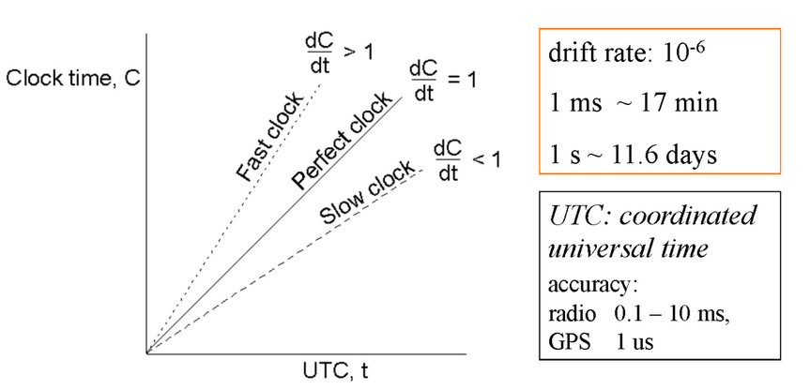
Clock Synchronization Problem
Relation between clock time and UTC when clocks ticks at different rates.

Slide 7
Reasons for Delay in Synchronization
Communication Link Failure
Fault Tolerance
Propagation Time
Non-Receipt of Acknowledgement
The Bandwidth of Communication Link

Slide 8
Wireless Sensors
Physically small sensing unit
Battery
Processor
Slow
Drift
Radio/antenna
Sensor modules
Covert
Short battery life

Slide 9
Applications
Temperature
Fire detection
Brake usage
Humidity
Flood detection
Pressure
Object tracking
Animal movement and migrations
Vehicle tracking
Noise levels
Search and rescue efforts
Locating a sniper’s position
Contamination levels
Monitoring pollution levels
Chemical/biological agent detection
Mechanical stress on supporting structures

Slide 10
Existing Synchronization Solutions
Network Time Protocol (NTP)
Computationally infeasible for wireless sensors
Reference Broadcast Synchronization (RBS)
Receiver-receiver synchronization
Timing-sync Protocol for Sensor Networks (TPSN)
Transmitter-receiver synchronization
Hybrid Synchronization

Slide 11
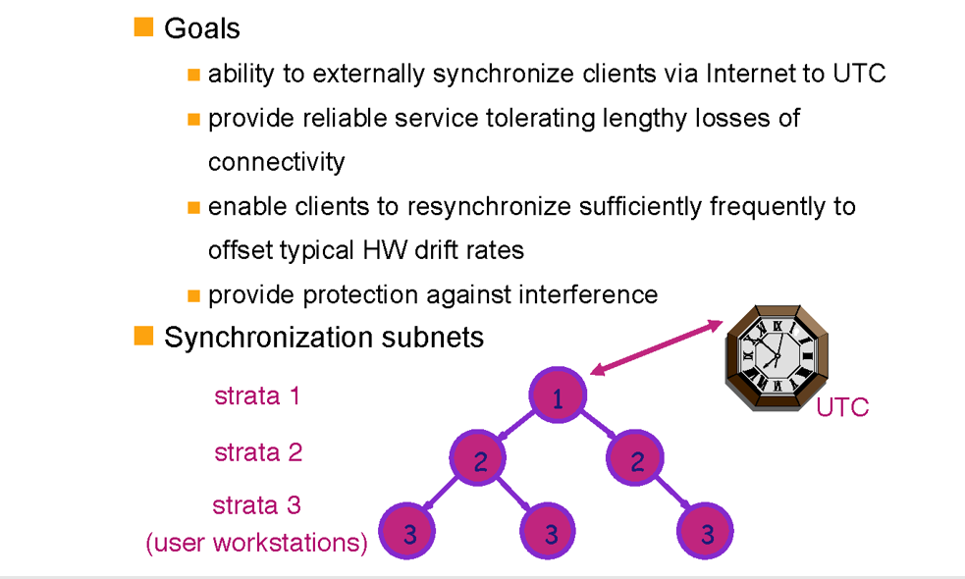
Network Time Protocol

Slide 12
NTP Modes
NTP Basic Idea
Layered client-server architecture, based on UDP message passing
Synchronization at clients with higher strata number less accurate due to increased latency to strata1 time server
Failure robustness: If a strata 1 server fails, it may become a strata 2 server that is being synchronized though another strata 1 server.
Multicast:
One computer periodically multicasts time info to all other computers on network
These adjust clock assuming a very small transmission delay
Only suitable for high speed LAN’s; yield’s low but usually acceptable sync.
Procedure-call:
Server accepts request from clients
Applicable where higher accuracy is needed ,or where multicast is not supported by the network’s hard-and-software
Symmetric:
Used where high accuracy is needed.

Slide 13
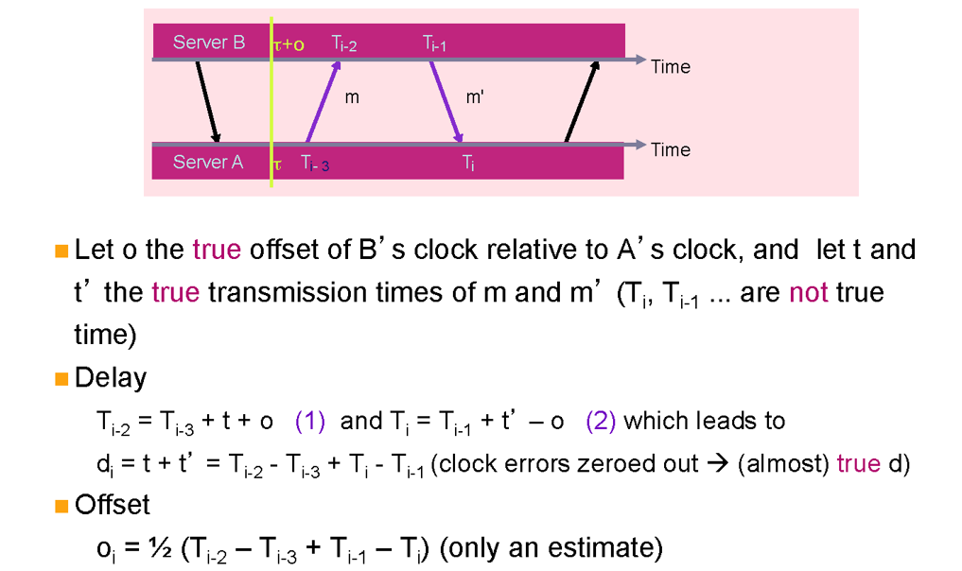
NTP Delay and Offset

Slide 14
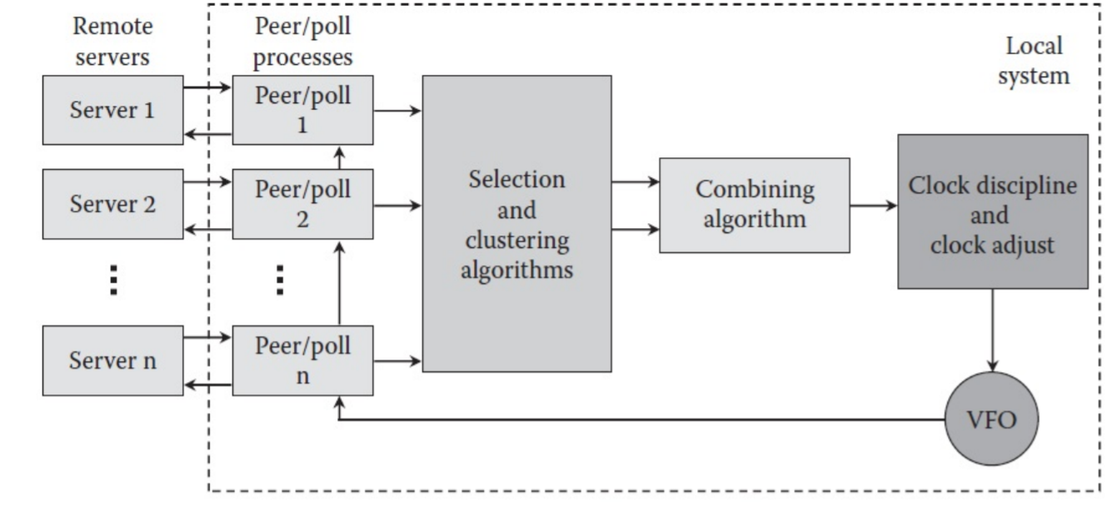
NTP Implementation model

Slide 15
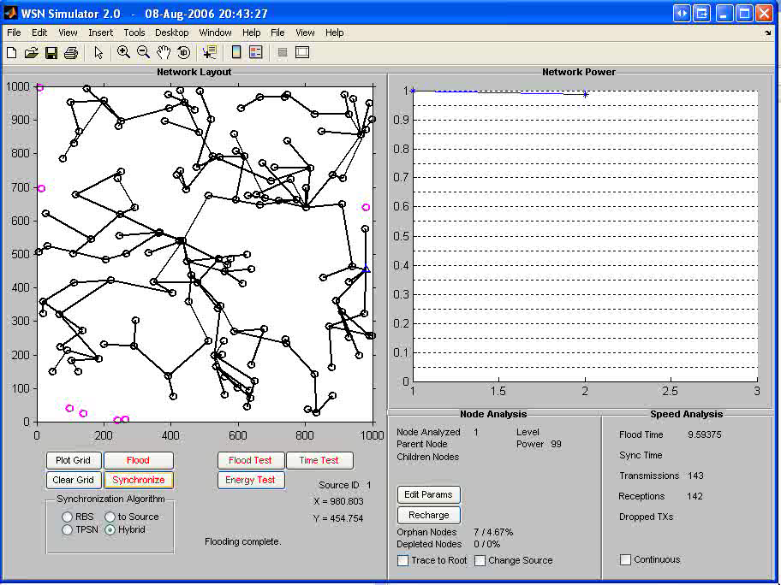
Reference Broadcast Synchronization
Receiver-to-receiver synchronization
Two stages
Transmitter broadcasts clock time
Receivers exchange observations

Slide 16
RBS Energy Usage
Given n receivers:
Transmissions grow as O(n)
Receptions grow as O(n²)

Slide 17
Timing-sync Protocol for Sensor Networks
Features
Sender-receiver bidirectional mechanism
Two phases of operation:
Level discovery and synchronization
Level discovery phase
Root node initiates level discovery
A node on receiving its level broadcasts it
Any node receiving multiple level packets takes the first one and ignores the others
Any node not receiving a level packet times out and sends a request for level packet

Slide 18

TPSN Model – Synchronization Phase
Each node (A) broadcasts synchronization_pulse
Timestamped at T1
Node B receives pulse at T2, broadcasts ack at T3
Node A receives ack at T4
Δ is clock drift
d is propagation delay

Slide 19
TPSN Energy Usage
Given n receivers:
Transmissions and receptions grow as O(n)
Large energy savings over RBS for large n
Less efficient for small n

Slide 20
Uncertainties
Sender uncertainty
RBS removes it completely
Minimized in TPSN by timestamping at MAC layer
Propagation/receiver uncertainties, and relative local clock drifts
TPSN outperforms RBS by factor of 2

Slide 21
Accuracy Comparison
 | TPSN | RBS
Avg error (μs) | 16.9 | 29.1
Worst-case error (μs) | 44 | 93
Best-case error (μs) | 0 | 0
% time error < avg | 64 | 53

Slide 22
Hybrid Synchronization
Complete system for WSN operation
Three stages
Build hierarchical tree with flooding
Transmitters know how many receivers are connected
Periodically synchronize sensors
Re-elect new root when current one dies

Slide 23
Hybrid Synchronization
RBS best for small n, TPSN best for large n
Calculate optimal cutoff value to choose RBS or TPSN algorithm (receiver_threshold)
Transmissions and receptions draw different current
where α is reception-to-transmission current ratio

Slide 24
Hybrid Synchronization Algorithm
If num_receivers < receiver_threshold
Transmitter broadcasts sync_request
For each receiver
Record local time of reception for sync_request
Broadcast observation_packet
Receive observation_packet from other receivers
Else
Transmitter broadcasts sync_request
For each receiver
Record local time of reception for sync_request
Broadcast ack_packet to transmitter with local time
Equate energies of both RBS and TPSN
Solve equation to find receiver_threshold

Slide 25
Sensor Synchronization Simulations
Verify the hybrid synchronization algorithm works with several sensor architectures
Run hybrid usRun RBS, TPSN, hybrid using optimal receiver_threshold
ing non-optimal receiver_threshold values
Change sensor architecture
Used 500 sensors per network

Slide 26
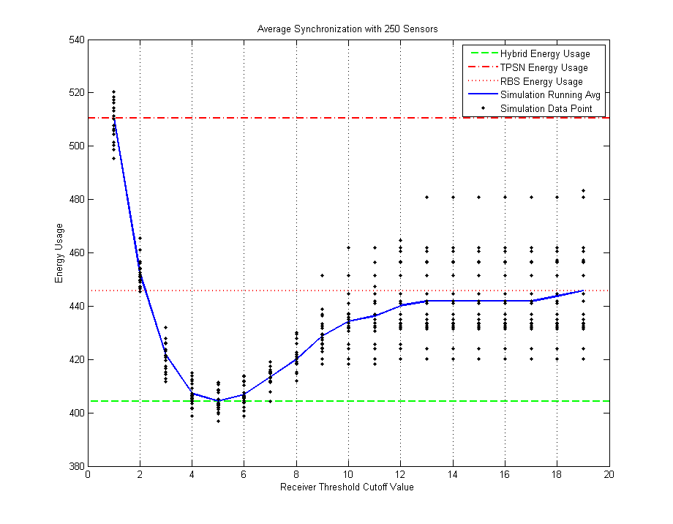
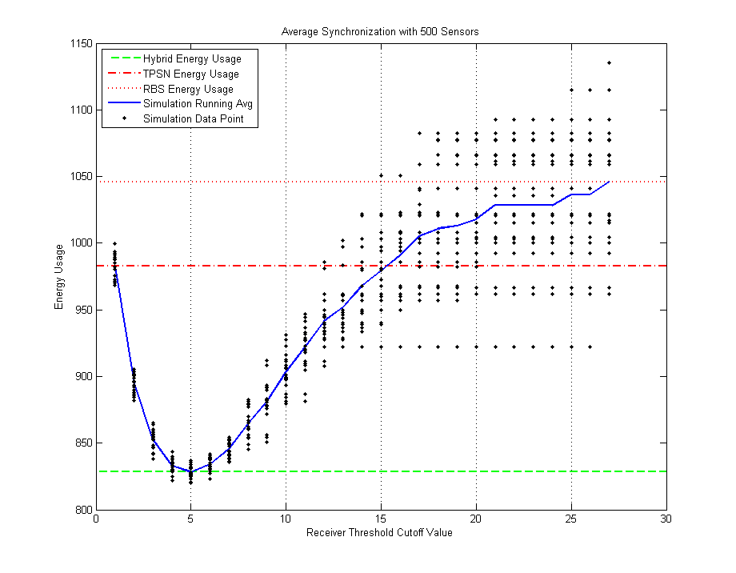
Synchronization Simulations for Variable Network Size
Synchronization Simulations for 250 Sensors
Synchronization Simulations for 500 Sensors

Slide 27
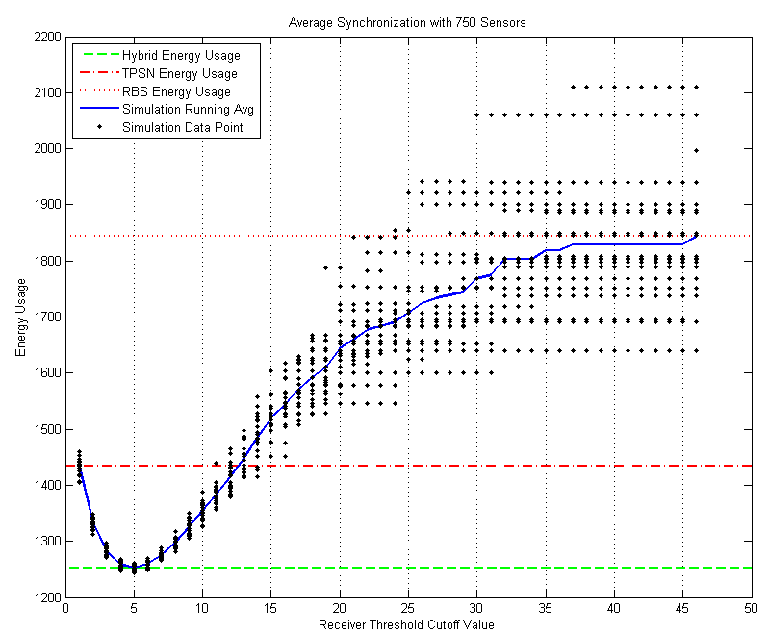
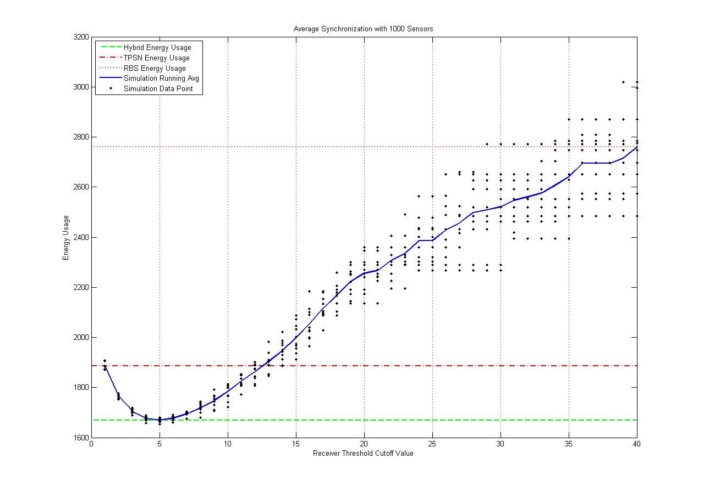
Synchronization Simulations for Variable Network Size
Synchronization Simulations for 750 Sensors
Synchronization Simulations for 1000 Sensors

Slide 28
Network Size Simulations
Sensors | 250 | 500 | 750 | 1000
RBS | 446 | 1046 | 1844 | 2762
TPSN | 511 | 983 | 1434 | 1885
Hybrid | 404 | 828 | 1253 | 1672
RBS Savings | 9.29% | 20.79% | 32.04% | 39.46%
TPSN Savings | 20.80% | 15.73% | 12.65% | 11.28%
Hybrid saves up to 50% over RBS, up to 20% over TPSN
Hybrid is still more efficient in networks favoring either RBS or TPSN

Slide 29
Conclusions:
Synchronization is necessary for most sensor networks to operate effectively
Both TPSN and RBS synchronize sensor clocks locate origin of gunshot blast
Neither TPSN nor RBS are designed for low energy usage
Hybrid algorithm adapts to any size network and saves energy over other algorithms

Slide 30
References
J. Elion, 1. Gird, and D. Estrin, "Fine-Grained Time Synchronization using Reference Broodcaiti,". Proc. 5th Symp. Op. Sys. Design and Implemenfotion, Barton, MA, DR. 2002.
K. Remer, 'Time Synchronization in Ad Hoc Networks," ACM MobiHcx '01, Lon Bwch, CA, Oct. 2001
Bell communications Research, “Digital Synchronization network plan,” Tech. Advisory TA-NPG000436, Nov. 1, 1986.
Defense Advanced Research Projects Agency, Internet Control Message Protocol, DARPA Network Working Group Rep. RFC-792, U.S.C. Inform. Sci. Inst., Sept. 1981.
I.F. Akyildiz, W. Su, Y. Sankarasubramanian, and E. Cayirci. A Survey on Sensor Networks. IEEE Communications Magazine, 40(8):102–114, Aug. 2002.
K. Arvind. Probabilistic Clock Synchronization in Distributed Systems. IEEE Transactions on Parallel and Distributed Systems, 5(5):474–487, May 1994.

