Slide 1


AUTOMATIC CLOTHS HANGING STAND
BY TEAM DIVINE HARMONY

Slide 2
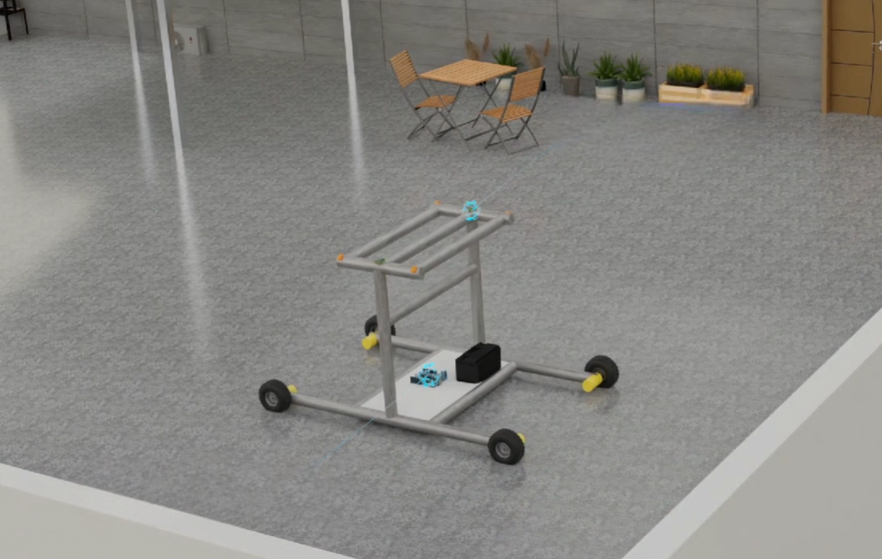
INTRODUCTION
We created an automatic cloth hanging stand that can move from one location to another based on the weather conditions in that area, protecting cloths. It also has the ability to track sunlight and ensure that cloths dry faster, thereby improving cloth health.

Slide 3

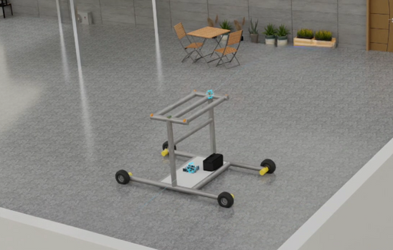

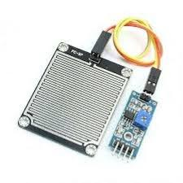


WORKING
Basically our model consist of Rain sensor and sunlight sensors combined together that work in sync to provide the maximum utility from the stand.
Stand is stationary
2.Rain starts
3.Rain sensors detect
water
4.Command is given
to the device to
start moving
5.It reaches the designate
spot, protecting the cloth

Slide 4

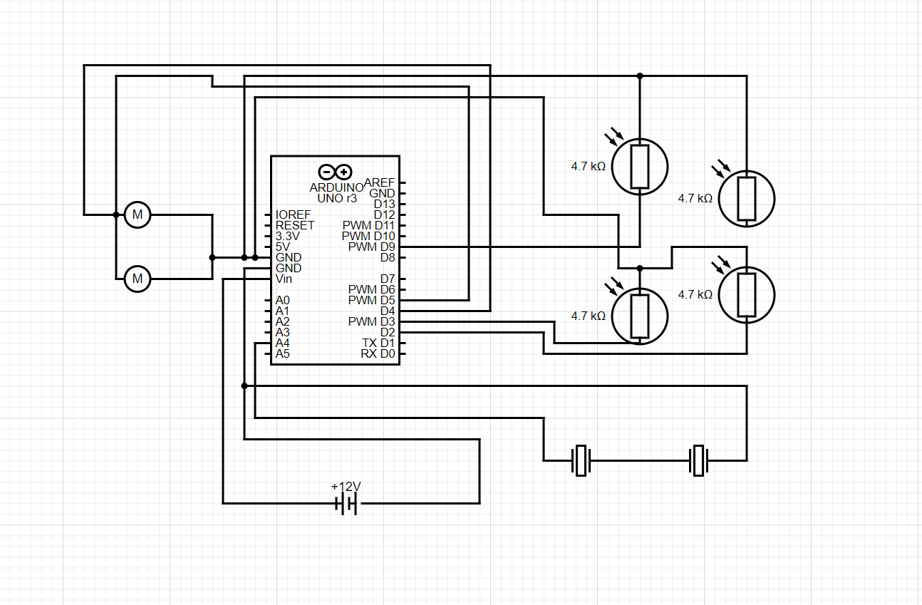
CIRCUIT DIAGRAM
Motor
LDR Sensors
Rain sensor

Slide 5
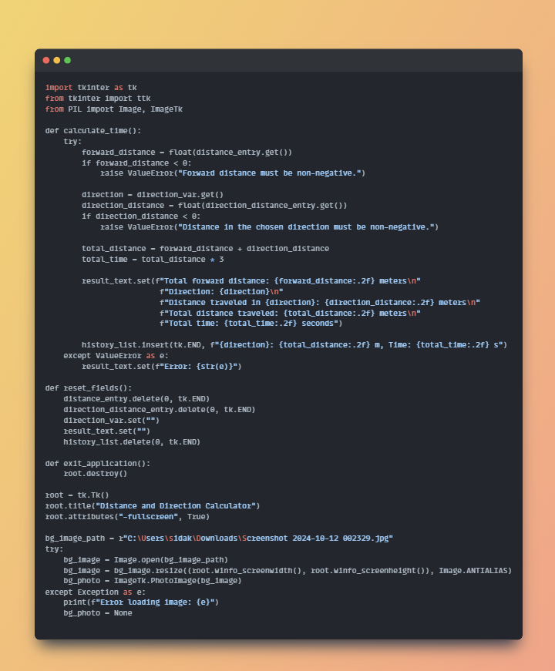
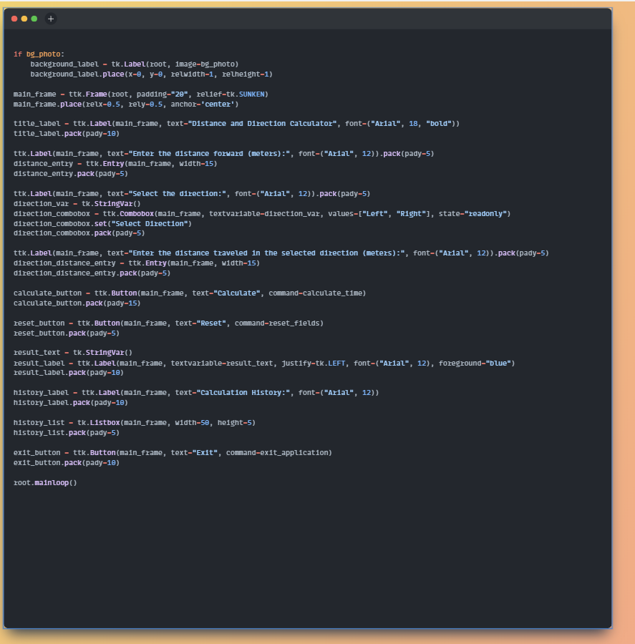
SOURCE CODE

Slide 6

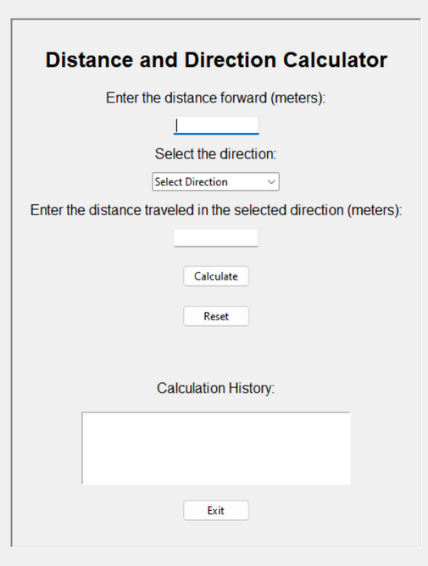
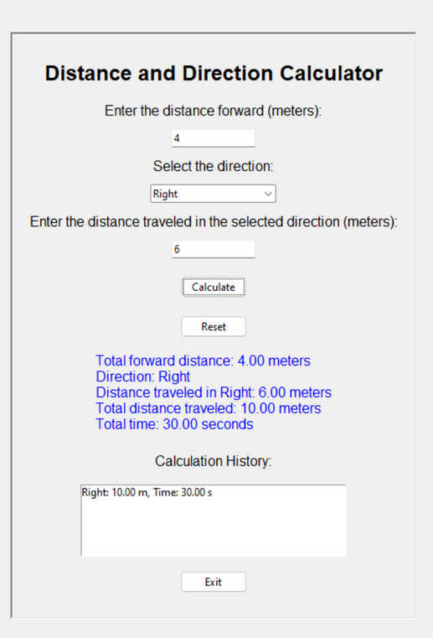
CONNECTIVITY
We have made an app to connect the device and program it according to the rooftop conditions and provide the path for the stand to move

Slide 7

ADVANTAGES
Advantages of cloth hanging stand are:
1.People acquire to save there time by no need to do some work (pickup there cloths) twicely.
2.Dirty clothes no need to wash for many times if the rain is falling down.
3.It is great for working professionals who are busy and also for aged people , as this minor detail might easily be overlooked by them.

Slide 8
THANK YOU

