Slide 1
PragatiDhara App Pitch Deck
Innovative solutions driving progress and growth
Notes:
---

Slide 2
Vision & Mission
Notes:
---
This slide references information from the following file: https://infosystechnologies-my.sharepoint.com/personal/ritika_mathur01_ad_infosys_com/Documents/Microsoft%20Copilot%20Chat%20Files/GreenFlow%20%E2%80%93%20Business%20Plan.md
Transforming Urban Mobility in India

Slide 3
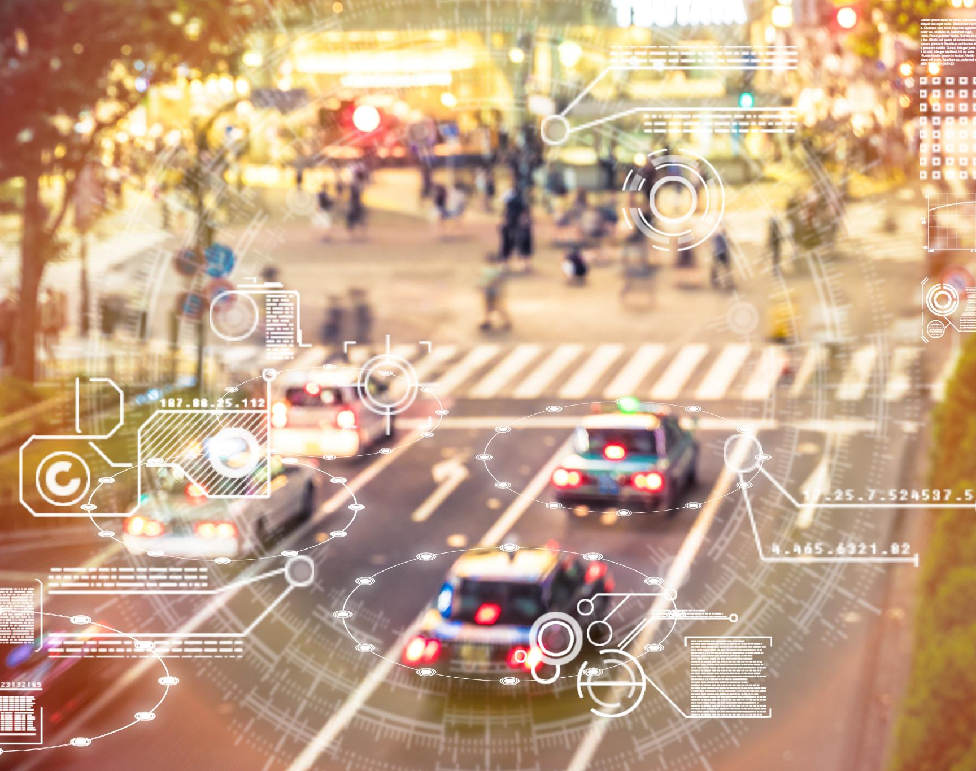
Transforming Urban Mobility in India
Citizen-Driven Traffic Management
  Citizens move from passive drivers to active data contributors, sharing real-time telemetry to directly alleviate congestion and emissions.
Integration of Green AI Models
  PragatiDhara leverages green AI technologies to optimize urban traffic for sustainability and smarter mobility solutions.
  Green AI (Federated & Low-Carbon) delivers real-time route optimization, ensuring every decision is smarter, faster, and cleaner.
Alignment with National Sustainability Goals
  Directly supports India’s Smart City Mission and Green Credit Program, making us a strategic partner in achieving national sustainability targets.
  Behavioral Change and Environmental Stewardship
  We foster a culture of Environmental Stewardship by rewarding eco-conscious choices, turning commuters into urban environmentalists.
Notes:
---
This slide references information from the following file: https://infosystechnologies-my.sharepoint.com/personal/ritika_mathur01_ad_infosys_com/Documents/Microsoft%20Copilot%20Chat%20Files/GreenFlow%20%E2%80%93%20Business%20Plan.md
The PragatiDhara app envisions a future where Indian cities are cleaner, smarter, and more sustainable through citizen-driven traffic management. Its mission is to build an intelligent mobility ecosystem that empowers every commuter to contribute to reducing congestion and emissions. By leveraging real-time data from users and integrating green AI models, PragatiDhara aims to revolutionize urban transportation. The platform encourages active participation from citizens, turning them into contributors rather than passive users. This vision aligns with national sustainability goals and supports initiatives like the Smart City Mission and Green Credit Program. The mission is not only technological but also behavioral—fostering a culture of responsible commuting and environmental stewardship.

Slide 4
Solution Architecture and Design
Notes:
---
This slide references information from the following file: https://infosystechnologies-my.sharepoint.com/personal/ritika_mathur01_ad_infosys_com/Documents/Microsoft%20Copilot%20Chat%20Files/GreenFlow%20%E2%80%93%20Business%20Plan.md
Crowdsourced AI-Powered Traffic Optimization

Slide 5
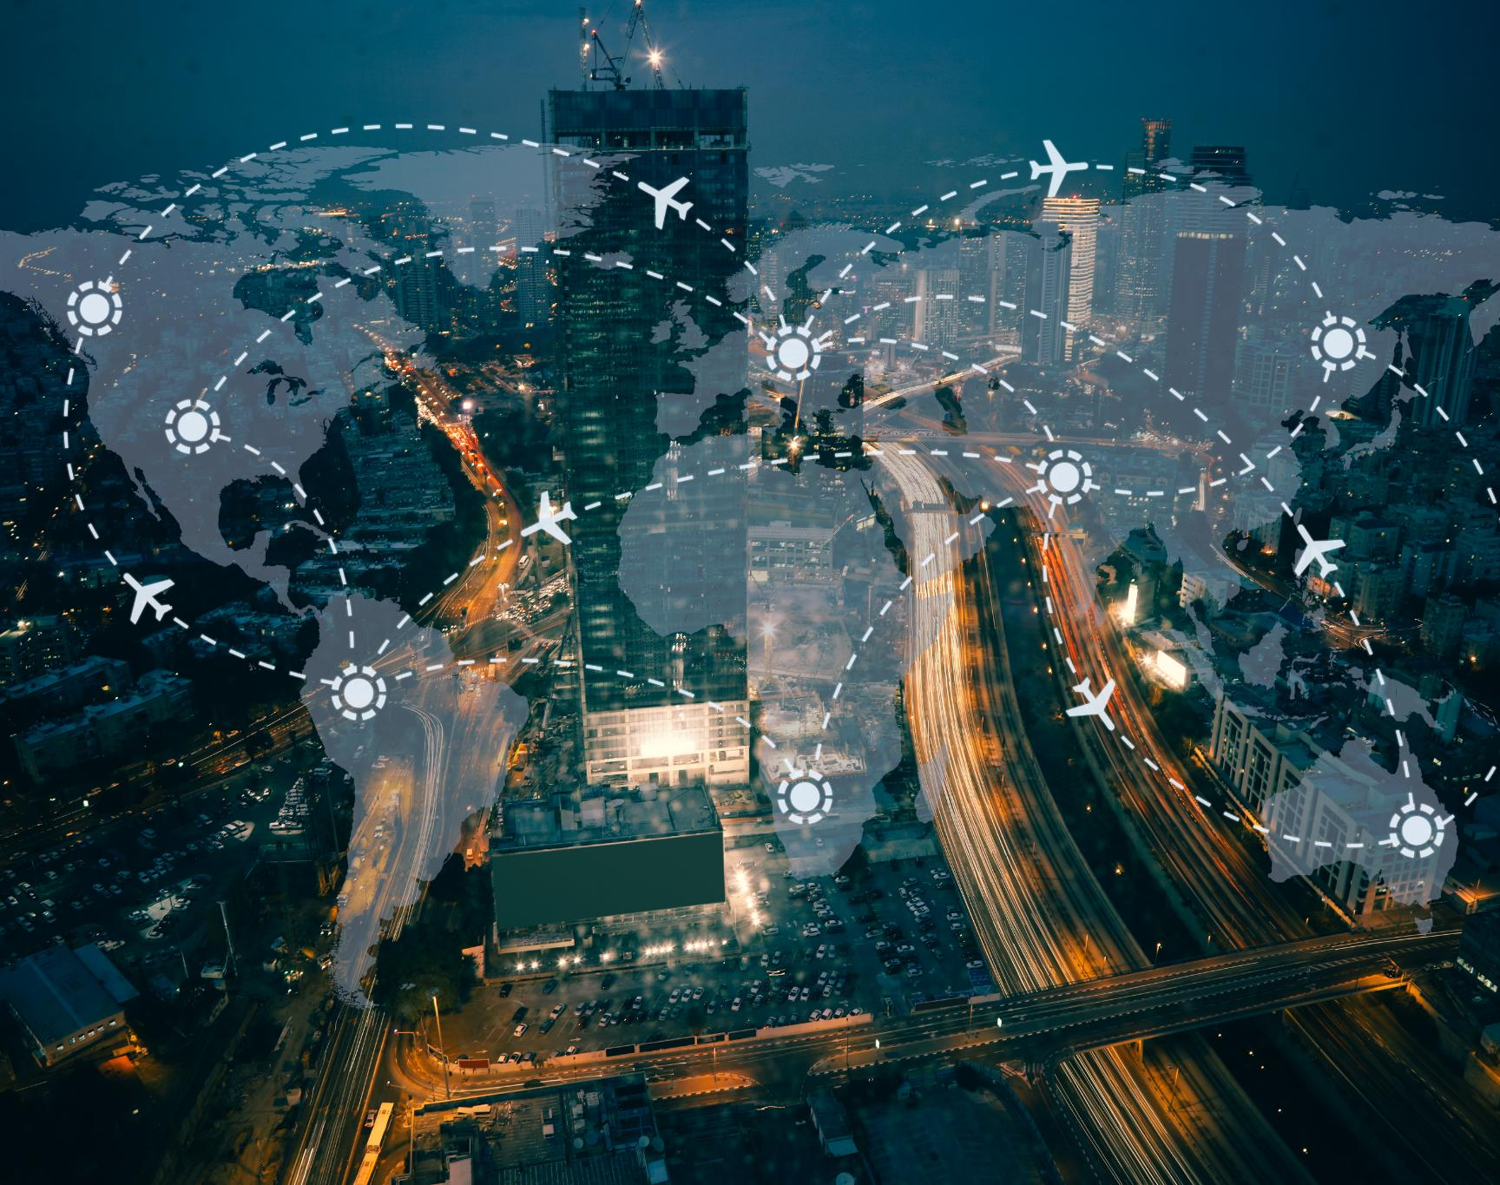
CrowdSourced Intelligence Meets Scalable AI
Cloud-Native Modular Framework
Dynamic Scalability: Utilizes a modern, secure Cloud-Native architecture for elastic scaling, managing millions of dynamic data streams simultaneously.
Modular API Design: Enables rapid integration and deployment across various Smart City systems and partner platforms.
Real-Time Data Collection
Instant Traffic Visibility: Collects precise, real-time mobile telemetry from commuters, transforming every phone into a dynamic sensor.
Proactive Prediction: Moves beyond simple reporting to predict congestion minutes in advance, enabling true proactive traffic optimization
Privacy-Preserving Federated Learning
Privacy by Design: Uses cutting-edge Federated Learning techniques to analyze patterns without ever centralizing raw user data.
Secure Pattern Recognition: Ensures user privacy is absolutely guaranteed while generating highly accurate models for dynamic re-routing.
Interoperability & Accessibility
Seamless Integration: Full API support ensures seamless connectivity with all major navigation and city management systems.
Inclusive User Experience: Features a Vernacular AI Voice Interface to ensure accessibility and ease of use for diverse users across India.
Notes:
---
This slide references information from the following file: https://infosystechnologies-my.sharepoint.com/personal/ritika_mathur01_ad_infosys_com/Documents/Microsoft%20Copilot%20Chat%20Files/GreenFlow%20%E2%80%93%20Business%20Plan.md
PragatiDhara’s architecture is built on a cloud-native, modular framework that enables scalable and secure traffic optimization. The solution collects real-time traffic data directly from commuters, using mobile telemetry to predict congestion and suggest eco-friendly routes. It employs federated learning to ensure user privacy while analyzing patterns for dynamic rerouting. The system integrates REST and WebSocket APIs for seamless connectivity with smart city infrastructure, ride-hailing platforms, and navigation services. This design allows for interoperability and rapid deployment across urban centers. The architecture also supports vernacular AI voice interfaces, making it accessible to a diverse user base. By combining citizen-sourced data with advanced AI, PragatiDhara creates a responsive and adaptive traffic management system.

Slide 6



High Level Solution Design
PragatiDhara Middleware
External Systems
PragatiDhara App
Uses own Mobile device
Rewards Mgmt.
Partners Integration for Reward Encashment
customer
Application Gateway
Uses own Mobile device
Vehicle Mgmt.
External Routes APIs & Traffic Congestion APIs
customer
AI Route prediction & Smart Decision Engine
Uses own Mobile device
External Rates APIs
(Fairs. Petrol, Charging etc.)
Security
Authorization
Streaming Layer
Cust. Real time data Processing
customer
Vahan APIs
(Vehicle Info / PUC Data.)
Incident / Breakdown Reporting
Travel enroute and Congestion Data
Web Access
Common Utilities & Data Access Layer
Middleware Deployment in less Co2 Emission Region or Data Centre
Programming Languages – GoLang for API Services Layer
AI Model – TensorFlow Lite or Equivalent Sustainable model for Predication
Streaming – Apache Kafka or Equivalent
customer
PragatiDhara Persistent Layer
Customer
Data
Rewards
Data
Additional Model Input Data
Vehicle
Data
Incident Reporting data
Notes:
---
This slide references information from the following file: https://infosystechnologies-my.sharepoint.com/personal/ritika_mathur01_ad_infosys_com/Documents/Microsoft%20Copilot%20Chat%20Files/GreenFlow%20%E2%80%93%20Business%20Plan.md
PragatiDhara’s architecture is built on a cloud-native, modular framework that enables scalable and secure traffic optimization. The solution collects real-time traffic data directly from commuters, using mobile telemetry to predict congestion and suggest eco-friendly routes. It employs federated learning to ensure user privacy while analyzing patterns for dynamic rerouting. The system integrates REST and WebSocket APIs for seamless connectivity with smart city infrastructure, ride-hailing platforms, and navigation services. This design allows for interoperability and rapid deployment across urban centers. The architecture also supports vernacular AI voice interfaces, making it accessible to a diverse user base. By combining citizen-sourced data with advanced AI, PragatiDhara creates a responsive and adaptive traffic management system.

Slide 7
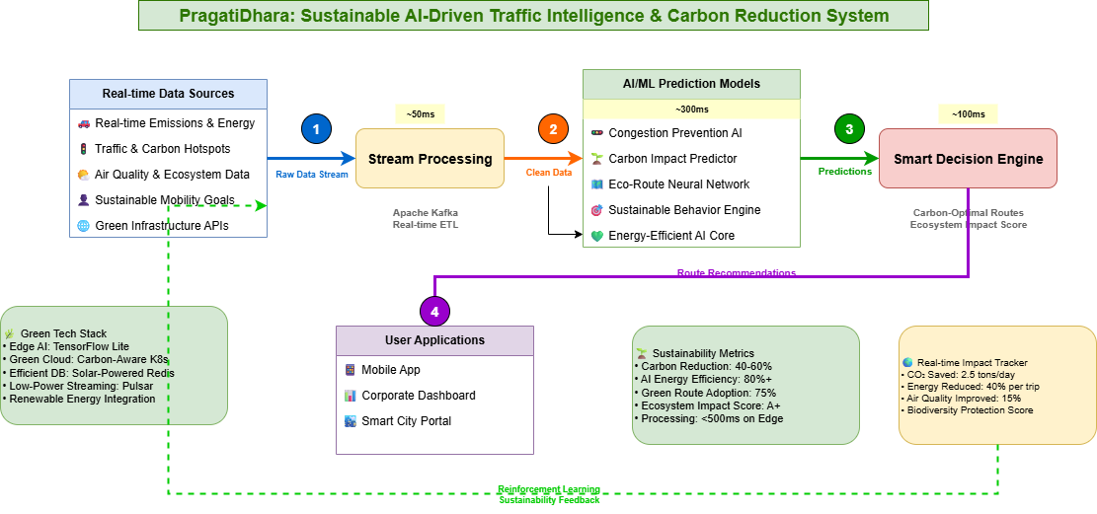
AI Prediction and Smart Decision Engine flow
Notes:
---
This slide references information from the following file: https://infosystechnologies-my.sharepoint.com/personal/ritika_mathur01_ad_infosys_com/Documents/Microsoft%20Copilot%20Chat%20Files/GreenFlow%20%E2%80%93%20Business%20Plan.md
PragatiDhara’s architecture is built on a cloud-native, modular framework that enables scalable and secure traffic optimization. The solution collects real-time traffic data directly from commuters, using mobile telemetry to predict congestion and suggest eco-friendly routes. It employs federated learning to ensure user privacy while analyzing patterns for dynamic rerouting. The system integrates REST and WebSocket APIs for seamless connectivity with smart city infrastructure, ride-hailing platforms, and navigation services. This design allows for interoperability and rapid deployment across urban centers. The architecture also supports vernacular AI voice interfaces, making it accessible to a diverse user base. By combining citizen-sourced data with advanced AI, PragatiDhara creates a responsive and adaptive traffic management system.

Slide 8
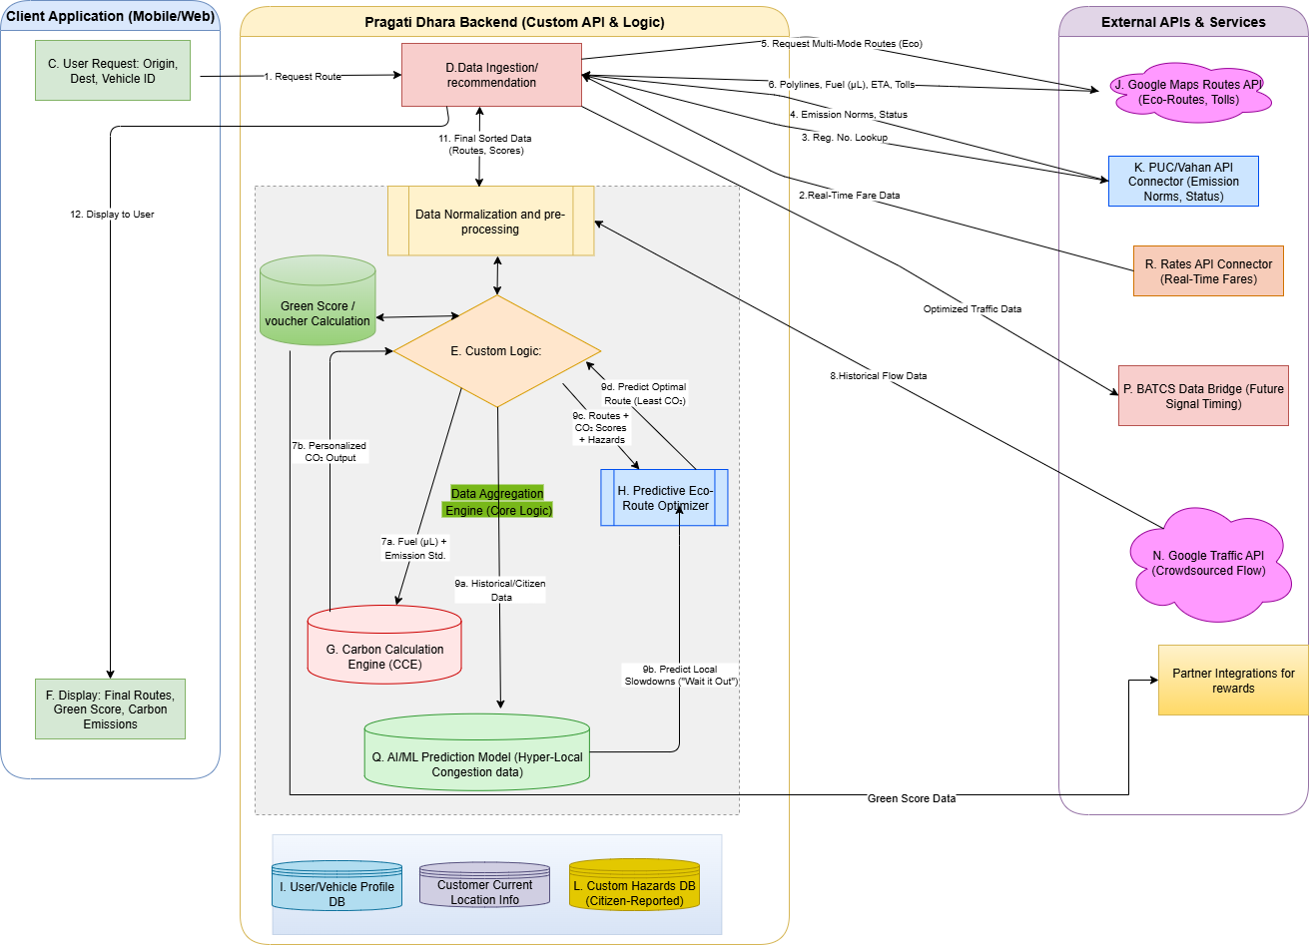
Detailed Solution Sketch
Notes:
---
This slide references information from the following file: https://infosystechnologies-my.sharepoint.com/personal/ritika_mathur01_ad_infosys_com/Documents/Microsoft%20Copilot%20Chat%20Files/GreenFlow%20%E2%80%93%20Business%20Plan.md
PragatiDhara’s architecture is built on a cloud-native, modular framework that enables scalable and secure traffic optimization. The solution collects real-time traffic data directly from commuters, using mobile telemetry to predict congestion and suggest eco-friendly routes. It employs federated learning to ensure user privacy while analyzing patterns for dynamic rerouting. The system integrates REST and WebSocket APIs for seamless connectivity with smart city infrastructure, ride-hailing platforms, and navigation services. This design allows for interoperability and rapid deployment across urban centers. The architecture also supports vernacular AI voice interfaces, making it accessible to a diverse user base. By combining citizen-sourced data with advanced AI, PragatiDhara creates a responsive and adaptive traffic management system.

Slide 9
Sustainable AI Implementation
Notes:
---
This slide references information from the following file: https://infosystechnologies-my.sharepoint.com/personal/ritika_mathur01_ad_infosys_com/Documents/Microsoft%20Copilot%20Chat%20Files/GreenFlow%20%E2%80%93%20Business%20Plan.md
Eco-Friendly Routing and Emission Reduction

Slide 10
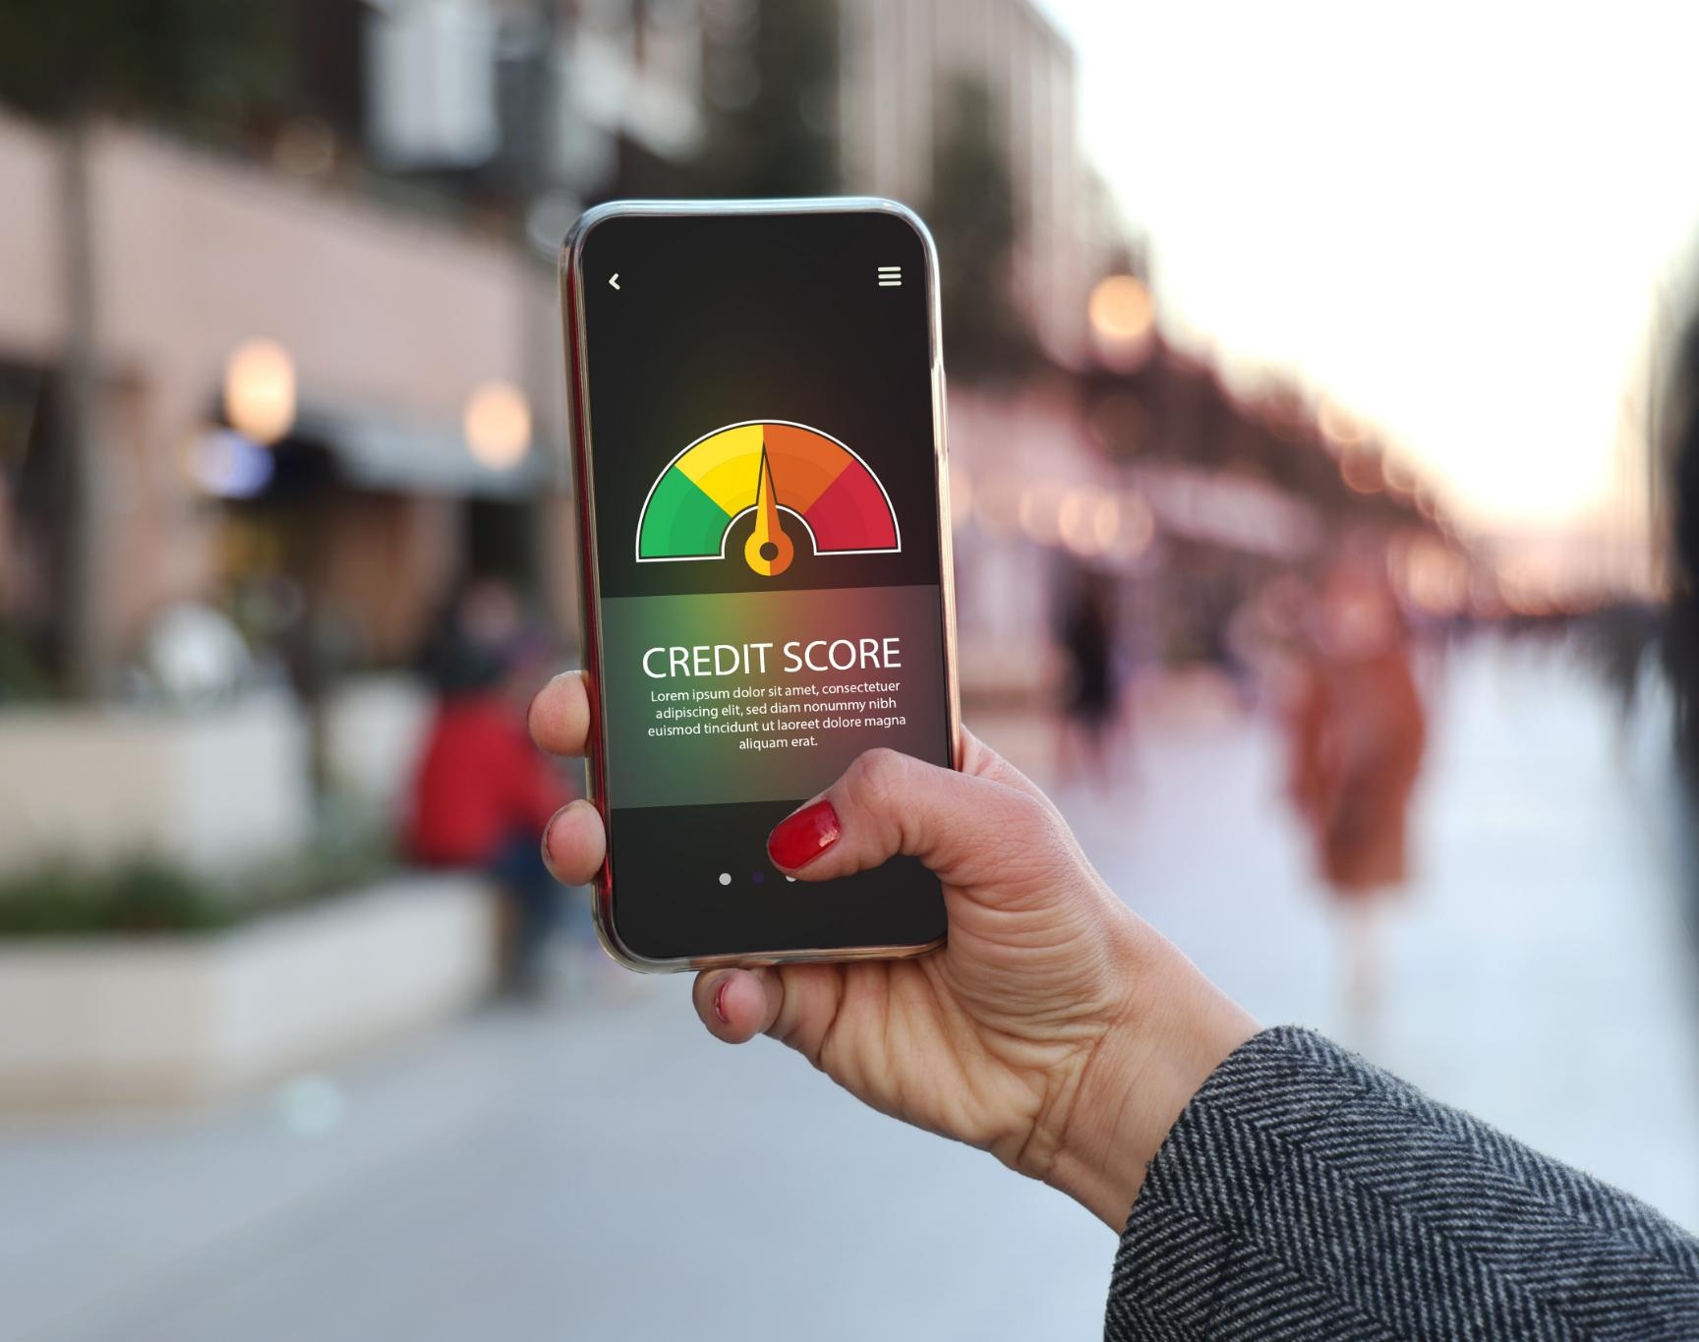
Eco-Friendly Routing and Emission Reduction
Privacy-First Sustainable AI
Decentralized Intelligence: Leverages Federated Learning to process data locally, dramatically reducing cloud usage and the associated carbon footprint.
Guaranteed Privacy: Analyzes traffic patterns without ever accessing or storing raw, personal user location data.
Actionable Environmental Impact
Instant CO₂ Visualization: Calculates and displays real-time CO₂ savings per route, making the environmental benefit tangible and personal for the user.
Fuel & Time Savings: Utilizes powerful Predictive Traffic Analysis to anticipate and re-route around congestion, immediately lowering fuel consumption and emissions.
The GreenPoints Incentive Engine
Driving Behavior Change: Users earn GreenPoints for every sustainable choice (eco-routing, ride-sharing, etc.).
High-Value Rewards: Points are redeemable for direct financial benefits, including fuel discounts, EV charging credits, and retail coupons.
Notes:
---
This slide references information from the following file: https://infosystechnologies-my.sharepoint.com/personal/ritika_mathur01_ad_infosys_com/Documents/Microsoft%20Copilot%20Chat%20Files/GreenFlow%20%E2%80%93%20Business%20Plan.md
PragatiDhara integrates sustainable AI practices to minimize environmental impact. It uses federated learning to process data locally on user devices, reducing cloud dependency and preserving privacy. The app calculates CO₂ savings for each route and visualizes the environmental benefits of eco-routing. Users are incentivized through GreenPoints, which can be redeemed for fuel discounts, EV charging credits, or retail coupons. This gamified approach encourages sustainable behavior and aligns with India’s Green Credit Program. The AI models also support predictive traffic analysis, helping users avoid congestion and reduce fuel consumption. PragatiDhara’s commitment to sustainability extends to its support for SDG 11—Sustainable Cities and Communities—by promoting green mobility and citizen engagement.

Slide 11
Innovation and Differentiation
Notes:
---
This slide references information from the following file: https://infosystechnologies-my.sharepoint.com/personal/ritika_mathur01_ad_infosys_com/Documents/Microsoft%20Copilot%20Chat%20Files/GreenFlow%20%E2%80%93%20Business%20Plan.md,https://infosystechnologies-my.sharepoint.com/personal/ritika_mathur01_ad_infosys_com/_layouts/15/Doc.aspx?sourcedoc=%7B6016006D-88A3-4714-9424-A4CBD25946EA%7D&file=Our%20USP.docx&action=default&mobileredirect=true
Unique Features and Competitive Edge

Slide 12
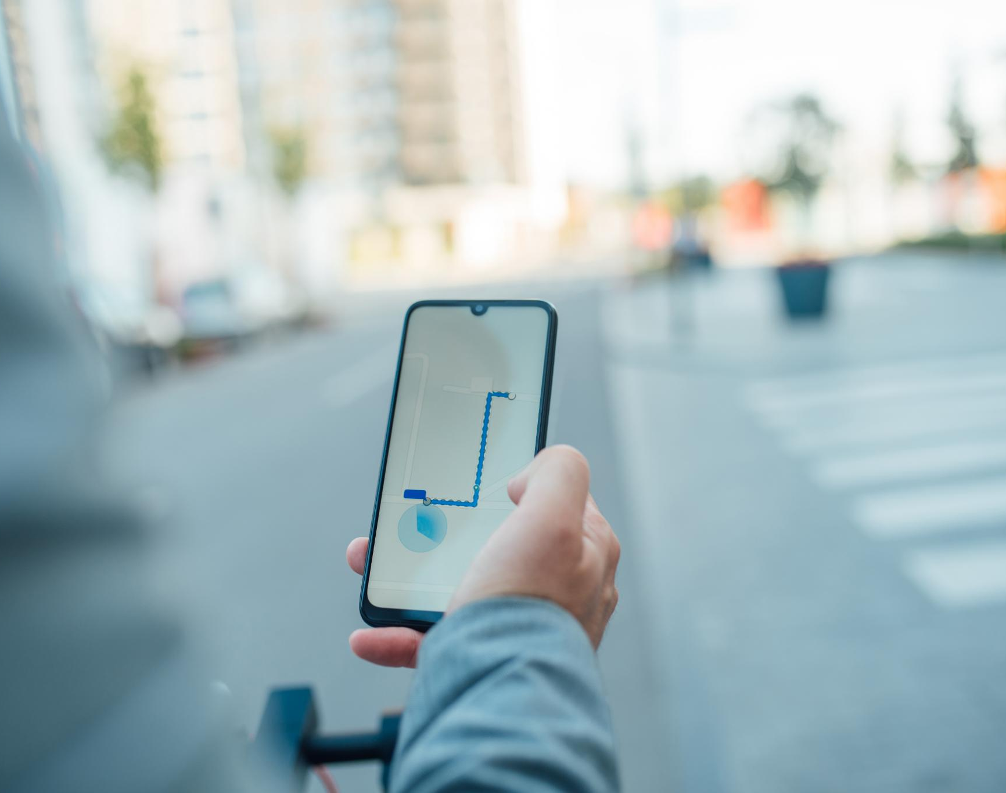
Gamified Engagement & Hyperlocal Intelligence
AI-Powered Hyperlocal Intelligence
We go beyond typical traffic data using unique, real-time insights:
Hyperlocal Hazard Reporting: Users submit real-time data on unique Indian traffic hazards like potholes, illegal parking, and stray cattle, drastically improving map accuracy and safety.
Green Route Priority: Our algorithms prioritize green route options using crowdsourced data, not just the fastest, ensuring navigation actively reduces congestion and emissions.
Ecosystem & Accessibility
We integrate seamlessly and are built for all of India:
Seamless Integration: Full API support for partners including Google Maps, Smart City Systems, and ride-hailing apps, enabling instant reporting for ESG dashboards.
Vernacular AI Support: Features native language support via Vernacular AI, making the entire system accessible and usable across India's diverse communities.
Gamified Behavior Change
We transform the user experience from passive driving to active participation.
Gamified Eco Rewards: Our GreenPoints ecosystem rewards users for sustainable actions, creating a high-retention loop that directly encourages eco-friendly behavior and civic engagement.
Notes:
---
This slide references information from the following file: https://infosystechnologies-my.sharepoint.com/personal/ritika_mathur01_ad_infosys_com/Documents/Microsoft%20Copilot%20Chat%20Files/GreenFlow%20%E2%80%93%20Business%20Plan.md,https://infosystechnologies-my.sharepoint.com/personal/ritika_mathur01_ad_infosys_com/_layouts/15/Doc.aspx?sourcedoc=%7B6016006D-88A3-4714-9424-A4CBD25946EA%7D&file=Our%20USP.docx&action=default&mobileredirect=true
PragatiDhara stands out through its innovative features and user-centric design. Unlike traditional navigation apps, it offers real-time crowd-sourced traffic insights and green route recommendations. The app includes vernacular AI for regional language support, enhancing accessibility and engagement. Users earn GreenPoints for eco-friendly actions, creating a gamified ecosystem that rewards sustainable behavior. PragatiDhara integrates seamlessly with Google Maps, ride-hailing apps like Ola and Uber, and smart city ATCS systems. Its API-ready architecture allows for easy integration with ESG dashboards and corporate mobility solutions. These differentiators position PragatiDhara as a complementary platform that enhances existing systems while promoting sustainability and civic participation.

Slide 13
Implementation and Roadmap
Notes:
---
This slide references information from the following file: https://infosystechnologies-my.sharepoint.com/personal/ritika_mathur01_ad_infosys_com/Documents/Microsoft%20Copilot%20Chat%20Files/GreenFlow%20%E2%80%93%20Business%20Plan.md
Phased Rollout Strategy

Slide 14
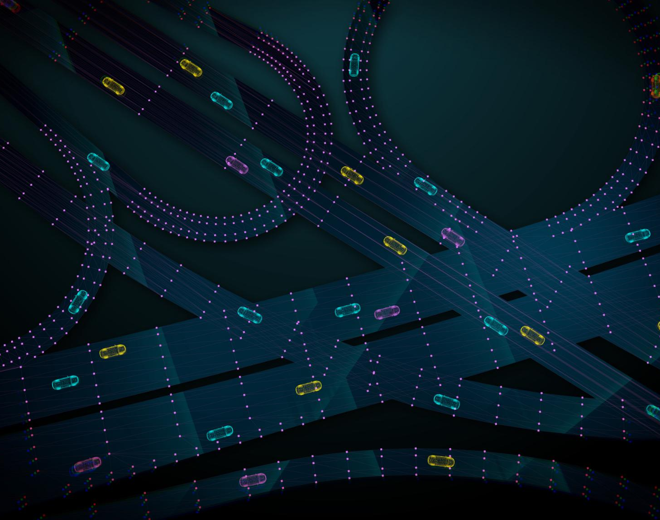
Phased Rollout Strategy
Phase 1: Prototype and Pilot
  Launch prototype and pilot in Pune and Hyderabad with 50,000 users and key partnerships.
Phase 2: Metro Expansion and Rewards
  Expand app to five major metros and introduce GreenPoints rewards marketplace for users.
Phase 3: Scale and Integration
  Scale platform to ten cities integrating Smart City ATCS and enhancing ESG analytics.
Strategic Roadmap Benefits
  Phased rollout ensures measurable impact, validates solutions, and builds a strong ecosystem.
Notes:
---
This slide references information from the following file: https://infosystechnologies-my.sharepoint.com/personal/ritika_mathur01_ad_infosys_com/Documents/Microsoft%20Copilot%20Chat%20Files/GreenFlow%20%E2%80%93%20Business%20Plan.md
PragatiDhara’s implementation plan is structured into three phases to ensure effective deployment and scalability. Phase 1 focuses on launching a prototype and pilot in Pune and Hyderabad, targeting 50,000 users and forming partnerships with fuel companies and traffic departments. Phase 2 expands the app to five major metros and introduces the GreenPoints rewards marketplace. Phase 3 scales the platform to ten cities, integrating with Smart City ATCS systems and enhancing ESG analytics capabilities. This roadmap is designed to build momentum, validate the solution in diverse urban contexts, and establish a robust ecosystem of partners and users. The phased approach ensures that each stage delivers measurable impact and prepares the platform for national adoption.

Slide 15
Market Validation and Impact Potential
Notes:
---
This slide references information from the following file: https://infosystechnologies-my.sharepoint.com/personal/ritika_mathur01_ad_infosys_com/Documents/Microsoft%20Copilot%20Chat%20Files/GreenFlow%20%E2%80%93%20Business%20Plan.md
Addressable Market and Growth Forecast

Slide 16
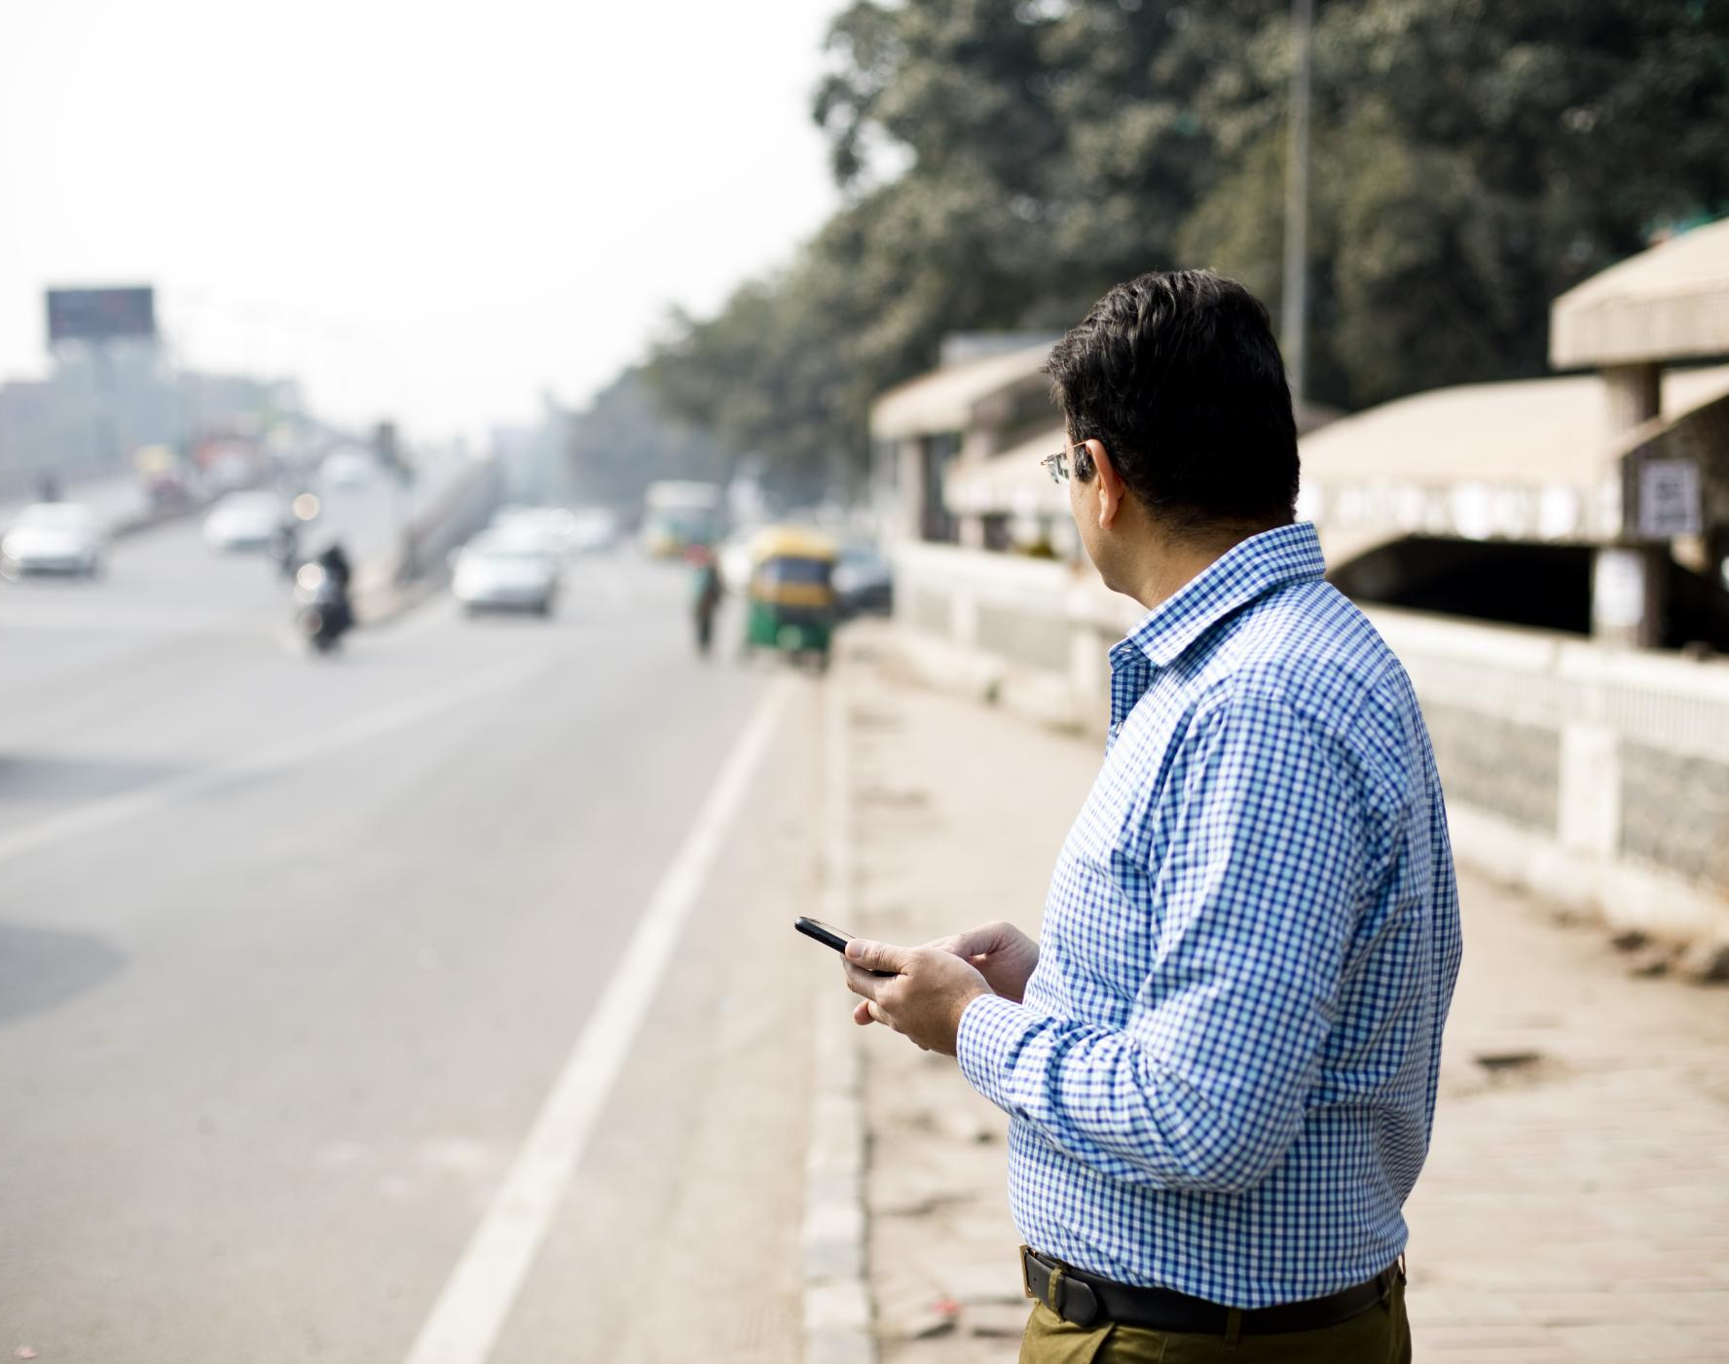
Addressable Market and Growth Forecast
Massive Opportunity, Measurable ROI
The challenge is enormous, making the market potential even larger.
Metric | Investment Thesis | Data Point
National Economic Drag | Congestion is costing India billions in wasted fuel and productivity loss annually. | ₹1.5 Lakh Crore (or $18 Billion) annual economic loss from congestion in four major cities alone.
Total Addressable Market (TAM) | The total Indian Mobility market, which we disrupt and support. | ₹55,000 Cr (~$6.6B) – Urban Mobility (Your original figure, conservative and focused on the immediate segment).
Serviceable Market (SAM) | Smartphone users in target cities ready for app adoption and incentives. | ₹15,000 Cr (~$1.8B) – Smartphone users in Tier-1 & Tier-2 cities.
Obtainable Market (SOM) | Our conservative 3-year revenue target. | ₹500 Cr (~$60M) – Projected from 2M active, monetized users.
Notes:
---
This slide references information from the following file: https://infosystechnologies-my.sharepoint.com/personal/ritika_mathur01_ad_infosys_com/Documents/Microsoft%20Copilot%20Chat%20Files/GreenFlow%20%E2%80%93%20Business%20Plan.md
PragatiDhara targets a substantial market opportunity in India’s urban mobility sector. The Total Addressable Market (TAM) is estimated at ₹55,000 Crore (~$6.6B), encompassing all urban commuters and corporate mobility solutions. The Serviceable Available Market (SAM) focuses on smartphone users in Tier-1 and Tier-2 cities, valued at ₹15,000 Crore (~$1.8B). The Serviceable Obtainable Market (SOM) aims to capture ₹500 Crore (~$60M) by acquiring 2 million active users across ten cities within three years. This market validation is supported by India’s increasing smartphone penetration, urbanization, and policy support for sustainable mobility. PragatiDhara’s impact potential includes reduced fuel consumption, lower CO₂ emissions, and improved traffic flow, contributing to economic and environmental benefits.

Slide 17
Addressable Market and Growth Forecast
PragatiDhara's Quantifiable Impact (Projected in 3 Years)
We don't just reduce traffic; we deliver measurable results that align with national environmental goals.
Impact Area | Target Metric | The Financial/Environmental Outcome
Efficiency | 40% faster commute times | Recovering up to 70 hours of productive time per commuter annually.
Sustainability | 25% CO₂ reduction per user annually | Smart traffic solutions can globally cut up to 923 MMT of CO₂ by 2030—we lead this charge in India.
Profitability (B2B) | ₹100K+ savings for fleet partners | Direct cost reduction via optimized routes, lower fuel consumption, and minimized vehicle wear-and-tear.
Adoption | 2M+ Active Users | Creating the largest incentivized civic-data network in India.
Notes:
---
This slide references information from the following file: https://infosystechnologies-my.sharepoint.com/personal/ritika_mathur01_ad_infosys_com/Documents/Microsoft%20Copilot%20Chat%20Files/GreenFlow%20%E2%80%93%20Business%20Plan.md
PragatiDhara targets a substantial market opportunity in India’s urban mobility sector. The Total Addressable Market (TAM) is estimated at ₹55,000 Crore (~$6.6B), encompassing all urban commuters and corporate mobility solutions. The Serviceable Available Market (SAM) focuses on smartphone users in Tier-1 and Tier-2 cities, valued at ₹15,000 Crore (~$1.8B). The Serviceable Obtainable Market (SOM) aims to capture ₹500 Crore (~$60M) by acquiring 2 million active users across ten cities within three years. This market validation is supported by India’s increasing smartphone penetration, urbanization, and policy support for sustainable mobility. PragatiDhara’s impact potential includes reduced fuel consumption, lower CO₂ emissions, and improved traffic flow, contributing to economic and environmental benefits.

