Slide 1

Problem Statement
To run GenAI on Intel AI Laptops and Simple LLM Inference on CPU and fine-tuning of LLM Models using Intel® OpenVINO™

Slide 2
Unique Idea Brief (Solution)
We utilized the TinyLlama-1.1B-Chat-v1.0 model while constructing a chatbot for our project.
In order to boost speed, the model is set up with OpenVINO and adjusted with INT 4 precision for optimization.

Slide 3
Features Offered
Interactive Chatbot:
Chatbot that engages in two-way conversations.
Offers an engaging and interactive chat experience.
Can manage a range of inquiries from users and offer useful, courteous, and truthful answers.
Fine-Tuned Model:
Model that has been adjusted or optimized to perform better.
Employs the Tiny Llama 1B version, adjusted with INT4 compressed weights to improve efficiency.
The model's size is 696.44 MB when using INT4 compressed weights.

Slide 4
Features Offered
Optimized for Efficiency:
Suitable for deployment on devices with limited computational resources.
Designed for maximum productivity.
Model is enhanced with OpenVINO to increase speed of response and reduce resource usage.
Appropriate for use on devices with restricted computing capabilities.

Slide 5
Process flow
Model Selection : Select model for inference.
Model Fine-tuning : Fine-tune the Tiny Llama 1B model to reduce size with INT4 compressed weights is 696.44 MB to optimize performance.
Intel Open VINO Optimization: Apply OpenVINO to further optimize the model.
Deployment: Deploy the optimized model for which Extensive testing was conducted to ensure stability and performance for end-user interaction.

Slide 6
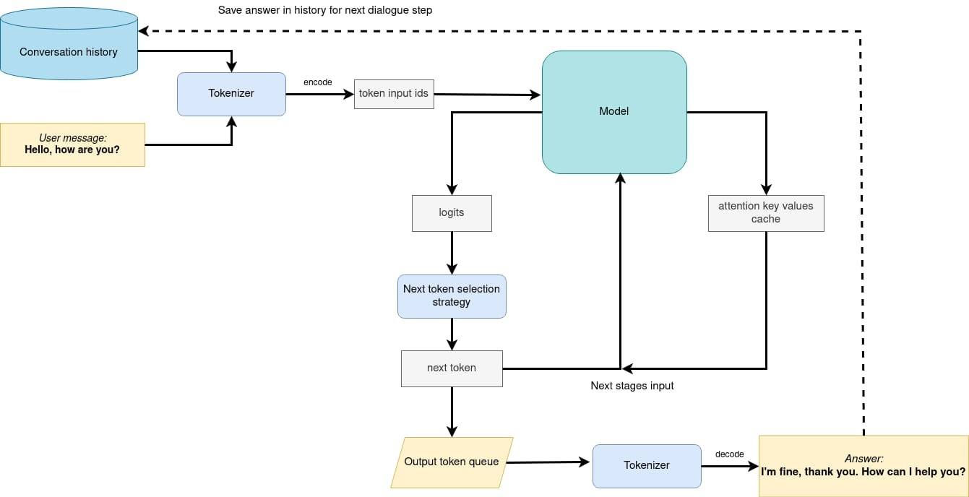
Architecture Diagram

Slide 7
Technologies used
TinyLlama-1.1B-Chat-v1.0: The base LLM model used for the project.
OpenVINO: For quantization and optimization of the model.

Slide 8
Team members and contribution:
Contributions | Name
Fine tuning and Quantization | Om Gadhvi
Helper functions for Running the model | Ritika Mayekar

Slide 9
Conclusion
The project successfully demonstrates the capability of running advanced GenAI applications on Intel AI Laptops, specifically through the implementation of an efficient and user-friendly chatbot. By leveraging the Tiny Llama 1B model, optimized with Intel® OpenVINO™ and fine-tuned using INT4 precision, we have shown that complex language models can perform effectively on consumer-grade CPUs.
This project underscores the potential for democratizing AI technology, bringing powerful language models to a broader audience without the need for specialized hardware. As we look to the future, this project serves as a stepping stone towards more accessible and integrated AI solutions in everyday computing environments.

