Slide 1

Seasonal Agricultural Performance Analysis
Student Name : Ritika Dayanand Moolya
College Name : Pillai College of Arts, Commerce & Science
AICTE STU ID : STU6a6b4abc5f50a1785416380

Slide 2

PROBLEM STATEMENT
Agricultural activities are influenced by seasonal variations in environmental conditions, farming practices, resource availability and market conditions. As a result, agricultural performance may differ from one season to another.
However, raw agricultural data does not clearly explain how agricultural performance changes across seasons or what patterns can be observed in different seasonal conditions.
The problem is to analyze the given agricultural dataset and investigate seasonal differences in agricultural performance by identifying meaningful patterns, trends, relationships and variations within the available data.

Slide 3
Project Description
This project performs exploratory data analysis and visualization on agricultural data to identify seasonal patterns, productivity trends, profitability, resource efficiency, and disease/pest risk. The analysis examines factors such as environmental conditions, soil characteristics, farming inputs, irrigation methods, crop types, and market conditions that influence agricultural performance across seasons. The objective is to derive meaningful insights that support data-driven farming, resource allocation, crop planning, and agricultural decision-making.

Slide 4

WHO ARE THE END USERS?
Primary End Users:
Farmers – Identify high-performing seasons, crops, irrigation methods, and resource-use patterns to improve farm productivity and profitability.
Agricultural Analysts – Analyze seasonal trends, crop performance, environmental relationships, and agricultural KPIs.
Agricultural Consultants – Use insights to provide data-driven recommendations on crop selection, farming practices, and resource allocation.
Government Agricultural Departments – Support agricultural planning, seasonal policies, resource allocation, and productivity improvement programs.
Agribusinesses – Evaluate crop performance, market conditions, profitability, and regional agricultural trends for business and supply-chain decisions.
Secondary End Users:
Agricultural Researchers – Study relationships between environmental conditions, farming practices, and crop outcomes.
Water Resource Planners – Analyze water consumption and water-efficiency patterns across crops, regions, and seasons.

Slide 5

Technology Used
  Programming Language: Python
  Libraries: Pandas, Matplotlib, NumPy, Seaborn
  Development Environment:- Google Colab

Slide 6
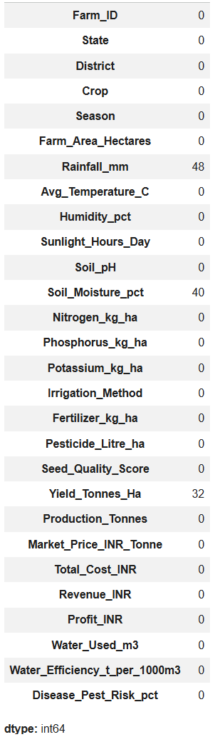
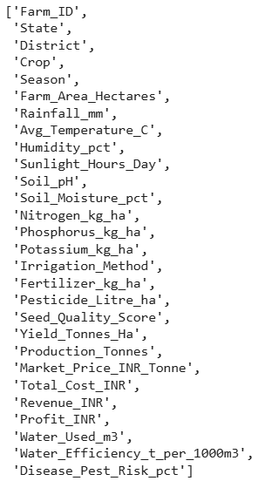


RESULTS
(DATA EXPLORATION AND QUALITY ASSESSMENT)
Missing Value Detection
Column Overview
Dataset Dimension before handling missing values
Duplicate Record Detection

Slide 7
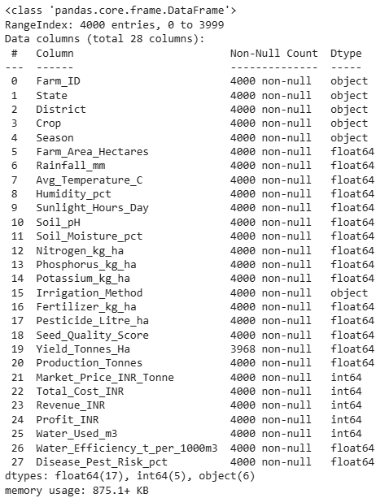

RESULTS
(DATA CLEANING AND PREPROCESSING)
Quick Summary of DataFrame
Missing values handling process: Missing yield values were handled using a temporary DataFrame containing only available yield records while preserving the original dataset for other analyses. Missing rainfall and soil moisture values were imputed using State-and-Season-wise medians to preserve local and seasonal patterns.
Dataset Dimension of temporary DataFrame of Yield

Slide 8
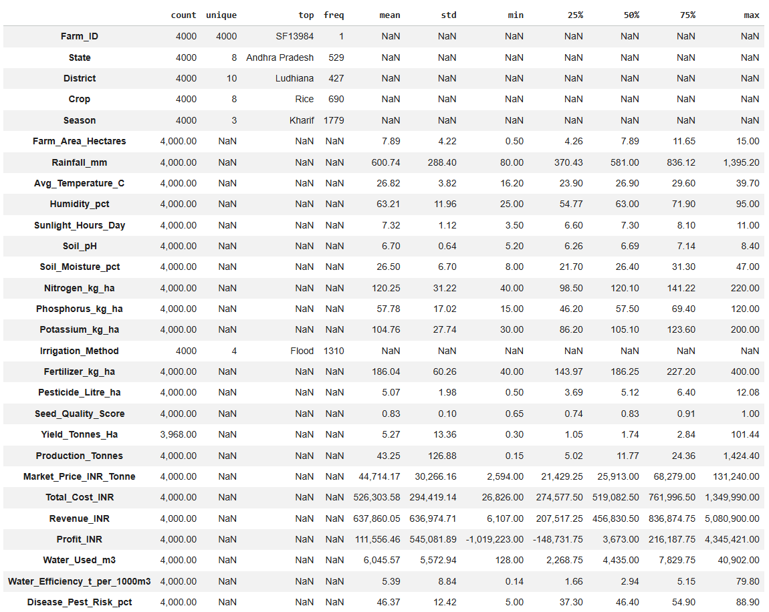
RESULTS
Descriptive statistics after data cleaning

Slide 9
RESULTS
Key Findings from above Descriptive Statistics:
1. Total Records: The dataset contains 4,000 farm-level records across different states, districts, crops, and seasons.
2. Geographical Coverage: The dataset includes 9 states and 10 districts, providing geographical variation in agricultural activities.
3. Crop Diversity: The dataset contains 8 different crop types, allowing comparison of agricultural performance across crops.
4. Seasonal Coverage: Agricultural activities are recorded across 3 different seasons, enabling seasonal performance analysis.
5. Farm Area: Farm sizes range from 0.50 to 15 hectares, with an average farm area of approximately 7.89 hectares.
6. Rainfall: Average rainfall is approximately 600.74 mm, with values ranging from 80 mm to 1,395.20 mm, indicating substantial variation in rainfall conditions.
7. Temperature: The average temperature is approximately 26.82°C, ranging from 16.20°C to 39.70°C.
8. Humidity: Average humidity is approximately 63.21%, with observations ranging from 25% to 95%.
9. Soil Moisture: The average soil moisture level is approximately 26.50%, ranging from 8% to 47%.
10. Soil pH: The average soil pH is approximately 6.70, with values ranging from 5.20 to 8.40, indicating variation in soil conditions.
11. Fertilizer Usage: Farms use an average of approximately 186.04 kg/ha of fertilizer, with usage ranging from 40 to 400 kg/ha.
12. Seed Quality: The average seed quality score is approximately 0.83, with scores ranging from 0.50 to 1.00.
13. Agricultural Yield: Among the 3,968 records with available yield values, the average yield is approximately 5.27 tonnes/ha, with values ranging from 0.30 to 101.44 tonnes/ha.
14. Production: Average agricultural production is approximately 43.25 tonnes per farm, ranging from 0.15 to 1,424.40 tonnes.
15. Market Price: The average market price is approximately ₹44,714 per tonne, with prices ranging from ₹2,594 to ₹1,241,000 per tonne, showing considerable variation across the dataset.
16. Total Cost: The average total agricultural cost is approximately ₹5.26 lakh per farm, with costs ranging from ₹26,826 to ₹13.50 lakh.
17. Revenue: Farms generate an average revenue of approximately ₹6.38 lakh, with revenue ranging from ₹6,107 to ₹50.80 lakh.
18. Profitability: The average profit is approximately ₹1.12 lakh per farm. Profit ranges from a loss of approximately ₹10.19 lakh to a maximum profit of approximately ₹43.45 lakh, indicating significant variation in financial performance.
19. Water Usage: Average water usage is approximately 6,045.57 m³ per farm, ranging from 128 to 40,902 m³.
20. Disease & Pest Risk: The average disease and pest risk is approximately 46.37%, with values ranging from 5% to 88.90%, indicating considerable variation in agricultural risk conditions.

Slide 10
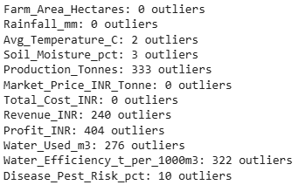
RESULTS
(OUTLIER DETECTION AND VISUALIZATION)
Number of Outliers in each Numeric Columns:

Slide 11
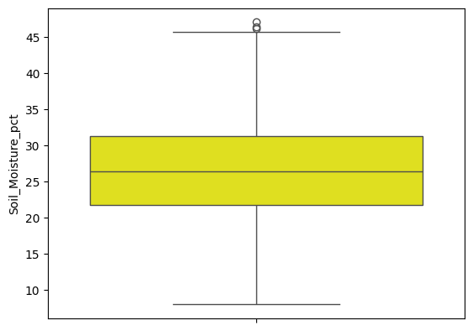
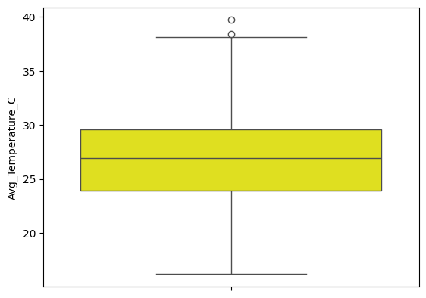
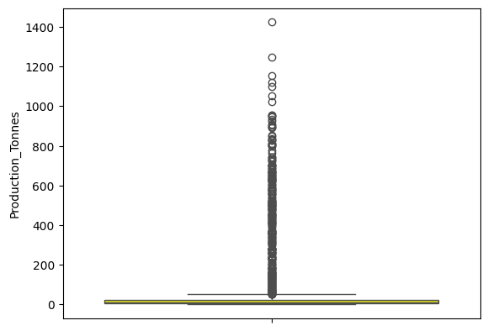
RESULTS
(OUTLIER DETECTION AND VISUALIZATION)

Slide 12
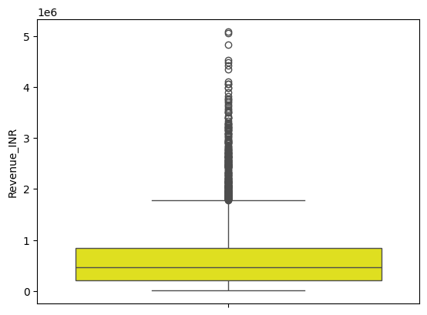
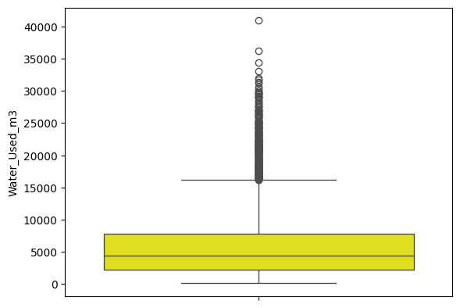
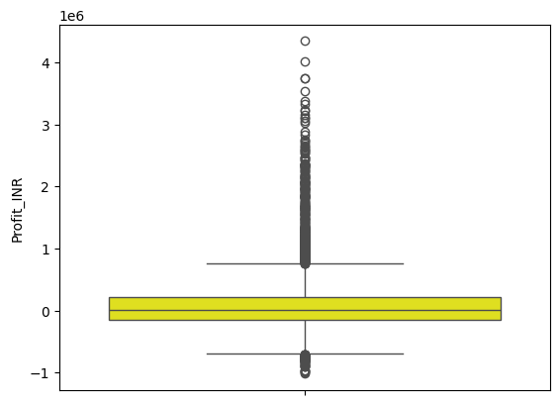
RESULTS
(OUTLIER DETECTION AND VISUALIZATION)

Slide 13
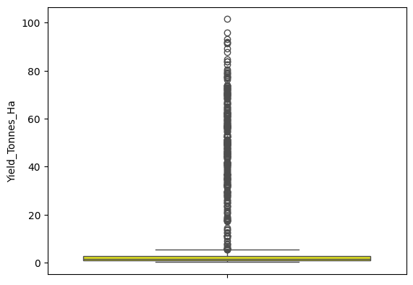
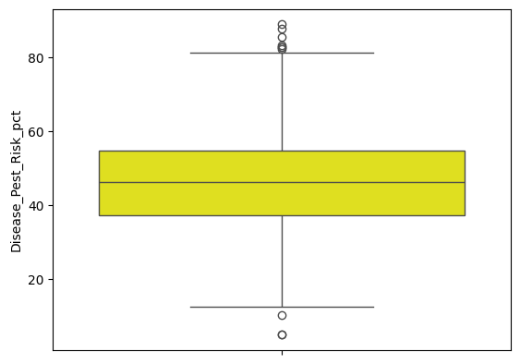
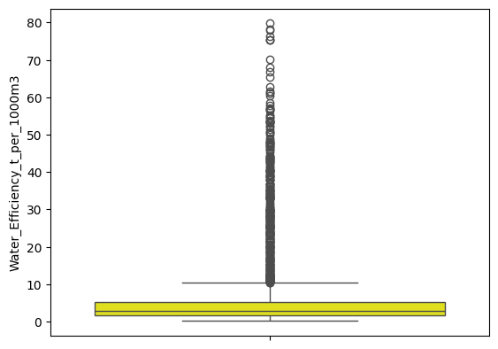
RESULTS
(OUTLIER DETECTION AND VISUALIZATION)

Slide 14
RESULTS
(OUTLIER DETECTION AND VISUALIZATION)
Observation of Boxplot Analysis:
Potential outliers were identified using boxplots. The observations are based on the values lying beyond the boxplot whiskers. These observations were used for screening purposes only, and no outliers were removed because extreme values may represent plausible agricultural variations and the objective was to observe unusual values rather than remove observations without evidence of data-entry errors.

Slide 15
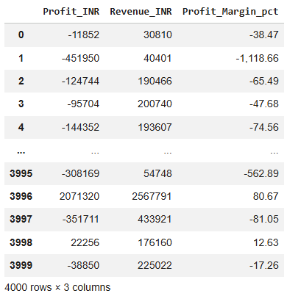
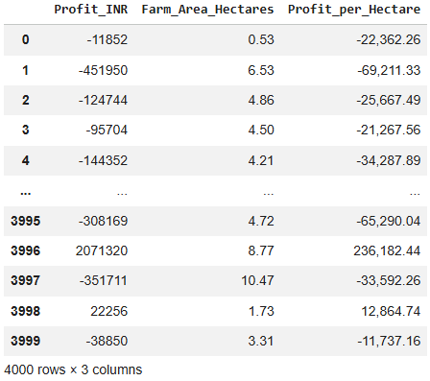
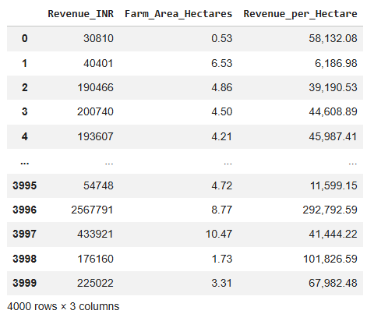
RESULTS
(FEATURE CREATION)
Profit Margin (%)
Profit Per Hectare
Revenue Per Hectare

Slide 16
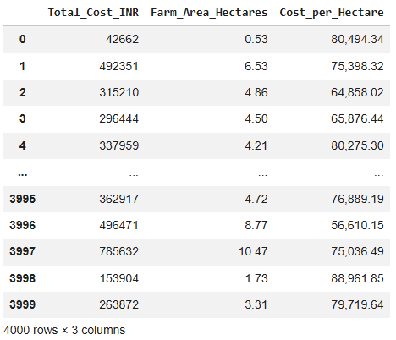
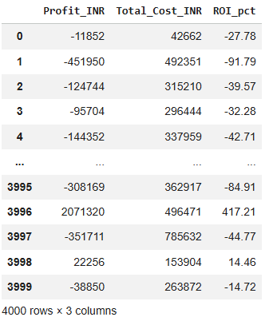
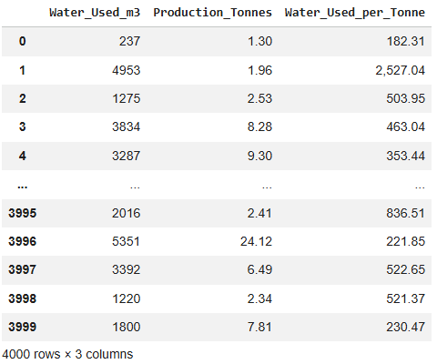
RESULTS
(FEATURE CREATION)
Cost Per Hectare
ROI (%)
Water Used Per Tonne

Slide 17
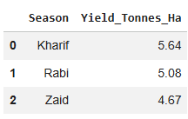
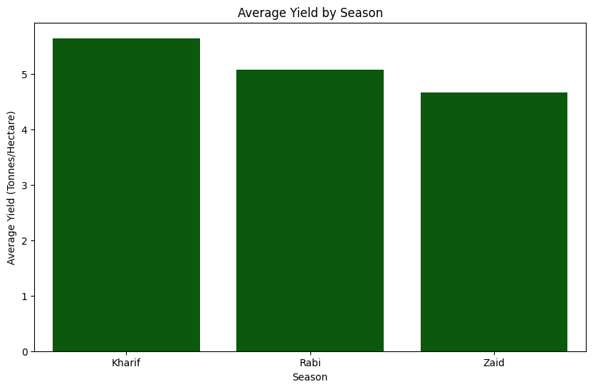
RESULTS
(SEASONAL PERFORMANCE ANALYSIS)
Average Yield by Season
TO FIND: Which season has the highest average yield?
Analytical Statement:
The 'Average Yield by Season' bar chart indicates that the Kharif season has the highest average yield per hectare, followed by Rabi, and then Zaid, suggesting Kharif is generally the most productive season in terms of yield.

Slide 18
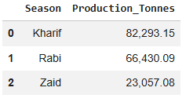
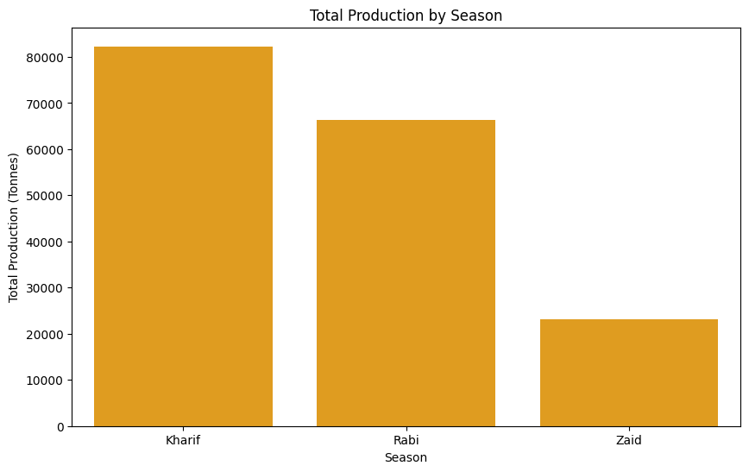
RESULTS
(SEASONAL PERFORMANCE ANALYSIS)
Total Production by Season
TO FIND: Which season has the highest total production?
Analytical Statement:
The 'Total Production by Season' bar chart indicates that the Kharif season has the highest total production, followed by Rabi, and then Zaid, suggesting Kharif is the most productive season in terms of overall output.

Slide 19
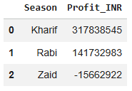
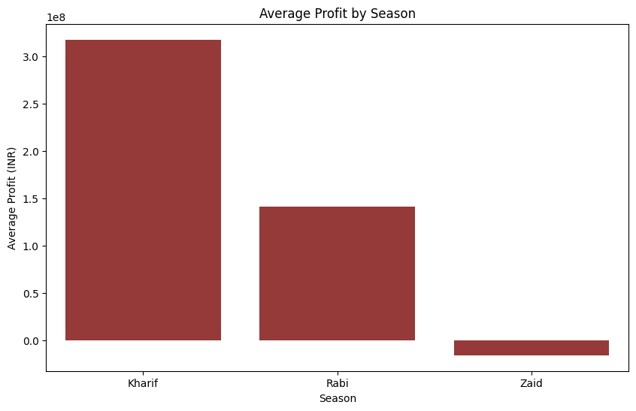
RESULTS
(SEASONAL PERFORMANCE ANALYSIS)
Average Profit by Season
TO FIND: Which season has the highest average profit?
Analytical Statement:
The 'Average Profit by Season' bar chart indicates that the Kharif season has the highest average profit, followed by Rabi, while the Zaid season shows an overall loss.

Slide 20
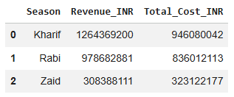
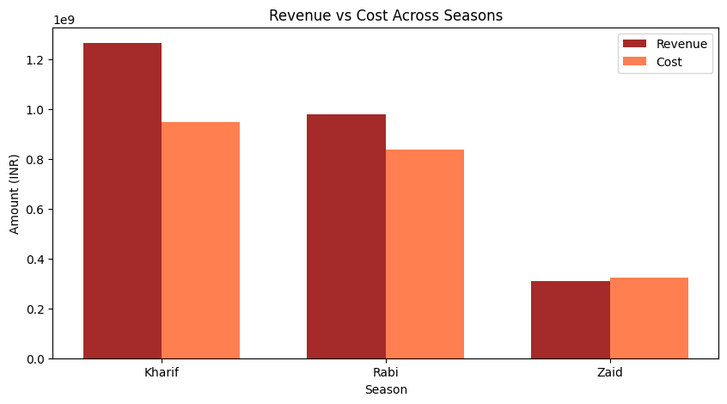
RESULTS
(SEASONAL PERFORMANCE ANALYSIS)
Revenue vs Cost across Seasons
TO FIND: How do revenue and cost vary across seasons?
Analytical Statement:
The 'Revenue vs Cost Across Seasons' bar chart reveals that the Kharif season generates significantly more revenue than its costs, indicating high profitability. The Rabi season also shows a positive margin with revenue exceeding costs. In contrast, the Zaid season demonstrates higher costs than revenue, suggesting it operates at a loss.

Slide 21
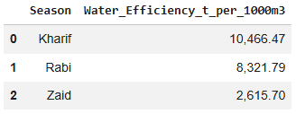
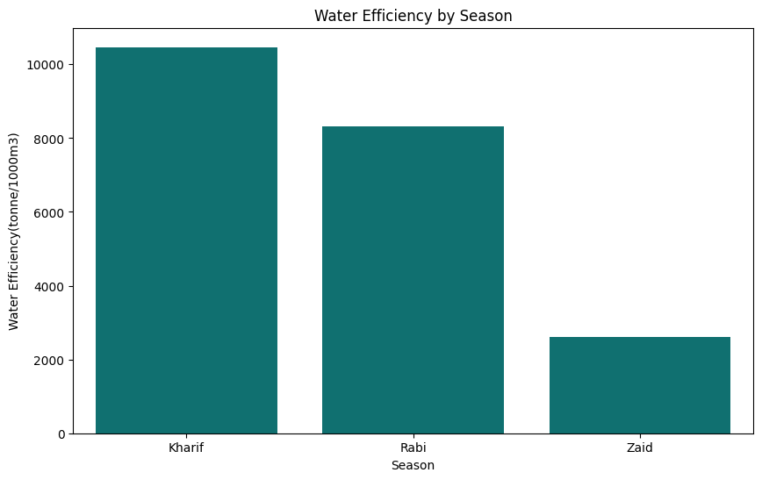
RESULTS
(SEASONAL PERFORMANCE ANALYSIS)
Water Efficiency by Season
TO FIND: Which season has the best water efficiency?
Analytical Statement:
The 'Water Efficiency by Season' bar chart indicates that the Kharif season has the highest water efficiency, producing the most tonnes per 1000m³ of water, followed by Rabi, and then Zaid. This suggests that Kharif is the most water-efficient season for agriculture.

Slide 22
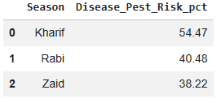
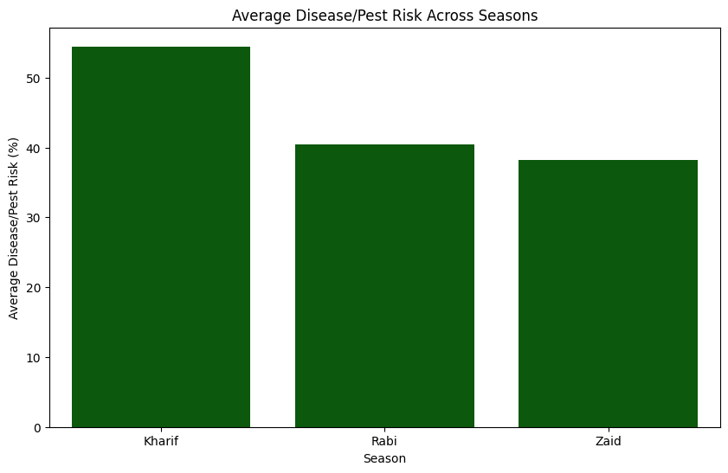
RESULTS
(SEASONAL PERFORMANCE ANALYSIS)
Disease/Pest Risk by Season
TO FIND: Which season has the highest disease/pest risk?
Analytical Statement:
The 'Average Disease/Pest Risk Across Seasons' bar chart indicates that the Kharif season has the highest average disease and pest risk, followed by Rabi, and then Zaid. This suggests that the Kharif season is most susceptible to disease and pest outbreaks.

Slide 23
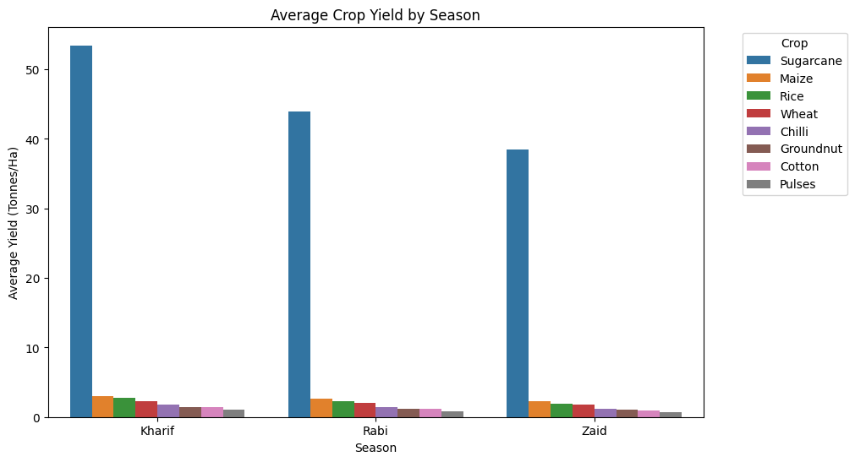
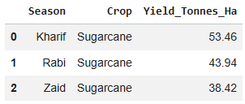
RESULTS
(CROP PERFORMANCE ANALYSIS)
Average Crop Yield by Season & Average Crop Profit by Season:
TO FIND: Which crops perform best in each season?
Best Crop by Yield:
Analytical Statement:
The 'Average Crop Yield by Season' bar chart clearly demonstrates that Sugarcane consistently achieves the highest average yield across all three seasons (Kharif, Rabi, and Zaid). Other crops show significantly lower yields compared to Sugarcane, indicating its strong productivity regardless of the season.

Slide 24
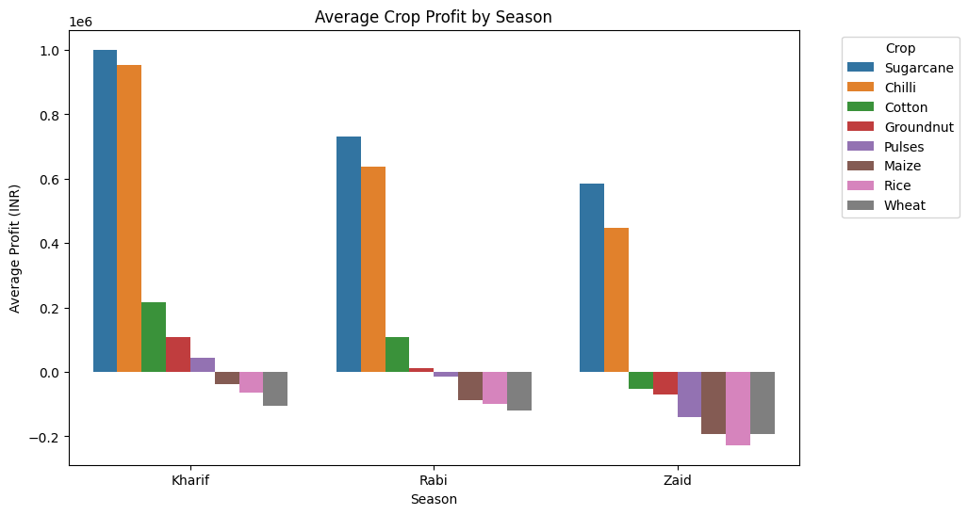
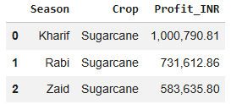
RESULTS
(CROP PERFORMANCE ANALYSIS)
Average Crop Yield by Season & Average Crop Profit by Season:
TO FIND: Which crops perform best in each season?
Best Crop by Profit:
Analytical Statement:
The 'Average Crop Profit by Season' bar chart indicates that Sugarcane consistently generates the highest average profit across all three seasons (Kharif, Rabi, and Zaid). Crops like Chilli also show good profitability in Kharif and Rabi. Conversely, Maize, Rice, and Wheat frequently show negative average profits, especially in the Zaid season, suggesting they are less profitable or incur losses during these periods.

Slide 25
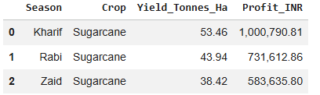
RESULTS
(CROP PERFORMANCE ANALYSIS)
Average Crop Yield by Season & Average Crop Profit by Season:
TO FIND: Which crops perform best in each season?
Compare Crop Performance by Yield and Profit Across Seasons:
Analytical Statement:
The 'Crop Performance by Yield and Profit Across Seasons' data clearly indicates that Sugarcane is the top-performing crop, consistently achieving the highest yield and profit across all three seasons (Kharif, Rabi, and Zaid). This highlights Sugarcane's robust performance and profitability regardless of the agricultural season.

Slide 26
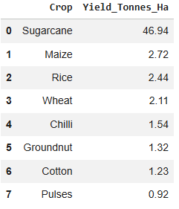
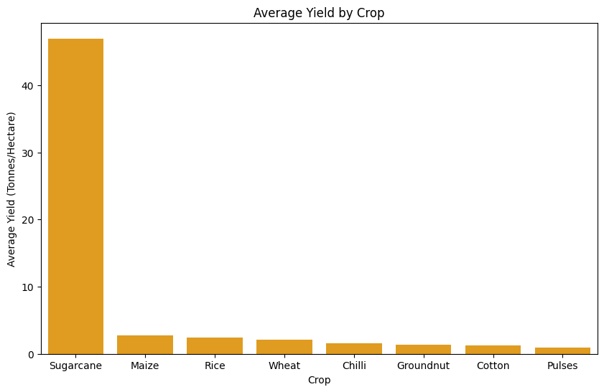
RESULTS
(CROP PERFORMANCE ANALYSIS)
Average Yield by Crop
TO FIND: Which crop has the highest average yield?
Analytical Statement:
The 'Average Yield by Crop' bar chart clearly indicates that Sugarcane has the highest average yield per hectare, significantly outperforming all other crops. This suggests Sugarcane is the most productive crop in terms of yield.

Slide 27
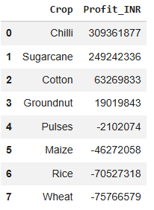
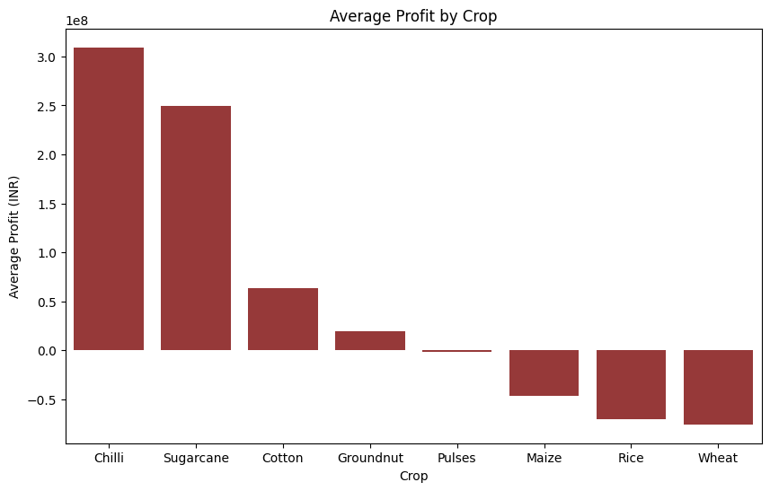
RESULTS
(CROP PERFORMANCE ANALYSIS)
Average Profit by Crop
TO FIND: Which crop generates the highest total/average profit?
Analytical Statement:
The 'Average Profit by Crop' bar chart clearly shows that Chilli and Sugarcane are the most profitable crops, generating significant total profits. In contrast, Wheat, Rice, Maize, and Pulses appear to be unprofitable, as indicated by their negative total profit values.

Slide 28
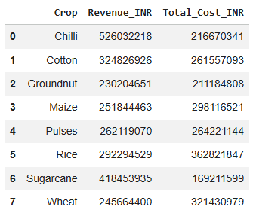
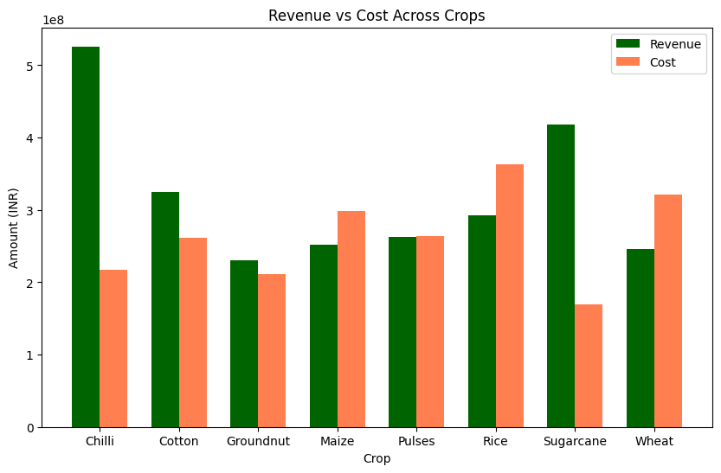
RESULTS
(CROP PERFORMANCE ANALYSIS)
Revenue vs Cost across Crops
TO FIND: How do revenue and cost vary across crops?
Analytical Statement:
The 'Revenue vs Cost Across Crops' bar chart clearly shows that Chilli and Sugarcane have substantially higher revenues compared to their costs, indicating strong profitability. Cotton and Groundnut also show revenues exceeding costs, suggesting they are profitable crops. In contrast, Maize, Pulses, Rice, and Wheat all demonstrate costs that are higher than their revenues, highlighting their unprofitability within this dataset.

Slide 29
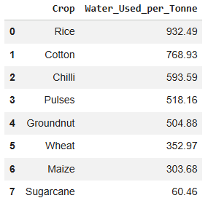
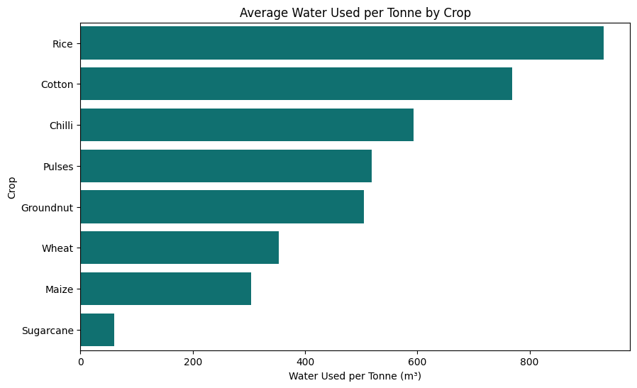
RESULTS
(CROP PERFORMANCE ANALYSIS)
Average Water Used Per Tonne by Crop
TO FIND: Which crop requires the most water to produce 1 tonne?
Analytical Statement:
The 'Average Water Used per Tonne by Crop' bar chart reveals that Rice and Cotton require the most water per tonne of production, indicating lower water efficiency for these crops. In stark contrast, Sugarcane requires significantly less water per tonne, highlighting its high water efficiency.

Slide 30
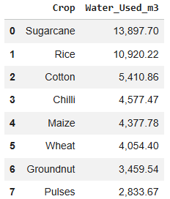
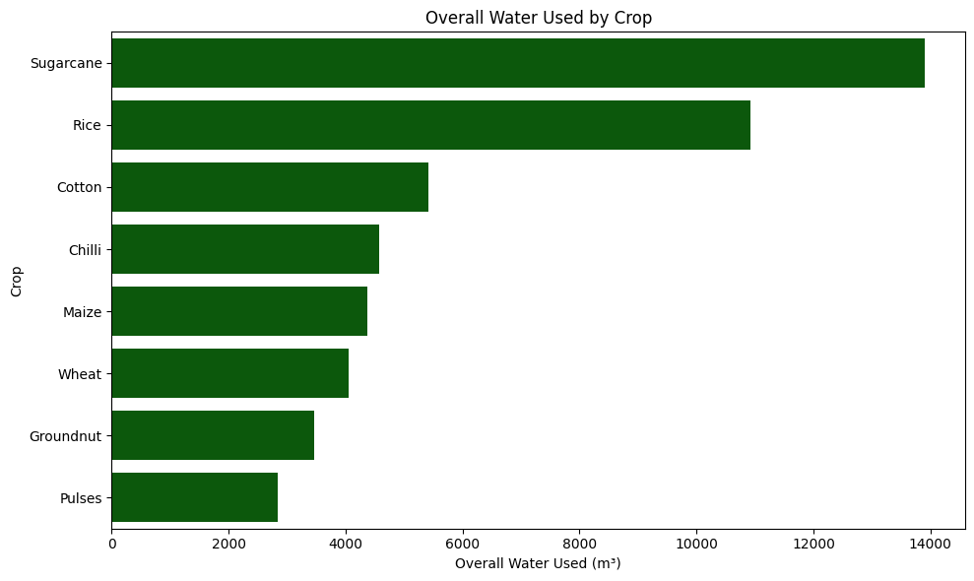
RESULTS
(CROP PERFORMANCE ANALYSIS)
Overall Water Used by Crop
TO FIND: Which crop uses the most water overall?
Analytical Statement:
The 'Overall Water Used by Crop' bar chart indicates that Sugarcane and Rice are the crops that consume the most water in terms of total volume. In contrast, Pulses, Groundnut, Wheat, and Maize require significantly less overall water, suggesting they are less water-intensive crops in terms of total usage across the dataset.

Slide 31
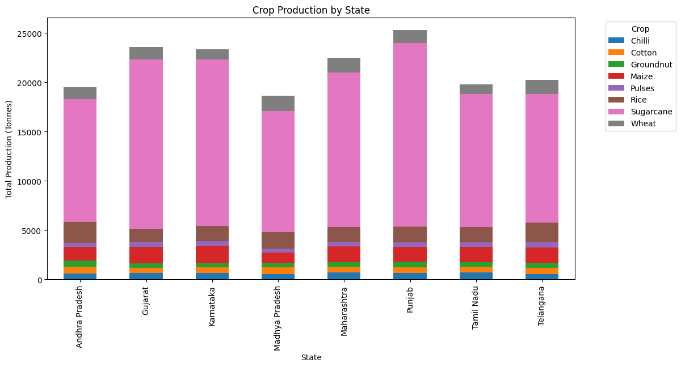
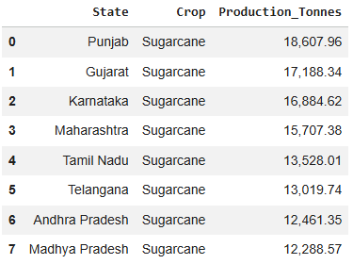
RESULTS
(CROP PERFORMANCE ANALYSIS)
State-wise Crop Production Analysis
TO FIND: How does crop production vary across states, and which crops contribute most to state-level production?
Analytical Statement:
The 'Crop Production by State' stacked bar chart clearly illustrates that Sugarcane is the dominant crop, contributing the highest production volume across all listed states. This indicates that state-level agricultural output is heavily influenced by Sugarcane cultivation, making it the top-performing crop in terms of total production for each state

Slide 32
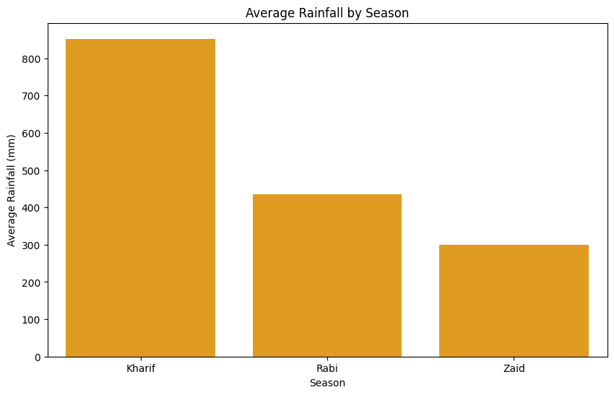

RESULTS
(ENVIRONMENTAL FACTOR ANALYSIS)
Rainfall Analysis: Seasonal Variation and Association with Yield
TO FIND: How does rainfall vary across seasons? Is it associated with yield?
Analytical Statement:
The 'Average Rainfall by Season' bar chart indicates that the Kharif season receives the highest average rainfall, followed by the Rabi season, and then the Zaid season, which experiences the lowest average rainfall. This suggests that Kharif is the wettest agricultural season.
The Pearson Correlation coefficient between Rainfall and Yield is 0.03. This indicates a very weak positive linear relationship, suggesting that rainfall, in this dataset, has a negligible direct association with agricultural yield.

Slide 33


RESULTS
(ENVIRONMENTAL FACTOR ANALYSIS)
Temperature Analysis: Seasonal Variation and Association with Yield
TO FIND: How does average temperature differ across seasons? Is it associated with yield?
Analytical Statement:
The 'Average Temperature by Season' bar chart indicates that the Zaid season has the highest average temperature, followed by the Kharif season, and then the Rabi season, which experiences the lowest average temperature. This suggests that Zaid is the hottest agricultural season.
The Pearson Correlation coefficient between Temperature and Yield is 0.01. This indicates an extremely weak positive linear relationship, suggesting that average temperature, in this dataset, has a negligible direct association with agricultural yield.

Slide 34


RESULTS
(ENVIRONMENTAL FACTOR ANALYSIS)
Soil Moisture Analysis: Seasonal Variation and Association with Yield
TO FIND: How does soil moisture vary across seasons? Is it associated with yield?
Analytical Statement:
The 'Average Soil Moisture by Season' bar chart indicates that the Kharif season has the highest average soil moisture, followed by the Rabi season, and then the Zaid season, which experiences the lowest average soil moisture. This pattern aligns with the rainfall distribution, suggesting that higher rainfall contributes to increased soil moisture during the Kharif season.
The Pearson Correlation coefficient between Soil Moisture and Yield is 0.01. This indicates an extremely weak positive linear relationship, suggesting that soil moisture, in this dataset, has a negligible direct association with agricultural yield.

Slide 35
RESULTS
(ENVIRONMENTAL FACTOR ANALYSIS)
Humidity VS Yield
TO FIND: Is humidity associated with yield?
Analytical Statement:
The Pearson Correlation coefficient between Humidity and Yield is 0.01. This indicates an extremely weak positive linear relationship, suggesting that humidity, in this dataset, has a negligible direct association with agricultural yield.

Slide 36
RESULTS
(ENVIRONMENTAL FACTOR ANALYSIS)
Disease/Pest Risk vs Yield
TO FIND: Is disease/pest risk associated with yield?
Analytical Statement:
The Pearson Correlation coefficient between Disease/Pest Risk and Yield is 0.01. This indicates an extremely weak positive linear relationship, suggesting that disease/pest risk, in this dataset, has a negligible direct association with agricultural yield.

Slide 37


RESULTS
(FARMING PRACTICE ANALYSIS)
Irrigation Method Analysis: Water Efficiency and Yield Comparison
TO FIND: Which irrigation method provides better water efficiency, and how does yield vary across irrigation methods?
Analytical Statement:
The 'Average Water Efficiency by Irrigation Method' chart shows that 'Rainfed' agriculture has the highest water efficiency (7.56 tonnes/1000m³), followed by 'Drip' (6.27 tonnes/1000m³). However, the 'Average Yield by Irrigation Method' chart indicates that 'Drip' irrigation leads to the highest average yield (6.62 Tonnes/Hectare), suggesting it is the most effective method for maximizing yield, even though 'Rainfed' is more water-efficient.

Slide 38

RESULTS
(FARMING PRACTICE ANALYSIS)
Water Efficiency vs Yield
TO FIND: Is Water Efficiency associated with Yield?
Analytical Statement:
The Pearson Correlation coefficient between Water Efficiency and Yield is 0.92. This indicates a very strong positive linear relationship, suggesting that as water efficiency increases, agricultural yield also tends to increase significantly.
The scatter plot of 'Water Efficiency vs Yield by Irrigation Method' visually confirms a strong positive correlation between water efficiency and yield. It shows that higher water efficiency generally leads to higher yields, and notably, 'Drip' irrigation appears to achieve both high water efficiency and high yields compared to other methods, while 'Rainfed' agriculture, despite having some high water efficiency points, shows a wider spread in yield.

Slide 39
RESULTS
(FARMING PRACTICE ANALYSIS)
Seed Quality vs Yield
TO FIND: Is seed quality associated with higher yield?
Analytical Statement:
The Pearson Correlation coefficient between Seed Quality and Yield is -0.01. This indicates an extremely weak negative linear relationship, suggesting that seed quality, in this dataset, has a negligible direct association with agricultural yield.

Slide 40


RESULTS
(FARMING PRACTICE ANALYSIS)
Fertilizer Analysis: Seasonal Variation, Crop Variation and Association with Yield
TO FIND: How does fertilizer usage vary across seasons and crops? Is it associated with yield?
Analytical Statement:
The 'Average Fertilizer Usage by Season' bar chart indicates that the Kharif season has the highest average fertilizer usage, followed closely by Rabi, and then Zaid. While Kharif shows slightly higher usage, the overall variation in average fertilizer usage across the seasons is not substantial.

Slide 41


RESULTS
(FARMING PRACTICE ANALYSIS)
Fertilizer Analysis: Seasonal Variation, Crop Variation and Association with Yield
TO FIND: How does fertilizer usage vary across seasons and crops? Is it associated with yield?
Analytical Statement:
The 'Average Fertilizer Usage by Crop' bar chart indicates that Maize has the highest average fertilizer usage, followed closely by Chilli and Groundnut. The usage across most other crops like Rice, Cotton, Sugarcane, Pulses, and Wheat is relatively similar and only slightly lower, suggesting that while there are minor variations, fertilizer application rates do not differ drastically among the crops in this dataset.

Slide 42
RESULTS
(FARMING PRACTICE ANALYSIS)
Fertilizer Analysis: Seasonal Variation, Crop Variation and Association with Yield
TO FIND: How does fertilizer usage vary across seasons and crops? Is it associated with yield?
Analytical Statement:
The Pearson Correlation coefficient between Fertilizer Usage and Yield is 0.00. This indicates an extremely weak, practically non-existent, linear relationship, suggesting that fertilizer usage, in this dataset, has no direct association with agricultural yield.

Slide 43


RESULTS
(FARMING PRACTICE ANALYSIS)
Pesticide Analysis: Seasonal Variation, Crop Variation and Association with Yield
TO FIND: How does pesticide usage vary across seasons and crops? Is it associated with yield?
Analytical Statement:
The 'Average Pesticide Usage by Season' bar chart indicates that Zaid has the highest average pesticide usage, followed closely by Kharif and Rabi. The differences across the three seasons are relatively small, suggesting that pesticide application rates remain fairly consistent across seasons in this dataset.

Slide 44


RESULTS
(FARMING PRACTICE ANALYSIS)
Pesticide Analysis: Seasonal Variation, Crop Variation and Association with Yield
TO FIND: How does pesticide usage vary across seasons and crops? Is it associated with yield?
Analytical Statement:
The 'Average Pesticide Usage by Crop' bar chart indicates that Groundnut has the highest average pesticide usage, followed closely by Chilli, Cotton, and Maize. Rice, Sugarcane, Wheat, and Pulses show slightly lower average usage, although the differences across crops are relatively small, suggesting that pesticide application rates are fairly consistent among the crops in this dataset.

Slide 45
RESULTS
(FARMING PRACTICE ANALYSIS)
Pesticide Analysis: Seasonal Variation, Crop Variation and Association with Yield
TO FIND: How does pesticide usage vary across seasons and crops? Is it associated with yield?
Analytical Statement:
The correlation coefficient between Pesticide Usage and Yield is -0.01, indicating a negligible negative association. This suggests that pesticide usage has almost no linear relationship with agricultural yield in the given dataset.

Slide 46


RESULTS
(FARMING PRACTICE ANALYSIS)
Nutrient Analysis: Seasonal Variation, Crop Variation and Association with Yield
TO FIND: How does nutrient usage vary across seasons and crops? Is it associated with yield?
Analytical Statement:
The 'Average Nutrient Usage Across Seasons' bar chart shows that Nitrogen has the highest average usage across all three seasons, followed by Potassium and Phosphorus. NPK usage remains relatively consistent across Kharif, Rabi, and Zaid, with only minor seasonal variations in the average application of each nutrient.

Slide 47


RESULTS
(FARMING PRACTICE ANALYSIS)
Nutrient Analysis: Seasonal Variation, Crop Variation and Association with Yield
TO FIND: How does nutrient usage vary across seasons and crops? Is it associated with yield?
Analytical Statement:
The 'Average Nutrient Usage by Crop' bar chart shows that Nitrogen has the highest average application across all crops, followed by Potassium and Phosphorus. Maize has the highest average Nitrogen usage, while Sugarcane has the highest average Phosphorus usage. Overall, nutrient application levels are relatively consistent across crops, with only minor variations in NPK usage.

Slide 48

RESULTS
(FARMING PRACTICE ANALYSIS)
Nutrient Analysis: Seasonal Variation, Crop Variation and Association with Yield
TO FIND: How does nutrient usage vary across seasons and crops? Is it associated with yield?
Analytical Statement:
The correlation analysis shows that Nitrogen and Phosphorus each have a correlation of 0.05 with Yield, while Potassium has a correlation of 0.00. These values indicate negligible positive associations, suggesting that individual NPK usage has very little linear relationship with agricultural yield in this dataset.

Slide 49


RESULTS
(FINANCIAL PERFORMANCE ANALYSIS)
Average Profit Per Hectare by Season
TO FIND: Which season has the highest average profit per hectare?
Analytical Statement:
The 'Average Profit Per Hectare by Season' bar chart indicates that Kharif has the highest average profit per hectare, followed by Rabi. In contrast, Zaid shows a negative average profit per hectare, indicating an average loss during this season. This highlights substantial variation in financial performance across seasons.

Slide 50


RESULTS
(FINANCIAL PERFORMANCE ANALYSIS)
Average Profit Margin by Season
TO FIND: Which season has the highest profit margin?
Analytical Statement:
The 'Average Profit Margin by Season' bar chart indicates that all three seasons have negative average profit margins. Kharif has the highest (least negative) profit margin, followed by Rabi, while Zaid has the lowest profit margin, indicating comparatively weaker financial performance.

Slide 51


RESULTS
(FINANCIAL PERFORMANCE ANALYSIS)
Average ROI by Season
TO FIND: Which season has the highest ROI?
Analytical Statement:
The 'Average ROI by Season' bar chart indicates that Kharif has the highest average ROI at approximately 35%, followed by Rabi at around 18%. Zaid has a negative average ROI of approximately -2%, indicating comparatively weaker investment returns during this season.

Slide 52


RESULTS
(FINANCIAL PERFORMANCE ANALYSIS)
Average Profit Per Hectare by Crop
TO FIND: Which crops generate the highest profit per hectare?
Analytical Statement:
The 'Average Profit Per Hectare by Crop' bar chart indicates that Sugarcane has the highest average profit per hectare, followed by Chilli. Cotton and Groundnut show positive but considerably lower average profits, while Pulses, Maize, Rice, and Wheat have negative average profits per hectare, indicating comparatively weaker financial performance for these crops.

Slide 53


RESULTS
(FINANCIAL PERFORMANCE ANALYSIS)
Average Profit Margin by Crop
TO FIND: Which crop has the highest profit margin?
Analytical Statement:
The 'Average Profit Margin by Crop' bar chart indicates that Chilli has the highest average profit margin, followed by Sugarcane. Cotton, Groundnut, Pulses, Maize, Wheat, and Rice have negative average profit margins, with Rice showing the lowest margin, indicating comparatively weaker financial performance.

Slide 54


RESULTS
(FINANCIAL PERFORMANCE ANALYSIS)
Average ROI by Crop
TO FIND: Which crop has the highest ROI?
Analytical Statement:
The 'Average ROI by Crop' bar chart indicates that Sugarcane has the highest average ROI at approximately 150%, followed by Chilli at around 143%. Cotton and Groundnut show positive but lower returns, while Pulses has a near-zero ROI. Maize, Rice, and Wheat have negative average ROI, with Wheat showing the lowest return, indicating comparatively weaker investment performance.

Slide 55
RESULTS
(FINANCIAL PERFORMANCE ANALYSIS)
Market Price VS Profit
TO FIND: Is market price associated with profit?
Analytical Statement:
The correlation coefficient between Market Price and Profit is 0.23, indicating a weak positive association. This suggests that higher market prices tend to be associated with higher profits, but the relationship is relatively weak in the given dataset.

Slide 56


RESULTS
(FINANCIAL PERFORMANCE ANALYSIS)
Average Profit Per Hectare by States
TO FIND: Which states have the highest average profit per hectare?
Analytical Statement:
The 'Average Profit Per Hectare by State' bar chart indicates that Punjab has the highest average profit per hectare, followed by Telangana, Maharashtra, and Karnataka. Gujarat and Tamil Nadu show moderate average profits, while Madhya Pradesh and Andhra Pradesh have the lowest, indicating some variation in financial performance across states.

Slide 57

RESULTS
(OVERALL CORRELATION ANALYSIS)
Overall Strong Correlation Analysis
TO FIND: What are the strongest relationships among the original numerical variables in the agricultural dataset?
Analytical Statement:
The strong correlation analysis shows that Farm Area and Total Cost have the strongest positive association (0.96), followed by Yield and Water Efficiency (0.92). Revenue is strongly associated with Profit (0.89), while Yield also shows strong associations with Production (0.89) and Water Efficiency (0.92). Environmental variables such as Rainfall and Humidity show moderate positive associations with Disease/Pest Risk (0.62 and 0.55 respectively). Overall, the strongest relationships are observed among farm size, production, water efficiency, and financial variables.

Slide 58

RESULTS
(OVERALL CORRELATION ANALYSIS)
Overall Strong Correlation Analysis
TO FIND: What are the strongest relationships among the original numerical variables in the agricultural dataset?
Analytical Statement:
The heatmap visually confirms the strong positive relationships identified in the correlation analysis, with the strongest associations observed between Farm Area–Total Cost (0.96), Yield–Water Efficiency (0.92), Revenue–Profit (0.89), and Yield–Production (0.89).

Slide 59

RESULTS
(OVERALL CORRELATION ANALYSIS)
Yield Correlation Analysis
TO FIND: Which original numerical variables have the strongest association with agricultural yield?
Analytical Statement:
The data shows strong positive correlations with Yield, with Water Efficiency having the strongest relationship (0.92), followed by Production (0.89). This indicates that higher yield is closely associated with improved water efficiency and greater production.

Slide 60
Future Scope
The Seasonal Agricultural Performance Analysis can be extended in the future in several ways:
Predictive Analysis – Develop machine learning models to predict crop yield, production, profitability, and disease/pest risk using environmental, soil, and farming factors.
Weather-Based Forecasting – Integrate real-time and historical weather data to study how changing rainfall, temperature, humidity, and sunlight conditions may affect crop performance.
Crop Recommendation System – Build a recommendation model that suggests suitable crops and seasons based on soil conditions, climate, water availability, and expected profitability.
Resource Optimization – Develop models to recommend efficient levels of irrigation, fertilizer, pesticide, and nutrient usage while maintaining or improving yield.
Real-Time Agricultural Monitoring – Integrate IoT sensors and satellite data to monitor soil moisture, temperature, rainfall, and crop conditions in real time.
Market Price Forecasting – Incorporate historical market data to predict crop prices and help farmers make better crop selection and selling decisions.
Interactive Dashboard – Develop an interactive dashboard using Power BI or Tableau to allow farmers, analysts, and agricultural authorities to explore seasonal and regional performance dynamically.
Geospatial Analysis – Use GIS and satellite imagery to identify high-performing agricultural regions, monitor crop conditions, and analyze spatial variations in productivity.
Climate Change Analysis – Extend the dataset over multiple years to investigate long-term changes in seasonal agricultural productivity and their relationship with changing environmental conditions.

Slide 61
GitHub Link
https://github.com/RitikaMoolya/Seasonal-Agricultural-Performance-Analysis

Slide 62

VOIS Course completion certificate - Course name - Data Visualization

Slide 63
Thank you
.
.

