Slide 1
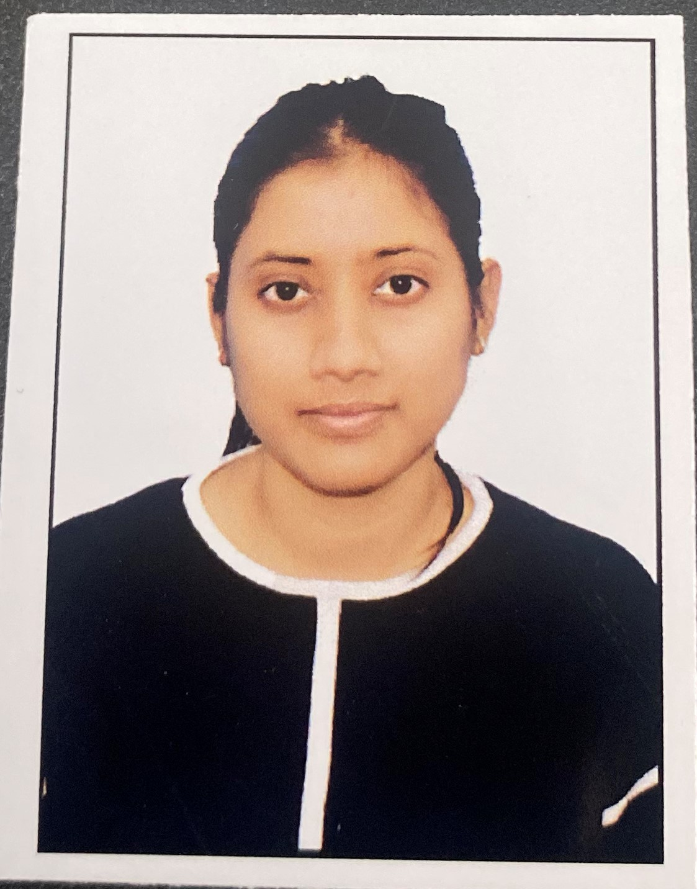

RITIKA RAJ
Analyst/Software Engineer
Bachelor of Technology,
Electronics and Telecommunication : 2018-22
I Transform L&D Left shift batch
MUMBAI
Skills
C# | Basics, OOPS, Exception Handling ,Arrays ,Collection and Generics, Delegates and Events, File Io and Serialization.
.NET Framework | ADO.NET,ASP.NET with MVC5 and WEB API, Entity Framework
Ado.net | Basics Architecture
C++ | Basics, OOPS Concepts
Database | SQL
Tools | GIT,POSTMAN
UI Technology | HTML5 ,CSS & Angular
Add On Skills | Communication Skills, Team Management
ritika.raj@capgemini.com
+91 8084380078
A4
Full Stack Developer
Understanding of RDBMS concepts using SQL Server.
Practical understanding of C# and SQL concepts using Visual Studio and SQL Server
Hands on experience in developing applications using .NET Framework, ADO.NET Core
Understanding of HTML5 , CSS and Angular CLI.
Completed case study on Online Shopping Cart System which is a Web-based System. Online Shopping Cart System is implemented to automate product purchase by converting the shopping system from manual to online. It provides the product searching facilities based on various factors such as categories and names. The main objective of the Online Shopping Cart System is to sell products and this project deals with developing
an e-commerce website for online shopping.
Technologies used:
ANGULAR
ASP.NET CORE
Microsoft SQL Server
Github Link
https://github.com/sdsameer07

