Slide 1
WOOT
Connecting the world one device at a time…

Slide 2
Product?
A general purpose secure IoT solution powered by T-Mobile’s cellular network provides seamlessly machine to machine interaction and provides emergency alerts.

Slide 3



Customer?
1. B2B product
2. Customers are:

Slide 4
Scope of Product?

Slide 5
Customer Experience?
Easy to use UI to track vitals on products
Get Mobile Alert when vitals out of normal range

Slide 6

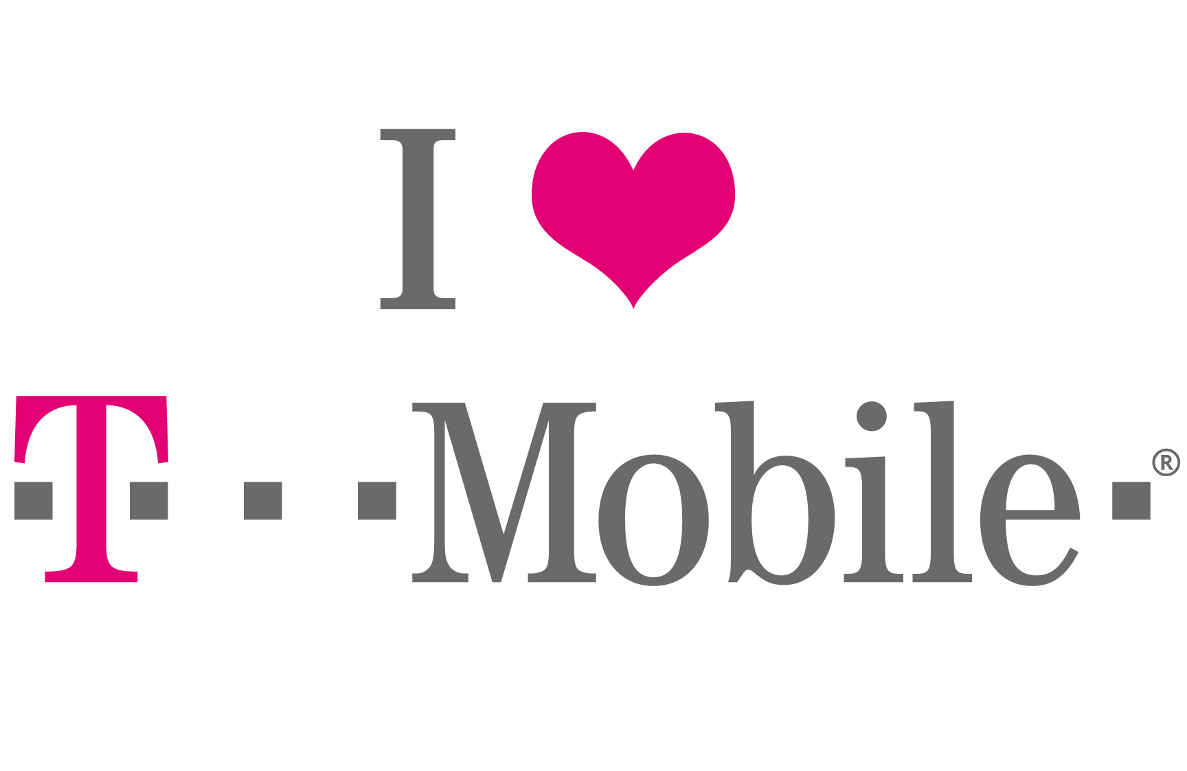
Hey T-Mobile!

Slide 7
Cost?!

Slide 8
Proprietary Hardware
(Temperature, Location, Heart Rate)
T-Mobile Network Enabled Internet
LAMBDA
{CHECK}
AWS SNS

