Slide 1
Artificial Intelligence Based Crop Recommendation
Team Name- The beavers
Team number – 18
Members-
Ritika jain
Harsh Singh
Varsha

Slide 2
Dataset and Parameters
The Dataset has been collected from various resources which include:
District wise, Season wise Area and Production of crops
District-wise, Crop-wise, Season-wise area irrigated.
https://www.kaggle.com/search?q=agriculture
The parameters that are considered include:
Climatic conditions: Temperature, Humidity, Rainfall
Soil Conditions: Moisture, pH, Chemicals (Potassium, Nitrogen, Phosphorus)
Season: Kharif, Rabi, All seasons

Slide 3
Machine Learning Models
Used Neural Networks and Decision Tree Classifier and Naïve Bayes
A dataset of 2200 values was used.
Achieved an accuracy of 97.6 % using Neural Networks
Achieved an accuracy of 93.18 % using Decision Tree Classifier
Achieved an accuracy of 99.5 % using Naïve Bayes Classifier

Slide 4
UNIQUE FEATURE
Integration with an IOT device
The data from which will be used for the test cases.
The Components used in the IOT integration include:
DHT11 - digital temp and humidity sensor
YL-69 PROBES AND YL-38 module for soil moisture Microcontroller-Arduino UNO
Wifi module - ESP8266
Cloud-Thingspeak
Channel Id: 1126318
Read Key: 16FOP2RLDHK4DUZC
Write Key: NEQ09XN1D1CQNLR4
(The channel has been made public so that it can be used further to make an app)

Slide 5
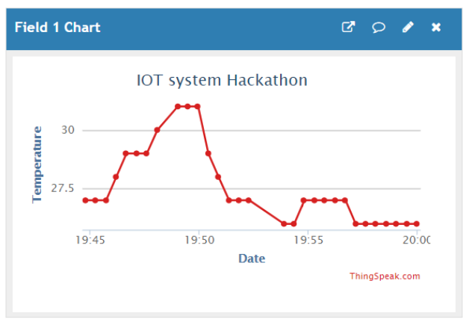
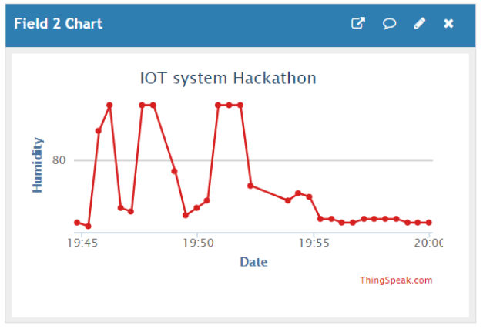
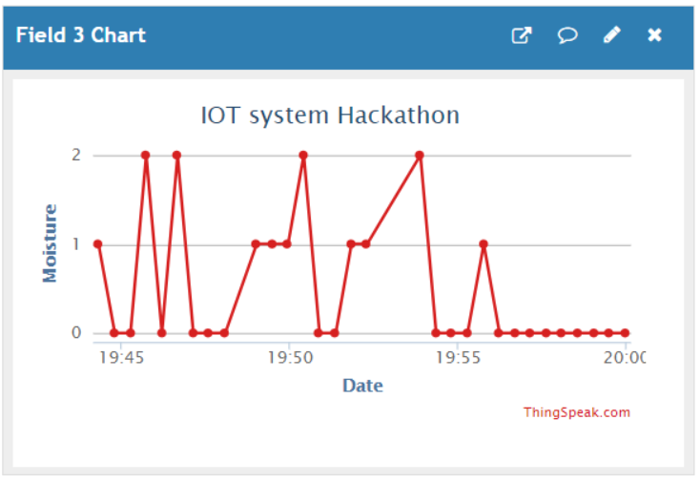

Slide 6
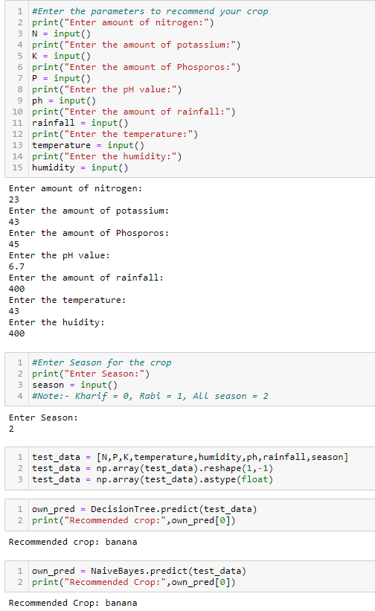
RESULTS
The required input parameters like Amount of nitrogen, potassium, phosphorus, ph value, temperature and humidity and the crop is recommended based on the input parameters.
The input parameters can be given either manually or through the IoT setup.

