Slide 1





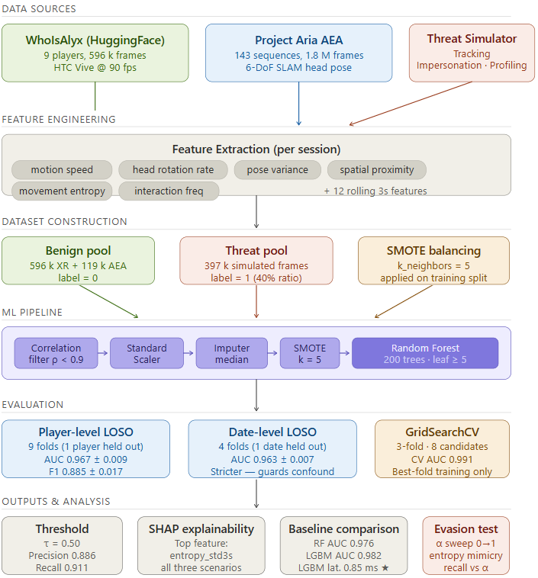
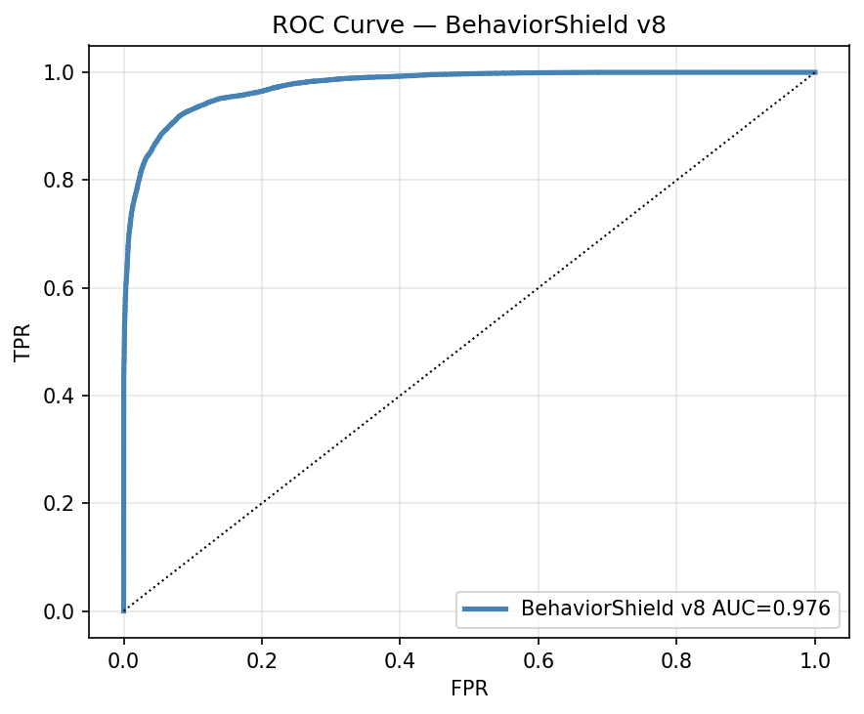





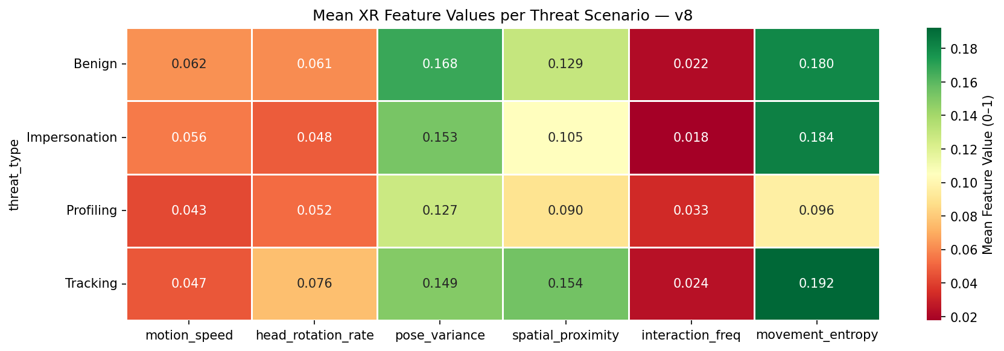
Real-Time Privacy Guardianship in XR Metaverses via AI-Driven Behavioral Analytics
BehaviorShield — Real XR Motion Capture · Rigorous LOSO Evaluation · SHAP Explainability
0.976
993,636
9 + 143
91.1% / 88.6%
0.85 ms
Best-Fold ROC-AUC (LOSO)
Annotated Behavioral Frames
VR Players + AEA Sequences
Threat Recall / Precision
LightGBM Inference Latency
THE PRIVACY THREAT
SYSTEM ARCHITECTURE
DATASET & METHOD
DETECTION PERFORMANCE
Embodied avatars turn continuous motion into a new attack surface. Encryption and access control cannot stop inference from observable kinematics — BehaviorShield profiles motion itself, in real time.
WhoIsAlyx (real VR capture): 9 players · 4 sessions · 596,182 benign frames @ 90 fps (HTC Vive)
Project Aria AEA cross-domain aug.: 143 real-world sequences → 119,236 frames injected (KS-test p<0.001)
Avatar Tracking
3 simulated threats → 993,636 total annotated frames (60% benign / 40% threat)
Blends toward a lagged copy of the target's path to infer real-world routines.
19 engineered features: 6 base kinematic + 12 rolling-3s stats + time-since-last; ρ<0.9 filter → 18 inputs
Behavioral Impersonation
SMOTE (k=5) + Random Forest (200 trees, leaf≥5) @ threshold 0.50
Interpolates rotation toward a victim's signature, fidelity degrading over time.
LOSO Protocol | AUC | F1
Player-level (9 folds) | 0.967±0.009 | 0.885±0.017
Date-level (4 folds) | 0.963±0.007 | 0.836±0.042
Best fold (player_06) | 0.976 | 0.899
92.0%
91.1%
88.6%
Accuracy
Recall
Precision
Spatial Profiling
89.9%
7.5%
0.976
Systematic grid traversal with dwell + backtracking builds a behavioral dossier.
F1-score
FPR
ROC-AUC
Three-tier pipeline: data ingestion → 19-feature engineering → Random Forest detection with SMOTE balancing and SHAP explainability.
EXPLAINABILITY — SHAP ANALYSIS
MODEL COMPARISON (AUC)
KEY TAKEAWAYS & NEXT STEPS
Top SHAP feature — all 3 threats:
movement_entropy_std3s
Tracking 0.205 · Profiling 0.202 · Imperson. 0.186
Top-3 features = 58.7% of total |SHAP|
Rolling stats lift AUC 0.70 → 0.977 (ablation)
Temporal rolling stats are essential — AUC rises 0.70 → 0.98
Cross-domain AEA augmentation curbs VR-specific overfitting
RF → interpretable (SHAP); LightGBM → real-time (0.85 ms, fits 90 fps)
Next: red-team adversarial data, live deployment, federated learning, transformer temporal models
Acknowledgment: Supported by NSTC, Taiwan (Grants NSTC112-2221-E-468-008-MY3 & NSTC114-2221-E-468-015)

