Slide 1

Sales Insights Data Analysis Project
Atliq Hardware's
Presented by: Ritik Chauhan

Slide 2
Agenda
1. Project Overview
2. Data Source
3. Tools and Techniques
4. Data Cleaning/Preparation (ETL)
5. Exploratory Data Analysis (EDA)
6. Data Analysis Queries
7. Results and Findings
8. Sales Analysis Observations
9. Conclusion and Implications

Slide 3
Project Overview
- Objective: Provide insights into sales performance of Atliq Hardwares
- End Product: Power BI dashboard to track revenue trends, sales quantity, and regional revenue breakdown

Slide 4
Data Source
- Primary Source: SQL database dump "db_dump_version_2.sql"
- Contains detailed sales information

Slide 5
Tools and Techniques
- SQL Server: Data Analysis
- PowerBI: Creating Reports
- Data Cleaning/Preparation: ETL

Slide 6
Data Cleaning/Preparation (ETL)
Tasks Performed:
- Loaded and analyzed data using SQL
- Created a star schema data model in Power BI
- Cleaned and transformed data by removing null and irrelevant values
- Handled duplicate currency values in the transactions table

Slide 7
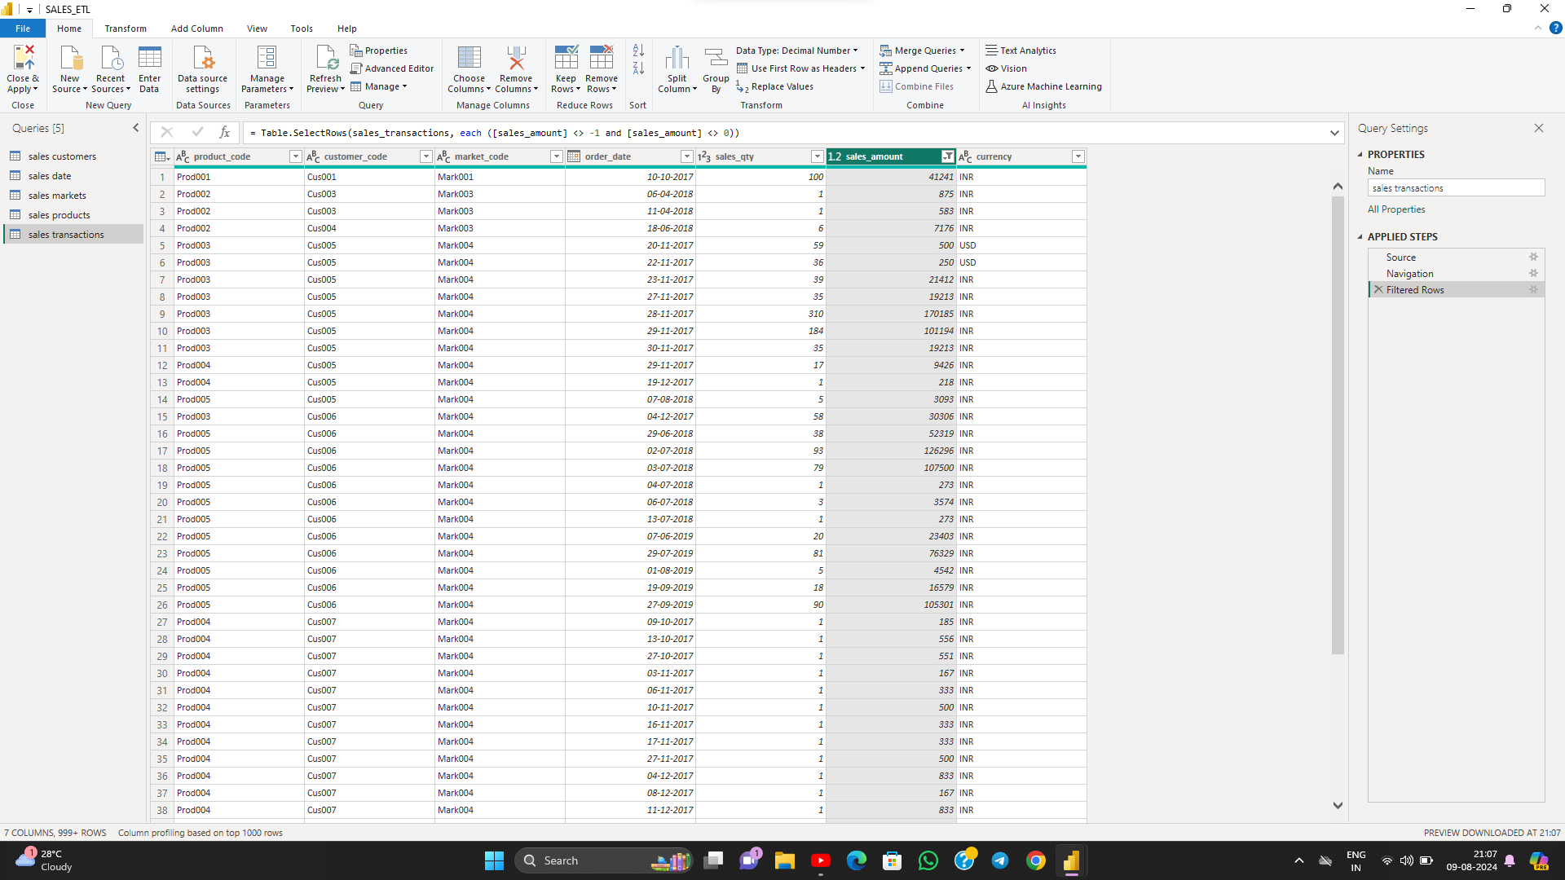
Data Cleaning/Preparation (ETL)
This image is a screenshot of Power BI Desktop,
displaying a data table named "sales transactions,"
which is part of an ETL (Extract, Transform, Load)
process. In the right-hand side pane, under "Query
Settings," there are three applied steps:
1.Source
2.Navigation
3.Filtered Rows (indicating that some r
ows have been filtered based on the condition
[sales_amount] <> 0)

Slide 8
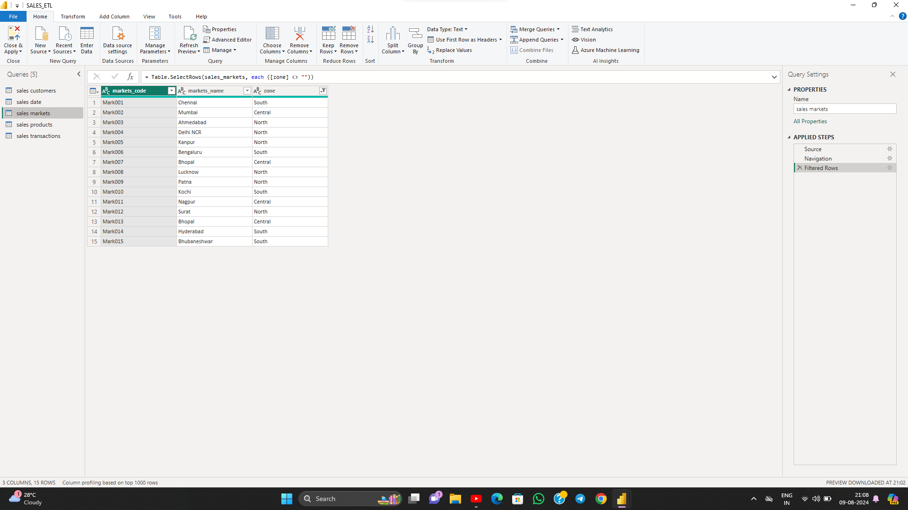
Data Cleaning/Preparation (ETL)
T
This image is a screenshot of Power BI Desktop
, displaying a data table named "sales markets,"
which is part of an ETL (Extract, Transform, Load)
process.In the right-hand side pane, under "Query
Settings," there are three applied steps:
Source
Navigation
Filtered Rows (indicating that some rows have
been filtered based on the condition [zone] <> "")
The top menu options include Home, Transform,
Add Column, View, Tools, and Help, along with
various tools for managing data and columns.
This ETL process is crucial for transforming raw
market data into a structured format suitable for
analysis and reporting.

Slide 9
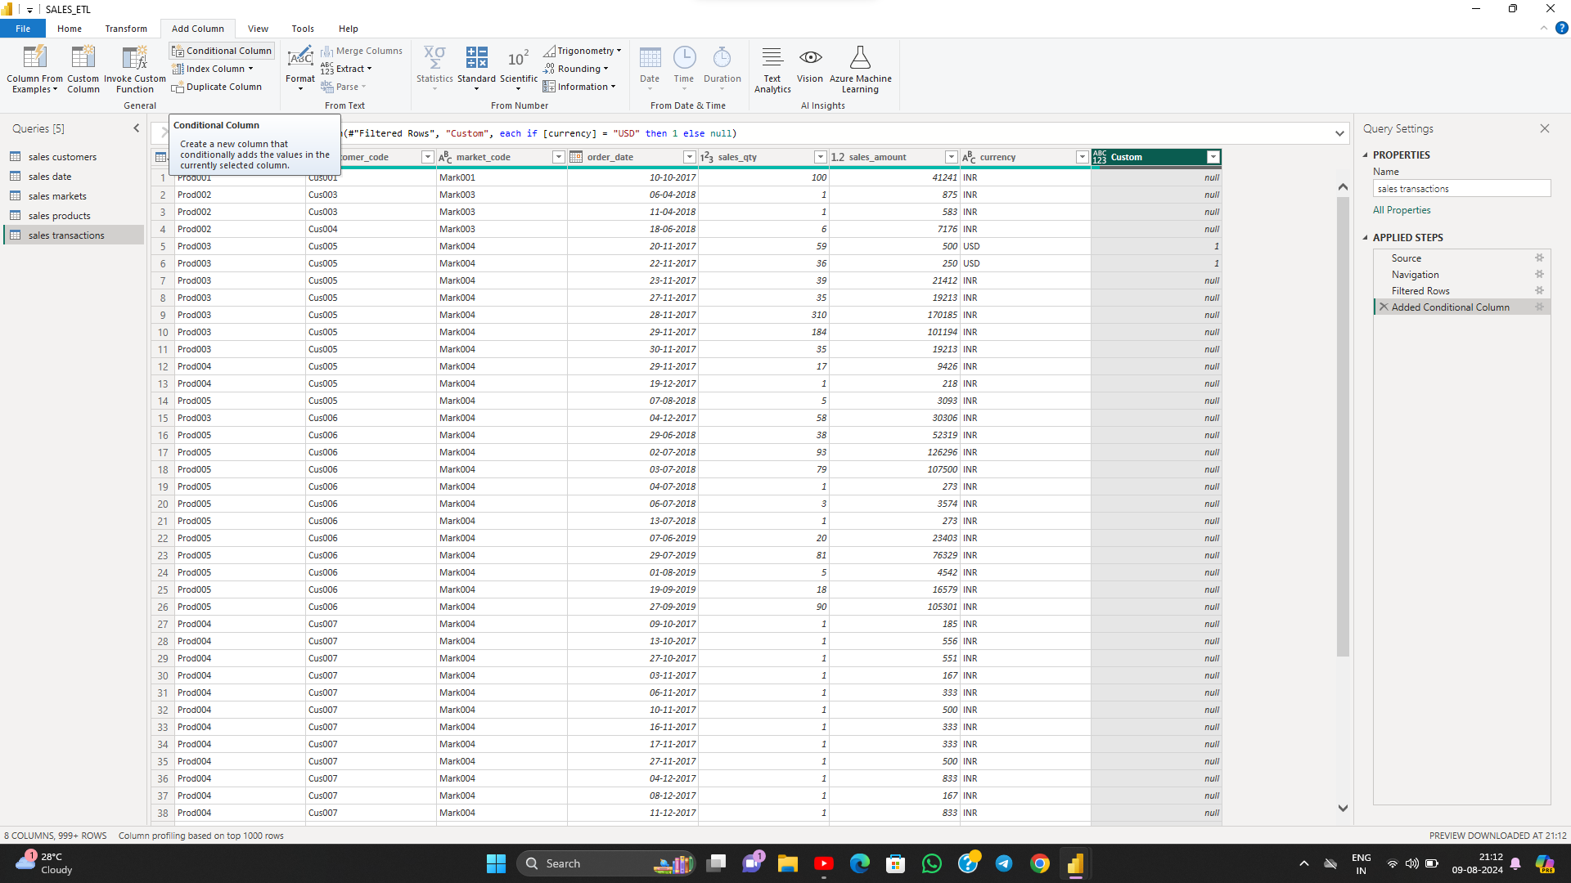
Data Cleaning/Preparation (ETL)
This image is a screenshot of Power BI Desktop, displaying a
data table named "sales transactions," which is part of an
ETL (Extract, Transform, Load) process . In the right-hand
side pane, under "Query Settings," there are
four applied steps:
Source
Navigation
Filtered Rows (indicating that some rows have been
filtered based on the condition [sales_amount] <> 0)
Added Conditional Column (a new step that adds
a column based on a condition)
The top menu options include Home, Transform, Add
Column, View, Tools, and Help, along with various tools
for managing data and columns. The "Custom" column
was added as a conditional column, which likely checks
if the currency is "USD" and then sets a value accordingly.
This ETL process is essential for transforming raw sales
transaction data into a structured format suitable for
analysis and reporting.

Slide 10
Data Cleaning/Preparation (ETL)
This image shows a screenshot of a Power Query Editor in Microsoft Power BI (or possibly Excel) being used as part of an ETL (Extract, Transform, Load) process. It displays the following details:
**Table Name:** "sales transactions" under the "Queries" section on the left.
2. **Applied Steps:** Includes "Source," "Navigation," "Filtered Rows," and "Added Conditional Column."
3. **Formula/Logic Used:** A custom column is added with the logic:
```plaintext
Table.AddColumn(#"Filtered Rows", "update_sales_amount", each if [currency] = "USD" then [sales_amount]*83 else [sales_amount])
```
This formula updates the `sales_amount` by multiplying it by 83 if the currency is in USD; otherwise, it remains unchanged.
4. **Additional Information:**
- There is a preview of the data, showing columns like `product_code`, `customer_code`, `market_code`, and financial details.
- The status bar at the bottom indicates the number of columns and rows being profiled.
- The weather information "28°C Cloudy" is displayed in the bottom-left corner of the screen.
This screen represents a typical transformation step in the ETL process, where data is being manipulated and prepared for loading into a final destination or report.

Slide 11
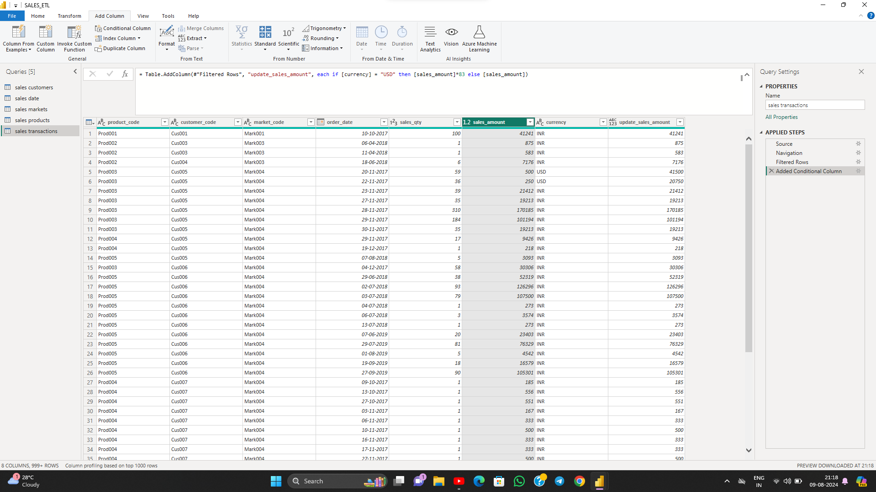
Data Cleaning/Preparation (ETL)

Slide 12
Exploratory Data Analysis (EDA)
Key Questions Answered:
- Overall sales trend
- Top customers
- Peak sales periods

Slide 13
Data Analysis Queries
- Show all customer records: SELECT * FROM customers;
- Total number of customers: SELECT count(*) FROM customers;
- Transactions for Chennai market: SELECT * FROM transactions where market_code='Mark001';
- Distinct product codes sold in Chennai: SELECT distinct product_code FROM transactions where market_code='Mark001';

Slide 14
Data Analysis Queries
Transactions in US dollars: SELECT * from transactions where currency="USD“
- Transactions in 2020: SELECT transactions.*, date.* FROM transactions INNER JOIN date ON transactions.order_date=date.date where date.year=2020;
- Total revenue in 2020: SELECT SUM(transactions.sales_amount) FROM transactions INNER JOIN date ON transactions.order_date=date.date where date.year=2020 and transactions.currency="INR\r" or transactions.currency="USD\r";

Slide 15
Data Analysis Queries
- Total revenue in January 2020: SELECT SUM(transactions.sales_amount) FROM transactions INNER JOIN date ON transactions.order_date=date.date where date.year=2020 and and date.month_name="January" and (transactions.currency="INR\r" or transactions.currency="USD\r");
- Total revenue in Chennai in 2020: SELECT SUM(transactions.sales_amount) FROM transactions INNER JOIN date ON transactions.order_date=date.date where date.year=2020 and transactions.market_code="Mark001";

Slide 16
Power BI Dashboard
- The Power BI dashboard provides detailed insights into sales data.
- It includes key performance indicators (KPIs) and visualizations such as bar graphs and line charts.
- You can interact with the dashboard by selecting specific parameters like year and market.
- To access the full dashboard, please refer to the provided Power BI file: sales2.pbix.

Slide 17
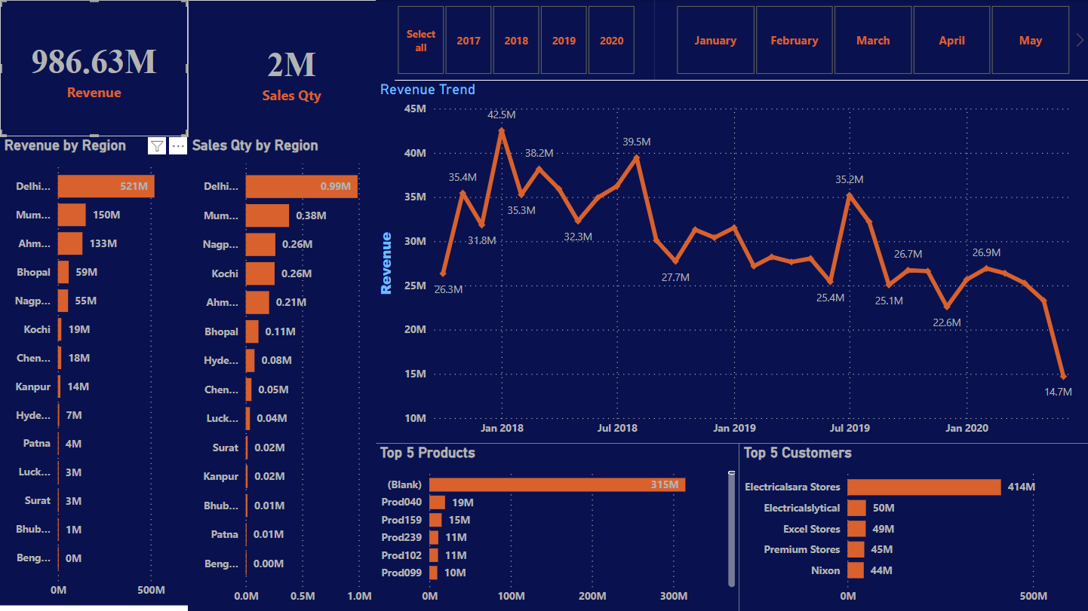
Power BI Dashboard Insights
Dashboard visualizes the overall sales performance with key metrics like total revenue and sales quantity. It highlights regional performance with Delhi leading in both revenue and sales quantity.

Slide 18
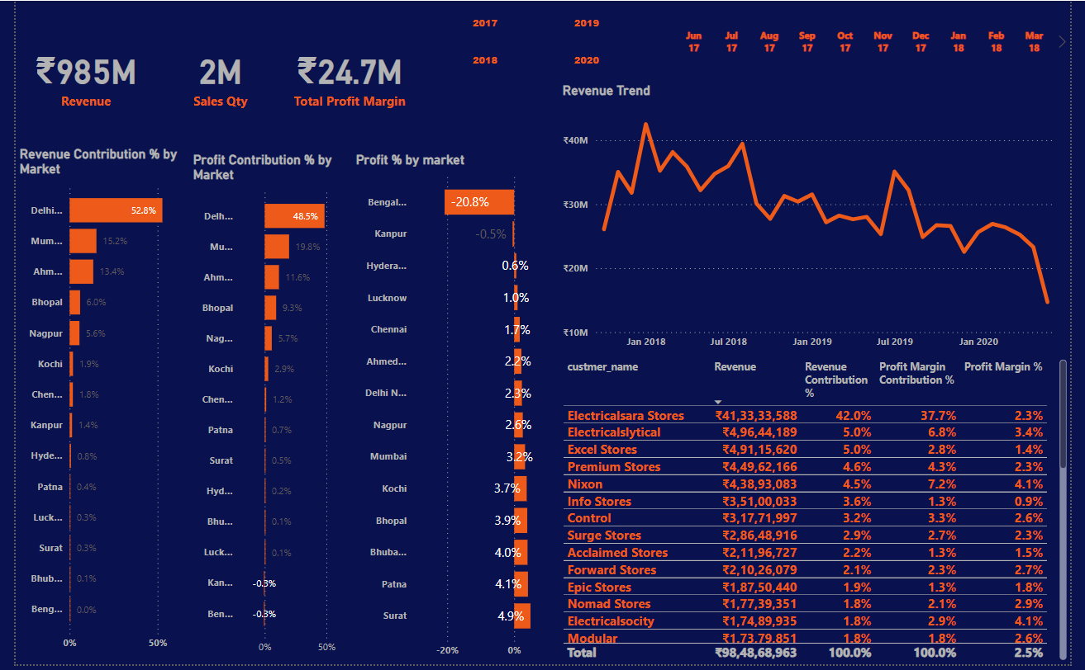
Market-Wise Contribution Analysis
-This Power BI dashboard provides an in-depth analysis of the
market-wise revenue and profit contributions. Key metrics include:
- Revenue Contribution % by Market: Delhi leads with 52.8%, followed
by Mumbai and Ahmedabad.
- Profit Contribution % by Market: Delhi again leads with 48.5%, with
Mumbai and Ahmedabad contributing significantly.
- Profit % by Market: Shows varied performance across markets, with
some markets like Bengal having negative profit margins.
- Revenue Trend: A line chart showing revenue trends over time,
highlighting peak and low periods.
- Top Customers: A table listing key customers and their respective
Revenue, revenue contribution, and profit margin contributions.
This analysis helps identify high-performing regions and customers,
providing insights for strategic decision-making.

Slide 19
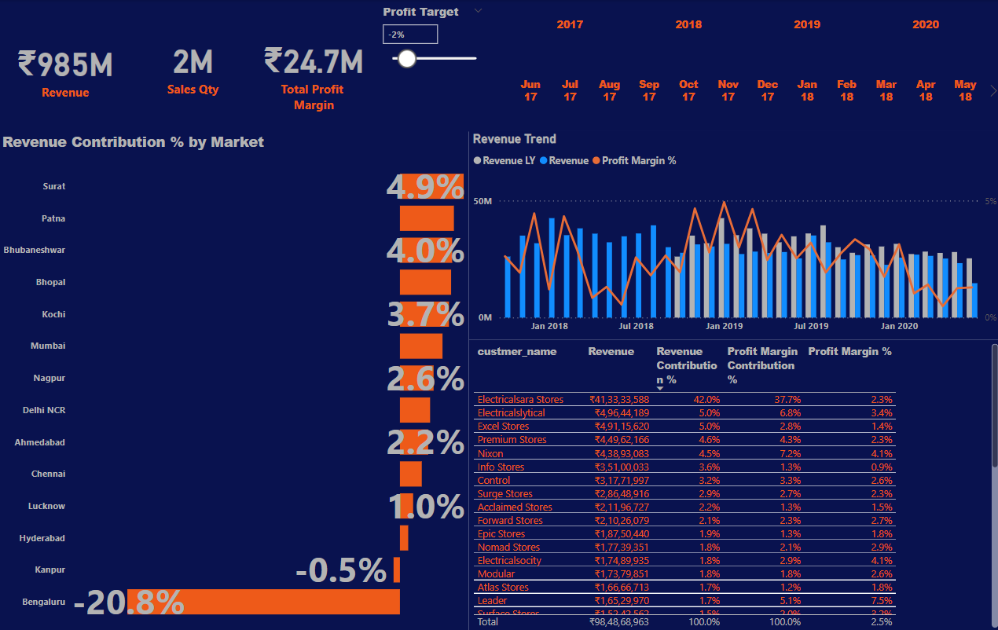
Market-Wise Contribution Analysis
This dashboard focuses on the revenue contribution percentage by market, highlighting top markets like Surat and Patna with significant contributions. However, it also shows regions like Bengaluru with negative contribution.

Slide 20
Results and Findings
Sales Insights Dashboard:
- Key performance indicators (KPIs): Revenue, sales quantity, profit margin, and profit margin%
- Visualizations: Bar graphs and line charts
- Interactivity: Selection of parameters like year and market
- Filtering options
- Zone-wise and market-wise analysis

Slide 21
Sales Analysis Observations
- Overview: Key insights on regional performance and profitability
Observations:
- Revenue vs. Profit Margin%: Delhi leads in revenue; Bhubaneswar in profit margin percentage
- Profit Margin Contribution: Mumbai as top contributor

Slide 22
Conclusion and Implications
- Strategic Marketing Investments: Focus on high-profit margin regions like Bhubaneswar
- Strategy Replication: Implement successful strategies from Mumbai in other regions

