Slide 1
CHINOOK MUSIC STORE
RITIK KATIYAR

Slide 2

Agenda
Chinook Overview
Problem Statement
Data Schema
Data Cleaning & Validation
Key Metrics and Visualization
Recommendations

Slide 3

Chinook Overview
Chinook is a digital music store database containing customer, sales, track, album, artist, and genre data.
The database stores music purchase and customer transaction information.
The project uses SQL analysis to study customer behavior and sales trends.

Slide 4

Problem Statement
Analyze Chinook music sales data to understand customer purchasing behavior and sales performance.
Identify trends in customers, tracks, genres, and country-wise sales.
Generate insights and recommendations to support business growth and customer retention.

Slide 5
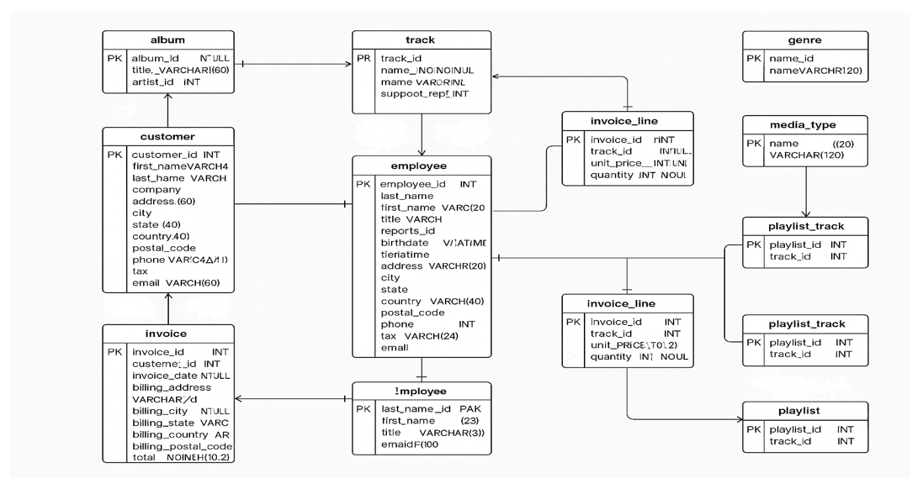
Data Schema

Slide 6
Data Cleaning & Validation
Customer table had missing values in Company, State, and Fax columns.
Track table contained a high number of missing values in the Composer column.
One NULL value in employee reports-to column was valid because the top-level manager has no reporting manager.
Duplicate records were identified only in invoice-line and playlist tables.
Validated joins and relationships between tables to ensure accurate analysis.

Slide 7
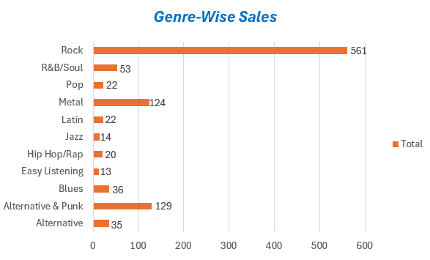
Best-Selling Genre Analysis
Rock is the top-selling genre in the USA contributing around 53% of total sales.
Alternative & Punk and Metal are the
next most popular genres.
Genres like TV Shows and Soundtrack generate the lowest sales due to lower customer demand.

Slide 8
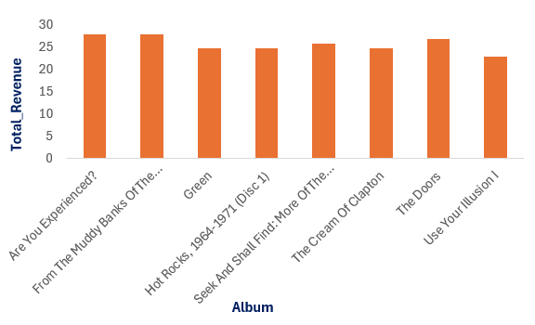
Album-Based Sales Analysis
From The Muddy Banks Of The Wishkah & Are You Experienced? generated the highest revenue in the USA.
Most top-performing albums belong to the Rock genre, showing strong customer demand.
Artists like Nirvana, Jimi Hendrix, & The Doors contribute significantly to album sales.

Slide 9
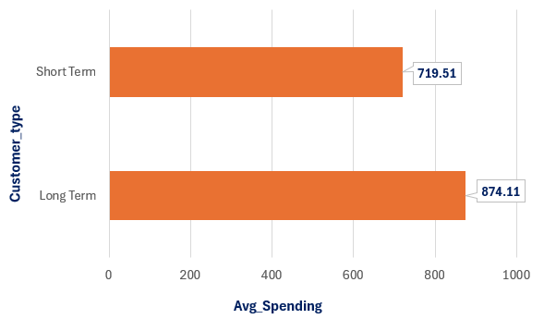
Customer Loyalty Analysis
Long-term customers have higher average spending (874.11) than short-term customers (719.51).
Long-term customers show higher basket size (86) and purchase frequency (11), indicating stronger loyalty.
Short-term customers show lower spending and activity, highlighting the need for better retention strategies.

Slide 10
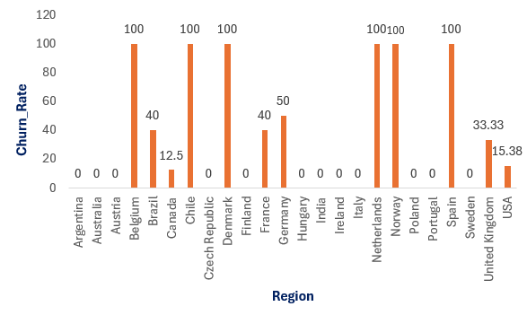
Regional Market Analysis
6 countries show 100% churn, indicating-no recent customer activity.
USA & Canada have low churn (<20%) with highest active customers (13 & 8).
11 out of 24 countries show 0% churn,
indicating active customers.
Churn varies due to demand, income,
market maturity, and competition.

Slide 11
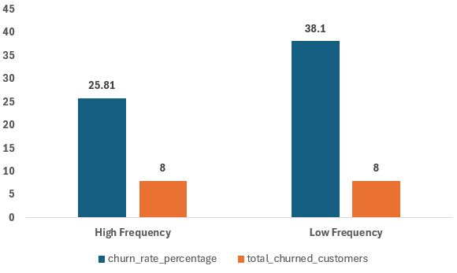
Churn Segmentation
Low Frequency – Low Value segment shows the highest churn (38.1%),making it the most at-risk group.
High Frequency – Low Value segment has a moderate churn rate (25.81%), indicating that frequent purchases alone don’t ensure retention.

Slide 12
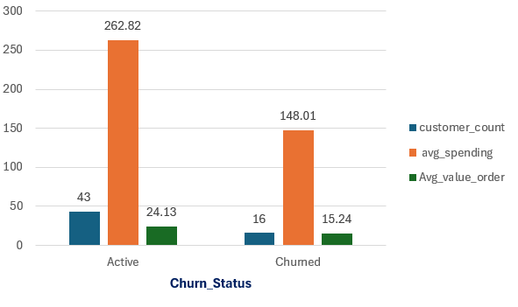
Customer Lifetime Value(CLV)
Customer distribution: 43 Active and 16 Churned customers.
Active customers have higher average spend (262.82) and order value (24.13).
Churned customers show lower average spend (148.01) and order value (15.24).
Key insight: Lower spending and order value are strongly associated with customer churn.

Slide 13
Recommendations
Improve underperforming genres (TV Shows, Soundtracks) using targeted promotions & curated recommendations.
Expand marketing focus on top genres like Rock, Alternative & Punk to maximize revenue growth.
Convert short-term customers into long-term users through loyalty programs and engagement incentives.
Re-activate inactive regions and improve retention in low-performing countries using localized strategies.
Prioritize high-risk and low-value customers with win-back campaigns, personalized offers, and retention-focused engagement.

Slide 14


