Slide 1

In-Field Testing of Digital Microfluidic Biochips using Multi-Agent Reinforcement Learning
Ritik Kumar Koshta (234101044)
Supervisor: Dr. Sukanta Bhattacharjee
DEPARTMENT OF COMPUTER SCIENCE AND ENGINEERING
INDIAN INSTITUTE OF TECHNOLOGY GUWAHATI
GUWAHATI- 781039, ASSAM

Slide 2
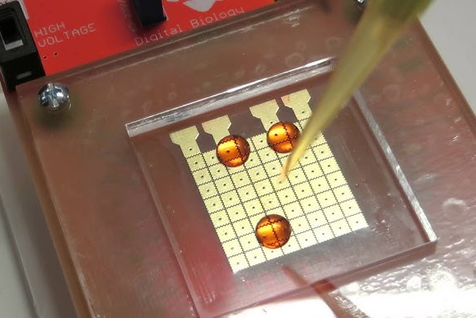
Presentation Overview
Introduction to Digital Microfluidic Biochips (DMBs)
Related Definitions and Problem Formulation
Literature Review
Background of Reinforcement Learning
Reinforcement Learning based In-Field Testing
Experimental Setup and Results
Conclusion
References

Slide 3
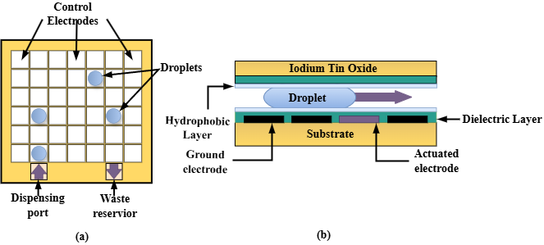
Introduction to Digital Microfluidic Biochips
Programmable lab-on-chip platforms capable of manipulating discrete droplets of fluid on a 2D electrode array using electrical actuations.
Applications: Point-of-Care diagnosis, nucleic acid analysis, and cell-based assays.
Technology: Electrowetting-on-dielectric (EWOD).

Slide 4
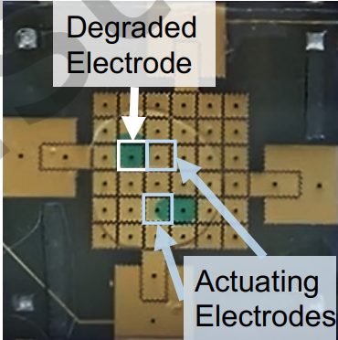
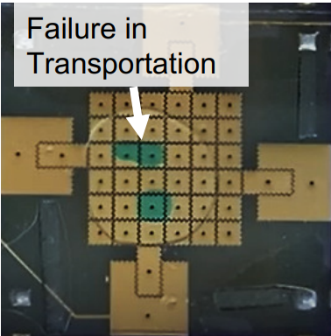
DMB Testing
Why Testing Matters?
Ensuring reliability is critical, especially for safety-critical bioassays.
In-field testing verifies functionality in real-time during assay execution.
Defects:
Electrode Degradation: Over time, electrodes experience wear due to:
Residual charge: Accumulated charges that hinder droplet movement.
Trapped charge: Permanent damage within the dielectric layer.
Droplet Transportation Failures:
Movement is impeded by degraded electrodes.
Increased chances of bioassay failure.
Risk of Contamination
Unintended merging of droplets due to close proximity during routing.

Slide 5
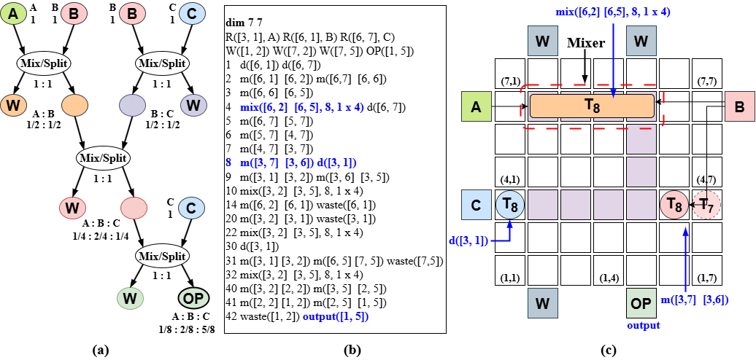
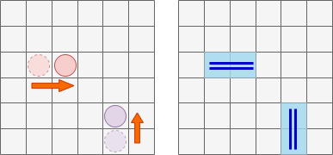
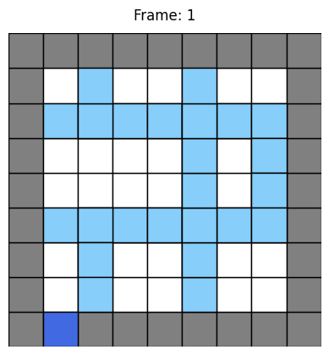
Terminologies
Footprint Edge:
A grid edge on the DMB that is used by assay droplets during transport operations
Assay Footprint:
Set of all vertices on which a droplet was present during assay execution.
Figure 2: Mapping of a Sequential-mixing assay in 1:2:5 on a 7×7array: (a) sequencing graph, (b) synthesized output, and (c) final mapping along with droplets position.
Notes:
Show examples of footprint edges
Assay footprint – define correctly (see papers) and give example

Slide 6
Problem Statement
W
W
The smallest unit which ensure the reliability of the biochip is a Footprint Edge, so if somehow I can state that all the footprint edges are working properly I can state the chip is reliable.
In-Field Testing of DMB
Input: An actuation sequence for implementing a bioassay on the target DMB.
Output: A test droplet routing plan, including both the path and schedule, from source to sink reservoirs.
Objective: Determine a routing plan such that:
Test droplets cover assay footprint edges.
Test droplets do not collide with assay droplets (i.e., they must avoid entering the 3 × 3 grid centered on any assay droplet at the same time step).
The total routing time is minimized.
B
A
C
W
OP

Slide 7
Literature Review: DMB Testing
Table 1: Characteristics of Various Test Approaches for DMBs
Test Approach | Testing Type | Def. Detect. | No. of Test Droplet | Scalability | Approach Type
Offline Testing [Su et al., 2007][Mitra et al., 2011] | Structural | Full | 1–2 (heuristic) | till 15×15 | PMF/CPP
Online error detection [Mitra et al., 2012] | Functional | Partial | Nil | any size | Table-driven
In-field (concurrent) [Su et al., 2006b] | Structural (Hamiltonian) | Partial | 1–2 (heuristic) | till 15×15 | ILP
In-field (concurrent) [Su et al., 2007] | Structural (Eulerian) | Full | 1–2 (heuristic) | till 15×15 | PMF (Heuristic)
In-field (concurrent) [Bhattacharjee et al., 2017] | Structural (Eulerian) | Full | up to 4 | till 15×15 | SAT
Offline Testing [Dinh et al., 2015] | Structural (Eulerian) | Full | any number | till 30×30 | ILP/Heuristic
In-field (concurrent) Proposed | Structural (Eulerian) | Full | up to 4 | till 50×50 | Reinf. Learn.

Slide 8
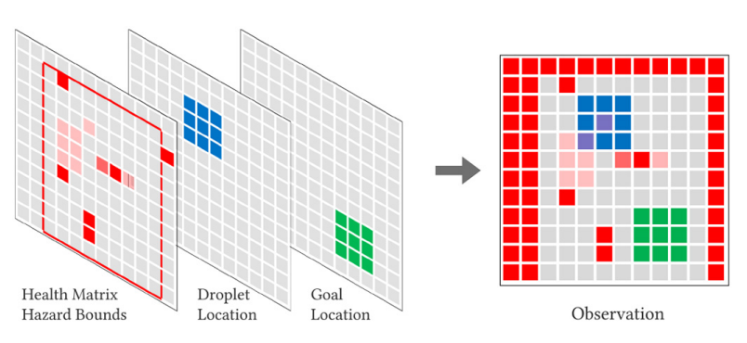
Literature Review: RL in DMB Design Automation
Recently, reinforcement learning-based approaches have gained attention for scalable and adaptive droplet routing under faulty conditions.
Liang et al. [Liang and Zhong, 2020; Liang et al., 2024] proposed an RL-based approach for adaptive droplet routing based on electrode health conditions.
Kawakami et al. [Kawakami et al., 2023] introduced a deep RL method that can dynamically adapt to both known and unknown faults during droplet routing.
A multi-agent deep RL algorithm was developed for routing multiple droplets on micro-electrode dot array (MEDA) biochips [Zhong et al., 2018], utilizing on-chip sensing capabilities [Liang, 2021, Elfar et al., 2022].
Notes:
This slide is ugly

Slide 9
Limitation of Existing DMB Testing
Existing DMB testing methods at mostly designed for offline testing
Limitation: can’t detect runtime fault
Existing In-field DMB testing methods use SAT solvers to find a test plan (test droplet routing path + scheduling)
Limitation: not scalable
Recently, deep-RL has gained attention for scalable and adaptive droplet routing [Refs]
Limitation: Training deep-RL model is difficult and computationally expensive
No deep-RL based in-field testing was proposed
Proposed method leverage tabular RL for finding in-field test plan
Advantages:
Easy to train
Converge to an optimal solution over long run
Scalable to DMB grid up to size 50 x 50

Slide 10
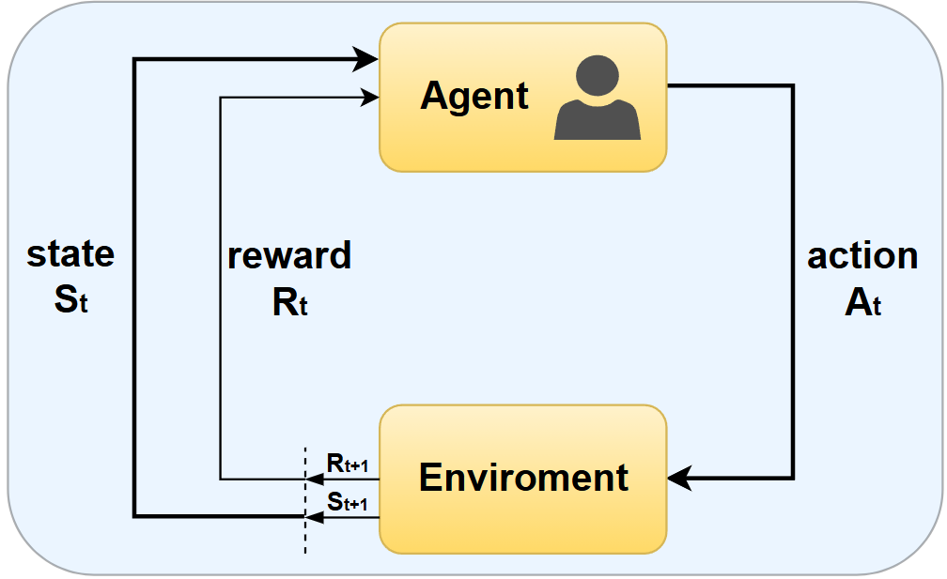
Background of Reinforcement Learning
Reinforcement Learning (RL) is a learning paradigm where an agent learns to make decisions by interacting with an environment.
The goal is to learn a policy that maximizes the cumulative reward over time.
At each time step t, the agent:
observes the current state s_{t},
selects an action a_{t},
receives a reward r_{t},
transitions to the next state s_{t+1}.
The agent learns from trial and error using the reward signals to improve its actions.
Figure 3: Agent–Environment interaction in a Markov decision process.

Slide 11
Q-Learning Algorithm
Q-Learning is a value-based, off-policy RL algorithm.
It learns the optimal action-value function Q∗(s,a) which estimates the expected return for taking action a in state s and following the optimal policy thereafter.
Update Rule:
Q(s_{t},a_{t}) ← Q(s_{t},a_{t}) + α[r_{t}+γ max_{a′}Q(s_{t+1},a′) − Q(s_{t},a_{t})]
α =learning rate
γ =discount factor
Converges to optimal Q-values with sufficient exploration and learning iterations.
Action selection is often done using ϵ-greedy policy.

Slide 12
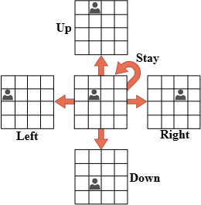
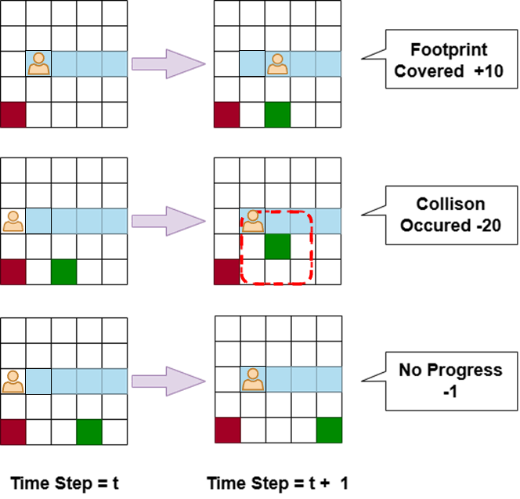

Reinforcement Learning-Based In-Field Testing
An MDP modeling of in-field testing
States (S): All possible situations the agent can be in.
Actions (A): All possible decisions the agent can make.
Transition Function (T): Probability of moving from one state to another given an action.
Reward Function (R): Immediate feedback received after transitioning between states.
Discount Factor (γ): Determines the importance of future rewards (0 ≤ γ ≤ 1).
Single Agent Solution
States (S): S_{t}​ = (agent_pos , time_step) i.e. (x,y,t)
Actions (A): A = {Up, Down, Left, Right, Stay}
Transition Function (T):
Reward Function (R): +10 for covering a footprint, -20 for colliding with an obstacle, -1 for non-rewarding moves and additional bonus at the end of Episode: Rt ​= 50 × (total_footprints / covered_footprints​)
Discount Factor (γ): 0.99
Notes:
Merge Slide 13 and 14

Slide 13
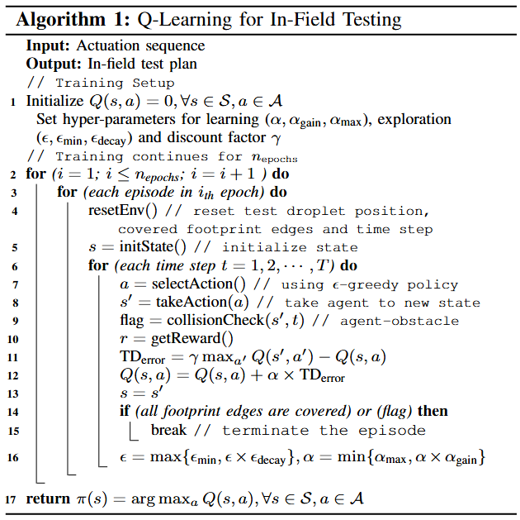
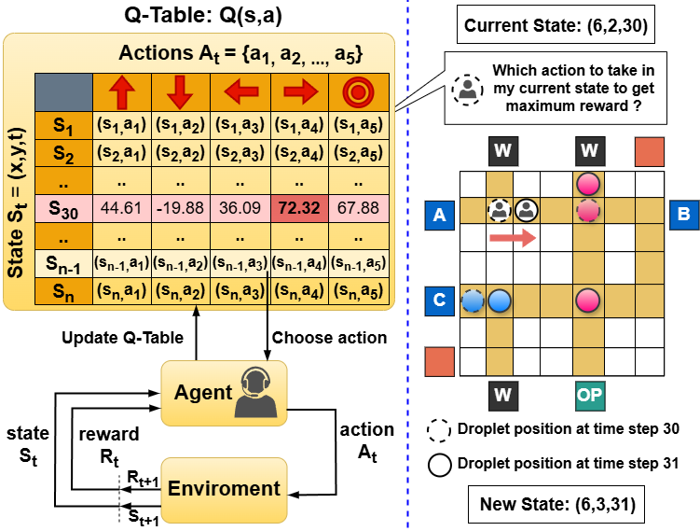
Training of a Single RL Agent
Figure 4: Single agent Q-Learning architecture. The agent updates the Q-table during training (left) and uses the optimized Q-table to navigate the DMB during deployment (right).

Slide 14
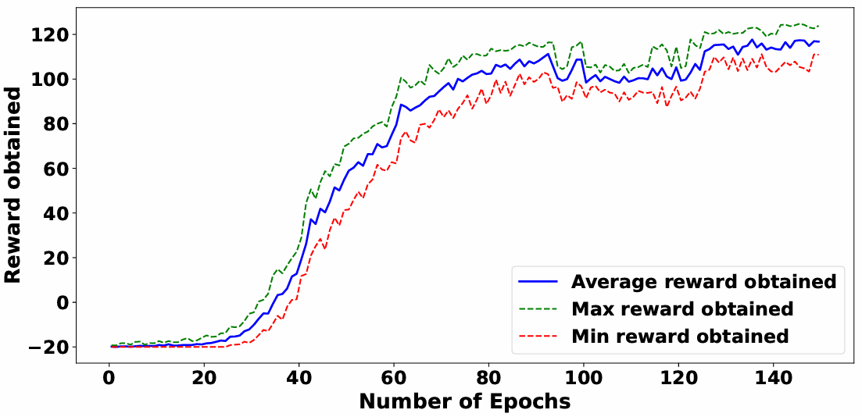
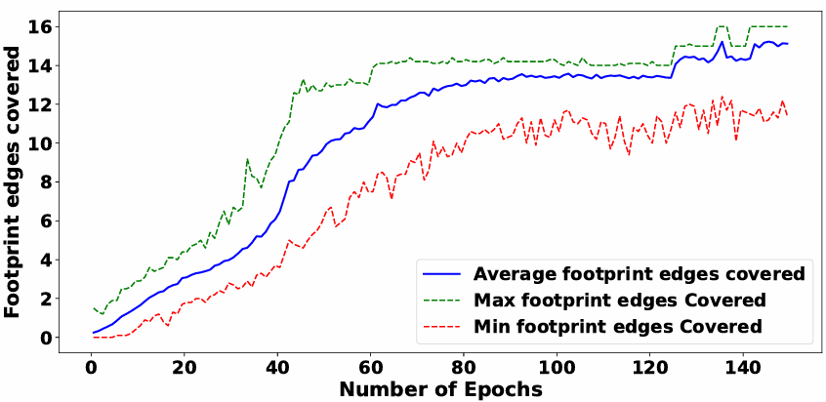
Learning Curve Analysis
Figure 5: Training performance of the agent on Sequential-mixing assay. The graph shows the reward agent obtained per epoch.
Figure 6: Footprint edges covered per epoch by the agent during training in the Sequential-mixing assay.

Slide 15
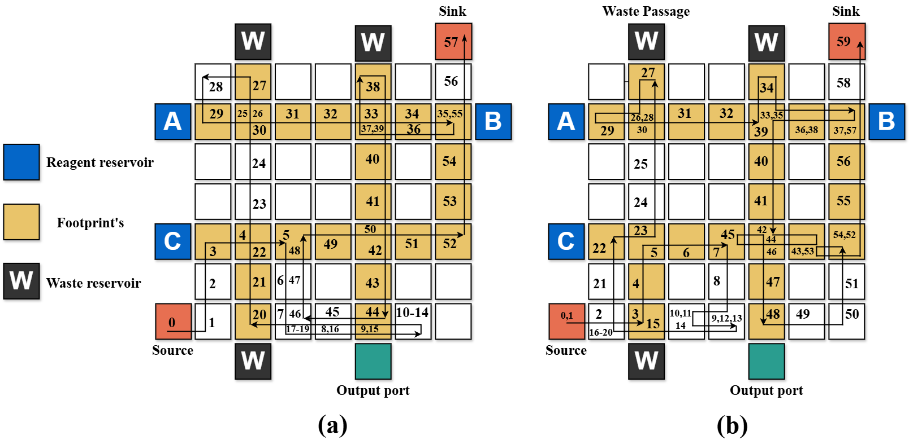
Test Path Planning: SAT-Based vs Proposed Method
Figure 7: Test paths obtained for the Sequential-mixing assay: (a) SAT-based method, (b) Proposed method.

Slide 16
Test Path Planning: SAT-Based vs Proposed Method
RL-based solution achieves matching edge coverage (66.67%) and comparable test application time (59 vs. 57) to SAT, demonstrating its effectiveness.
This shows that the RL-based method can generate solutions with TAT and edge coverage comparable to those obtained by the SAT solver, while requiring significantly less runtime.

Slide 17
Experimental Setup and Results I
Table 2: Summary of Assays used for comparing different approaches
Test ID | Assay Name | Dimension | Tassay
Assay 1 | InVitro [Bhattacharjee et al., 2017] | 7 × 7 | 36
Assay 2 | Sequential mixing of three reagents (Fig.2) | 7 × 7 | 42
Assay 3 | Multiple target mixture preparation: A : B : C = 1 : 2 : 1 and A : C : D = 1 : 2 : 1. | 9 × 9 | 122
Assay 4 | MinMix mixing [Bhattacharjee et al., 2018] R₁ : R₂ : R₃ : R₄ = 95 : 87 : 59 : 15 | 11 × 11 | 192
Assay 5 | Multiple target mixture preparation: A:B:C:D:E = 1:1:1:2:10, and 1:1:1:1:10:2 | 13 × 13 | 155
Assay 6 | Three instances of PCR mixture [Roy et al., 2014] | 16 × 16 | 220
Table 3: Comparison of Experiments on Test Assays Across Methods
Test ID | Tassay | # Footprints Edges | # Agents | Test Application Time (SAT / ε-greedy / Opt. greedy) | Running Time (s) (SAT / ε-greedy / Opt. greedy) | Edge Coverage % (SAT / ε-greedy / Opt. greedy)
Assay 1 | 36 | 20 | 1 | 45 / 46 / 46 | 0.74 / 88.77 / 68.24 | 75.00 / 70.00 / 70.00
Assay 2 | 42 | 24 | 1 | 57 / 65 / 59 | 7.25 / 78.00 / 69.19 | 66.67 / 62.50 / 66.67
Assay 3 | 122 | 104 | 1 | 159 / 186 / 179 | 4831.05 / 1094.54 / 983.49 | 73.91 / 69.23 / 68.26
Assay 4 | 192 | 49 | 1 | 192 / 207 / 202 | 852.01 / 762.16 / 715.41 | 100 / 95.91 / 97.95
Assay 5 | 155 | 108 | 1 | 191 / 220 / 210 | 12698.28 / 1275.11 / 1201.97 | 88.04 / 83.33 / 85.18
Assay 6 | 220 | 126 | 1 | NA / 256 / 252 | Time Out / 1396.39 / 1249.65 | NA / 92.06 / 92.85

Slide 18
From Single-Agent Success to Multi-Agent Necessity
Achievements So Far
Successfully modeled the in-field testing problem on DMB as an MDP.
Trained a single-agent Q-learning model that:
Avoids assay droplets and navigates the grid efficiently.
Achieves competitive edge coverage compared to SAT (e.g., 66.67% for Assay 2).
Performs well on small- to medium-sized assays (Scalable).
Designed a reward function that balances safety, coverage, and efficiency.
Significantly reduced training time with little increase in TAT in most cases.
Motivation for Multi-Agent RL
Scalability Issues:
Single agent struggles with larger grids and higher assay complexity.
Coverage becomes suboptimal as the agent cannot reach all footprint edges efficiently.
Longer Convergence Time with increasing assay size.
Inefficient exploration in dense environments with many assay droplets.

Slide 19

Multi-Agent Extension
Multi-Agent Solution
This solution is basically the extension of our Single agent solution.
Since conventional MARL approaches (e.g., centralized training, parameter sharing) do not scale well due to the exponential growth in joint state-action spaces.
We modeled each test droplet as an independent Q-learning agent.
Agents maintain separate Q-tables, learn their own policies, and operate in distinct spatial quadrants of the DMFB grid.
Avoids the overhead of centralized coordination and global Q-tables.
We implemented a Priority-based action execution prevents collisions between agents:
In a 2-agent system, Agent 1 moves first.
Agent 2 selects an action and checks if it will not result in a collision with Agent 1's new position.
If no collision is predicted, Agent 2 moves.
If a collision would occur, Agent 2 remains in its current position.
If a collision happens, only Agent 1 is penalized.

Slide 20
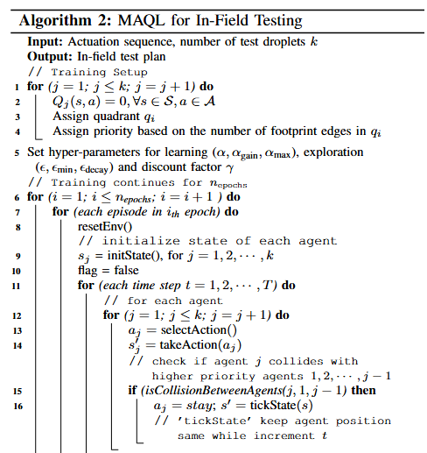
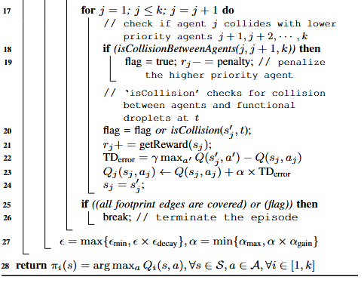
Training of a Multiple RL Agent’s

Slide 21
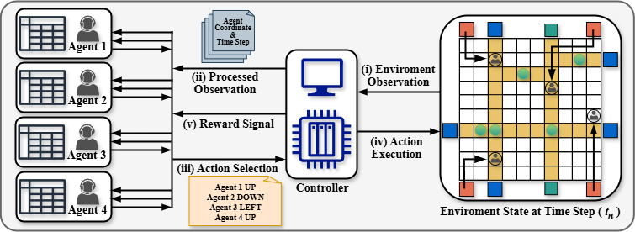
Multi-Agent Architecture
Figure 8: High level overview of the multi-agent reinforcement learning (MARL) framework for in-field testing of digital microfluidic biochips.

Slide 22
Demonstrations of Multi-Agent In-Field Testing
Multiplexed InVitro Assay on a (16x16) grid
Mixing of six reagents: A:B:C:E:G:H = 1:1:2:2:1:1 and A:B:D:F:G:H = 1:1:2:2:1:1

Slide 23
Experimental Setup and Results II
Table 4: Summary of Assays used for comparing different approaches
Test ID | Assay Name | Dimension | Tassay
Assay 7 | Multiplexed InVitro [Su et al., 2006a] | 16 × 16 | 160
Assay 8 | Plasmid DNA [Bhattacharjee et al., 2018] mixing ratios = (57:28:6:6:6:3:150) | 16 × 16 | 195
Assay 9 | Multiplexed InVitro & Glucose [Su et al., 2006a, Su et al., 2007] | 18 × 23 | 203
Assay 10 | Mixing of six reagents: A:B:C:E:G:H = 1:1:2:2:1:1 and A:B:D:F:G:H = 1:1:2:2:1:1 | 30 × 30 | 184
Assay 11 | Four instances of Multiplexed Glucose assays [Su et al., 2007] | 32 × 32 | 128
Assay 12 | Combined execution of five complex assays—Assay 2,4,6,8 and 10 | 50 × 50 | 533
Table 5: Comparison of Experiments on Test Assays Across Methods
Test ID | Tassay | # Footprints Edges | # Agents | Test Application Time (SAT / ε-greedy / Opt. greedy) | Running Time (s) (SAT / ε-greedy / Opt. greedy) | Edge Coverage % (SAT / ε-greedy / Opt. greedy)
Assay 7 | 160 | 319 | 4 | 160 / 207 / 182 | 19825.27 / 1842.81 / 1695.78 | 100.00 / 87.77 / 95.61
Assay 8 | 195 | 115 | 1 | NA / 243 / 220 | Time Out / 1366.26 / 1197.09 | NA / 83.47 / 87.82
Assay 9 | 203 | 382 | 4 | NA / 277 / 239 | Time Out / 2058.34 / 1975.68 | NA / 84.03 / 97.12
Assay 10 | 184 | 261 | 4 | NA / 218 / 211 | Time Out / 2178.30 / 2094.44 | NA / 95.40 / 98.08
Assay 11 | 128 | 252 | 4 | NA / 171 / 151 | Time Out / 1673.85 / 1587.95 | NA / 84.92 / 90.47
Assay 12 | 533 | 768 | 4 | NA / 636 / 598 | Time Out / 8312.18 / 7893.27 | NA / 91.53 / 95.18

Slide 24
Conclusion
The proposed RL based in-field testing framework achieves near-optimal test plans with significantly reduced computation time.
For example, in Assay 5, RL achieves ∼3% less coverage than SAT but with a ∼10× speedup (1275s vs. 12,698s) on a 13×13 grid.
In more complex assays (Assay 7–12), SAT solvers failed to generate test plans, while RL based methods successfully produced high-coverage solutions within reasonable runtime.
Among the two RL strategies, optimistic Q-learning converged faster and achieved better test application time (TAT) compared to ϵ-greedy.
These results demonstrate that the RL based approach is scalable, efficient, and effective for in-field test generation on DMBs.

Slide 25
Acknowledgements
I would like to express my sincere gratitude to:
Dr. Sukanta Bhattacharjee, Department of Computer Science and Engineering, IIT Guwahati, for his continuous guidance, encouragement, and insightful feedback throughout this work.
Dr. Arghyadip Roy, Mehta Family School of Data Science and Artificial Intelligence, IIT Guwahati, for his valuable suggestions and technical inputs that significantly contributed to the development of this research. Their support has been instrumental in shaping this work and bringing it to completion.
Thank You!
r.koshta@iitg.ac.in

Slide 26
References I
Bhattacharjee, S., Chen, Y.-L., Huang, J.-D., and Bhattacharya, B. B. (2018). Concentration-resilient mixture preparation with digital microfluidic lab-on-chip. ACM Transactions on Embedded Computing Systems (TECS), 17(2):1–12.
Bhattacharjee, S., Mitra, D., and Bhattacharya, B. B. (2017). Robust in-field testing of digital microfluidic biochips. ACM Journal on Emerging Technologies in Computing Systems (JETC), 14(1):1–17.
Dinh, T. A., Yamashita, S., Ho, T.-Y., and Chakrabarty, K. (2015). A general testing method for digital microfluidic biochips under physical constraints. In 2015 IEEE International Test Conference (ITC), pages 1–8. IEEE.
Elfar, M., Chang, Y.-C., Ku, H. H.-Y., Liang, T.-C., Chakrabarty, K., and Pajic, M. (2022). Deep reinforcement learning-based approach for efficient and reliable droplet routing on meda biochips. IEEE Transactions on Computer-Aided Design of Integrated Circuits and Systems, 42(4):1212–1222.
Kawakami, T., Shiro, C., Nishikawa, H., Kong, X., Tomiyama, H., and Yamashita, S. (2023). A deep reinforcement learning-based routing algorithm for unknown erroneous cells in dmfbs. In 2023 21st IEEE Interregional NEWCAS Conference (NEWCAS), pages 1–5. IEEE.
Liang, T.-C. (2021). Parallel droplet control in meda biochips using multi-agent reinforcement learning. In International Conference on Machine Learning.
Liang, T.-C., Chang, Y.-C., Zhong, Z., Bigdeli, Y., Ho, T.-Y., Chakrabarty, K., and Fair, R. (2024). Dynamic adaptation using deep reinforcement learning for digital microfluidic biochips. ACM Transactions on Design Automation of Electronic Systems, 29(2):1–24.
Liang, T.-C. and Zhong, Z. (2020). Adaptive droplet routing in digital microfluidic biochips using deep reinforcement learning. In Proceedings of the 37th International Conference on Machine Learning.

Slide 27
References II
Mitra, D., Ghoshal, S., Rahaman, H., Chakrabarty, K., and Bhattacharya, B. B. (2011). Test planning in digital microfluidic biochips using efficient eulerization techniques. Journal of Electronic Testing, 27:657–671.
Mitra, D., Ghoshal, S., Rahaman, H., Chakrabarty, K., and Bhattacharya, B. B. (2012). On-line error detection in digital microfluidic biochips. In 2012 IEEE 21st Asian Test Symposium, pages 332–337. IEEE.
Roy, S., Kumar, S., Chakrabarti, P. P., Bhattacharya, B. B., and Chakrabarty, K. (2014). Demand-driven mixture preparation and droplet streaming using digital microfluidic biochips. In Proceedings of the 51st Annual Design Automation Conference, pages 1–6.
Su, F., Hwang, W., and Chakrabarty, K. (2006a). Droplet routing in the synthesis of digital microfluidic biochips. In Proceedings of the design automation & test in Europe conference, volume 1, pages 1–6. IEEE.
Su, F., Hwang, W., Mukherjee, A., and Chakrabarty, K. (2007). Testing and diagnosis of realistic defects in digital microfluidic biochips. Journal of Electronic Testing, 23(2):219–233.
Su, F., Ozev, S., and Chakrabarty, K. (2006b). Concurrent testing of digital microfluidics-based biochips. ACM Transactions on Design Automation of Electronic Systems (TODAES), 11(2):442–464.
Zhong, Z., Li, Z., Chakrabarty, K., Ho, T.-Y., and Lee, C.-Y. (2018). Micro-electrode-dot-array digital microfluidic biochips: Technology, design automation, and test techniques. IEEE Transactions on Biomedical Circuits and Systems, 13(2):292–313.

