Slide 1


Pitch deck
FLIGHT PRICE PREDICTION
MADE BY :- RITIK CHAUHAN

Slide 2
OVERVIEW
The objective of the Flight Price Prediction project is to develop machine learning models that can accurately predict flight prices based on various input features. By leveraging Random Forest and Decision Tree classifiers, the project aims to help airlines optimize their pricing strategies and assist travelers in planning their trips more efficiently.

Slide 3
Data Preparation
In the Data Preparation, we will walk through the process of building a robust machine learning model, starting with data loading, where we import the dataset into our environment for analysis. We then proceed with Exploratory Data Analysis (EDA), focusing on feature selection to identify the most relevant features. The next step involves data cleaning and processing, specifically handling any missing values to ensure the dataset's integrity. Following this, we train our models using techniques like Random Forest and Decision Tree. To optimize our models, we employ hyperparameter tuning with RandomizedSearchCV, which helps in enhancing model performance. We then evaluate the models using various metrics, concluding with an assessment of accuracy through metrics such as RMSE, MAE, MSE, and R Square to gauge the model's effectiveness and precision.

Slide 4
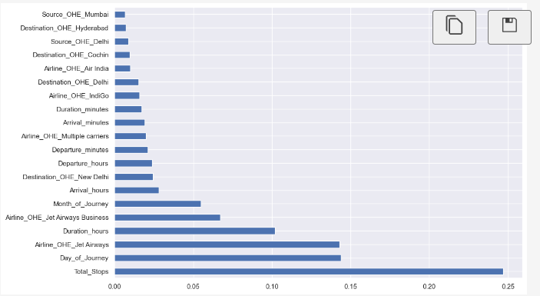

Feature Importance
I used the ExtraTreesRegressor for selecting the important feature.

Slide 5

Model Training
Random Forest : A Random Forest regressor was trained using the prepared dataset. Random Forest is an ensemble method that builds multiple decision trees and merges them to get a more accurate and stable prediction.
2. Decision Tree : A Decision Tree regressor was also trained for comparison. Decision Trees split the data into subsets based on the most significant feature, aiming to create the most homogenous branches.

Slide 6
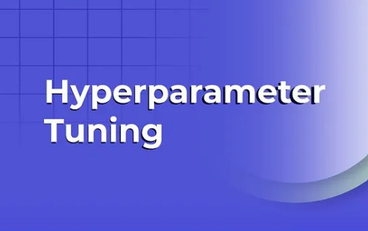
Hyperparameter Tuning
Randomized Search CV : Hyperparameter tuning was performed using Randomized Search CV to find the best parameters for the Random Forest model. This process involves searching across different hyperparameters to find the combination that results in the best performance.
2. Parameters Tuned: :
In the process of tuning a Random Forest model, several key hyperparameters are optimized to enhance performance. The number of trees in the forest, denoted by n_estimators, determines how many decision trees are built. The max_depth specifies the maximum depth each tree can grow, influencing the model's complexity. The min_samples_split sets the minimum number of samples required to split an internal node, while min_samples_leaf defines the minimum number of samples needed at each leaf node to prevent overfitting. Lastly, max_features controls the number of features considered when splitting each node, balancing between model diversity and accuracy.

Slide 7
Accuracy
Model Name | RMSE | MAE | MSE | R2 SQUARE
Random Forest | 2090.865 | 1181.12 | 4371719.39 | 0.797
Decision Tree | 858.403 | 380.299 | 736856.89 | 0.965

Slide 8

Conclusion
The project successfully demonstrated the use of Random Forest and Decision Tree regressor in predicting flight prices. Hyperparameter tuning significantly improved the performance of the Random Forest model. Future work could involve exploring more advanced algorithms and additional features to further enhance prediction accuracy.

Slide 9
Thank you

