Slide 1
RESUME SCREENING
PRESENTED BY:
CHAUHAN RITIK SINGH
ANKIT PEDNEKAR

Slide 2
INTRODUCTION
Resume screening is the process of determining whether a candidate is qualified for a role based his or her education, experience, and other information captured on their resume.
Job description and any other relevant information should also be compared with resume.

Slide 3
WHAT IS RESUME SCREENING?
Resume screening is the process of determining whether a candidate is qualified for a role based his or her education, experience ,and other information captured on their resume.

Slide 4
WORKING OF PROJECT
Screen resumes based on the job’s minimum qualification.
01
Screen resumes based on the job’s preferred qualifications
02
03
Screen resumes based on the shortlist of candidates you want to move onto the interview phase
04
Select the resume according to the comapanys needs.

Slide 5
MODULES IN OUR PROJECT
KNN
-k-nearest neighbours algorithm
K-nearest neighbors (KNN) algorithm is a type of supervised ML algorithm which can be used for both classification as well as regression predictive problems.
NLP
Natural language processing (NLP)
NLP is the ability of a computer program to understand human language as it is spoken and written -- referred to as natural language.

Slide 6
LIBRARIES USED IN OUR PROJJECT
NUMPY
MATPLOTLIB
NumPy is a Python library used for working with arrays
Matplotlib is an amazing visualization library in Python for 2D plots of arrays.
SCIPY
01
02
03
04
05
SEABORN
PANDAS
Seaborn is a Python data visualization library based on matplotlib.
Pandas is an open-source library that is made mainly for working with relational or labeled data both easily and intuitively.

Slide 7
NEED’S IN COMPANY
WORK EXPERIENCE
EDUCATION
SKILLS
PERSONALITY

Slide 8
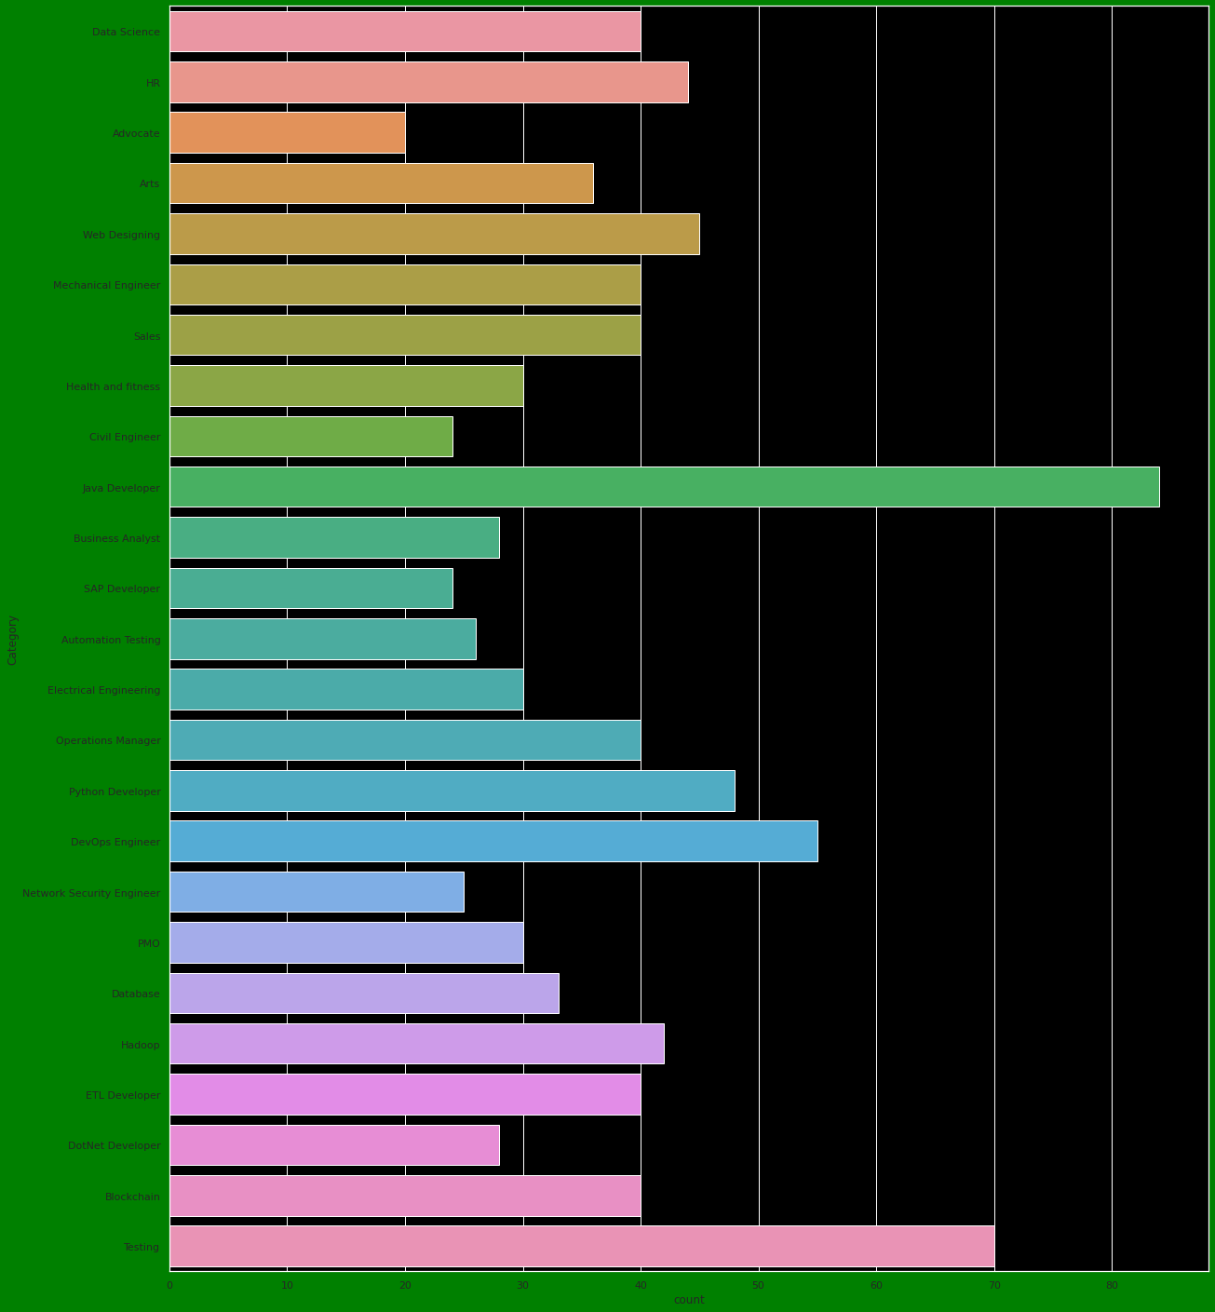
BARGRAPH

Slide 9
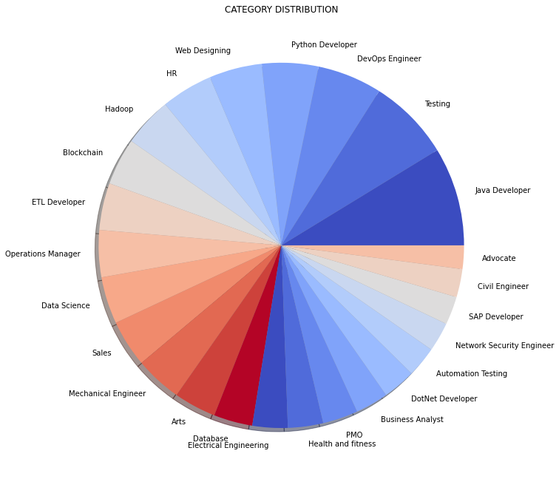
PIE-CHART

Slide 10
THANK YOU

