Slide 2
TEAM NAME : Hackers2.0
Team leader : Himanshi Gupta
Team Members : Bhaskar Chaturvedi
Ritik Vishwkarma
Nisha chakrawarti

Slide 3
Problem Statement
Open Innovation :
Ensuring public safety and security has become a critical issue in today's world, as criminal activities and security breaches continue to rise. With the increasing use of technology, it is becoming more important to implement efficient and effective security systems that can authenticate individuals and prevent security breaches in public places.

Slide 4
Solution Statement
Facial recognition technology Can be used as a solution for global security and authentication problem by providing a secure and reliable method of verifying identity.
Collect a database of facial images of individuals that You want to authenticate.
Prepare the image by resizing and normalizing them to a common size ,and grayscale or RGB format .
Train a facial recognition model using a deep learning Algorithms such as CNN.
Deploy the model in a secure system that captures an individual’s facial image ,and compares it to the database of images to authenticate the individual’s identity.
Optionally , use additional security measures such as biometric sensors.

Slide 5
Tech Stacks
Hardware requirement : camera/webcam , processor, memory, storage, graphics proccessing unit, power supply , network connectivity.
Software requirement : Operating system: The AI virtual air canvas software will need to be compatible with the operating system of the computer or device being used. This may require a specific version of Windows, macOS , or Linux.
TOOL USED: PyCharm,vscode
LIBRARIES: NumPy , OpenCV , tkinter,cv2
LANGUAGE: Python
DATABASE: Mysql

Slide 6
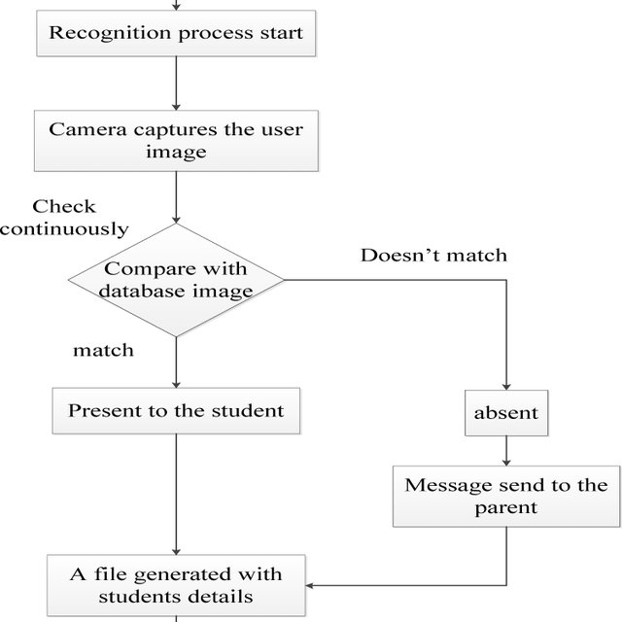
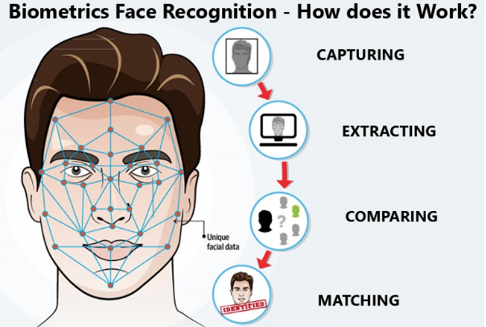
Wireframing /Architecture of the project flow
a

Slide 7
Future Scope of the project
school/college attendance system
Personalization
Enhance security
Airport

