Slide 1
SMART HOME FLAME DETECTION WITH WATER TANK
217378370
The system monitors if there is fire, if fire is detected water pump will be energized.

Slide 2
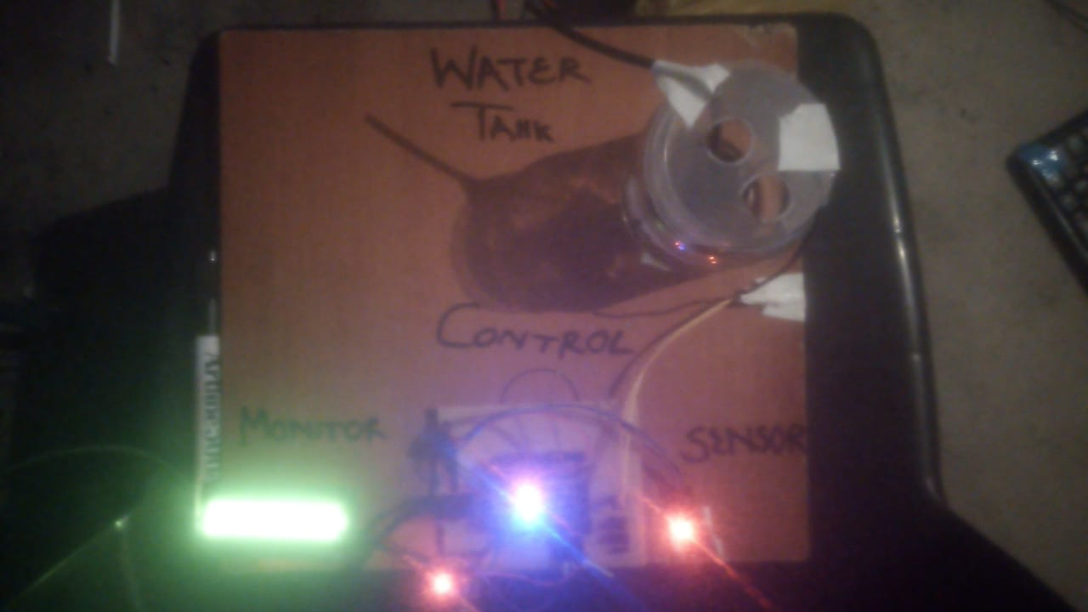
FULLY FIRE DETECTOR SYSTEM *Sensor monitors if there is fire

Slide 3
COMPONENTS USED
ESP32 Microcontroller
DIY Sensor(flame sensor)
LCD (Monitor)
Water Pump
Water Tank

Slide 4
SYSTEM PROCESS
When fire is detected the water pump inside the tank will be energized and pump water until fire is out.
Also the sensor value will always be sent to the database.
The sensor value will be displayed on the LCD

Slide 5


WATER TANK
The water pump is placed inside the water tank to pump water when fire is detected.

Slide 6
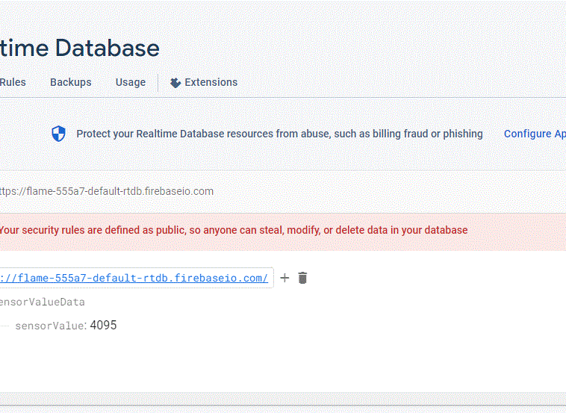
DATABASE
User have access to the database by seeing the fire level sensor value.

Slide 7

LCD DISPLAY
Sensor value displayed on the screen

Slide 8

WEBSITE
For the user to access this must login, in order to read data from database

Slide 9

SUMMARY
This system enables or assist the user/homeowner by monitoring and making sure the fire is kept out when is detected.

