Slide 1
Using the New
UTD PowerPoint
Template
UTD Communications
August 16, 2023

Slide 2
Basic “How to” on Using This Template
UTD PowerPoint Template
1
3
Fonts & File Formats
Charts
2
4
Master Pages
UTD Logos

Slide 3
FONTS & FILE FORMATS
1
Are you creating this on your own,
or is this a group effort?

Slide 4
Fonts & File Formats
UTD PowerPoint Template
Fonts:
Are you co-creating a presentation with others? Across PC’s and Mac?
Are you distributing the PowerPoint to others?
File Formats:
This PowerPoint is designed for
“On-Screen” at 16:9
(Best for presenting in classroom A/V systems)
Always save as “PPTX”
(Best for sharing across Mac and PC,
most up-to-date format as opposed to “PPT”)

Slide 5
Fonts & File Formats
UTD PowerPoint Template
Fonts:
Are you co-creating a presentation with others? Across PC’s and Mac?
Are you distributing the PowerPoint to others?
YES:
Use fonts compatible on both Mac & PC platforms
(Arial, Times, Avenir, Cambria, Century Gothic, +)
NO:
Experiment with font options, get creative
Try Google Fonts – fonts.google.com
If you have Adobe Creative Cloud fonts.adobe.com

Slide 6
Using Master Pages for layout.
2
This template is made for screens with a 16:9 ratio (think HD TV),
with with 15 Layout Options.

Slide 7
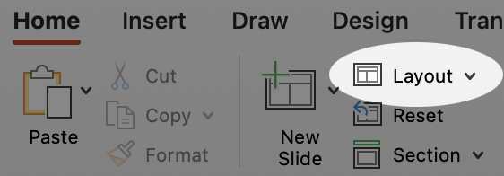
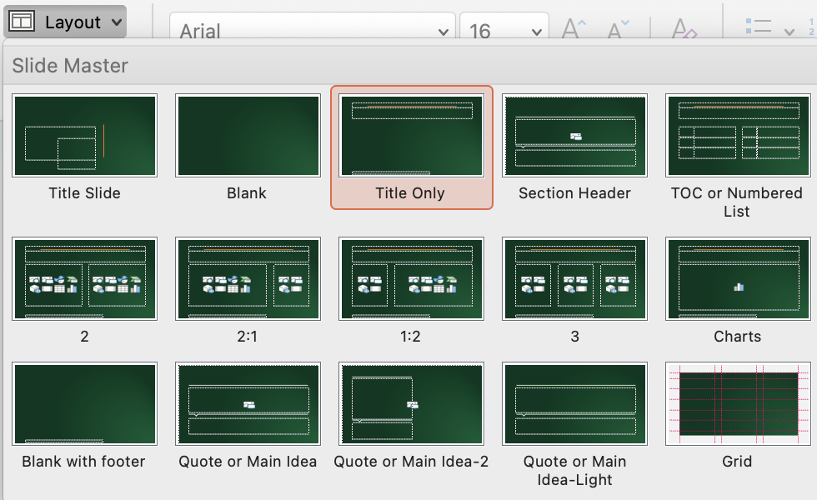
This slide uses the “Title Only” layout.
The University of Texas at Dallas – PowerPoint Template
  Any slide can be changed by choosing “Layout” in the toolbar.
  This example slide uses the “Title Only” Layout

Slide 8
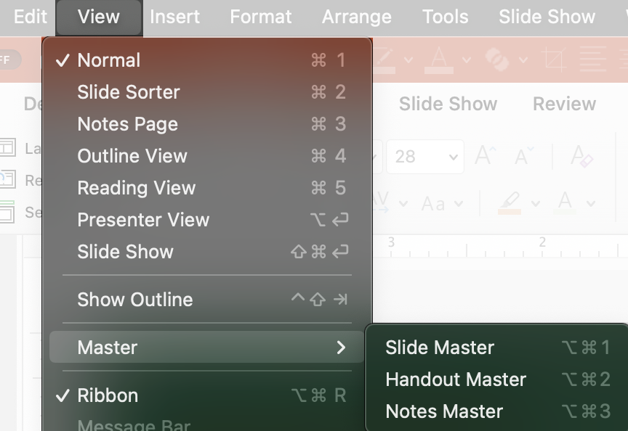
How to edit Master Pages
The University of Texas at Dallas – PowerPoint Template
  Slide Master is a set of layouts to use for quick content arrangement.
  Main base layout for font and color styling
  Can create additional layouts for specific
  slide needs.
  Use for quick content layouts
  Change them to customize
  the way you would like
  Use to quickly layout your content

Slide 9
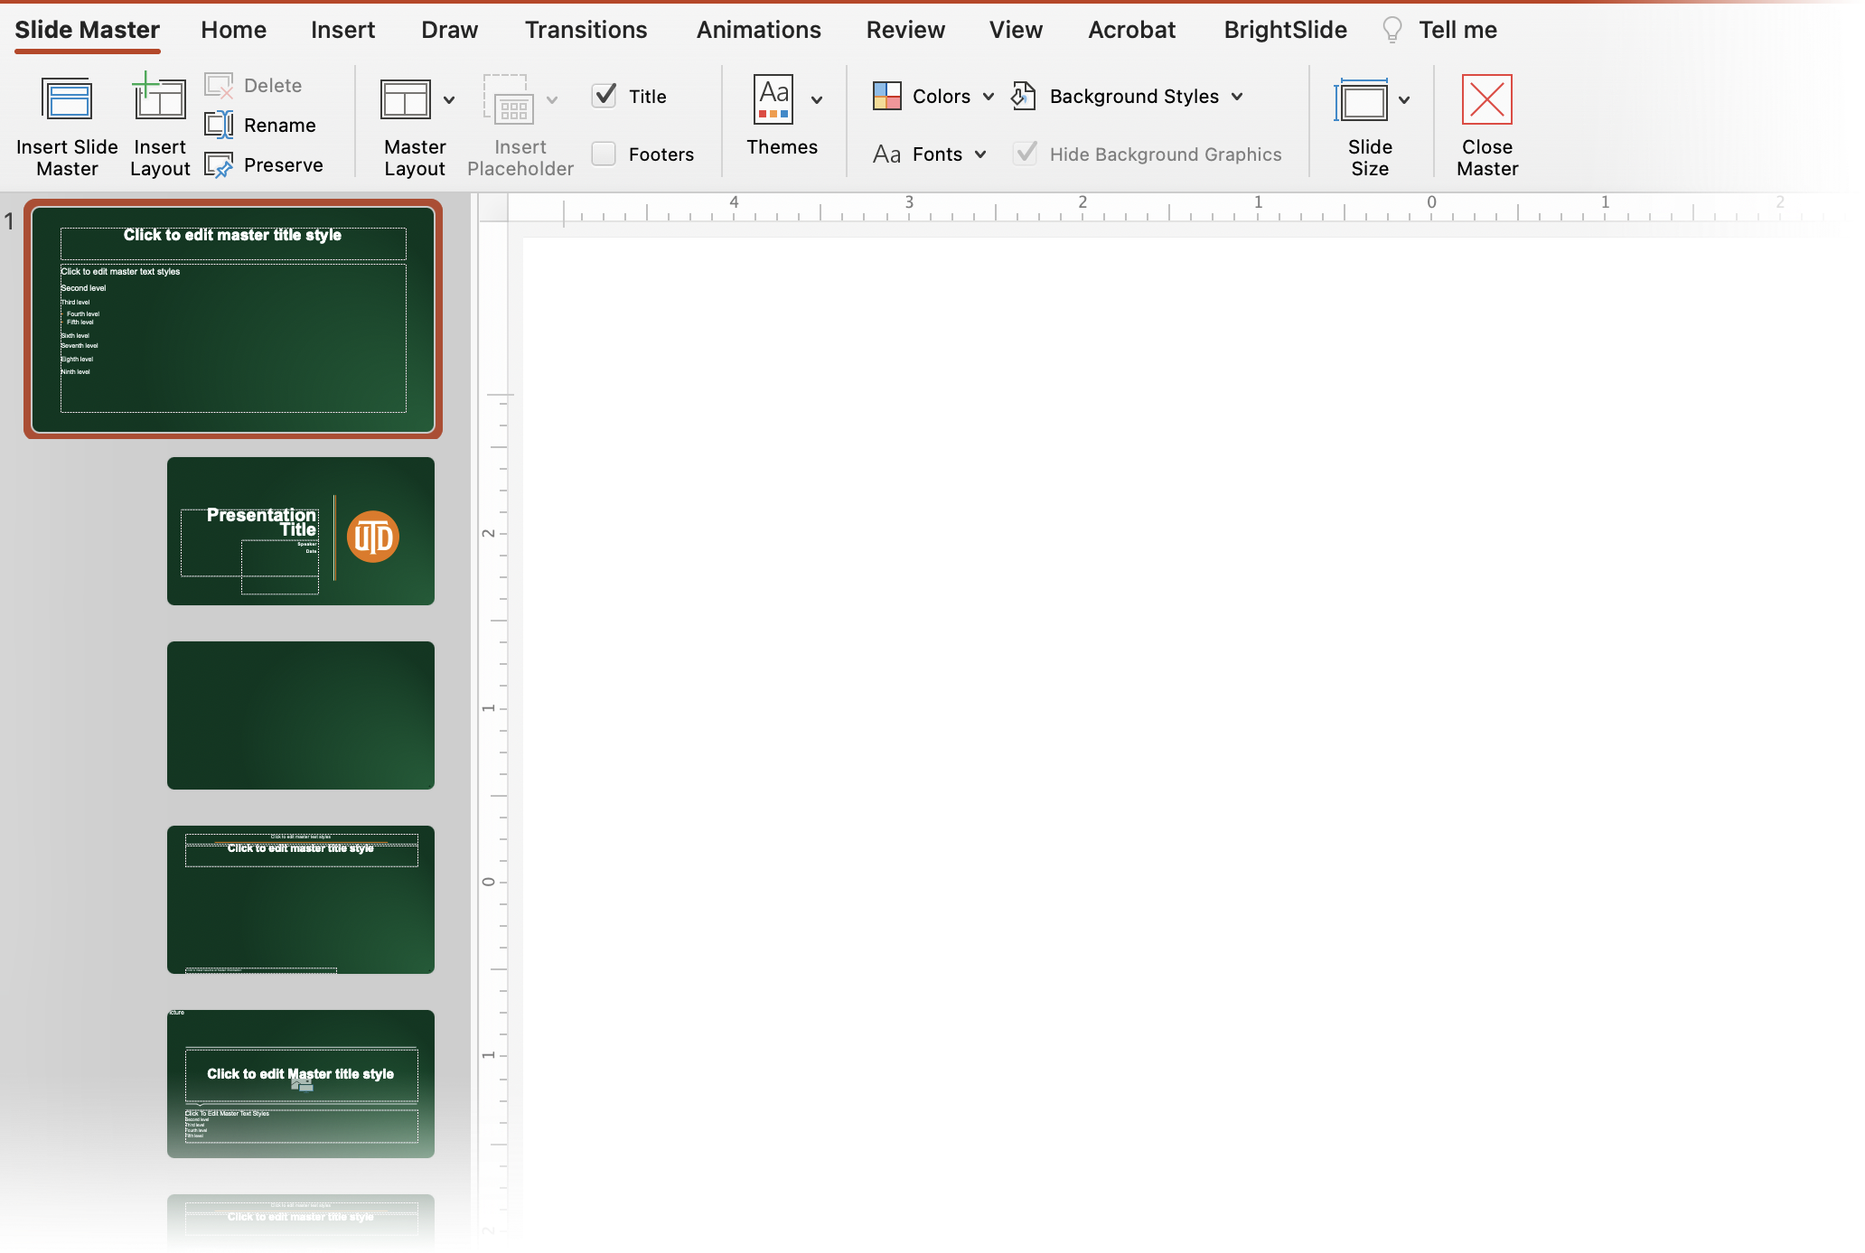
How to edit Master Pages
The University of Texas at Dallas – PowerPoint Template
  Slide Master Toolbar
  Think of these as “Templates” to be use multiple times
  Can modify and create additional layouts

Slide 10
Charts & Adding Data
3
Charts are here for color reference.

Slide 11
Layout “Charts”
Choose this layout for independent content area.
  Chart Example.

Slide 13
Additional “Charts” Layout
Choose this layout for independent content area.

Slide 14
Graphics & UTD Logos
4
Using Graphics and UTD Logos.

Slide 15
UTD logos are here as one image.
Crop to choose your style.
Can change color and transparency (available when using .svg file formats only)

Slide 16
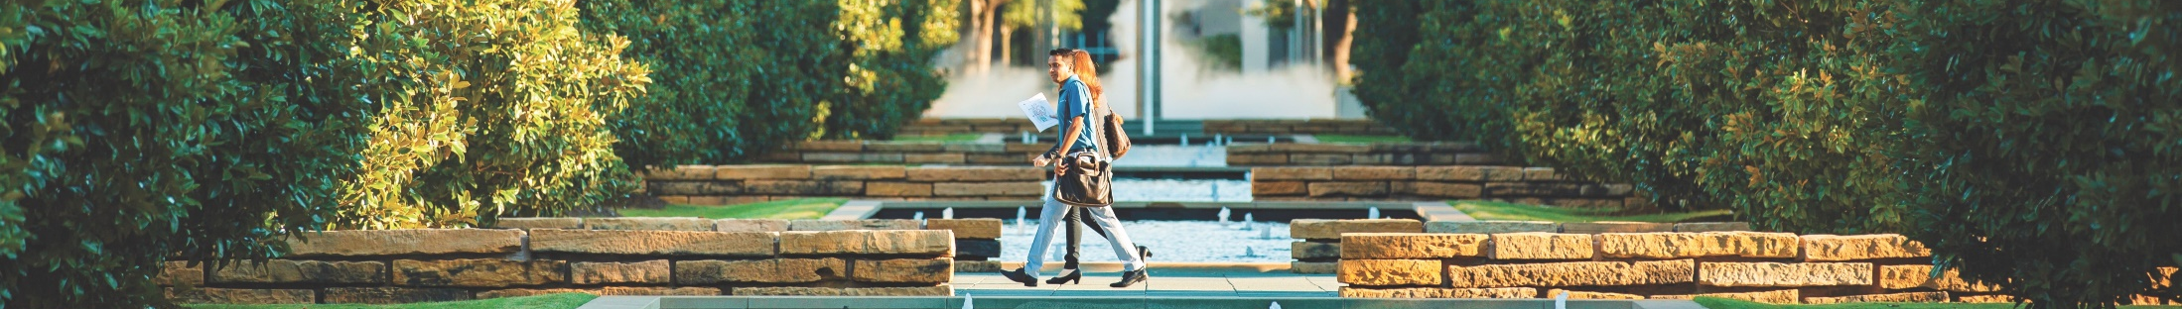
Adding images

Slide 17
Thank you for listening.
Hope these templates help!

