Slide 1
AI-Driven Wearable Bioelectronics in
Digital Healthcare
Guangqi Huang^{1,2} · Xiaofeng Chen³ · Caizhi Liao^{1,2}*
¹Dept. of Bioelectronics, Shenzhen University of Advanced Technology, China · ²Dept. of Engineering, University of Cambridge, UK · ³Dept. of Chemistry, The University of Texas at Austin, USA · *corresponding author
Biosensors (MDPI) · 2025 · Vol. 15, Issue 7, Article 410 · doi:10.3390/bios15070410
RITTIK PATRA
BMEN 6367 · Fall 2026
Department of Bioengineering
Team Venus
Paper 1 [AI in Bioelectronics ]
Notes:
Good morning. I'm Rittik Patra, Team Venus. I'm presenting 'AI-Driven Wearable Bioelectronics in Digital Healthcare' by Huang, Chen and Liao, Biosensors 2025, a 46-page review. I'll read it as an engineering pipeline, explain every figure and table, and finish with my critique and questions.
IF ASKED: Affiliations: Shenzhen University of Advanced Technology; University of Cambridge; UT Austin. Corresponding author: Caizhi Liao. Vol. 15, issue 7, article 410; doi:10.3390/bios15070410; 225 references.

Slide 2
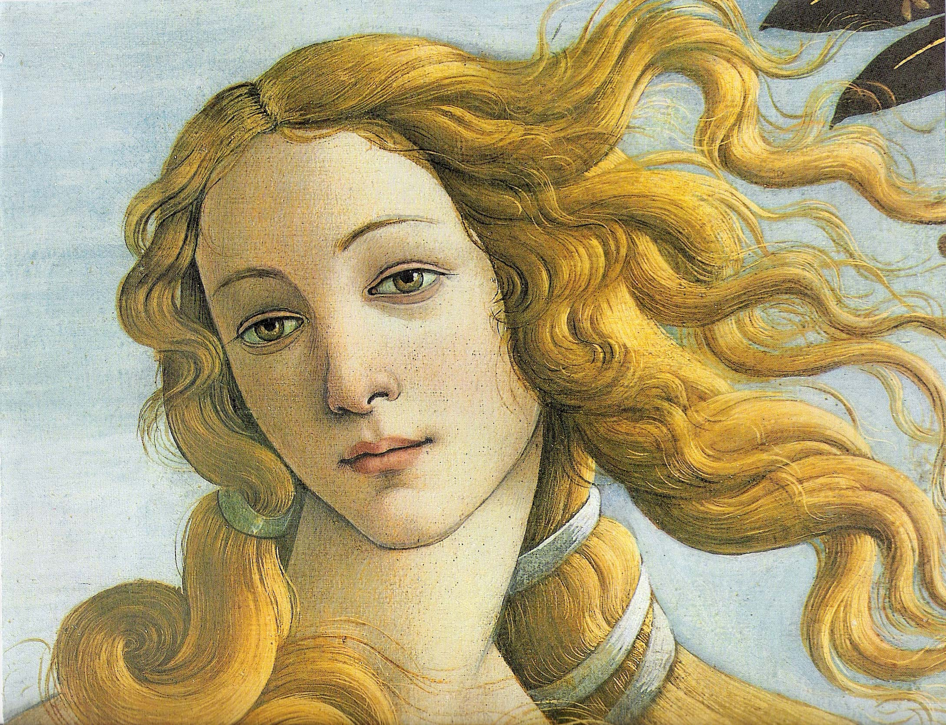
AI-Driven Wearable Bioelectronics in
Digital Healthcare
Guangqi Huang^{1,2} ·
Xiaofeng Chen³ ·
Caizhi Liao^{1,2}*
¹Dept. of Bioelectronics, Shenzhen University of Advanced Technology, China · ²Dept. of Engineering, University of Cambridge, UK · ³Dept. of Chemistry, The University of Texas at Austin, USA · *corresponding author
Biosensors (MDPI) · 2025 · Vol. 15, Issue 7, Article 410 · doi:10.3390/bios15070410
RITTIK PATRA
BMEN 6367 · Fall 2026
Department of Bioengineering
Team Venus
Paper 1 [AI in Bioelectronics ]
Notes:
Good morning. I'm Rittik Patra, Team Venus. I'm presenting 'AI-Driven Wearable Bioelectronics in Digital Healthcare' by Huang, Chen and Liao, Biosensors 2025, a 46-page review. I'll read it as an engineering pipeline, explain every figure and table, and finish with my critique and questions.
IF ASKED: Affiliations: Shenzhen University of Advanced Technology; University of Cambridge; UT Austin. Corresponding author: Caizhi Liao. Vol. 15, issue 7, article 410; doi:10.3390/bios15070410; 225 references.

Slide 3
AI-Driven
Wearable Bioelectronics in Digital Healthcare
Guangqi Huang^{1,2} ·
Xiaofeng Chen³ ·
Caizhi Liao^{1,2}*
¹Dept. of Bioelectronics, Shenzhen University of Advanced Technology, China · ²Dept. of Engineering, University of Cambridge, UK · ³Dept. of Chemistry, The University of Texas at Austin, USA · *corresponding author
RITTIK PATRA
BMEN 6367 · Fall 2026
Department of Bioengineering
Team Venus
Paper 1 [AI in Bioelectronics ]

Slide 4

Clinic visits sample your physiology at ~3 × 10⁻⁸ Hz
BACKGROUND · SIGNIFICANCE
Paroxysmal episode between visits: never recorded
Clinic visit
Clinic visit
Wearable: continuous stream, every beat, every day
day 0
day 365 →
17.9 M
828 M
2×
cardiovascular deaths per year (WHO, cited in the review)
adults with diabetes in 2022 (NCD-RisC, Lancet 2024); the review cites WHO's older 422 M
growth of the 60+ population by 2050 → demand for long-term monitoring
1 visit per year ≈ 1 / (3.2 × 10⁷ s). By Nyquist, only processes with periods longer than ~2 years are resolved; arrhythmias, glucose excursions and nocturnal desaturations fall between samples.
Interactive
Visualization:
Huang, Chen & Liao · Biosensors 2025, 15, 410
Notes:
[0:35 · ends at 0:50] SAY: Why does this matter? A yearly clinic visit samples your physiology at about three times ten to the minus eight hertz. By Nyquist, anything faster than a two-year cycle is invisible: a paroxysmal AF episode or night-time hypoglycemia falls between visits, as in the sketch. The burden is large: 17.9 million cardiovascular deaths a year, 828 million adults with diabetes, and a doubling of people over 60 by 2050. The paper's thesis: continuous sensing plus AI moves care from reactive to proactive and personal.
IF ASKED: The review cites WHO's older figure of 422 million with diabetes; NCD-RisC (Lancet 2024) estimates 828 million adults in 2022, which strengthens the case. The linked interactive model compares yearly ECG, Holter, a 14-day patch and a smartwatch: P(capture) = 1 − e^(−λ(T + d)).

Slide 5
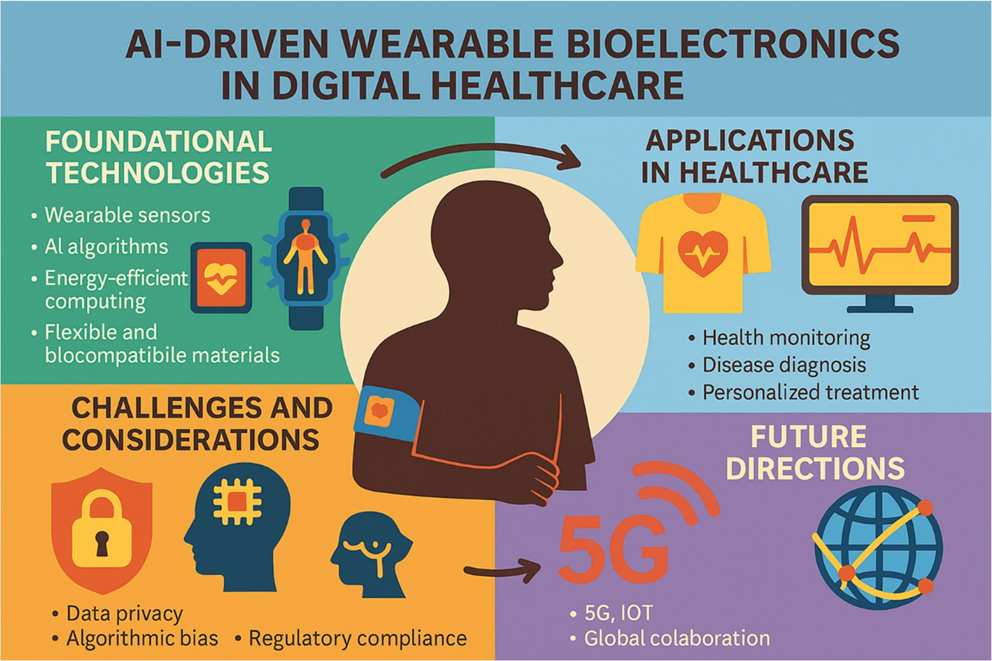
Continuous signals, scarce clinical insight
BACKGROUND · PROBLEM STATEMENT & OBJECTIVE
Problem statement
Wearables already stream noisy, multimodal signals under milliwatt power budgets. The unsolved step is turning those signals into reliable, private, regulated clinical decisions — limited by energy, motion artifacts, interoperability, algorithmic bias and validation.
Objective: a comprehensive review on five fronts
1
Hardware — sensors, materials, power, signal acquisition (§2)
2
AI — algorithms, edge computing, AI–biosensor fusion framework (§3)
3
Applications — monitoring, diagnosis, prognosis, EHR integration (§4)
4
Challenges — privacy, bias, regulation, liability, cost (§5)
5
Future & policy — 5G/IoT, affordability, staged approval (§6–7)
Fig. 1 — the review's map: foundations → applications → challenges → future directions. Conceptual schematic; no data.
Huang, Chen & Liao · Biosensors 2025, 15, 410
Notes:
[0:30 · ends at 1:20] SAY: The problem is no longer the sensor. Wearables already stream noisy, multimodal signals under milliwatt power budgets; the unsolved step is turning them into reliable, private, regulated clinical decisions. The objective is a comprehensive review on five fronts: hardware, AI, applications, challenges, and future directions with policy. Figure 1 is the authors' map of that structure. It is conceptual, with no data.
IF ASKED: The five fronts map onto Sections 2–7. Figure 1 flows from foundational technologies to applications, challenges and future directions (5G/IoT, global collaboration).

Slide 6
A narrative review, read as a five-layer system
METHODS · HOW THE REVIEW WAS BUILT
Narrative
225
12 + 5
None
descriptive synthesis; no meta-analysis, no new data
references across 8 sections, 46 pages
figures + tables; 7 figures reproduced from primary papers
search strategy, databases, dates or inclusion criteria reported
Where the 46 pages go (pages per section)
How I read it: a pipeline from molecule to decision
Hardware (§2) takes 11 pages; applications and AI 7 each; the policy framework that the abstract highlights gets about 1.
Each methods slide that follows is one layer of this pipeline.
1
Sense
2
Power
3
Acquire
4
Infer
5
Act
biosensors, form factors, materials
harvesting, flexible batteries, low-power radios
filtering, multimodal fusion, BLE / NFC
ML, DL, RL; edge AI; fusion framework
monitoring, diagnosis, EHR, policy
§2.1–2.2
§2.4
§3
§2.3
§4–7
Huang, Chen & Liao · Biosensors 2025, 15, 410
Notes:
[0:25 · ends at 1:45] SAY: Methodologically, this is a narrative review: 225 references, no meta-analysis, and no search strategy, so selection bias cannot be judged. The chart shows where the pages go: hardware 11, AI and applications 7 each, and the policy framework highlighted in the abstract only about one. I'll walk the paper as five layers: sense, power, acquire, infer, act.
IF ASKED: 12 figures and 5 tables; 7 figures are reproduced from primary papers. No databases, date range or inclusion criteria are reported.

Slide 7
Every biosensor is a three-stage transduction chain
METHODS · SENSING PRINCIPLE · TABLE 1
Analyte
Bioreceptor
Transducer
Processor
glucose, lactate, cortisol, K⁺, CRP in sweat, ISF or saliva
enzyme → aptamer or molecularly imprinted polymer
electrochemical, optical or FET readout
cloud analysis → on-device TinyML
µA/mM → nA/pM (~1000×)
500 → <20 ms; 100 → <5 mW
the target
Km 10–30 mM → Kd < 1 nM
Table 1 · Generation | Response time | Sensitivity | Stability | Selectivity
2000–2010 | >30 s | µM–mM | hours / days | antibody-dependent
2010–2020 | 2–10 s | nM–µM | weeks | aptamer / MIP-based
2020–present | <1 s | pM–nM | months | AI-enhanced multimodal
Reading Table 1: ~3 orders of magnitude in sensitivity and >30× in speed over two decades; selectivity moved from chemistry (antibodies) to computation (AI deconvolution of cross-reactive arrays, e.g. dopamine vs uric acid).
Caveat: Table 1 is uncited and coarse; the generation boundaries are illustrative, not measured.
Huang, Chen & Liao · Biosensors 2025, 15, 410
Notes:
[0:35 · ends at 2:20] SAY: Layer one, sensing. Every biosensor is a three-stage chain: a bioreceptor binds the analyte, a transducer turns binding into current, voltage or light, and a processor decides. Table 1 compresses two decades into three generations: response time from over 30 seconds to under one, sensitivity from micromolar to picomolar, stability from hours to months, and selectivity from antibodies to AI-enhanced multimodal sensing. That is about three orders of magnitude in sensitivity. But the table is uncited, so treat its boundaries as illustrative.
IF ASKED: Glucose oxidase Km 10–30 mM → molecularly imprinted polymers with Kd < 1 nM; laser-scribed graphene transducers ~1000× sensitivity; on-device inference cut latency 500 → <20 ms and power 100 → <5 mW.

Slide 8
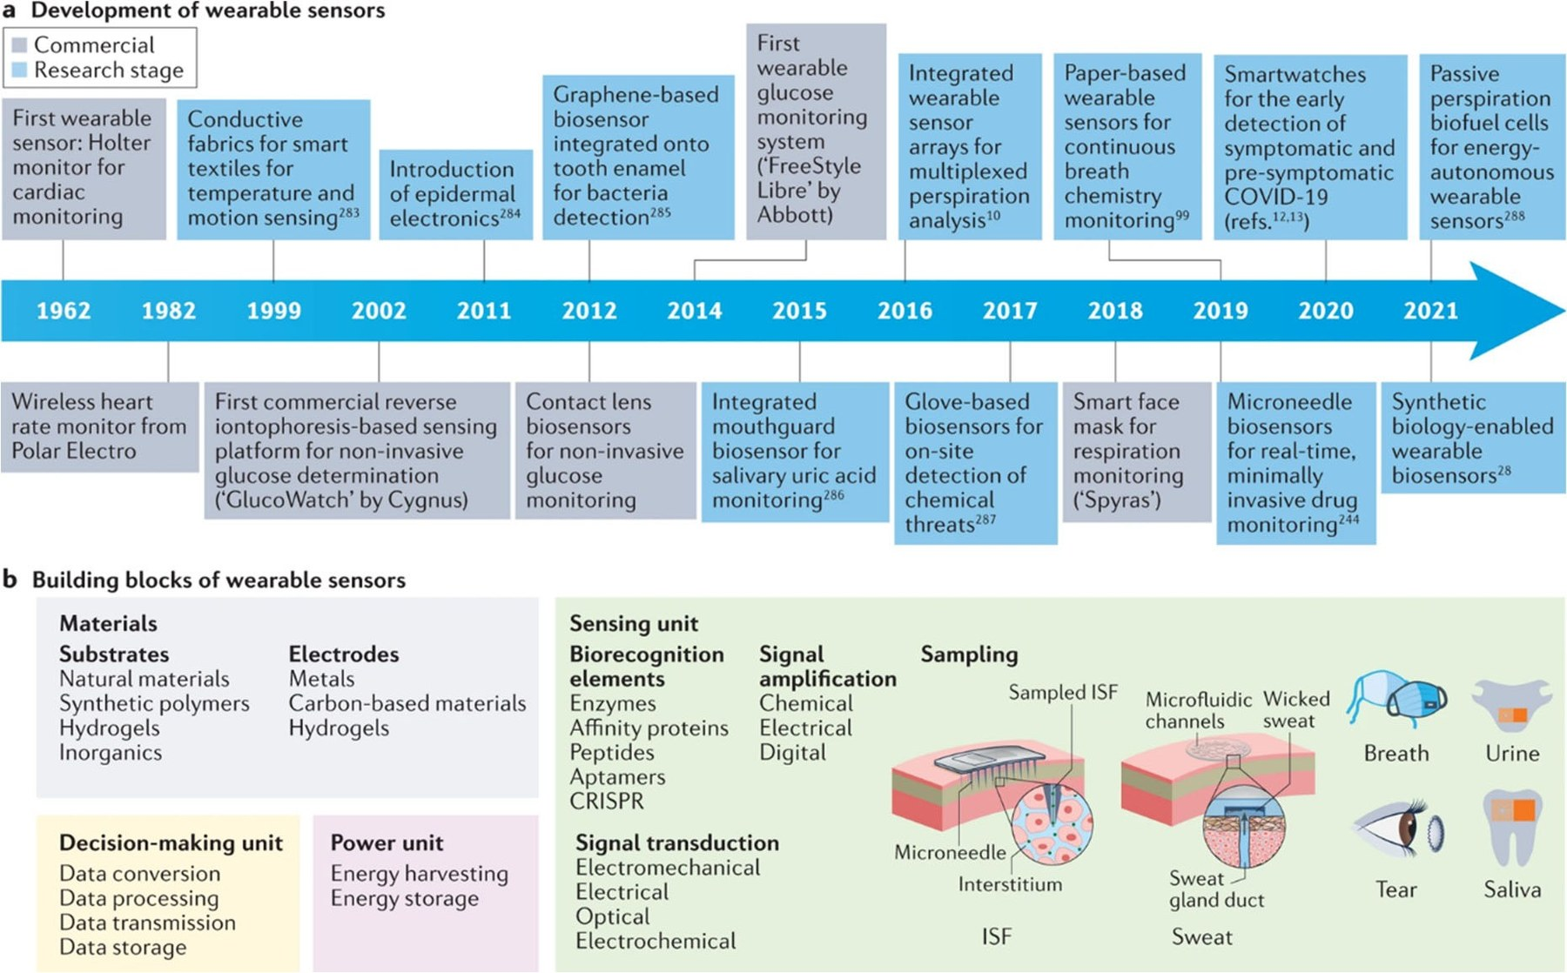
Six decades of wearables, five building blocks
METHODS · FORM FACTORS · FIG. 2
(a) Milestones (grey = commercial, blue = research): heart first (Holter 1962, Polar 1982), then glucose (GlucoWatch 2002, FreeStyle Libre 2014), sweat chemistry (2016), microneedles (2019), biofuel-cell sensors (2021).
(b) Building blocks: materials · sensing unit · sampling · power · decision-making, the youngest block and the one where AI enters. Source: Ates et al., Nat. Rev. Mater. 2022.
Huang, Chen & Liao · Biosensors 2025, 15, 410
Notes:
[0:20 · ends at 2:40] SAY: Figure 2, from Ates et al., gives the history: grey boxes are commercial, blue are research. Cardiac monitoring came first, with the Holter in 1962, then glucose, sweat chemistry, microneedles and biofuel cells. Panel b shows five building blocks. The newest is decision-making, and that is where AI enters.
IF ASKED: Milestones: Polar 1982, GlucoWatch 2002, FreeStyle Libre 2014, multiplexed sweat sensing 2016, microneedles 2019, biofuel-cell sensors 2021. Source: Ates et al., Nat. Rev. Mater. 2022.

Slide 9
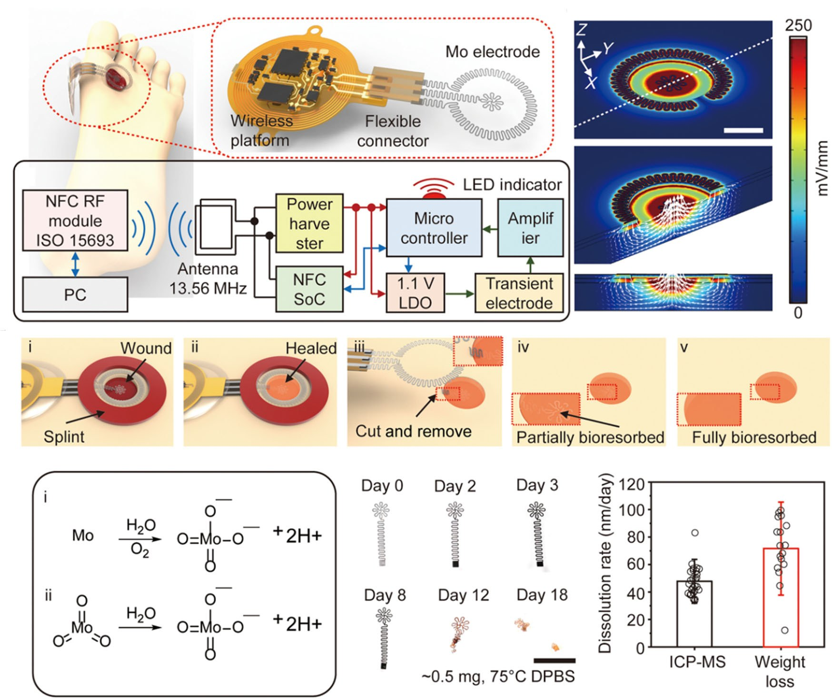
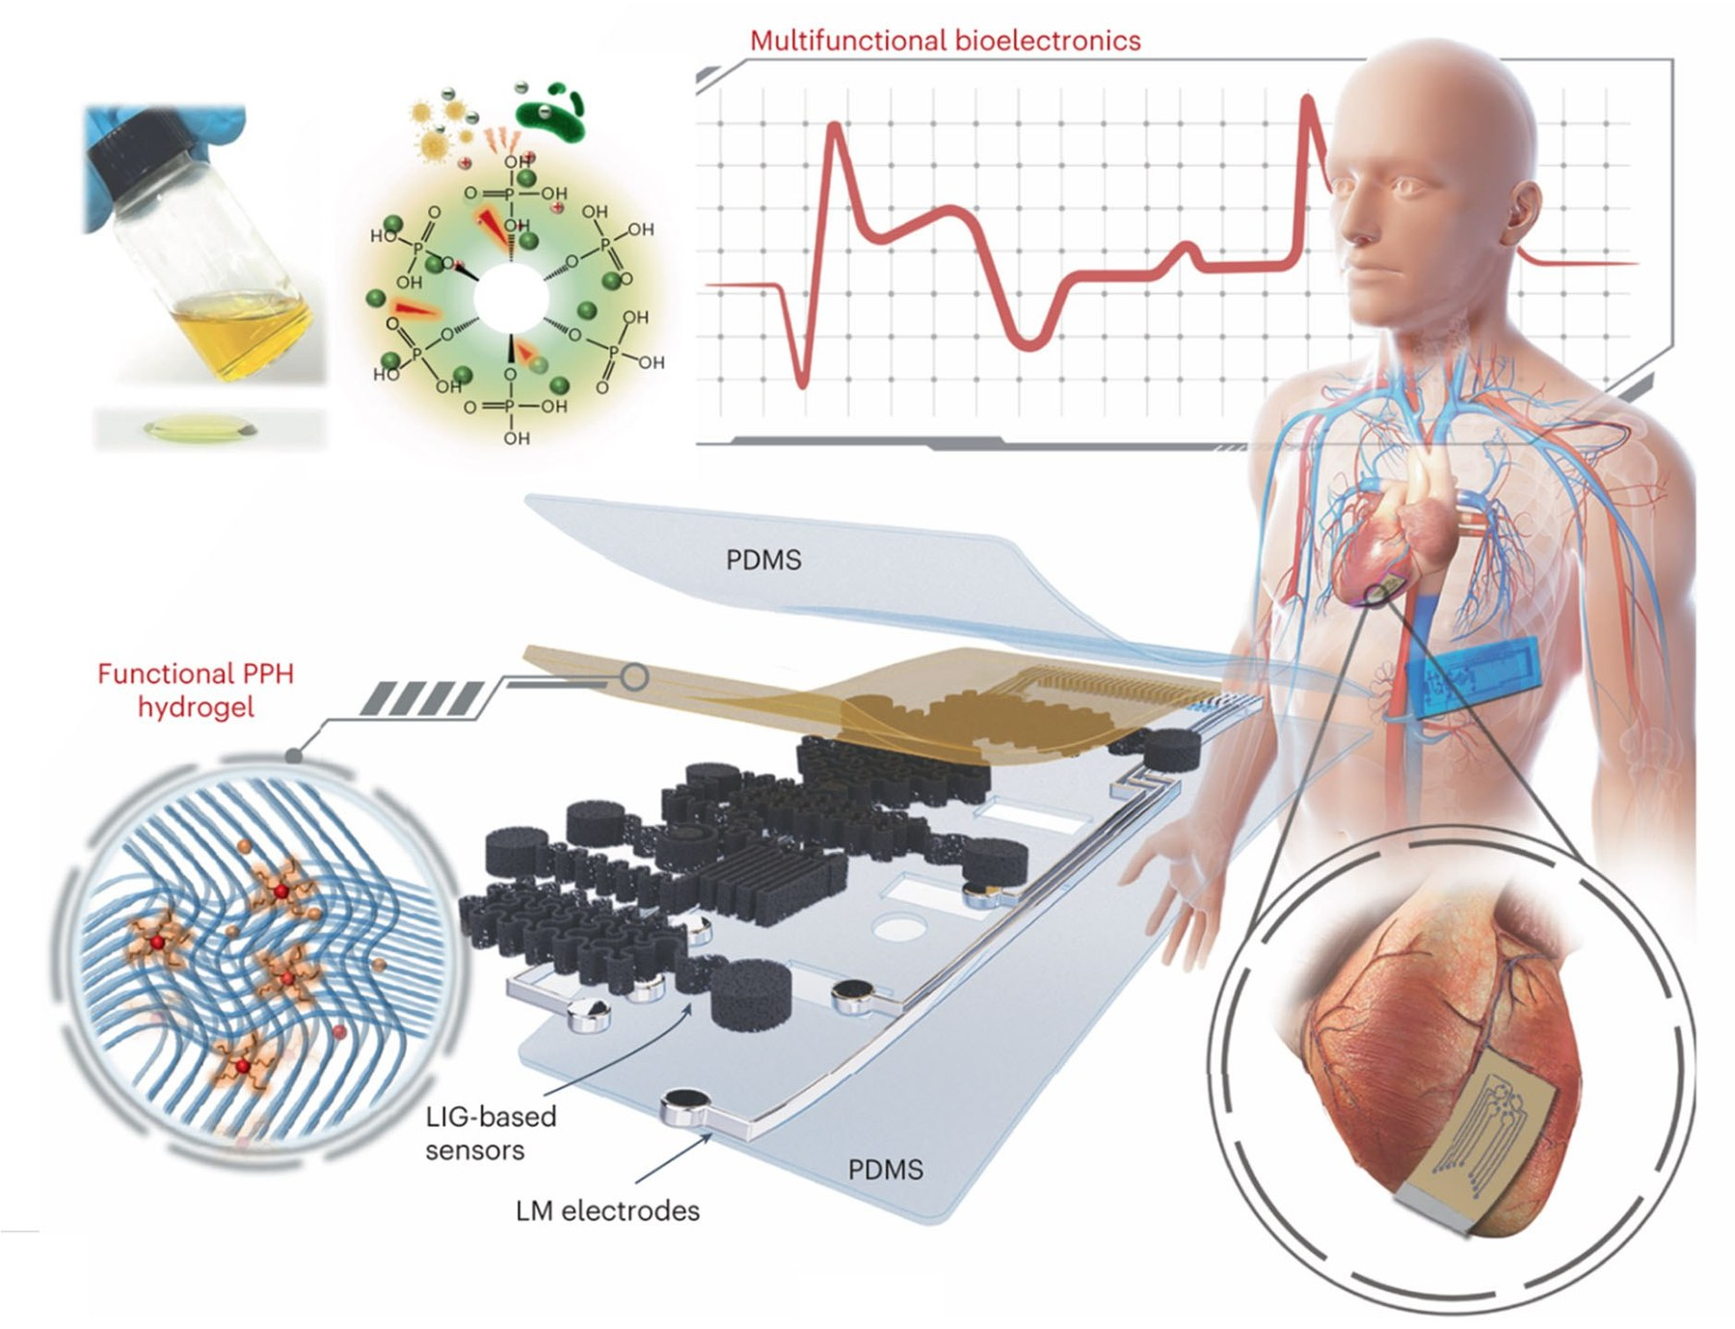
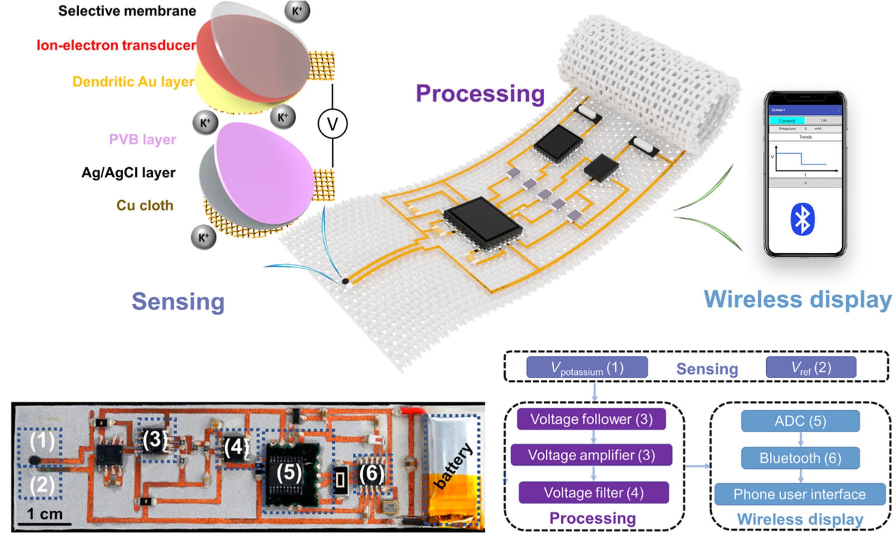
Three device archetypes: dissolve, conform, weave
METHODS · FORM FACTORS · FIGS. 3, 4, 5
Fig. 3 · Dissolve
Fig. 4 · Conform
Fig. 5 · Weave
Battery-free wound electrotherapy (Song, Sci. Adv. 2023). A 13.56 MHz NFC link powers Mo electrodes; after healing, Mo oxidizes to MoO₄²⁻ and resorbs (~50–70 nm/day in a 75 °C accelerated test).
Graphene–hydrogel interface (Lu, Nat. Electron. 2024). Laser-induced graphene sensors and liquid-metal electrodes in PDMS, coated with an antibacterial PPH hydrogel, soft enough for the beating heart.
In-textile sweat-K⁺ wristband (Ma, Sci. Adv. 2023). Ion-selective membrane on Cu cloth vs Ag/AgCl reference; follower → amplifier → filter → ADC → Bluetooth on a 2.5 × 9 cm patch.
Physics link: the K⁺ wristband is potentiometric, so its output follows the Nernst equation, ideally ≈59 mV per decade of [K⁺] at 25 °C; the Mo electrode's service life is set by its dissolution rate.
Huang, Chen & Liao · Biosensors 2025, 15, 410
Notes:
[0:35 · ends at 3:15] SAY: Figures 3 to 5 are three device archetypes. Dissolve: Song et al.'s battery-free wound patch is powered over 13.56 megahertz NFC, and its molybdenum electrode oxidizes and resorbs, so it never needs removal. Conform: Lu et al.'s laser-induced graphene sensors in PDMS, coated with an antibacterial hydrogel, are soft enough for a beating heart. Weave: Ma et al.'s textile wristband measures sweat potassium potentiometrically, ideally 59 millivolts per decade, then amplifies, digitizes and sends it over Bluetooth.
IF ASKED: Mo dissolves at ~50–70 nm/day in a 75 °C accelerated test (Song, Sci. Adv. 2023). Lu, Nat. Electron. 2024. Ma, Sci. Adv. 2023: ion-selective membrane on Cu cloth vs Ag/AgCl reference; 2.5 × 9 cm patch.

Slide 10
Materials: match the tissue, not just the circuit
METHODS · MATERIALS · TABLE 2
hydrogel ~kPa
Ecoflex
skin
PDMS
polyimide ~2.5 GPa
silicon ~160 GPa
~10⁵–10⁶× stiffer than skin →
1 kPa
soft-tissue window
1 MPa
1 GPa
100 GPa
Table 2 · Material | Key property | Reported metric | Used for | Limitation
Graphene | high σ, flexible | glucose 0.1–10 µM, <1 s | ECG, sweat, strain | costly to make
PDMS | stretch ≤ 300% | E 0.1–3 MPa, >10k cycles | substrates, patches | insulating
PEDOT:PSS | σ 100–1000 S/cm | 50–300 Ω/sq, >1 month | OECTs, neural | humidity-sensitive
Hydrogel | E ~ kPa, ionic | swelling 200–500% | wounds, drug delivery | dehydrates
Ag nanowires | σ ~10⁶ S/m | >90% transparent | clear electrodes | oxidation risk
Ecoflex | stretch ≤ 900% | tensile ~1 MPa | motion sensors | low conductivity
MXene Ti₃C₂Tₓ | metallic, hydrophilic | 500–1500 F/cm³ | energy storage | oxidizes; scale-up
Cellulose NF | biodegradable, cheap | (row incomplete in paper) | — | —
Why thin films work: bending stiffness D = E·t³ / 12(1−ν²), so a 1 µm film is 10⁹× less stiff in bending than a 1 mm slab of the same material.
Huang, Chen & Liao · Biosensors 2025, 15, 410
Notes:
[0:30 · ends at 3:45] SAY: Table 2 lists eight materials, and one piece of physics explains it: mechanical mismatch. Skin and hydrogels sit at kilopascals to megapascals; silicon is 160 gigapascals, up to six orders of magnitude stiffer. So materials are either intrinsically soft, like PDMS, Ecoflex and hydrogels, or conductors made thin, because bending stiffness scales with thickness cubed. Every row trades something: PEDOT:PSS is humidity-sensitive, hydrogels dry out, nanowires oxidize.
IF ASKED: D = E·t³ / 12(1 − ν²): a 1 µm film is ~10⁹× less stiff in bending than a 1 mm slab. PDMS stretches to 300%, Ecoflex to 900%; PEDOT:PSS 100–1000 S/cm. Editorial issues: the cellulose row is incomplete in the published table, and graphene's 'sensitivity' (0.1–10 µM) is a concentration range.

Slide 11
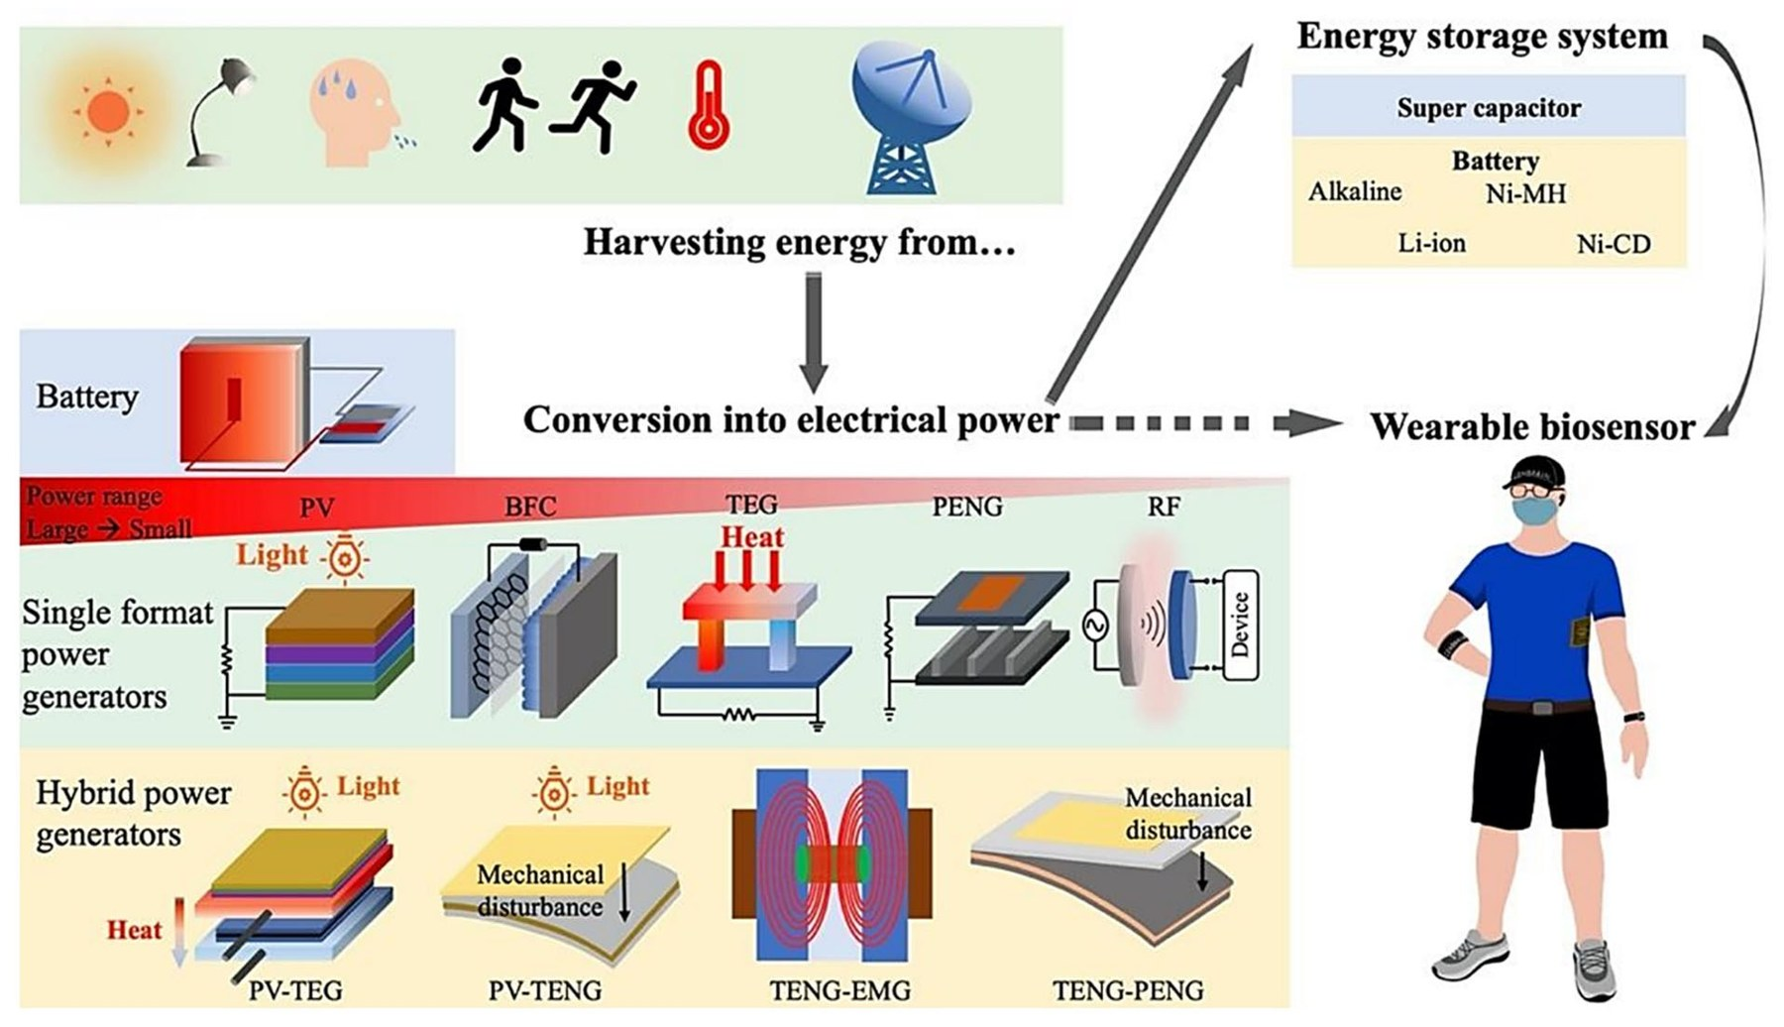
Power is the hard ceiling on on-body intelligence
METHODS · POWER · FIG. 6
Harvesters: photovoltaic, biofuel cell (sweat lactate/glucose), thermoelectric, piezo- and triboelectric nanogenerators, RF and electromagnetic; hybrids pair two sources.
Reality check: skin-to-air ΔT of ~5 K at 310 K caps a thermoelectric at the Carnot limit, 5/310 ≈ 1.6%.
Reported budgets: 100 mW per analysis (cloud era) → <5 mW TinyML → <1 mW multi-analyte → <10 µW neuromorphic target.
Fig. 6 (Rong et al., Sensors 2021): harvest → convert → store → sense.
Runtime on a 200 mAh (0.74 Wh) battery at each budget
Interactive
Visualization:
Huang, Chen & Liao · Biosensors 2025, 15, 410
Notes:
[0:30 · ends at 4:15] SAY: Layer two, power. Figure 6 is the energy chain: harvest light, heat, motion, sweat or radio; convert; store; sense. Harvesting is weak: a thermoelectric on skin sees about 5 kelvin, so Carnot caps it near 1.6%. So compute power decides lifetime. On a 200 milliamp-hour battery, using the review's budgets: a 100 milliwatt cloud-era cycle lasts 7 hours, TinyML about 6 days, a 1 milliwatt system a month, and a 10 microwatt neuromorphic chip about 8 years.
IF ASKED: Battery math is mine: 0.74 Wh ÷ power draw, continuous; it ignores the sensor front-end, radio bursts and self-discharge. Figure 6 from Rong et al., Sensors 2021. The linked explorer lets you change battery size and duty cycle.

Slide 12
The data: continuous, noisy, sparsely labeled
METHODS · DESCRIPTIONS OF DATA
Biophysical
Biochemical
Clinical context
ECG, PPG, accelerometer / gyroscope, temperature, skin conductance, respiration
glucose, lactate, cortisol, K⁺/Na⁺, uric acid, CRP, H₂O₂, NO, pH
EHR records (FHIR); fundus, CT, mammography, H&E images; stethoscope audio
sweat · ISF · saliva · tears · breath
sampled ~0.1–100 Hz
the inputs behind Table 5
Processing chain described in §2.4 and §3.2 (my sketch)
1
Raw
2
Denoise
3
Features
4
Infer
5
Act
ECG + motion artifact
band-pass, wavelet, 1D-CNN
R–R → HRV; FFT; PCA
AF vs sinus; LSTM forecast
alert <100 ms; to EHR
No new dataset. The review aggregates metrics reported elsewhere, usually without n, cohort or task definition.
Data limits it names: >10,000 labelled samples per model; rare events are label-starved; BLE/NFC links risk eavesdropping and tampering.
Huang, Chen & Liao · Biosensors 2025, 15, 410
Notes:
[0:30 · ends at 4:45] SAY: Layer three, data. The review has no new dataset; it describes three signal families: biophysical, like ECG and PPG sampled at 0.1 to 100 hertz; biochemical, in sweat, interstitial fluid, saliva or breath; and clinical context from EHRs and images. My sketch shows the chain: raw ECG with motion artifact, denoise, extract R–R features, classify AF versus sinus, and act, with an alert inside 100 milliseconds. The limits: over 10,000 labels per model, and rare events are label-starved.
IF ASKED: Denoising by band-pass, wavelets or 1D-CNNs; features include HRV, FFT and PCA; EHR integration via FHIR. BLE/NFC links risk eavesdropping and tampering.

Slide 13
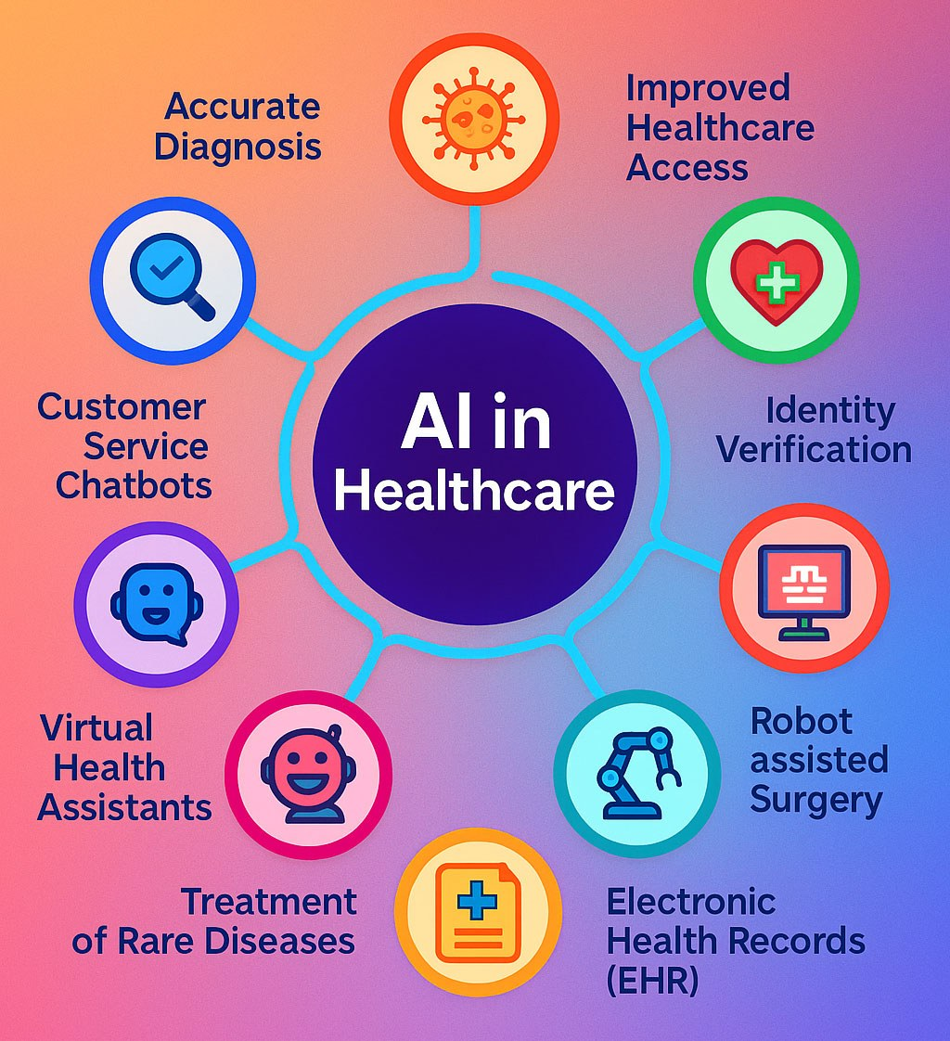
An algorithm toolbox for on-body constraints
METHODS · ALGORITHMS · TABLE 3 · FIG. 7
Classical supervised
Deep learning
LR · decision tree · random forest · SVM · KNN · naïve Bayes
MLP · CNN · RNN / LSTM · Transformer
Learns features from raw signals; data-hungry, opaque.
Interpretable, tiny, fast; limited on raw waveforms.
TinyCNN arrhythmia: 95–98% sensitivity at <5 mW; RNN glucose forecast: Se 78–95%, Sp 85–95%
Random-forest fall detection: >90% within 100 ms on a Cortex-M4; ~40% less power than DL
Unsupervised / generative
Reinforcement learning
k-means · PCA · t-SNE · VAE
policy learned from reward
Structure without labels; personal baselines.
Adapts dosing or stimulation online; reward design and safety are open problems.
Fig. 7 — AI across healthcare. Conceptual, not wearable-specific.
VAE hypoglycemia detection: 85–90% precision, <200 KB, 30% fewer false alarms
Closed-loop insulin dosing; deep-brain-stimulation tuning
Table 3 lists 13 algorithm families with applications, advantages and limitations. The trade-off that matters on the body: interpretability and energy (classical) versus representational power (deep).
Huang, Chen & Liao · Biosensors 2025, 15, 410
Notes:
[0:30 · ends at 5:15] SAY: Layer four, inference. Table 3 lists thirteen algorithm families; I grouped them into four with the wearable numbers the text reports. Classical models are tiny and interpretable: a random forest detects falls within 100 milliseconds on a Cortex-M4. Deep models learn from raw waveforms: a TinyCNN reaches 95 to 98% arrhythmia sensitivity under 5 milliwatts. Generative models learn personal baselines, and reinforcement learning adapts dosing but raises safety questions. Figure 7 is conceptual only.
IF ASKED: Random forest: >90% accuracy, ~40% less power than DL. Quantized VAE <200 KB: 85–90% precision, 30% fewer hypoglycemia false alarms. LSTM glucose forecast: Se 78–95%, Sp 85–95%. RL: closed-loop insulin, deep-brain stimulation tuning.

Slide 14
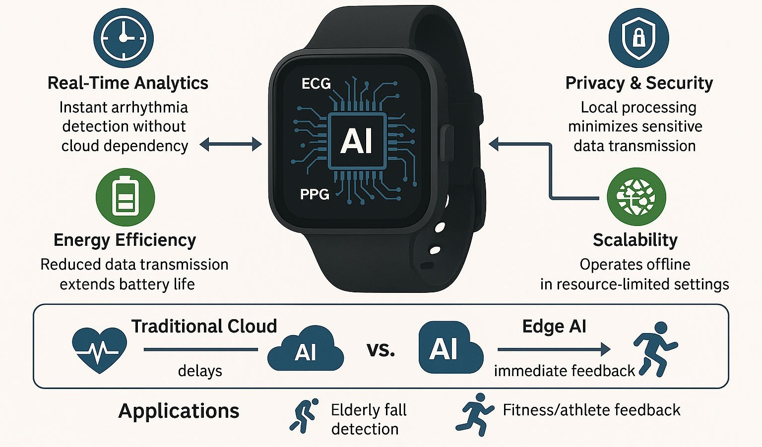
Edge AI: move inference onto the wrist
METHODS · EDGE COMPUTING · FIG. 8
Decision latency reported in the review (ms)
Fig. 8 — four edge benefits; cloud (delays) vs edge (immediate feedback).
Real-time: alerts inside the 100 ms window
Privacy: raw physiology stays on the device
Energy: the radio, not the math, drains the battery
Scale: works offline in low-connectivity settings
Reported gains: 30–50% fewer cloud calls and false alarms. Cost: below 8-bit, compression loses 15–20% accuracy → hybrid design: <100 kB model on the device for urgent detection, cloud for long-term trends.
Huang, Chen & Liao · Biosensors 2025, 15, 410
Notes:
[0:25 · ends at 5:40] SAY: Figure 8 is the case for edge AI: run the model on the watch. The chart puts the review's latency numbers on one axis: a cloud round trip near 500 milliseconds, a 100 millisecond alert budget, and under 20 on-device. Energy is the subtle point: the radio, not the math, drains the battery. The cost is 15 to 20% accuracy lost below 8-bit, hence hybrid designs.
IF ASKED: Reported gains: 30–50% fewer cloud calls and false alarms. Hybrid design: a <100 kB model on the device for urgent detection, the cloud for long-term trends.

Slide 15
The authors' AI–biosensor fusion framework
METHODS · ALGORITHMS & EVALUATION / VALIDATION (§3.4)
1
AI-enhanced sensing
2
Closed-loop design
• 1D-CNN denoising: >90% noise suppression
• Graph NNs: 15 new sensing composites, 10× faster
• Cross-attention fusion: +40–60% specificity
• GANs: bioreceptors with +35% binding affinity
• RL adaptive sampling (0.1–100 Hz): −75% power
• NAS balances <50 ms, pM sensitivity, <1 mJ per measurement
3
Intelligent diagnostics
4
Implementation roadmap
• Federated learning on each wearer's baseline
• Phase 1: PyTorch toolkits for benchtop sensors
• LSTM predicts sensor drift (MAE <0.5%) → recalibration, 3–5× stability
• Phase 2: TensorFlow Lite on Cortex-M7 / RISC-V
• Phase 3: FDA-aligned validation, drift monitoring
• Uncertainty flags route low-confidence calls to clinicians
Evaluation & validation criteria the authors propose (not tested in the review)
Reliability: <5% CV over 1,000 test cycles
Critical biomarkers: ≥80% specificity at 99% sensitivity
Deployment: diverse-cohort pre-market tests, post-market monitoring, annual bias audits
Huang, Chen & Liao · Biosensors 2025, 15, 410
Notes:
[0:35 · ends at 6:15] SAY: Section 3.4 is the review's main methodological contribution: an AI–biosensor fusion framework with four pillars. AI-enhanced sensing, with CNN denoising and cross-attention fusion. Closed-loop design, where graph networks, GANs and architecture search co-design the sensor itself. Intelligent diagnostics: federated personalization, drift prediction and uncertainty-based referral. And a three-phase roadmap to FDA-aligned validation. Their evaluation criteria: under 5% CV over 1,000 cycles, and 80% specificity at 99% sensitivity. Remember that 99%.
IF ASKED: >90% noise suppression; +40–60% specificity from fusion; RL sampling 0.1–100 Hz saves ~75% power. GNNs: 15 new composites, 10× faster; GANs: +35% binding affinity; NAS: <50 ms, pM, <1 mJ. LSTM drift MAE <0.5%, 3–5× stability. None of these criteria is tested in the review.

Slide 16
From signal to clinical use: what the review catalogs
RESULTS · APPLICATIONS IN DIGITAL HEALTHCARE (§4)
Signal (sensor) | AI task | Clinical use | Review §
ECG / PPG (watch, patch) | 1D-CNN rhythm classification | AF and arrhythmia alerts; stroke prevention | §4.1.2, §4.2.1
Interstitial glucose (CGM) | RNN / LSTM forecasting; VAE anomaly detection | early warning of hypo- and hyperglycemia | §3.1, §4.1.2
Accelerometer / gyroscope | random forest; gait and tremor features | falls in older adults; Parkinson's gait and tremor | §3.1, §4.2.1
HRV, skin conductance, sleep | stress and sleep-stage classification | stress, insomnia, apnea screening; CBT prompts | §4.1.3
Respiration, SpO₂, temperature | trend and anomaly detection | COPD, sleep apnea, infection, post-operative risk | §4.1.2, §4.2.2
Sweat CRP (Fig. 9) | on-patch immunoassay + analytics | inflammation in heart failure, COPD, infection | §4.1
Wound exudate (Fig. 10) | ML wound classification | chronic-wound healing prediction | §4.2
Into the record (§4.2.3): FHIR standards, Apple HealthKit and Google Fit feed EHRs; Fitbit–Epic and Withings–Cerner partnerships; CGM data populating diabetes records in pilots.
What is missing: no pooled outcome data (readmissions, mortality, cost) for any of these uses; claims are qualitative.
Huang, Chen & Liao · Biosensors 2025, 15, 410
Notes:
[0:30 · ends at 6:45] SAY: Section 4 covers applications; I condensed it into one map from signal to clinical use. ECG and PPG drive AF alerts; glucose monitors drive hypoglycemia forecasts; accelerometers detect falls and Parkinsonian tremor; HRV and sleep data support stress and apnea screening; sweat CRP and wound exudate are on the next slide. Results reach clinicians through FHIR and vendor partnerships. What is missing: pooled outcome data on readmissions, mortality or cost.
IF ASKED: Integration examples (§4.2.3): Apple HealthKit, Google Fit, Fitbit–Epic and Withings–Cerner partnerships; CGM data populating diabetes records in pilots.

Slide 17
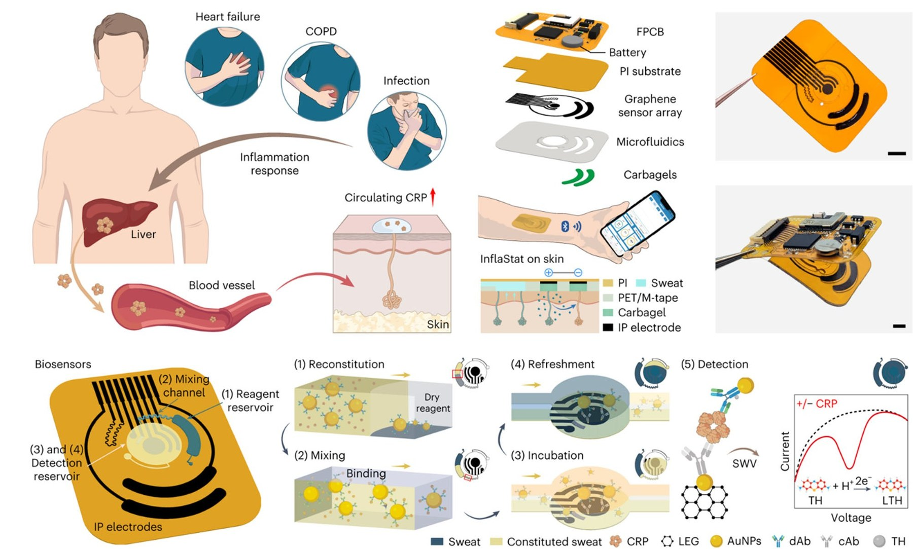
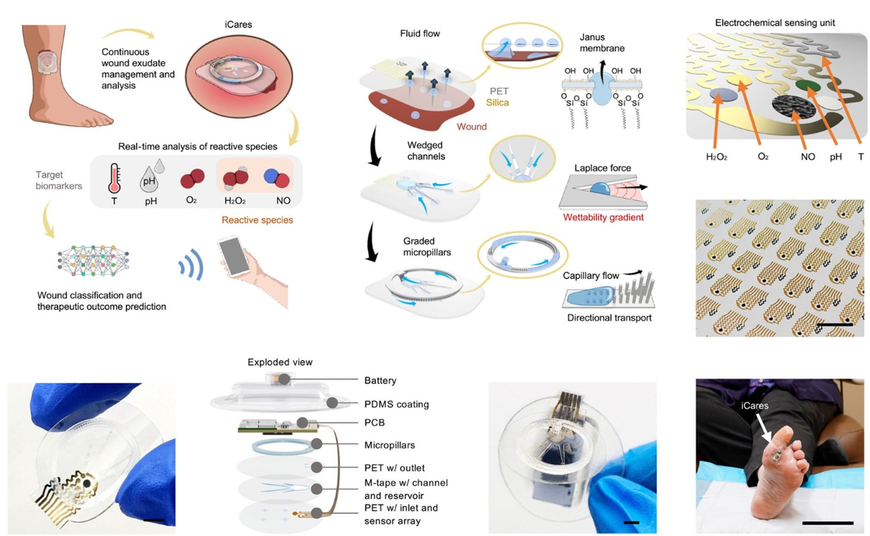
Two exemplars: sweat CRP patch, smart bandage
RESULTS · APPLICATION EXEMPLARS · FIGS. 9, 10
Fig. 9 · Inflammation read from sweat
Fig. 10 · Wound-exudate analytics
Tu et al., Nat. Biomed. Eng. 2023. Liver CRP reaches sweat; the patch induces sweat iontophoretically (carbachol gel), runs a 5-step microfluidic immunoassay (reconstitute, mix, incubate, refresh, detect) on laser-engraved graphene, and reads a thionine redox label by square-wave voltammetry.
Wang et al., Sci. Transl. Med. 2025. A Janus membrane, wedged channels and graded micropillars move exudate by wettability gradient and Laplace pressure; an electrochemical array reads H₂O₂, O₂, NO, pH and temperature; ML classifies the wound and predicts healing.
Why they matter: each closes the full loop (biofluid sampling → transduction → wireless link → ML decision). Gap: the review reports no clinical-outcome data for either device.
Huang, Chen & Liao · Biosensors 2025, 15, 410
Notes:
[0:35 · ends at 7:20] SAY: Two exemplars close the full loop. Figure 9, Tu et al.: inflammation raises C-reactive protein, which reaches sweat. The patch induces sweat by carbachol iontophoresis, runs a five-step immunoassay in microfluidics on laser-engraved graphene, and reads it by square-wave voltammetry. Figure 10, Wang et al. 2025: a smart bandage moves exudate with a Janus membrane and Laplace-pressure channels into an electrochemical array for peroxide, oxygen, nitric oxide and pH; machine learning classifies the wound and predicts healing. Neither reports clinical outcomes.
IF ASKED: Tu et al., Nat. Biomed. Eng. 2023 (thionine redox label). Wang et al., Sci. Transl. Med. 2025 (wettability gradient, graded micropillars, temperature sensing).

Slide 18
Table 4: traditional vs AI-enhanced biosensing
RESULTS · TABLE 4
Table 4 · Metric | Traditional | AI-enhanced | Improvement | Claimed clinical impact
Diagnostic accuracy | 72.3 ± 5.1% | 89.7 ± 2.3% | +24% (relative) | 38% fewer false negatives
Prediction latency | 2.1 ± 0.3 s | 0.4 ± 0.1 s | 5.2× faster | real-time intervention
Multi-analyte resolution | 3–5 biomarkers | 9–12 biomarkers | ~3× capacity | comprehensive profiling
Long-term stability | 15% drift / week | 4% drift / week | −73% drift | “fewer relapse”
Fold improvement implied by Table 4 (AI ÷ traditional)
Arithmetic checks out: 89.7 / 72.3 = 1.24; 2.1 / 0.4 = 5.25; (15 − 4) / 15 = 73%.
Read critically: no citation, task, dataset or n for any row; “accuracy” pooled across unnamed tasks and prevalence-dependent; ± without n cannot be tested; “fewer relapse” is undefined.
Huang, Chen & Liao · Biosensors 2025, 15, 410
Notes:
[0:30 · ends at 7:50] SAY: Results. Table 4 compares traditional with AI-enhanced biosensing; the chart shows the fold changes. Accuracy 72 to 90%, 1.24 times. Latency 2.1 to 0.4 seconds, 5 times faster. Three times more analytes, and drift from 15 to 4% per week. The arithmetic is consistent, but no row is cited or names a task, dataset or sample size, and accuracy depends on prevalence. Plausible direction, unverifiable magnitude.
IF ASKED: 89.7/72.3 = 1.24; 2.1/0.4 = 5.25; (15 − 4)/15 = 73% less drift. The claimed '38% fewer false negatives' cannot be checked without a task definition; 'fewer relapse' is undefined.

Slide 19
Table 5 in ROC space: strong, but mostly not wearable
RESULTS · TABLE 5
Sensitivity vs false-positive rate (1 − Sp)
Table 5 | Task · data | Se | Sp | AUC
DL CNN | Retinopathy · fundus | 90.5 | 91.6 | 0.963
AI-Rad | Lung nodule · CT | 92.0 | 86.5 | 0.94
Aidoc | Brain bleed · CT | 89.4 | 93.6 | 0.91
Google Health | Breast · mammogram | 89.0 | 94.5 | 0.945
PathAI | Breast · H&E slides | 94.6 | 93.8 | 0.98
Tempus xT | Oncology · NGS | 88.0 | 85.0 | 0.87
SkinVision | Melanoma · phone | 95.1 | 78.3 | 0.89
Eko | Murmur · stethoscope | 87.6 | 91.1 | 0.90
Se, Sp in %. Orange rows: point-of-care / consumer devices.
Scope: 6 of 8 are imaging or genomics AI; only Eko and SkinVision are point-of-care.
Benchmark: none reaches the authors' own 99% sensitivity (range 87.6–95.1%).
Best discriminator: PathAI, AUC 0.98 on H&E histopathology.
Huang, Chen & Liao · Biosensors 2025, 15, 410
Notes:
[0:35 · ends at 8:25] SAY: Table 5 lists eight AI systems validated on clinical data. I plotted them in ROC space, zoomed into the top-left corner. They cluster at 88 to 95% sensitivity and 78 to 95% specificity; PathAI is best, with AUC 0.98. Two observations. Scope: six of eight are imaging or genomics models; only Eko and SkinVision are point-of-care, and none is a wearable. And the dashed box is the authors' own benchmark, 99% sensitivity at 80% specificity. No system reaches it.
IF ASKED: Sensitivity range 87.6–95.1%. AUCs 0.87–0.98. Imaging/genomics: DL CNN retinopathy, AI-Rad lung CT, Aidoc brain CT, Google Health mammography, PathAI, Tempus xT.

Slide 20
PPV depends on prevalence, not just accuracy
RESULTS · BEYOND THE PAPER: WHAT A POSITIVE ALERT MEANS
Positive predictive value vs prevalence, from Table 5 Se/Sp (my calculation)
At 1% prevalence
4.2%
SkinVision (Se 95.1, Sp 78.3)
9.0%
Eko (Se 87.6, Sp 91.1)
13.4%
PathAI (Se 94.6, Sp 93.8)
4.8%
authors' benchmark (Se 99, Sp 80)
Screen 1,000 people with SkinVision: 9–10 of the 10 melanomas are flagged, along with ~215 false alarms.
Interactive
Visualization:
PPV = Se·p / [Se·p + (1 − Sp)(1 − p)]; assumes Se and Sp transfer to the screened population.
Huang, Chen & Liao · Biosensors 2025, 15, 410
Notes:
[0:30 · ends at 8:55] SAY: This goes beyond the paper, using its own numbers. Patients care about positive predictive value, which depends on prevalence. At 1% prevalence, SkinVision's PPV is about 4%: screen 1,000 people and you flag roughly 10 melanomas plus 215 false alarms. Eko reaches 9%, PathAI 13%. Even the authors' benchmark gives under 5%. So screening targets should be set on specificity and PPV, not sensitivity alone.
IF ASKED: PPV = Se·p / [Se·p + (1 − Sp)(1 − p)]. At p = 1%: SkinVision 4.2%, Eko 9.0%, PathAI 13.4%, benchmark 99/80 4.8%. Assumes Se and Sp transfer to the screened population (spectrum bias would lower them). The QR code opens the interactive version.

Slide 21
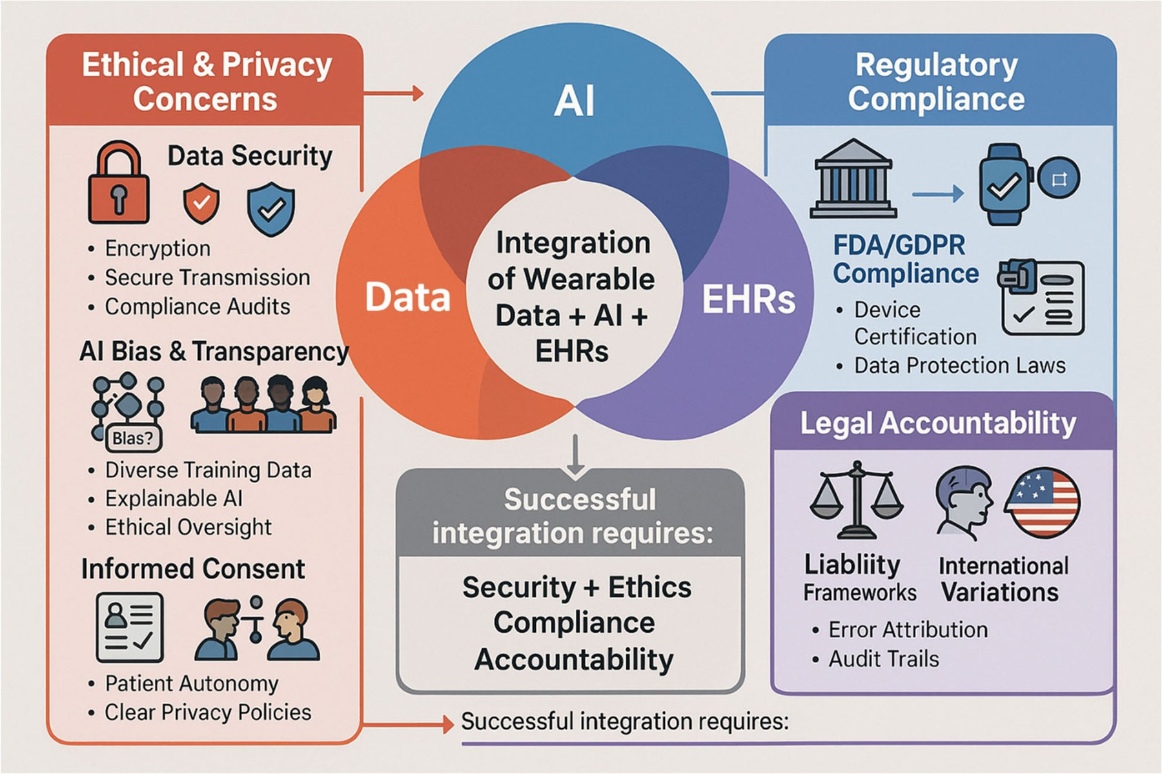
The barriers are now data, trust and regulation
DISCUSSION · CHALLENGES · FIG. 11 (§5)
>10k
15–20%
labelled samples per reliable model
accuracy lost below 8-bit compression
+14 mo
68%
longer FDA clearance for AI devices
of physicians (n = 120) hesitant without explainable AI
All four headline numbers are uncited in the review (§7).
Fig. 11 — Data + AI + EHR must satisfy ethics & privacy (encryption, bias, consent), regulation (FDA, GDPR; AES-256, role-based access) and legal accountability (liability, audit trails).
Cost (§5.3): carbon instead of noble-metal electrodes −90% material cost; roll-to-roll printing −40–60% vs batch; OTC hearing aids fell from ~$4,000 to ~$400 after FDA deregulation — technical and regulatory levers together.
Huang, Chen & Liao · Biosensors 2025, 15, 410
Notes:
[0:25 · ends at 9:20] SAY: Discussion. Figure 11 places data, AI and EHRs inside three constraints: ethics and privacy, regulation, and legal accountability. The review's barriers are quantitative: over 10,000 labels per model, 15 to 20% accuracy lost to compression, 14 months longer FDA clearance, and 68% of physicians hesitant without explainable AI. But all four numbers are uncited. Cost levers include carbon electrodes and roll-to-roll printing.
IF ASKED: Controls named: AES-256 encryption, role-based access, GDPR/FDA. Cost: carbon replacing noble metals (~90% of material cost); roll-to-roll ~40–60% cheaper than batch; OTC hearing aids fell from ~$4,000 to ~$400 after FDA deregulation.

Slide 22
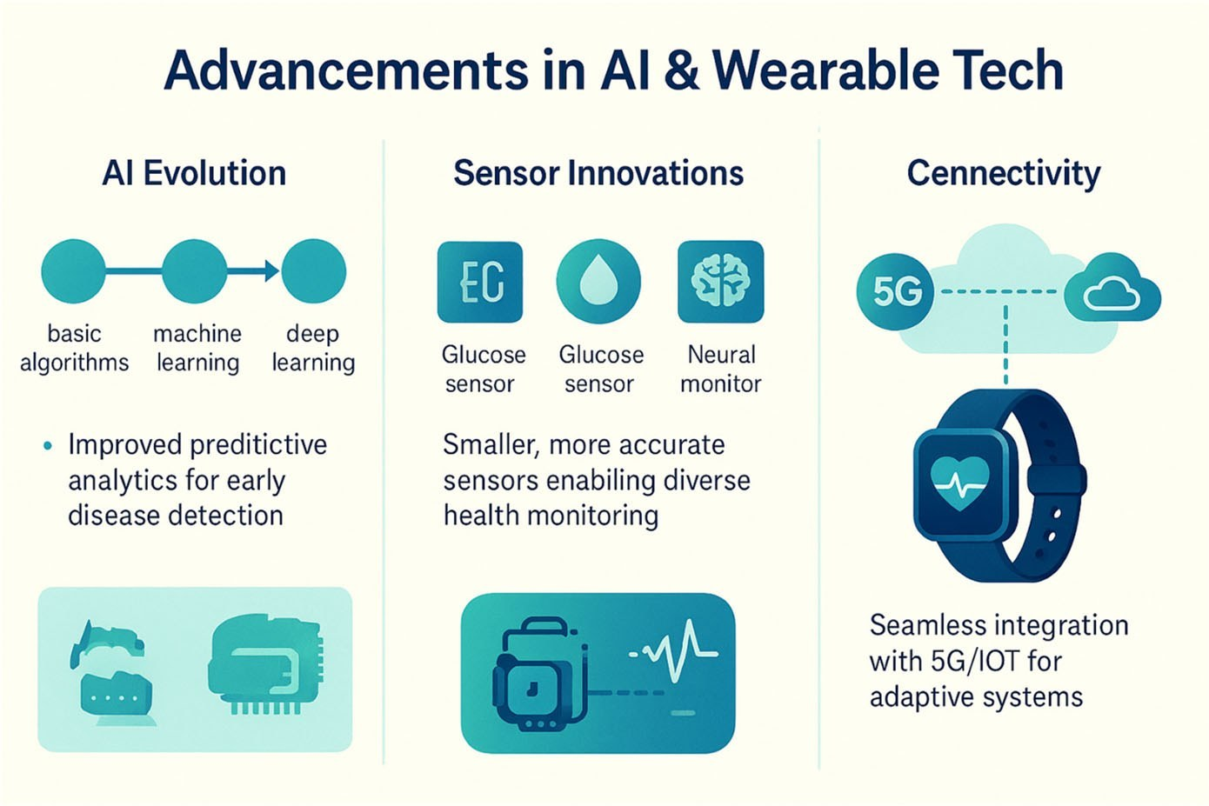
Future directions and a proposed policy roadmap
DISCUSSION · FUTURE DIRECTIONS · FIG. 12 · POLICY (§6–7)
Technology roadmap (§7)
2024–26
synthetic-data tools to halve training-data needs
2027–29
neuromorphic chips for <10 µW inference
2030+
quantum–AI hybrids for sensitivity limits (speculative)
Accessibility Index: cost <20% of median monthly income · modular · minimal training · local repair; score ≥75% → fast-track approval. KPIs: Gini of device distribution, QALYs per 1,000 users, cost per accurate diagnosis.
Fig. 12 — AI evolution, smaller sensors, 5G / IoT.
Five-phase rollout the authors propose
1
0–6 mo
2
6–18 mo
3
18–36 mo
4
3–5 yr
5
5+ yr
readiness: 5G, data governance
controlled clinical pilots
scale-up, outcome-based pay
EHR + public-health links
predictive optimization
Huang, Chen & Liao · Biosensors 2025, 15, 410
Notes:
[0:25 · ends at 9:45] SAY: Figure 12 and Sections 6 and 7 look forward, and go further than most reviews by proposing policy: a technology roadmap to neuromorphic chips under 10 microwatts by 2029; an Accessibility Index with fast-track approval above 75%; KPIs such as a Gini coefficient of device distribution and QALYs per thousand users; and a five-phase rollout. Thoughtful, but untested.
IF ASKED: Roadmap: synthetic-data tools 2024–26; quantum–AI hybrids after 2030 (speculative). Accessibility Index: cost <20% of median monthly income, modularity, minimal training, local repair. Rollout: readiness → controlled pilots → outcome-based scale-up → EHR/public-health links → predictive optimization.

Slide 23
Conclusions: what the review establishes
CONCLUSION
1
AI turns wearables from recorders into decision systems, wherever signal quality, power and labels allow.
2
Hardware has matured: pM–nM sensitivity, <1 s response, months of stability, tissue-soft and even resorbable devices.
3
Edge AI (<20 ms, <5 mW) is the enabling architecture for privacy and battery life; compression costs accuracy.
4
The binding constraints are now validation, bias, interoperability and liability, not sensing.
5
The review is a wide map plus a policy proposal, not a quantitative synthesis.
Huang, Chen & Liao · Biosensors 2025, 15, 410
Notes:
[0:20 · ends at 10:05] SAY: To conclude: AI turns wearables into decision systems. Hardware has matured. Edge AI is the enabling architecture, at some cost in accuracy. The bottleneck has moved to validation, bias, interoperability and liability. And this paper is a wide map with a policy proposal, not a quantitative synthesis.
IF ASKED: Hardware maturity per the review: pM–nM sensitivity, <1 s response, months of stability, soft and resorbable devices; edge AI <20 ms, <5 mW.

Slide 24
My assessment: a broad map with thin evidence
MY COMMENTS · CRITICAL ASSESSMENT
Strengths
Weaknesses
End-to-end scope: molecule → materials → power → AI → clinic → policy in one place.
No search protocol: databases, dates and inclusion criteria unreported, so selection bias is unknown.
Uncited or untraceable claims: all of Table 4; “68% of physicians (n = 120)”; “Singapore's Safer Wearables Initiative” cites an unrelated EHR-nursing paper [214]; FDA's Pre-Cert pilot, cited as accelerating approvals, ended in Sept 2022.
Quantitative anchors: sensor generations, edge latency and power targets.
Scope mismatch: Table 5 is mostly imaging AI; no listed system meets the authors' own 99%-sensitivity benchmark, and the benchmark itself gives <5% PPV at 1% prevalence.
Testable proposals: 99% / 80% benchmark, Accessibility Index, KPIs (Gini, QALYs).
Physiology slip (§4.1.3): stress lowers HRV (vagal withdrawal; Kim et al. 2018 meta-analysis), yet the text lists “elevated HRV” as a stress sign.
Cost and equity taken seriously: roll-to-roll printing, tiered pricing, repairability.
Decorative figures: Figs 1, 7, 8, 11, 12 are infographics with typos (“Cennectivity”, “Liabliity”) and no data.
Missing landmark evidence: Apple Heart Study (n = 419,297; notification PPV 0.84); skin-tone bias in optical sensing (occult hypoxemia 11.7% vs 3.6%, Sjoding 2020).
Huang, Chen & Liao · Biosensors 2025, 15, 410
Notes:
[0:40 · ends at 10:45] SAY: My assessment. Strengths: it is end-to-end, gives quantitative anchors, makes testable proposals, and takes cost and equity seriously. Weaknesses: no search protocol. Several headline numbers are uncited or mis-cited, including all of Table 4 and the physician survey, and FDA's Pre-Cert pilot, presented as accelerating approvals, ended in 2022. Table 5 barely covers wearables. There is a physiology slip: stress lowers HRV, per Kim's 2018 meta-analysis, yet the text calls elevated HRV a stress sign. And landmark evidence is missing: the Apple Heart Study, and skin-tone bias in pulse oximetry.
IF ASKED: 'Singapore's Safer Wearables Initiative' is cited to an EHR-nursing paper [214]. Figures 1, 7, 8, 11 and 12 are infographics with typos and no data. Apple Heart Study (Perez 2019): n = 419,297; notification PPV 0.84. Sjoding 2020: occult hypoxemia 11.7% in Black vs 3.6% in White patients.

Slide 25
Questions for the authors
MY COMMENTS · QUESTIONS TO THE AUTHORS
Q1
Search method. Which databases, dates and inclusion criteria produced the 225 references, and would a PRISMA-style protocol change any conclusion?
Q2
Table 4 provenance. Which tasks, datasets and sample sizes underlie 72.3% → 89.7% accuracy and 15% → 4% weekly drift?
Q3
Wearable evidence. Why represent wearables with imaging AI in Table 5? Which prospective wearable trials (e.g., the Apple Heart Study) belong there?
Q4
Benchmark design. Should the 99% / 80% target be restated as a PPV or alarm-burden target that scales with prevalence?
Q5
Adaptive models and bias. How does the staged framework map onto FDA Predetermined Change Control Plans (2024) and the EU AI Act, and should bias audits require validation across skin tones?
Thank you — questions and discussion welcome.
Huang, Chen & Liao · Biosensors 2025, 15, 410
Notes:
[0:25 · ends at 11:10] SAY: Five questions for the authors. What search method produced the 225 references? Where do Table 4's numbers come from? Why represent wearables with imaging AI? Should the benchmark be restated as a PPV that scales with prevalence? And how does the framework handle models that keep learning after approval, and should bias audits require validation across skin tones? Thank you.
IF ASKED: Q5 context: FDA Predetermined Change Control Plan guidance (final, Dec 2024) and the EU AI Act. The QR code opens the interactive companion. Backup slide 24 lists outside sources.

Slide 26
Sources beyond the reviewed paper
BACKUP · REFERENCES
[1]
Huang G, Chen X, Liao C. AI-driven wearable bioelectronics in digital healthcare. Biosensors 2025;15(7):410. doi:10.3390/bios15070410
[2]
NCD Risk Factor Collaboration. Worldwide trends in diabetes prevalence and treatment from 1990 to 2022. Lancet 2024. doi:10.1016/S0140-6736(24)02317-1
[3]
Kim H-G, Cheon E-J, Bai D-S, Lee YH, Koo B-H. Stress and heart rate variability: a meta-analysis and review of the literature. Psychiatry Investig 2018;15:235–245.
[4]
Sjoding MW, Dickson RP, Iwashyna TJ, Gay SE, Valley TS. Racial bias in pulse oximetry measurement. N Engl J Med 2020;383:2477–2478.
[5]
Perez MV, et al. Large-scale assessment of a smartwatch to identify atrial fibrillation. N Engl J Med 2019;381:1909–1917.
[6]
US FDA. The Software Precertification (Pre-Cert) Pilot Program: tailored total product lifecycle approaches and key findings. September 2022.
[7]
US FDA. Marketing submission recommendations for a Predetermined Change Control Plan for AI-enabled device software functions. Final guidance, December 2024.
[8]
Figures reproduced from the review (CC BY 4.0) and its sources: Ates et al., Nat Rev Mater 2022 (Fig 2); Song et al., Sci Adv 2023 (Fig 3); Lu et al., Nat Electron 2024 (Fig 4); Ma et al., Sci Adv 2023 (Fig 5); Rong et al., Sensors 2021 (Fig 6); Tu et al., Nat Biomed Eng 2023 (Fig 9); Wang et al., Sci Transl Med 2025 (Fig 10). All other diagrams, charts and calculations: presenter's own, from the review's data.
[9]
Anthropic, Claude, Opus 5. Anthropic, 2026. Accessed: Sep. 21, 2026. [Online]. Available: https://claude.ai
[10]
R. Patra, Wearable AI Explorer, 2026. [Online]. Available: https://rittik047.github.io/WearableAI_Simulator/
Notes:
Backup slide, not timed. Outside sources used to check the review's claims: updated diabetes prevalence (NCD-RisC 2024), the HRV–stress relationship (Kim 2018), pulse-oximetry bias (Sjoding 2020), the Apple Heart Study (Perez 2019), FDA's Pre-Cert closure report (2022) and PCCP guidance (2024). Figure credits for all reproduced panels are listed; every other diagram and chart was made for this presentation from the review's numbers.

