Slide 1
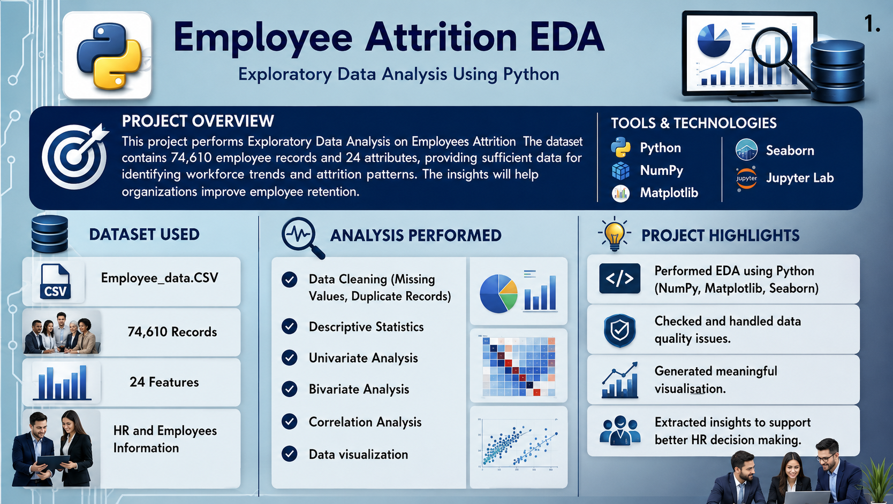

Slide 2
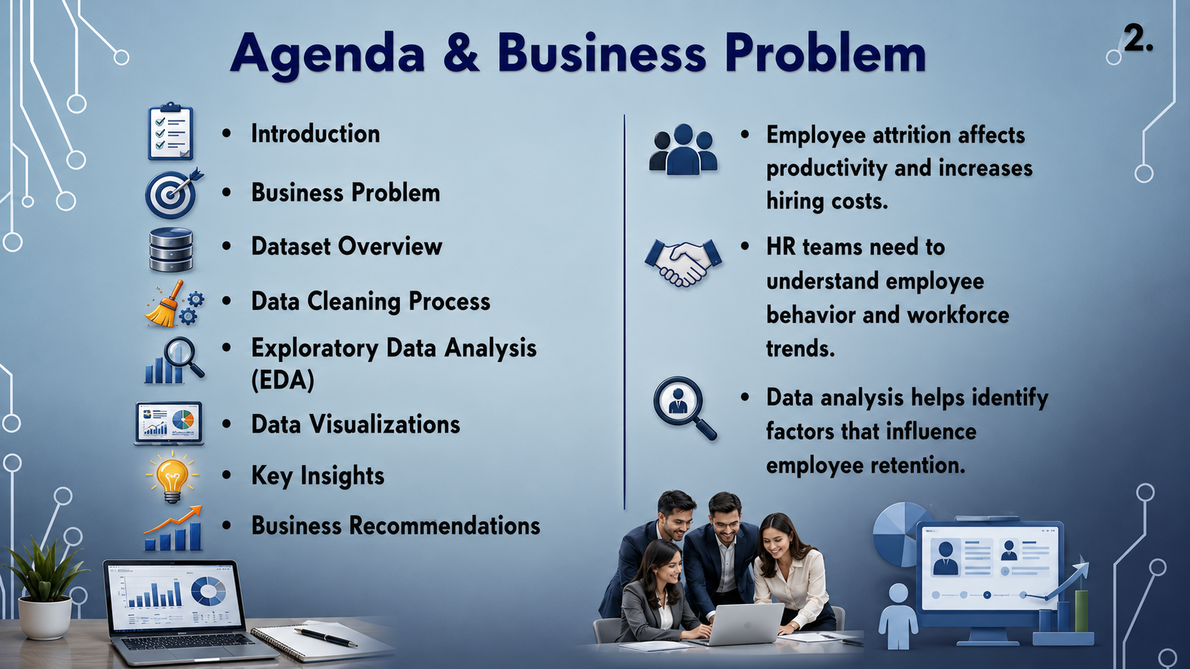

Slide 3
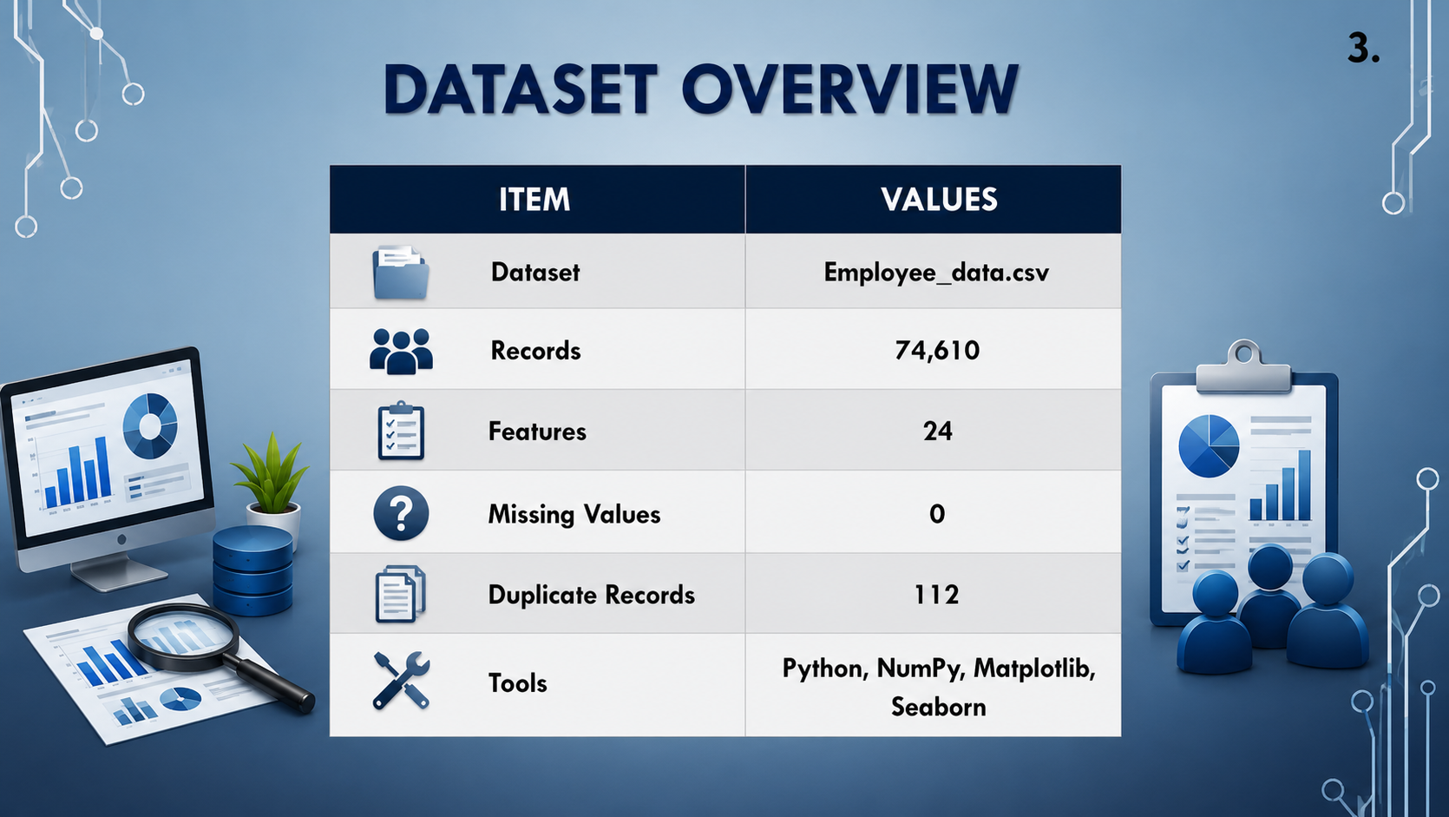

Slide 4
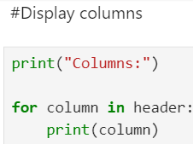
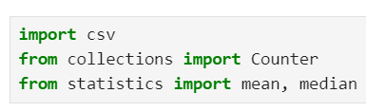
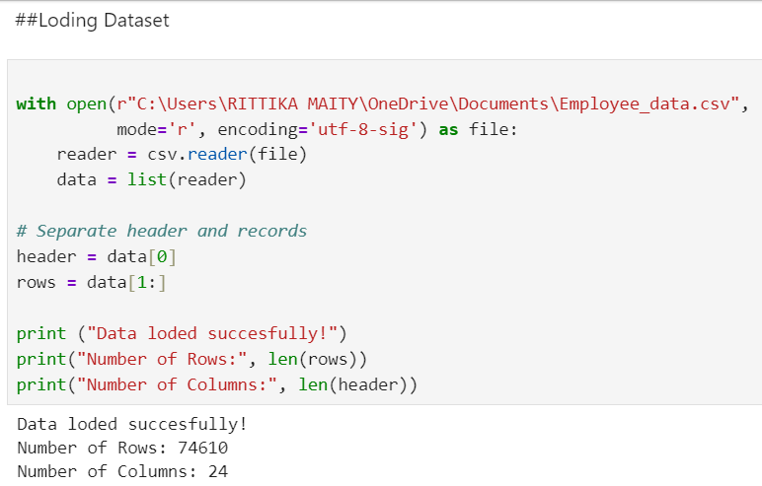

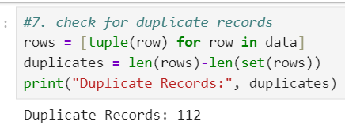
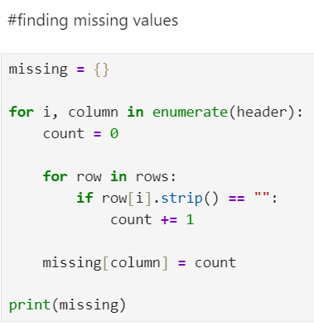
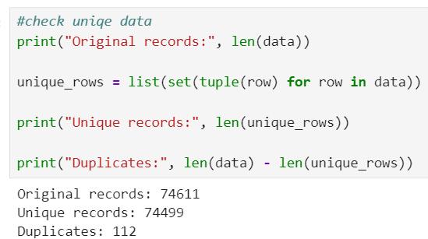
Data Import & Overview
Loaded dataset using CSV.
Check missing values
Check duplicate records
Prepared the dataset for analysis
4.

Slide 5
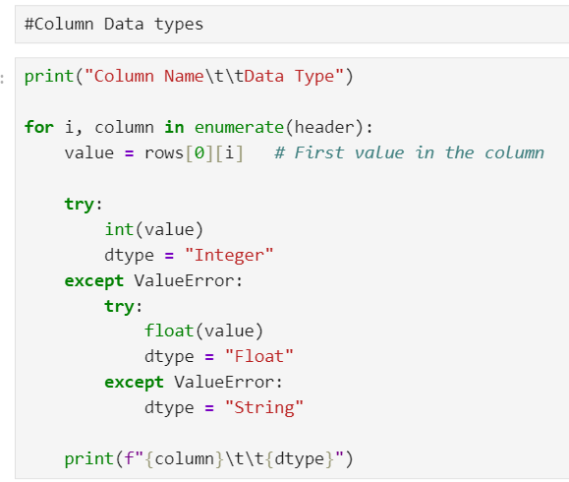
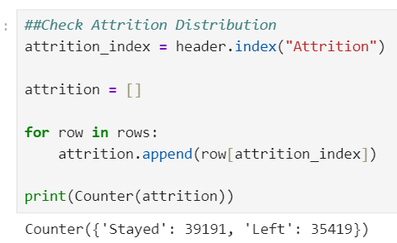
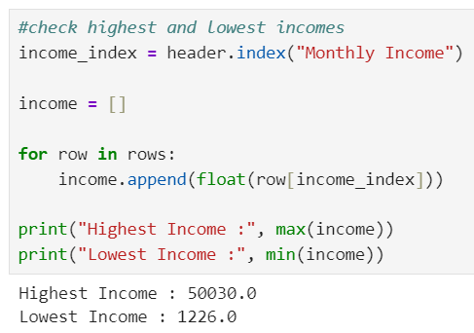
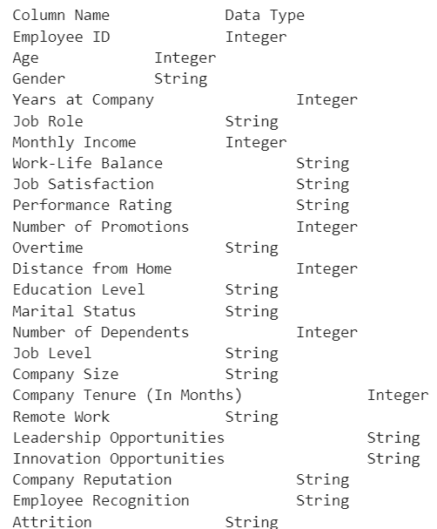
Check Column Data types
Check highest and lowest incomes
Check Attrition Distribution
5.

Slide 6
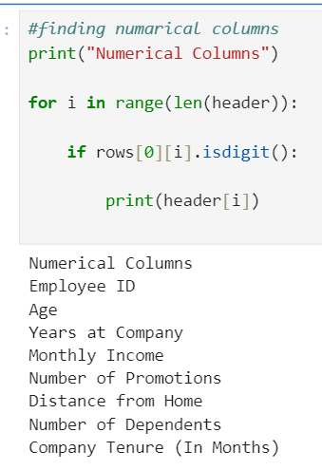
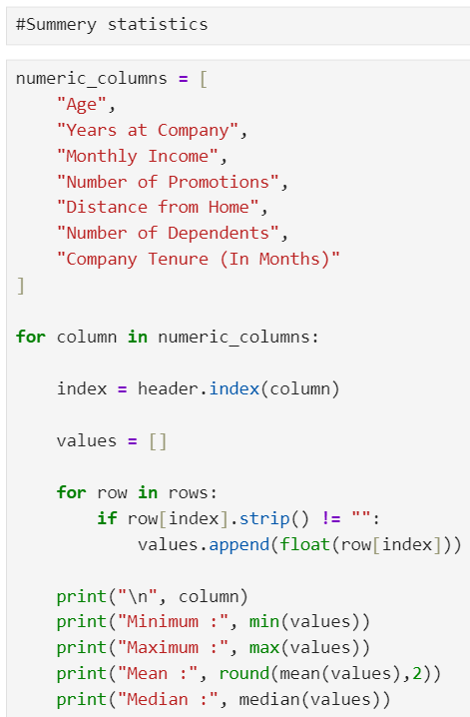
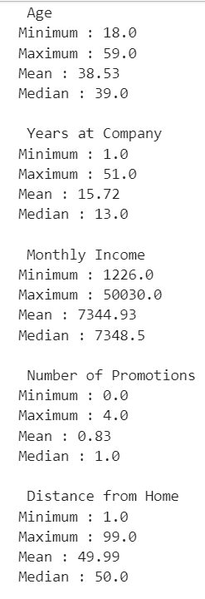
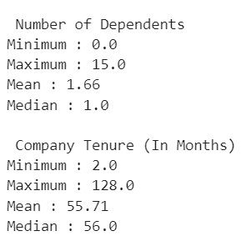
Statistical Analysis
6.

Slide 7
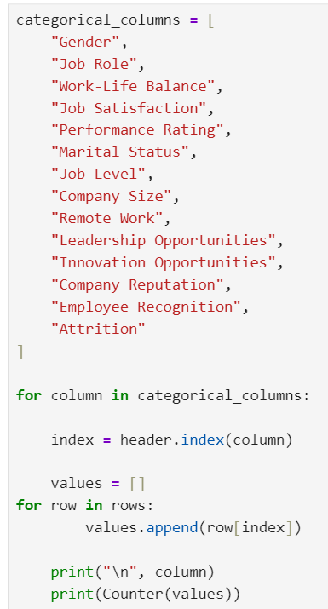
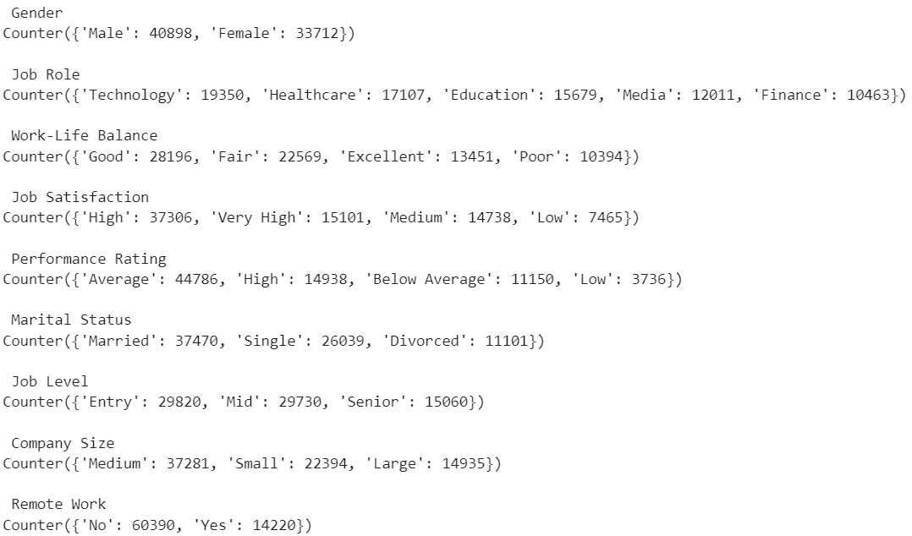
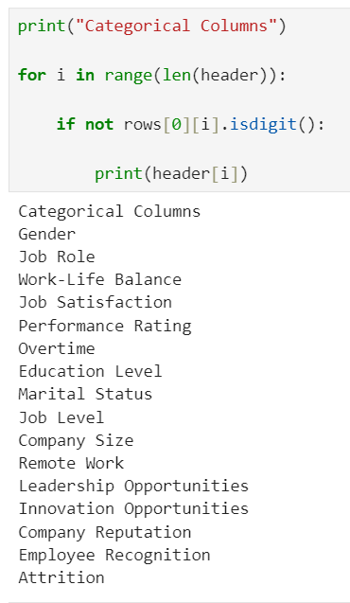
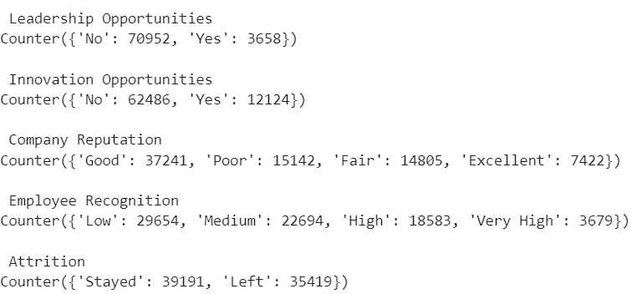
Analyse Categorical Columns
7.

Slide 8
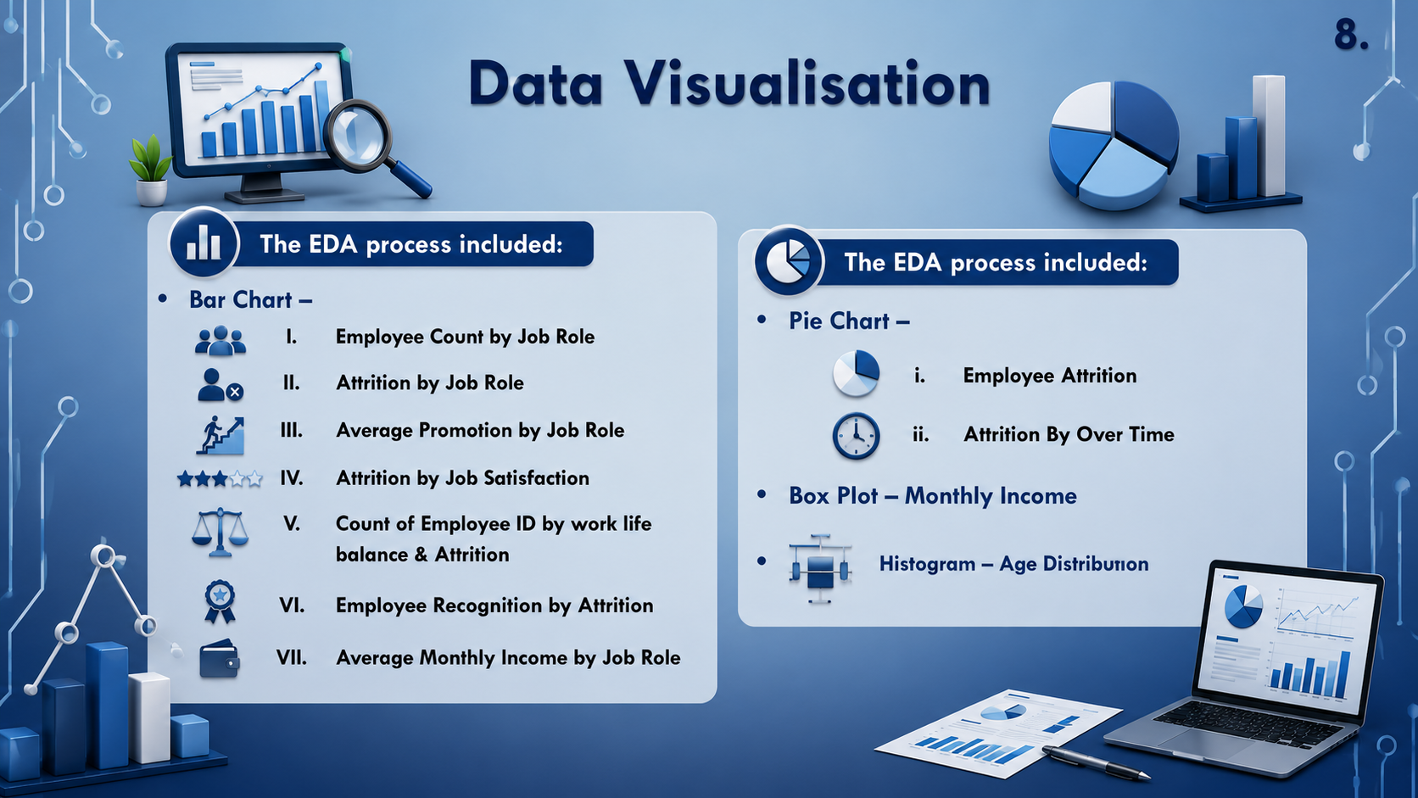

Slide 9
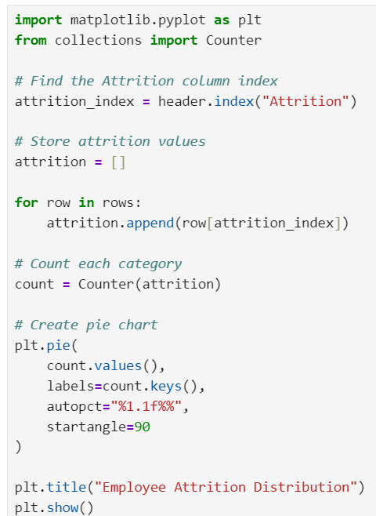
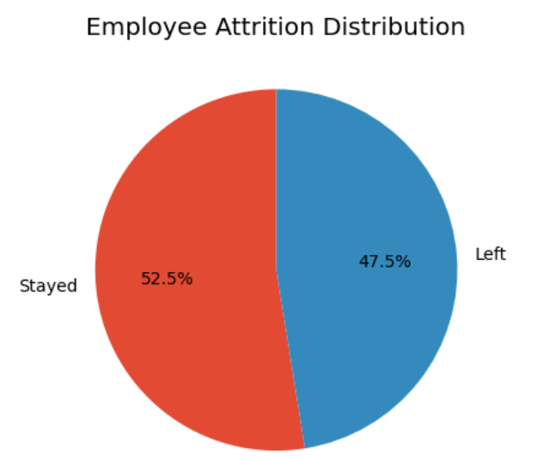
Employee Attrition Distribution(Pie Chart)
9.
Business Insight:
The proportion of Employees living is high, HR should investigate the reasons behind attrition and improve retention strategies.
Observations:
The chart shows the percentage of employees who stayed and those who left.
It provides a quick overview of the organization’s attrition level.

Slide 10
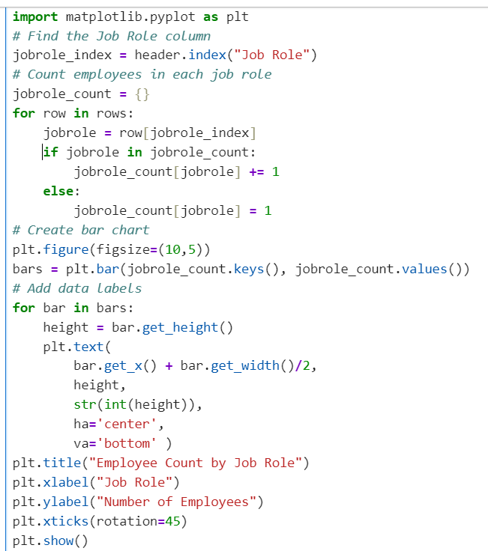
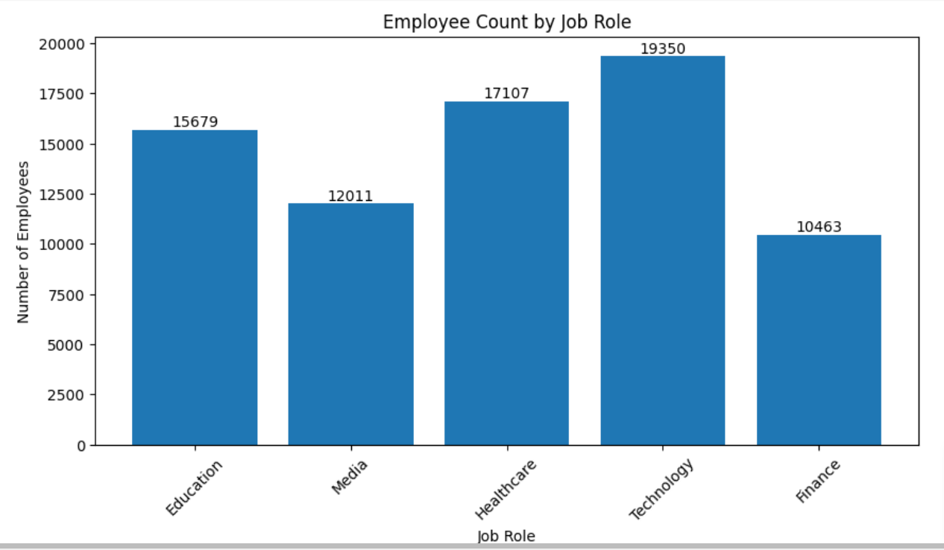
Employee Count by Job Role (Bar Chart)
10.
Business Insight:
HR can Use this information for Workforce planning, recruitment, and resource allocation.
Observations:
Employee numbers vary across different job roles.
Some roles have significantly more employees than others.

Slide 11
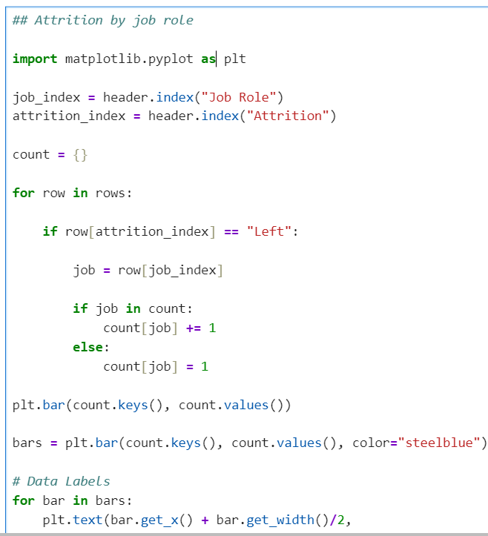
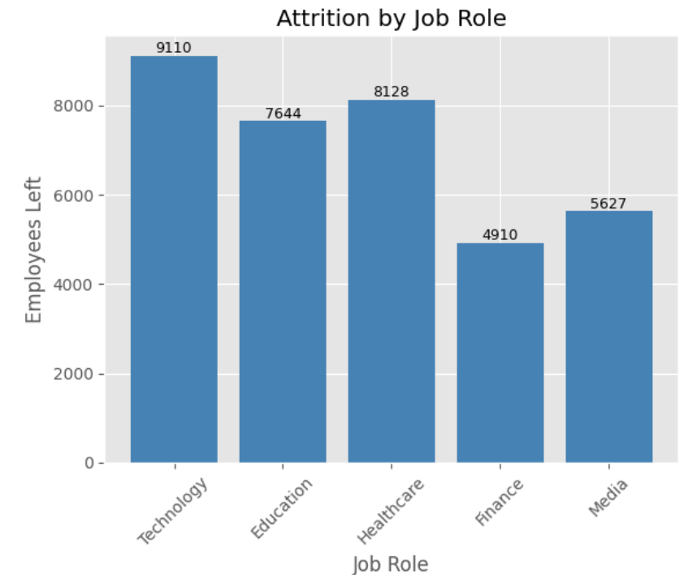
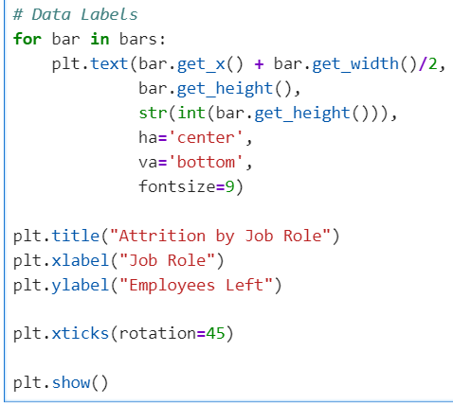
Attrition by Job Role
11.
Business Insight:
Technology has the highest employee attrition.
Healthcare and Education need better retention strategies.
Finance shows the strongest employee retention.

Slide 12
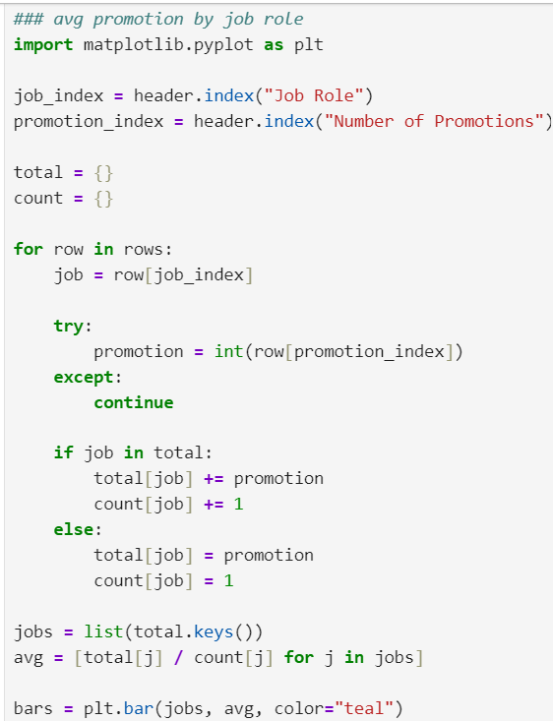
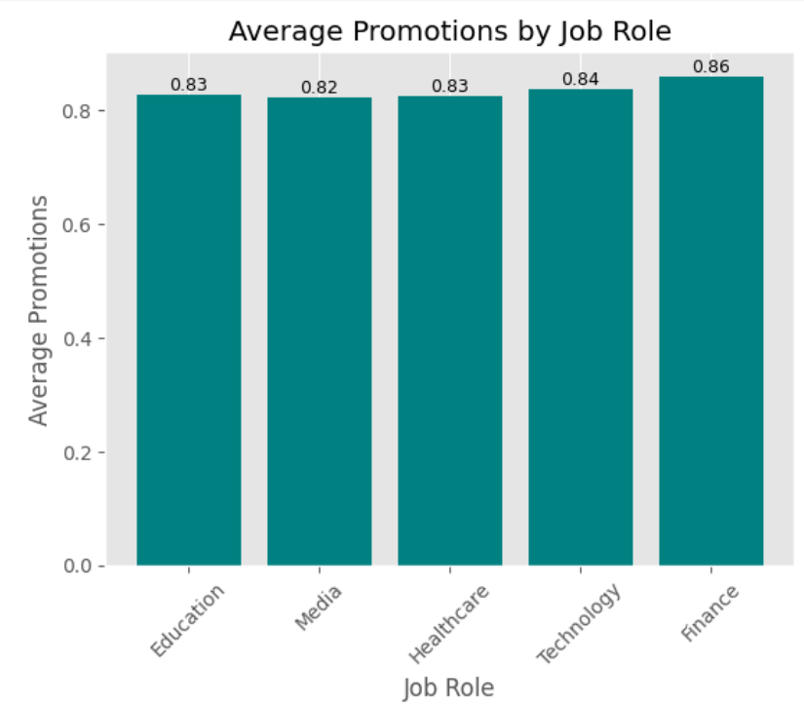
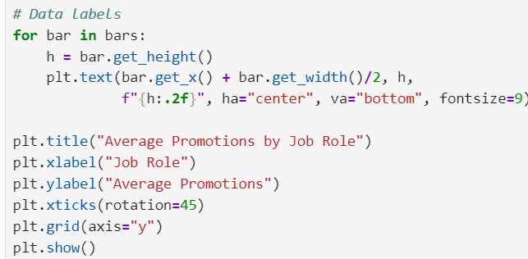
Average Promotion by Job Role
12.
Business Insight:
Finance has the highest average promotions.
Media has the lowest average promotions.
Promotion opportunities are fairly similar across all job roles.

Slide 13
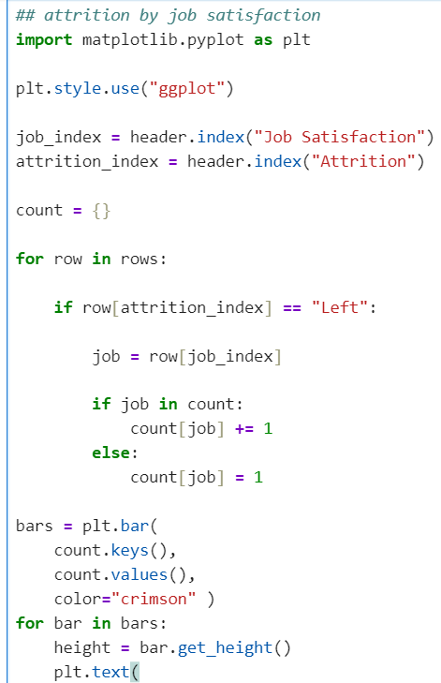
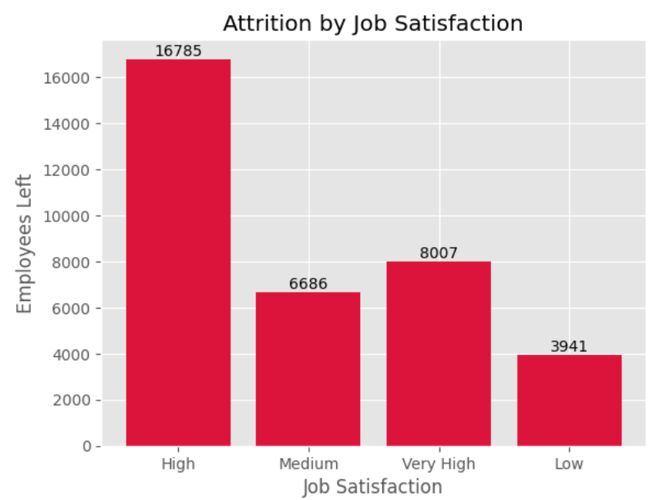
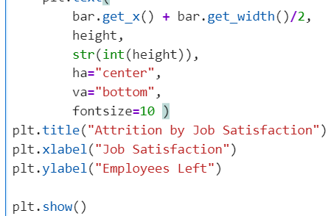
Attrition by Job Satisfaction
13.
Business Insight:
Employees with High job satisfaction show the highest attrition count.
  Low job satisfaction has the fewest employee exits.
  HR should analyze why employees with High satisfaction are still leaving and strengthen retention strategies

Slide 14
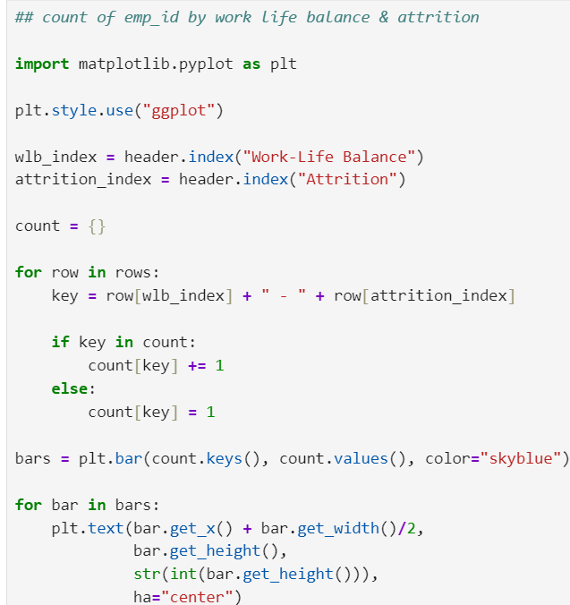
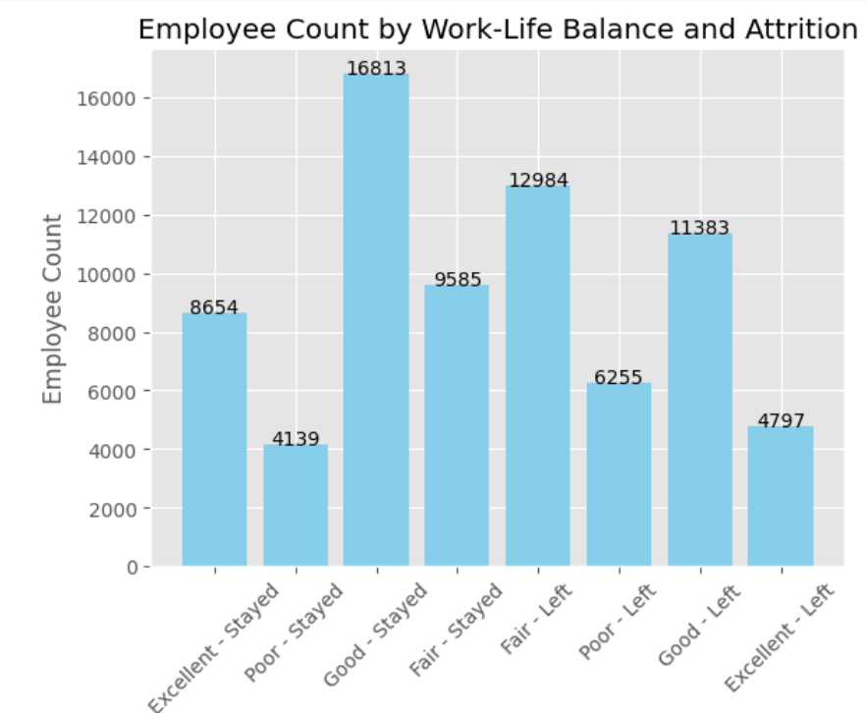
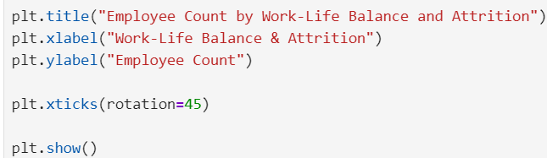
Count of Employee ID by work life balance & Attrition
14.
Business Insight:
Employees with Good work-life balance have the highest retention.
    Attrition is highest among employees with Fair work-life balance.
    Improving work-life balance may help reduce employee turnover

Slide 15
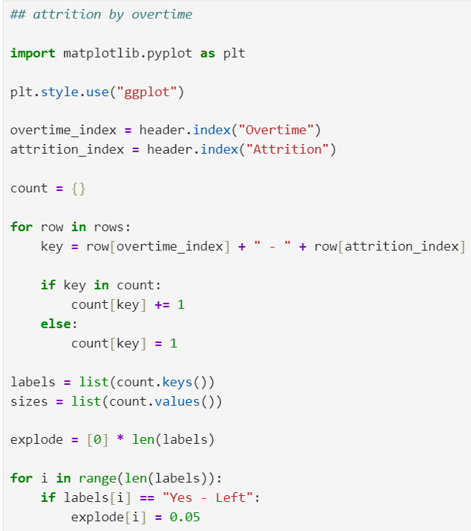
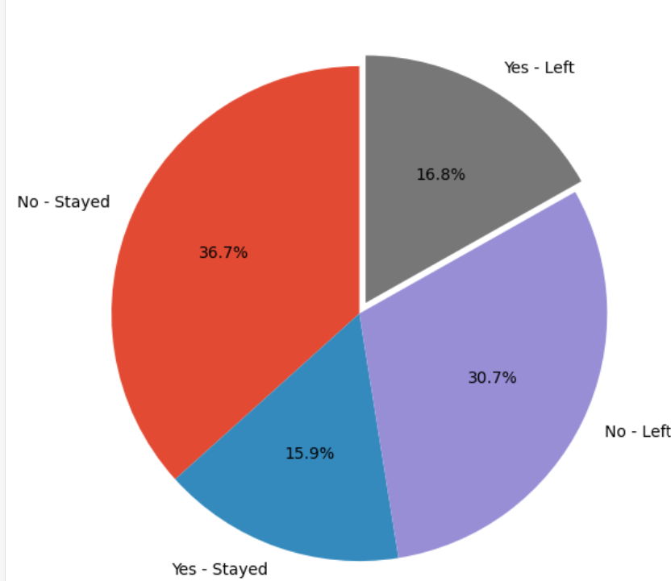
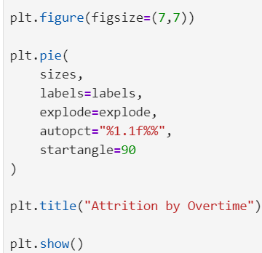
15.
Attrition By Over Time (pie Chart)
Business Insight:
Employees with No Overtime have the highest retention.
Employees working Overtime show a higher proportion of attrition.
Reducing excessive overtime may help improve employee retention.

Slide 16
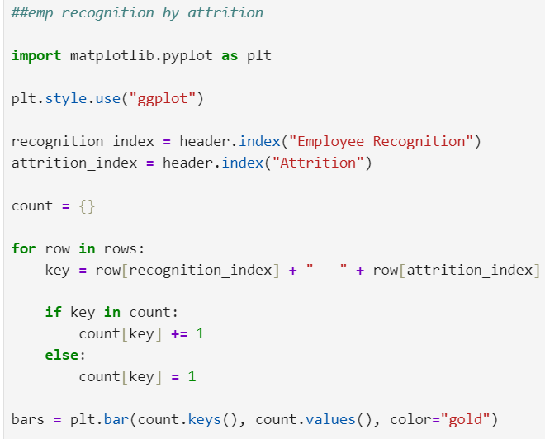
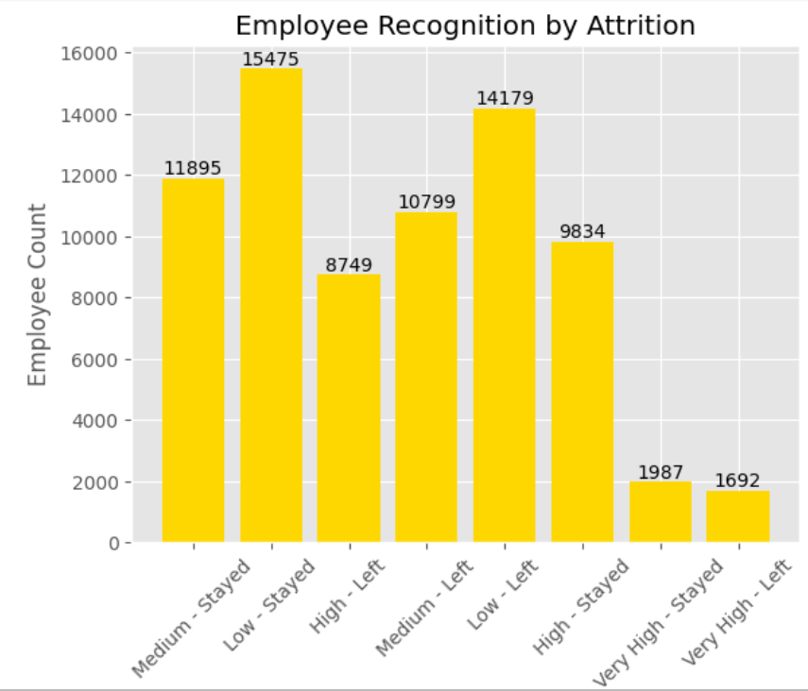
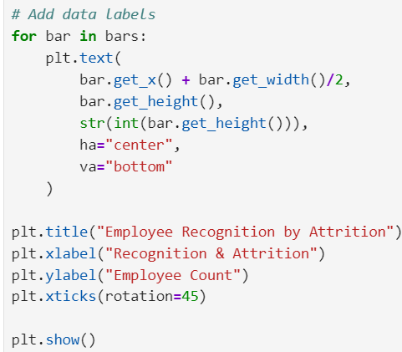
16.
Employee Recognition by Attrition
Business Insight:
Employees with Low recognition have the highest attrition, showing recognition may influence retention.
High and Very High recognition groups have fewer employees leaving than lower recognition groups.
Improving employee recognition programs could help increase retention and reduce attrition.

Slide 17
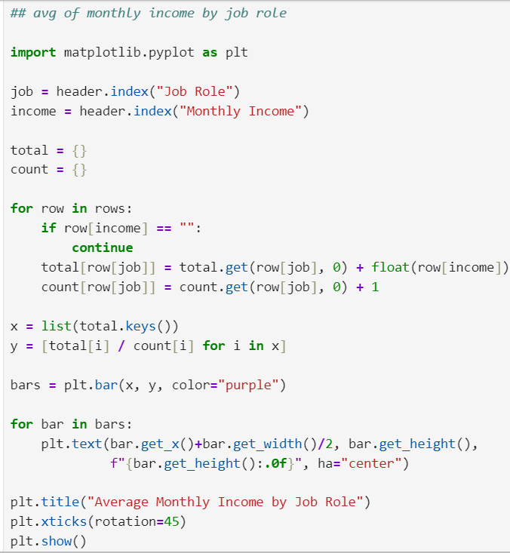
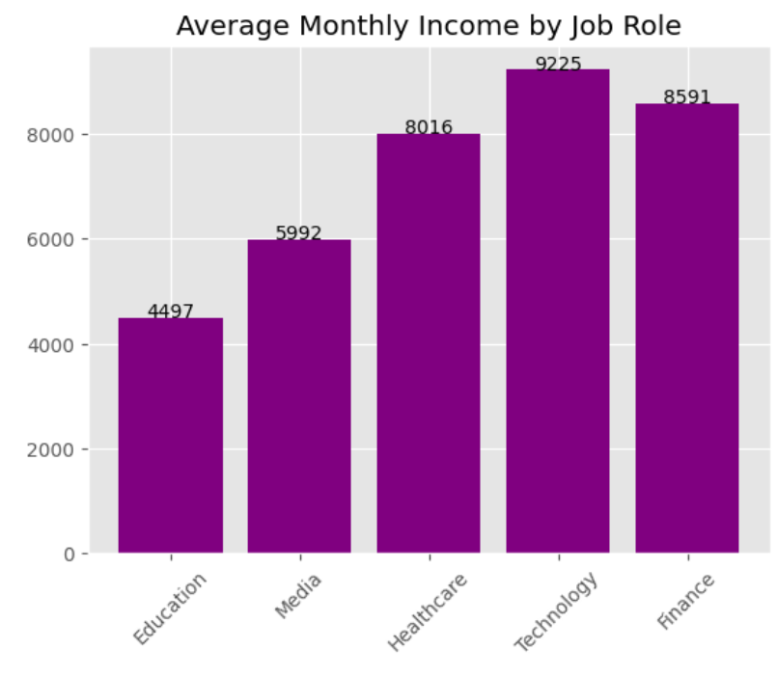
17.
Average Monthly Income by Job Role
Business Insight:
Technology has the highest average monthly income, while Education has the lowest.
Higher-paying job roles may require specialized skills and greater responsibilities.
Review salary structures in lower-paying roles to maintain fair compensation and improve retention.

Slide 18
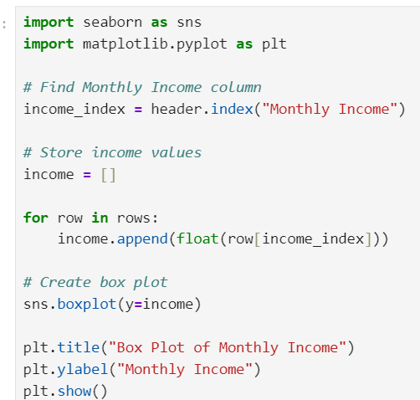
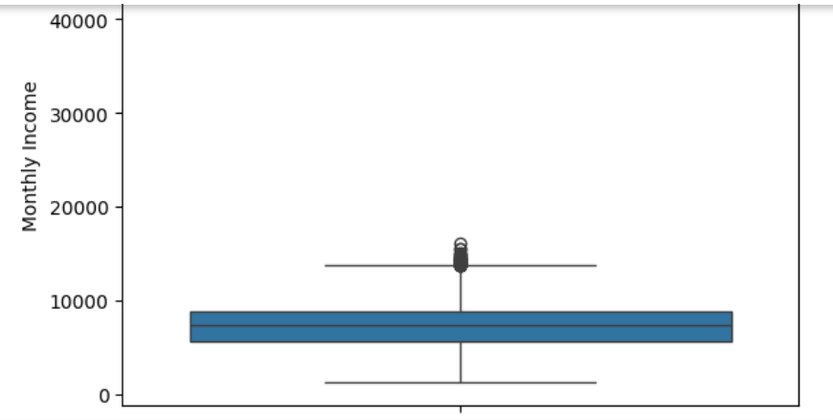
Monthly Income Analysis (Box Plot)
18.
Business Insight:
Higher Salaries like belong to senior or specialized roles.
HR can analyse Whether compensation aligns with job level and experience.
Observations:
The chart shows the percentage of employees who stayed and those who left.
It provides a quick overview of the organization’s attrition level.

Slide 19
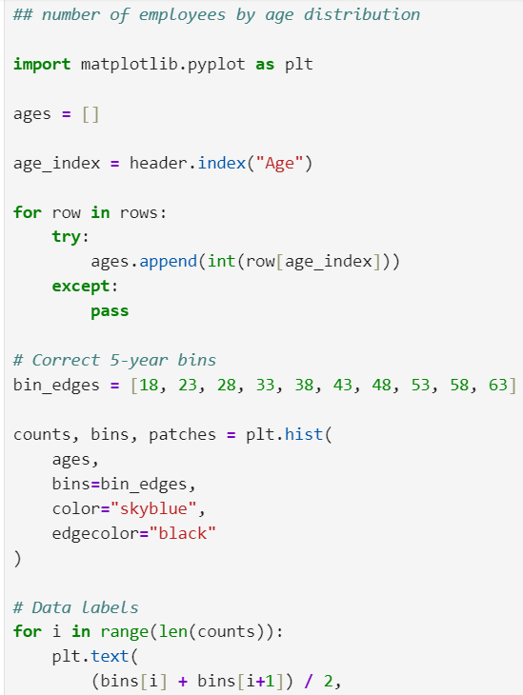
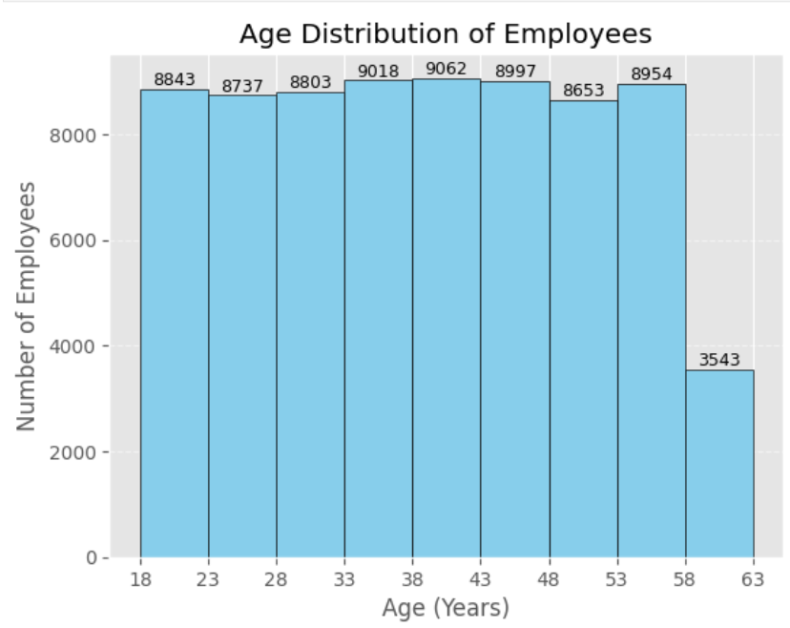

19.
Age Distribution of Employees (Histogram)
Business Insight:
Most employees are concentrated between 18–58 years, showing a balanced workforce across age groups.
Employee count drops sharply in the 58–63 age group, indicating fewer employees close to retirement.
The company should focus on career development and succession planning to maintain a balanced age distribution.

Slide 20


Slide 21


